Slide 1
CS3754
Textbook:
R. Elmasri and S.B. Navathe, “Fundamentals of Database Systems”, 6th Edition, Addison-Wesley, 2011, (ISBN-13: 9780136086208)
G. Luger, “Artificial Intelligence: Structures and Strategies for Complex Problem Solving”, 6th Edition, Addison-Wesley, 2009, (ISBN 0-321-54589-3)
Reference Book:
C) E. Sciore, “Database Design and Implementation”, John Wiley & Sons, 2009, (ISBN 978-0-471-75716-0)
D) Class notes under the directory of /local/pub/cs3754 on the computer garfield.

Slide 2
Learning Objectives
Define and understand the term Information Systems (IS)
Explain the technology, people, and organizational components of information systems
Describe the types of jobs and career opportunities in information systems and related fields
Describe the various types of information systems

Slide 3
Information Systems: Turn Data into Information
Data
Information
Raw material
Unformatted information
Generally has no context
Processed material
Formatted information
Data given context
Individual time cards for factory workers entered into the payroll system
Examples
Department Labor Report,
Project Status Report, Employee Payroll Checks

Slide 4
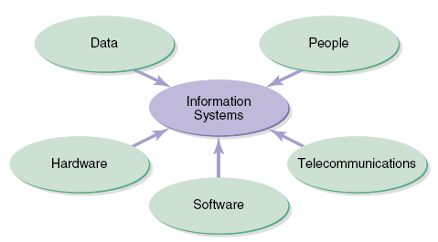
What are Information Systems?
- A combination of technical components
- Built and used by people to collect, create, and distribute useful data
- Used typically in organizational settings but are evolving for personal use

Slide 5
Information Systems Components: Data
Data
People
Information
Systems
Hardware
Telecommunications
Software
The raw inputs for entry into information systems
Organized, processed and stored by an IS to support user information needs
Provides basis for qualitative/quantitative analysis

Slide 6
Information Systems Components: Hardware
Data
People
Information
Systems
Hardware
Telecommunications
Software
The physical components of information systems
Hardware components include processors, input and output devices, and storage devices
Typical configurations based on application

Slide 7
Information Systems Components: Software
Data
People
Information
Systems
Hardware
Telecommunications
Software
The instructions that operate the information system
System software controls the hardware
Application software allows user tasks to perform specific tasks

Slide 8
Information Systems Components: Telecommunications
Data
People
Information
Systems
Hardware
Telecommunications
Software
The communication mechanism of information systems
Allows two or more computers to communicate (Internet)
Utilizes standard protocols for IS communication

Slide 9
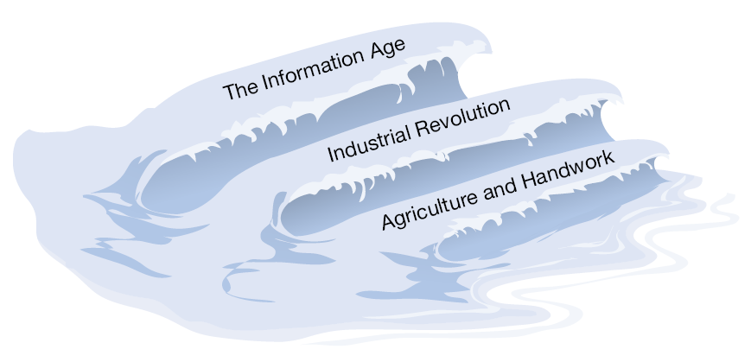
Information Society Evolution: Periods of Change
Agricultural
Industrial
Informational
(Prior to 1890’s)
(1890’s to 1960’s)
(1960’s to Present)

Slide 10
Information Society Evolution: Terms and Issues
Information Society
1960
2000
Knowledge Worker (Peter Drucker 1959)
A term invented to describe a future trend in the workforce
These will be professionals that create, modify and/or synthesize information as a fundamental part of their job
They will require higher education levels and received higher compensation than workers in agriculture or manufacturing
The term is still generally accepted today

Slide 11
Information Society Evolution: Terms and Issues
Information Society
1960
2000
Knowledge Society (Drucker - 1959)
Term invented to describe the next evolution of society
This evolution would be a result of the rise in the numbers and importance of knowledge workers in society
Education was described as the cornerstone of the knowledge society as it is core to the knowledge worker

Slide 12
Information Society Evolution: Terms and Issues
Information Society
1960
2000
New Economy (Wired Magazine - Late 1990s)
Similar to “knowledge society” but more descriptive
Describes a society where people use their brains more than their hands in their work and personal lives
Where communications technology and other IT systems will create global competition for all products and services
Other names: Digital Economy, Network Era, Internet Era

Slide 13
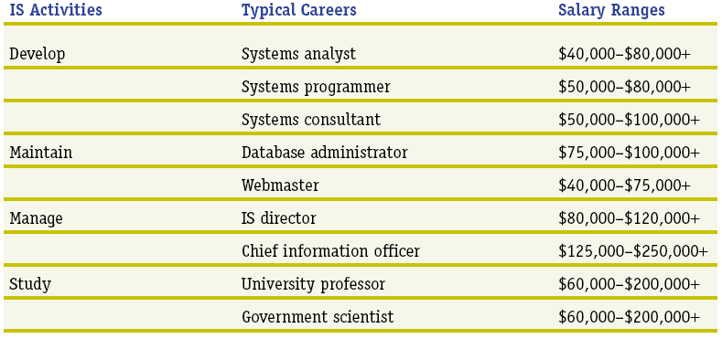
Typical Careers in Information Systems
Careers in information systems require high technical competence and generally pay well

Slide 14
Executive Roles in Information Technology
Manages External
Stakeholder Relationships
Sets Strategic Direction
Defines High Level IT
Needs for the Future
CEO
Chief Executive
Officer
COO
Chief Operations
Officer
CFO
Chief Financial
Officer
CIO
Chief Information
Officer
Manages Operations
Allocates Resources
Primary Consumer of IT within the Organization
Manages Accounting & Finance
Forecasts Needs and Secures Financial Resources
Allocates Budget for IT Expenditures

Slide 15
Executive Roles in Information Technology
CEO
Chief Executive
Officer
COO
Chief Operations
Officer
CFO
Chief Financial
Officer
CIO
Chief Information
Officer
Manages IT Organization and Operations
Forecasts IT Needs from Business Strategy
Sets Direction for IT Architecture and Organization
Plans, Designs and Delivers IT throughout the firm

Slide 16
Three Distinct Competencies of IS Professionals
Technical
Knowledge of hardware, software, networking, and security
Most IS professionals are not deep technical experts but can direct/manage others with the required technical skills
Business
Understand the nature of business including process, management, social, and communication domains
Unique skills over those with only technical skills
Systems
Knowledge of approaches and methods, also possess critical thinking and problem solving skills necessary to build and integrate large information systems
Unique skills over those with only technical skills

Slide 17
IS Impact on Organizations: New Opportunities
U.S. Internal Revenue Service (IRS) Creates a Website and Allows eFiling
Current IRS Tasks
New
Website
Modified IRS Tasks
Post Office
Stock Forms & Publications
Post Office
Minimal Stocking of Forms/Pubs
IRS Office
Mail Forms/Publications
Enter Tax Returns in System
Conduct Audits
IRS Office
Minimal Mailing Forms/Pubs
Reduced Entry of Tax Returns
Conduct Audits (MORE!)
IRS Hotline
Answer FAQs
Resolve Problems
Activate
eFiling
IRS Hotline
Reduced Answering FAQs
Resolve Problems
Implementation Results
Reduced labor costs in forms distribution, hotline support, data entry from access to info/materials on the website and efiling
Allow for redeployment of resources to primary activities including conducting audits and resolving problems

Slide 18
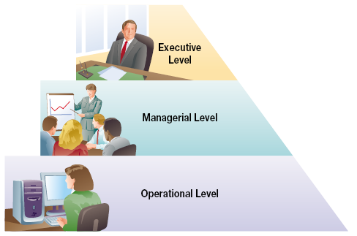
Levels of the Organization and Traditional Systems
Executive Information Systems
Decision Support Systems (both levels)
Management Information Systems
Transaction Processing Systems
Expert Systems
Functional Area Information Systems
(Across all levels within a function)

Slide 19
Traditional Information System Functions
Transaction
Processing Systems
Management
Information Systems
Executive
Information Systems
Decision Support
Systems
Expert Systems
Functional Area
Information Systems
Process day-to-day business event data
in an organization (Operational level)
Produce details information to help manage a firm or part of a firm (Managerial)
Provide very high-level, aggregate information
to support decisions (Executive)
Provide analysis tools and databases to support quantitative decision making (Multiple)
Mimic human expert in a particular area and provide answers or advice (Operational)
Support the activities within a specific functional area of the firm (All)

Slide 20
Other Information Systems - Not as Easy to Categorize
Office Automation System
Collaboration
System
Customer Relationship Management
Electronic
Commerce
Enterprise Resource
Planning System
Support a wide range of predefined, daily work activities of individuals or groups (e.g. MS Word)
Enable People to communicate, collaborate, and coordinate with each other (e.g. email)
Support the interaction between the firm and its customers (e.g. sales force automation or call center technology)
Enable customers to buy goods and service
from a firm’s website. (www.amazon.com)
Support and integrate all facets of the business (e.g. planning, manufacturing, sales, etc.)

Slide 21
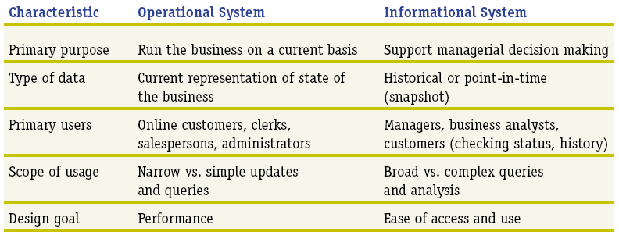
Operational vs Informational Systems

Slide 22
IS Competitive Advantage Perspectives: Who is Right?
“IT Doesn’t Matter” - Car 2003
As IT becomes more pervasive, technology becomes more standardized and ubiquitous
The result is that the same technologies are available to all competitors in an industry
This produces no competitive advantage
“The Engine that Drives Success: The Best Companies have the Models Because they Have the Best IT Strategies” - Lundberg 2004
Companies with bad business models fail regardless of IT systems or other capabilities
Companies with good business models use IT to execute successful business models and succeed

Slide 23
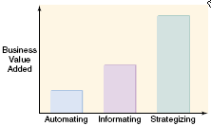
IS for Competitive Advantage: Business Value
Using IS to create/support business strategy is the most effective approach creating the most business value
Strategic IS systems are typically custom built and are integrated to support the business strategy
Strategic IS systems are by nature hard to replicate just as are good business models

Slide 24
Competitive Advantage: Dual Nature of Systems
FedEx Customer Website
versus
Denver International Airport Baggage System
IS That Works
(FedEx)
IS Gone Wrong
(DIA)
Evaluation Factors
Strategic in Nature
Established Technology
Capable Suppliers
Structured Implementation
Capable IS Support
Yes
Yes
Yes
Yes
Yes
Yes
No
??
No
??

Slide 25
The Future of Information Systems: Trends
Ownership and Control (Old School IS)
Large back logs of user requests…very poor service
Arrogance and feeling of ownership and control of IT
Can’t do attitude…told users why they couldn’t do things
Resulted in a very poor relationship with users
T
H
E
N
Business managers became technology savvy
Systems evolved and became easier to develop
Business organizations developed their own systems
Consulting and Service Mentality (New School IS)
IS is taking on an IT consulting role
“Service Mentality”…users are customers to be served
Proactively support and problem solve for their customers
Fundamentally believe that customers own the technology

Slide 26
IS Role in Change: Trends and Terms
Downsizing (Sometimes called Rightsizing)
Reducing organizational headcount to meet the financial goals of the organization
IT is viewed as the lever to provide the systems necessary to increase productivity
Outsourcing
Transferring business functions outside the organization to increase service levels and/or reduce operating cost
IT is not immune to this trend. Certain commodity IT technical jobs will be increasingly transferred overseas
IT must find better methods to manage offshore work

Slide 27
Global outsourcing
In U.S.
In 2003, $10 Billion for global outsourcing of software and services
In 2008, $31 Billion for global outsourcing. It will help the U.S. real gross domestic product(GDP) to be over $120 billion higher than without global outsourcing.

Slide 28
The Future for IS
IS needs will continue to grow as technology developments advance
Although outsourcing will continue, there will be strong demand for IS professionals
There is a need for personnel that can speak the language of technology and business and the skills to manage projects and people
Characteristics for success include: continuous learning and growth, finding new ways to add value, flexibility, and developing unique skills

