Slide 1
Production Systems
1
Notes:
1

Slide 2
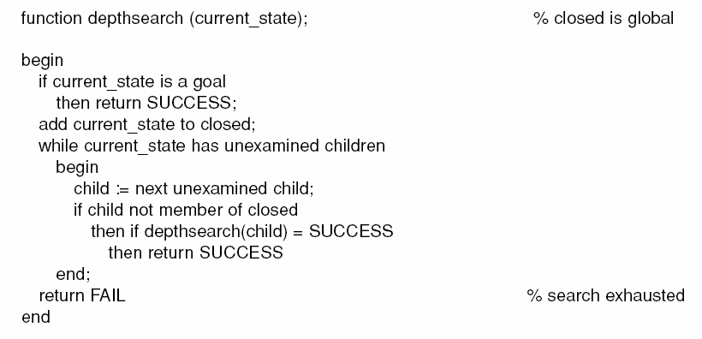
2

Slide 3
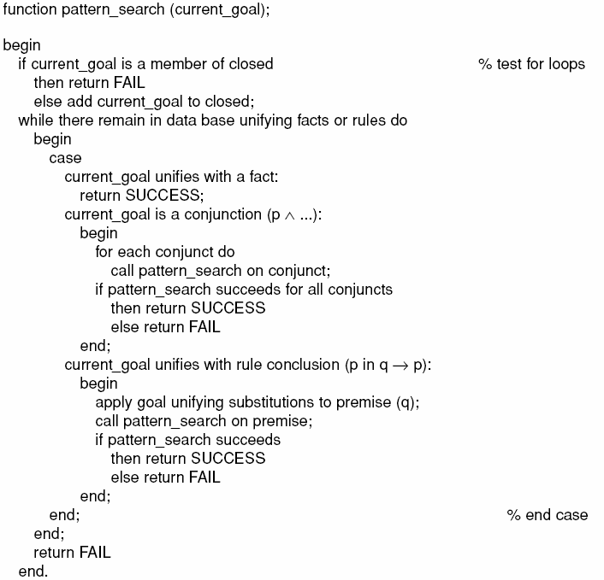
3

Slide 4
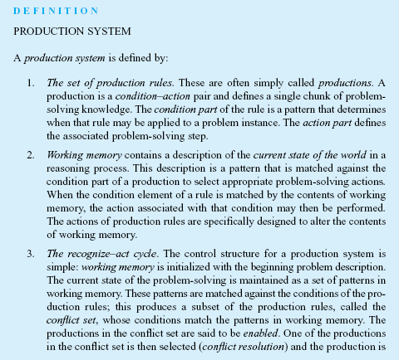
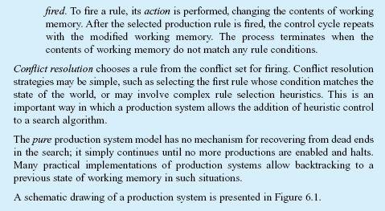
4

Slide 5
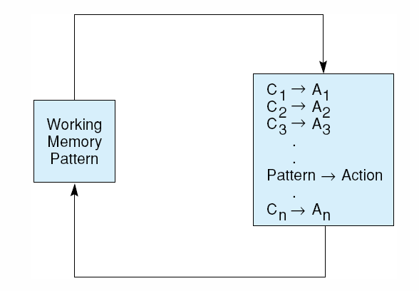
Fig 6.1 A production system. Control loops until working memory pattern no longer matches the conditions of any productions.
5

Slide 6
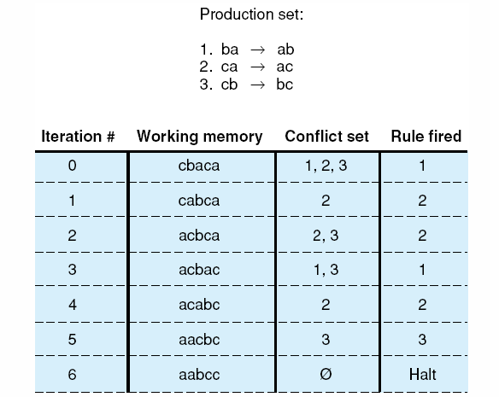
Fig 6.2 Trace of a simple production system.
6

Slide 7
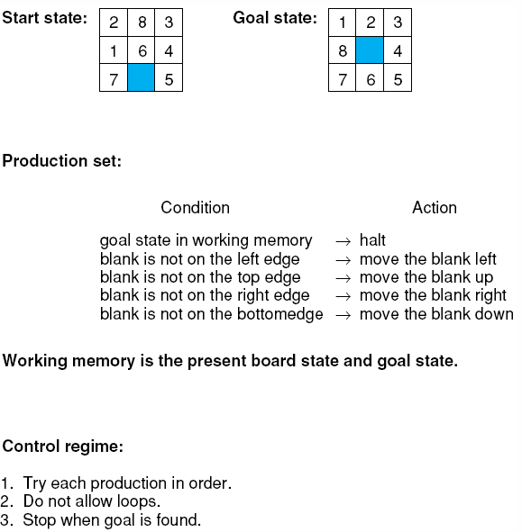
Fig 6.3 The 8-puzzle as a production system.
7

Slide 8
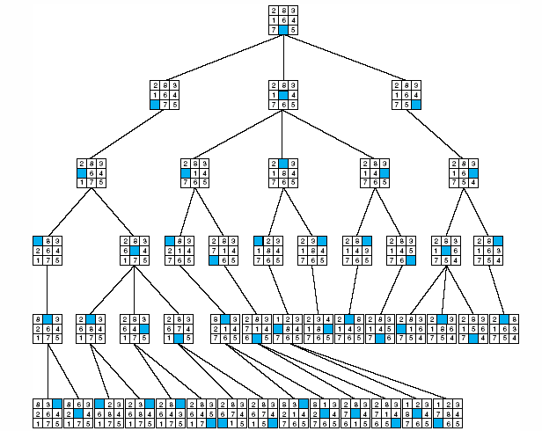
Fig 6.4 The 8-puzzle searched by a production system with loop detection and depth-bound , from Nilsson (1971).
8

Slide 9
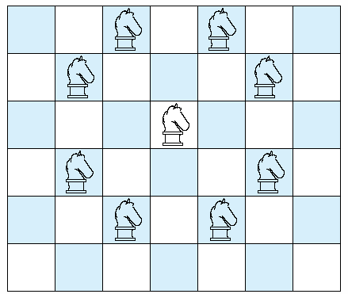
Fig 6.5 Legal moves of a chess knight.
9

Slide 10
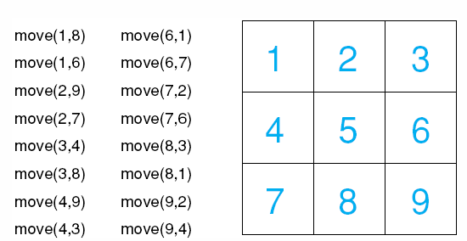
Fig 6.6 a 3 x 3 chessboard with move rules for the simplified knight tour problem.
10

Slide 11
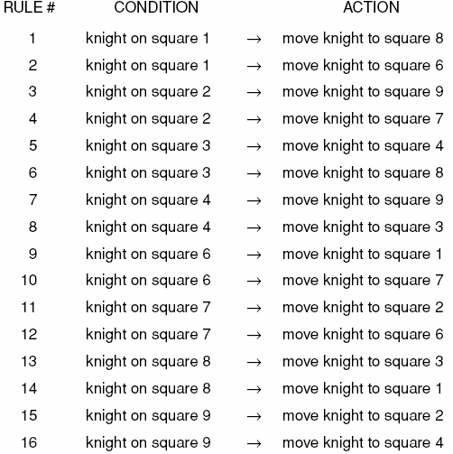
Table 6.1 Production rules for the 3 x 3 knight problem.
11

Slide 12
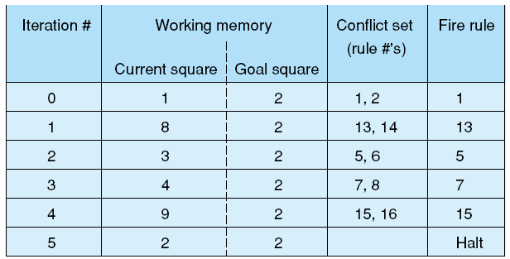
Fig6.7 A production system solution to the 3 x 3 knight’s tour problem.
12

Slide 13
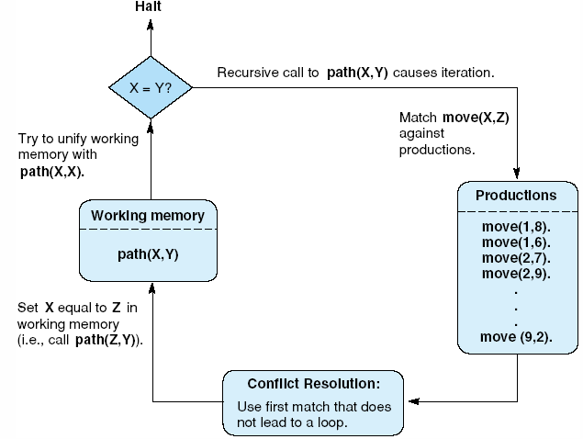
Fig 6.8 The recursive path algorithm as production system.
13
AI CLASS NOTES 4B, JOHN SHIEH, 2010

Slide 14
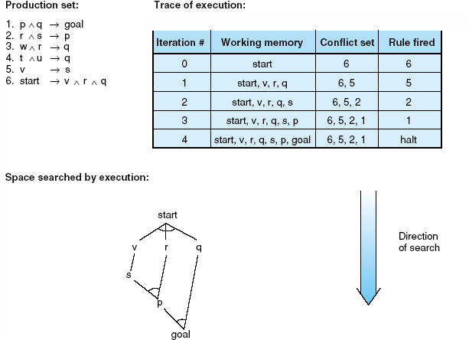
Fig 6.9 Data-driven search in a production system.
14

Slide 15
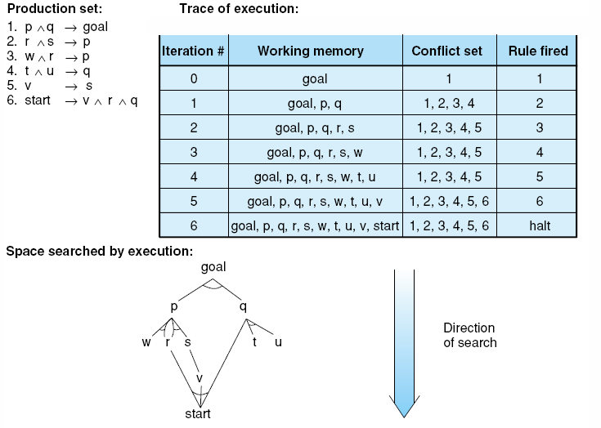
Fig 6.10 Goal-driven search in a production system.
15

Slide 16
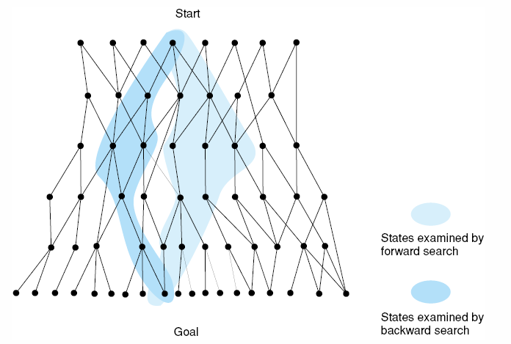
Fig 6.11 Bidirectional search missing in both directions, resulting in excessive search.
16

Slide 17
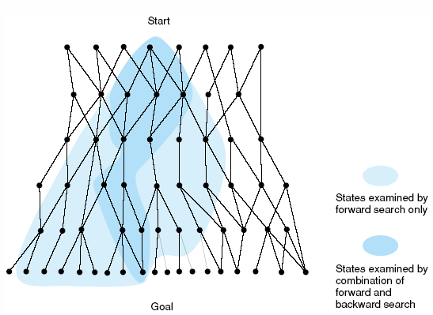
Fig 6.12 Bidirectional search meeting in the middle, eliminating much of the space examined by unidirectional search.
17

Slide 18
Major advantages of production systems for artificial intelligence
Separation of Knowledge and Control
A Natural Mapping onto State Space Search
Modularity of Production Rules
Pattern-Directed Control
Opportunities for Heuristic Control of Search
Tracing and Explanation
Language Independence
A Plausible Model of Human Problem-Solving
18

Slide 19
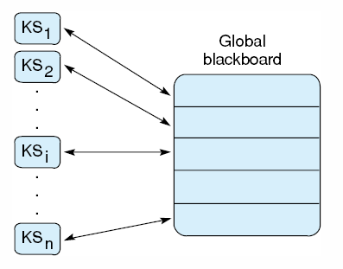
Fig 6.13 Blackboard architecture
19

