Slide 1
HEURISTIC SEARCH
4.0 Introduction
4.1 An Algorithm for Heuristic Search
4.2 Admissibility, Monotonicity, and Informedness
4.3 Using Heuristics in Games
4.4 Complexity Issues

Slide 2
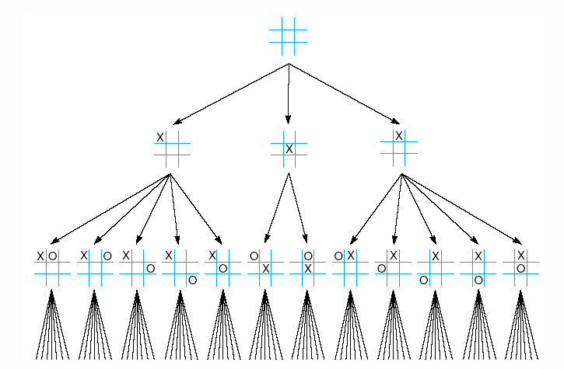
Fig 4.1 First three levels of the tic-tac-toe state space reduced by symmetry

Slide 3
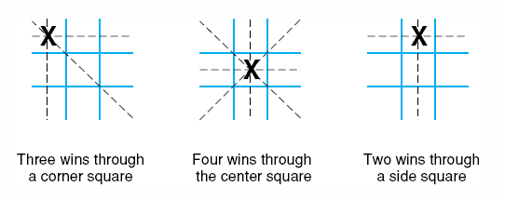
Fig 4.2 The “most wins” heuristic applied to the first children in tic-tac-toe.

Slide 4
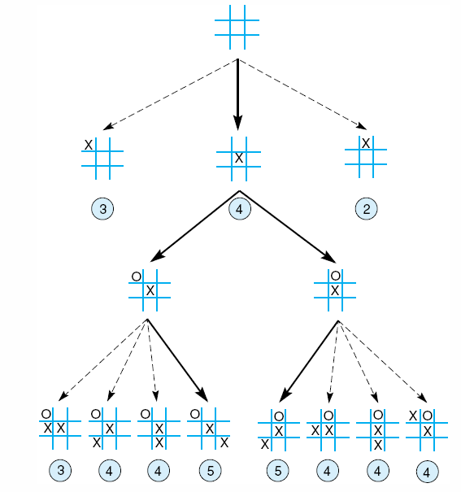
Fig 4.3 Heuristically reduced state space for tic-tac-toe.
4

Slide 5
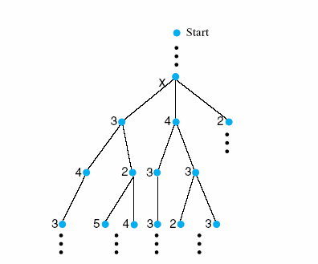
Fig 4.4 The local maximum problem for hill-climbing with 3-level look ahead
Notes:
Insert fig 4.4

Slide 6
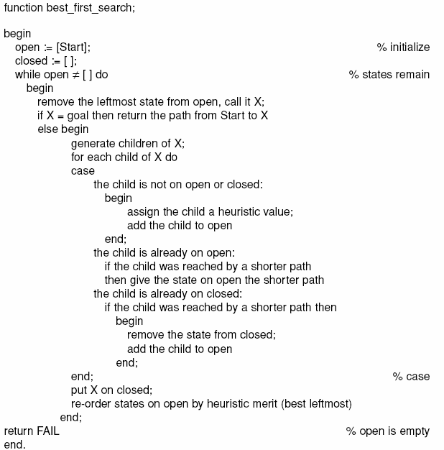

Slide 7
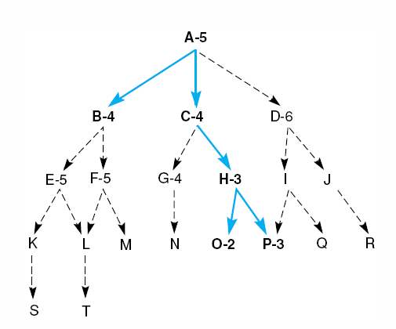
Fig 4.10 Heuristic search of a hypothetical state space.

Slide 8
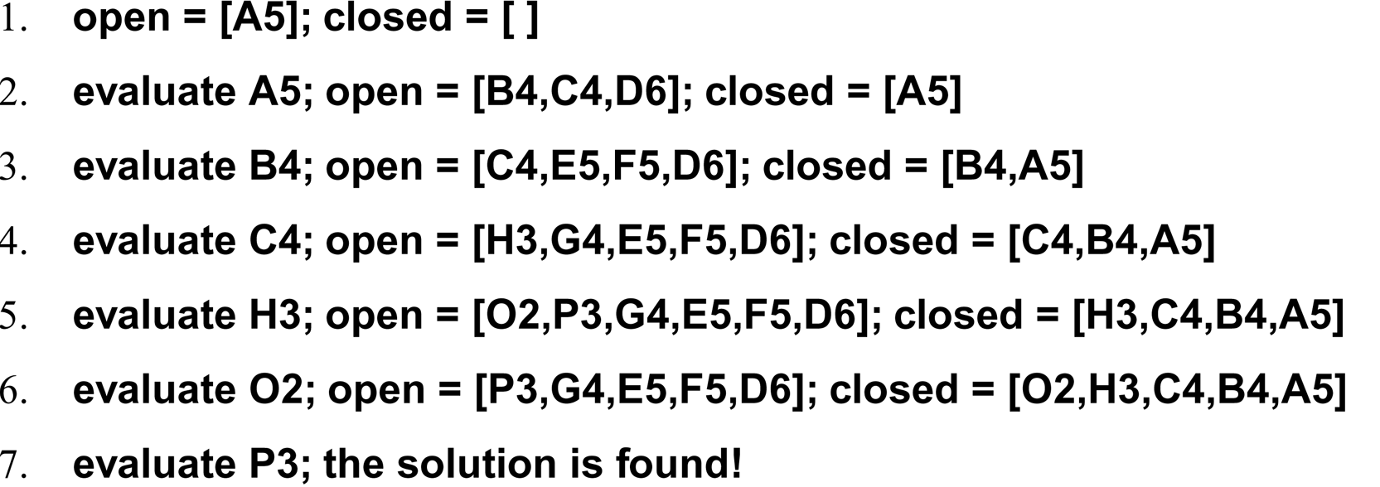
A trace of the execution of best_first_search for Figure 4.4

Slide 9
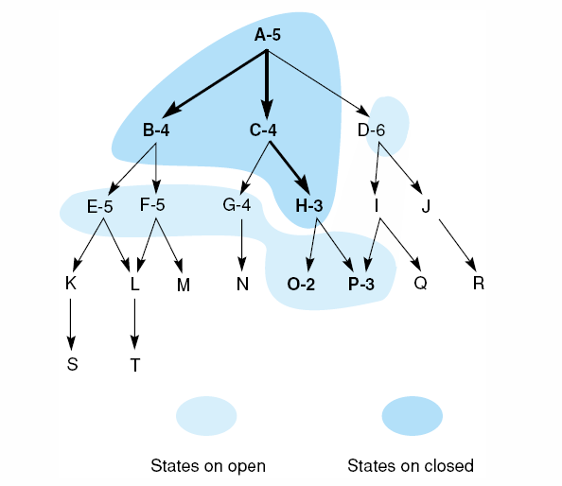
Fig 4.11 Heuristic search of a hypothetical state space with open and closed states highlighted.
15

Slide 10
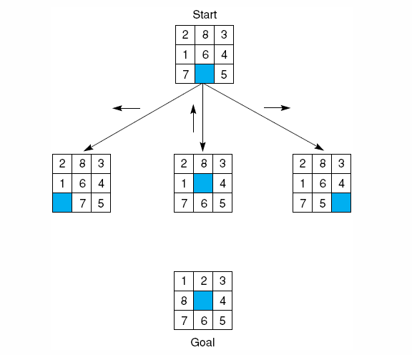
Fig 4.12 The start state, first moves, and goal state for an example-8 puzzle.
16
Notes:
Insert fig 4.12

Slide 11
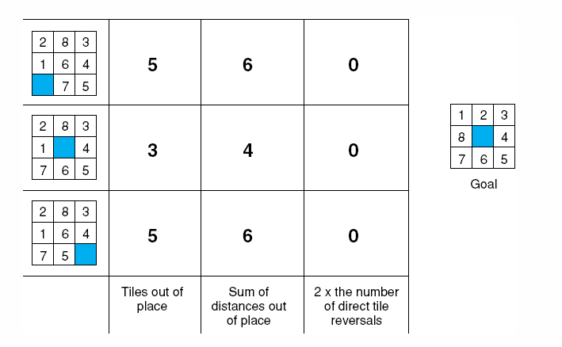
Fig 4.14 Three heuristics applied to states in the 8-puzzle.

Slide 12
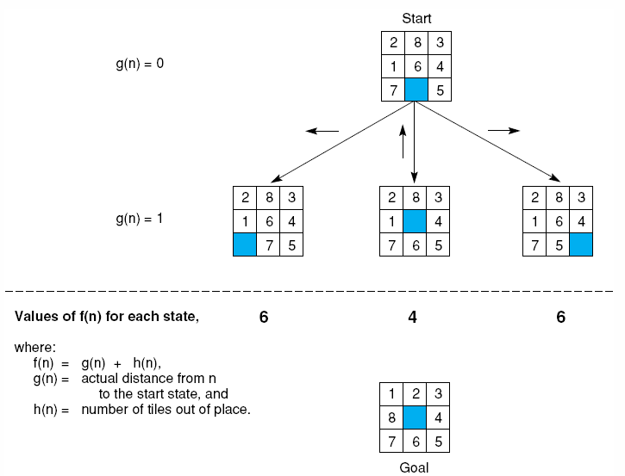
Fig 4.15 The heuristic f applied to states in the 8-puzzle.
18
Notes:
Insert fig 4.15

Slide 13
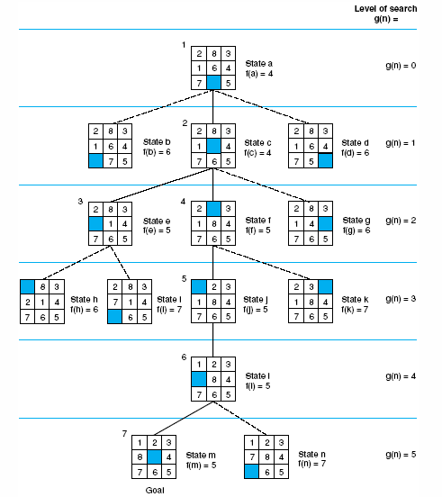
Fig 4.16 State space generated in heuristic search of the 8-puzzle graph.
Notes:
Insert fig 4.16

Slide 14
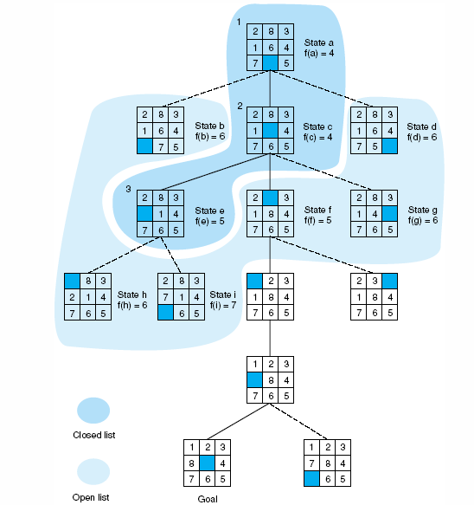
Fig 4.17 Open and closed as they appear after the 3rd iteration of heuristic search

Slide 15
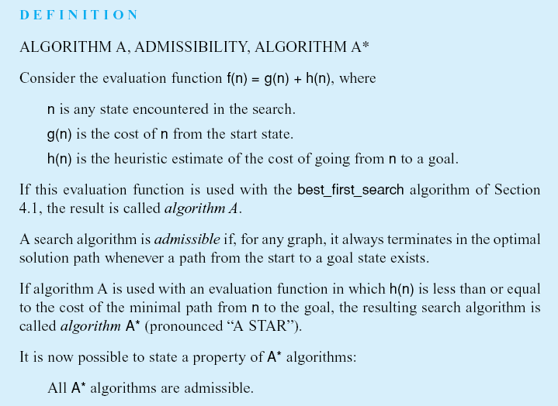
Notes:
Insert def box page 146

Slide 16
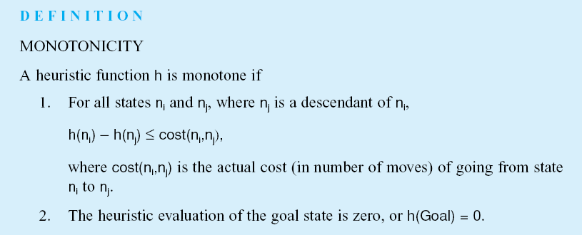
Notes:
Insert def box, pg 147

Slide 17
Notes:
Insert def box, pg 148

Slide 18
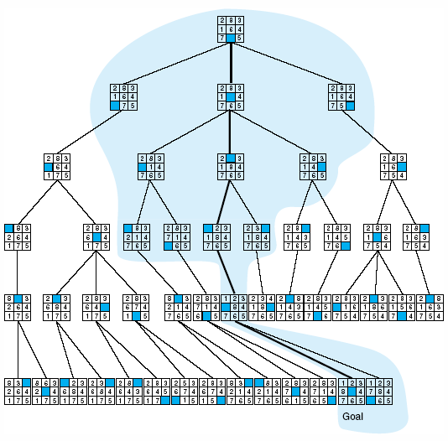
Fig 4.18 Comparison of state space searched using heuristic search with space searched by breadth-first search. The proportion of the graph searched heuristically is shaded. The optimal search selection is in bold. Heuristic used is f(n) = g(n) + h(n) where h(n) is tiles out of place.

Slide 19
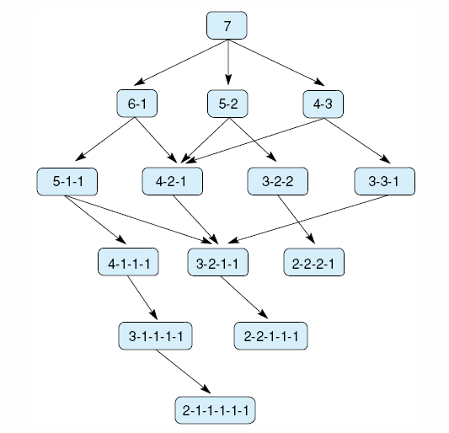
Fig 4.19 State space for a variant of nim. Each state partitions the seven matches into one or more piles.

Slide 20
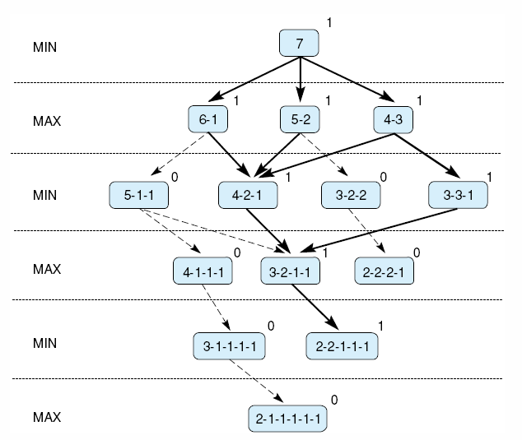
Fig 4.20 Exhaustive minimax for the game of nim. Bold lines indicate forced win for MAX. Each node is marked with its derived value (0 or 1) under minimax.
Notes:
Insert fig 4.20

Slide 21
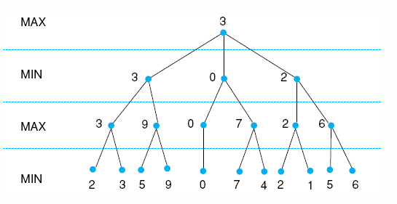
Fig 4.21 Minimax to a hypothetical state space. Leafstates show heuristic values; internal states show backed-up values.
Notes:
Insert fig 4.21

Slide 22
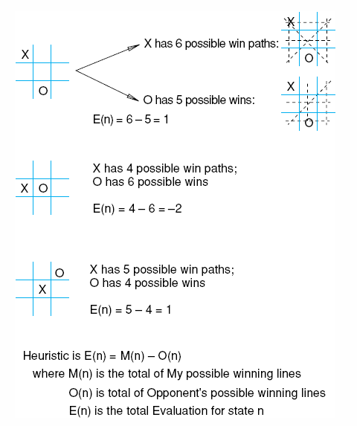
Fig 4.22 Heuristic measuring conflict applied to states of tic-tac-toe.

Slide 23
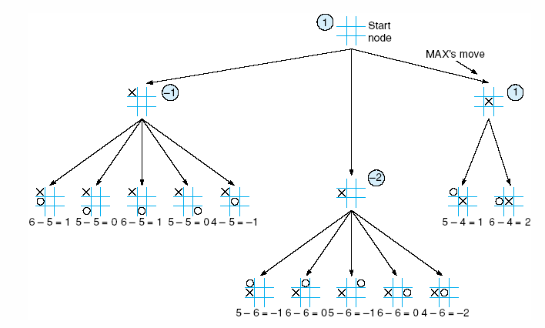
Fig 4.23 Two-ply minimax applied to the opening move of tic-tac-toe, from Nilsson (1971).

Slide 24
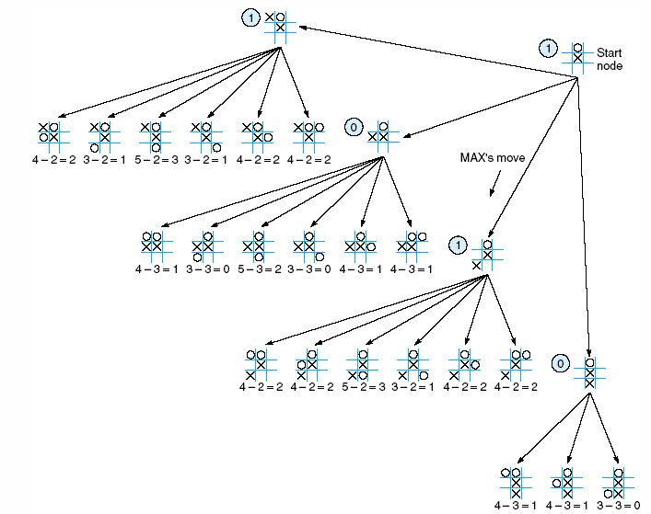
Fig 4.24 Two ply minimax, and one of two possible MAX second moves, from Nilsson (1971).

Slide 25
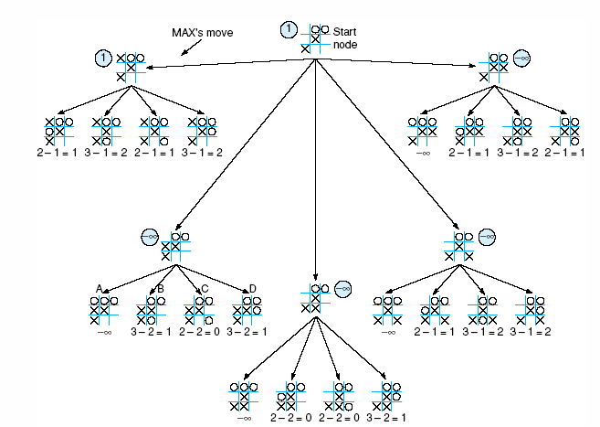
Fig 4.25 Two-ply minimax applied to X’s move near the end of the game, from Nilsson (1971).

Slide 26
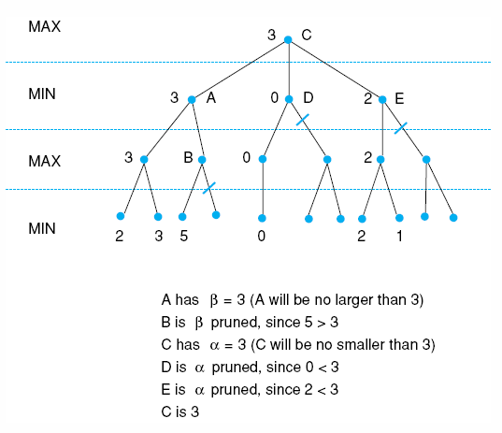
Fig 4.26 Alpha-beta pruning applied to state space of Fig 4.21. States without numbers are not evaluated.

Slide 27
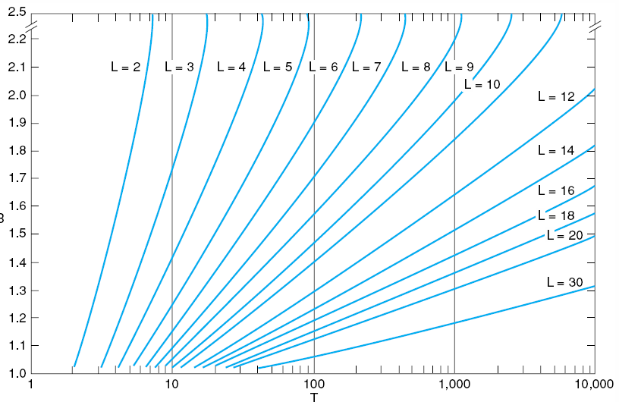
Fig 4.27 Number of nodes generated as a function of branching factor, B, for various lengths, L, of solution paths. The relating equation is T = B(B^{L} – 1)/(B – 1), adapted from Nilsson (1980).
Luger: Artificial Intelligence, 5th edition. © Pearson Education Limited, 2005
6

Slide 28
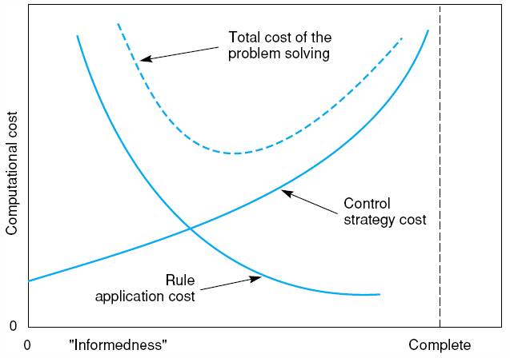
Fig 4.28 Informal plot of cost of searching and cost of computing heuristic evaluation against informedness of heuristic, adapted from Nilsson (1980).
7

Slide 29
Fig 4.29 The sliding block puzzle.
8

Slide 30
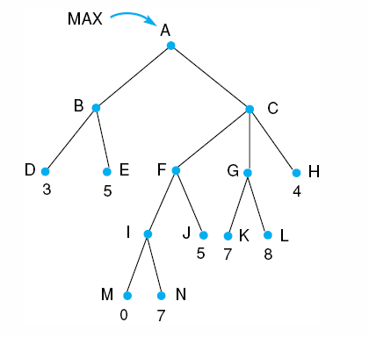
Fig 4.30.

Slide 31
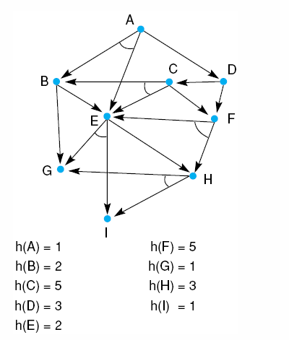
Fig 4.31.

