Slide 1
2018 Starcraft AI Competition Report and Results David Churchill, Richard Kelly Memorial University of Newfoundland

Slide 2
BWAPI

Slide 3
Tournament Results
www.StarcraftAICompetition.com
“Results / Files”

Slide 4
Tournament Format
Full Game – Starcraft Broodwar
Fog of War Enabled
Round Robin Format
1v1 Games
Bots ranked by final win percentage

Slide 5
Game Rules
60 minute game time-limit
Tie break with in-game score
No cheating or in-game glitches
Disqualified if cheating found
Bots penalized for slow computations
Game loss if bot goes over computation limit
File I/O - Learning

Slide 6
Why Not Starcraft 2?
Stacraft 2 EULA Violations:
In whole or in part, copy or reproduce (except as provided herein),translate, reverse engineer, derive source code from, modify, disassemble, decompile, or create derivative works based on the Game;
Use cheats, automation software (bots), hacks, or any other unauthorized third-party software designed to modify the Game experience, including without limitation, mods that violate the terms of this License Agreement or the Terms of Use;
Use any unauthorized third-party software that intercepts, "mines", or otherwise collects information from or through the Game or the Service, including without limitation any software that reads areas of RAM used by the Game to store information; provided, however, that Blizzard may, at its sole and absolute discretion, allow the use of certain third party user interfaces;
Modify or cause to be modified any files that are a part of the Game in any way not expressly authorized by Blizzard;

Slide 7
Why Not Starcraft 2?
Stacraft 2 EULA Violations:
In whole or in part, copy or reproduce (except as provided herein),translate, reverse engineer, derive source code from, modify, disassemble, decompile, or create derivative works based on the Game;
Use cheats, automation software (bots), hacks, or any other unauthorized third-party software designed to modify the Game experience, including without limitation, mods that violate the terms of this License Agreement or the Terms of Use;
Use any unauthorized third-party software that intercepts, "mines", or otherwise collects information from or through the Game or the Service, including without limitation any software that reads areas of RAM used by the Game to store information; provided, however, that Blizzard may, at its sole and absolute discretion, allow the use of certain third party user interfaces;
Modify or cause to be modified any files that are a part of the Game in any way not expressly authorized by Blizzard;

Slide 9
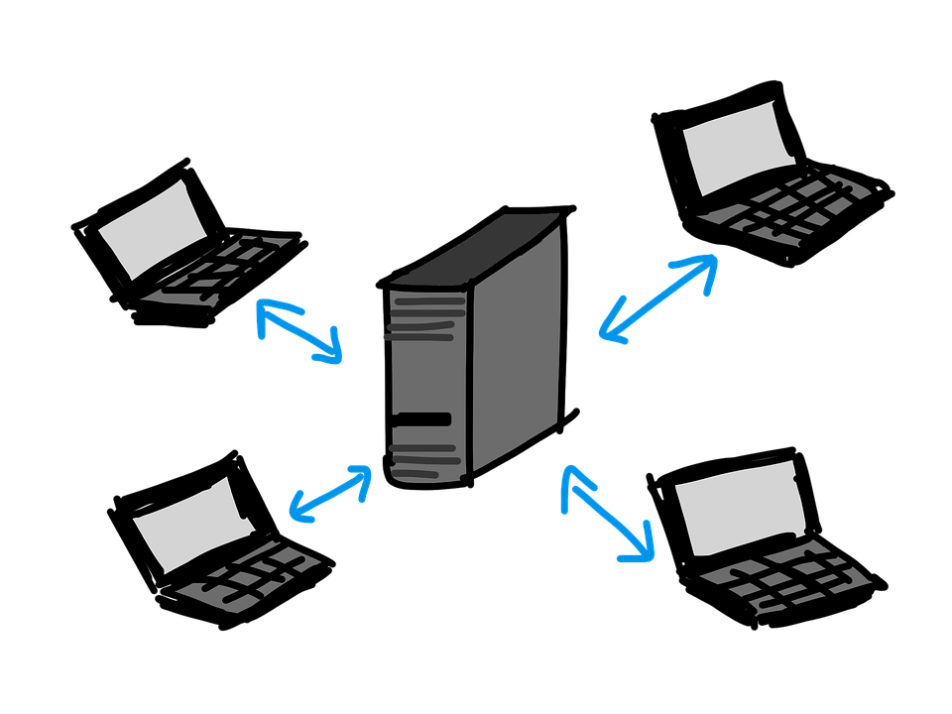
Why Not StarCraft 2?

Slide 10
 | Bot Name | Author Name | Affiliation | Race | BWAPI | Type | Status
1 | BlueBlueSky | Pengfei Hou | Independent | Protoss | 4.1.2 | dll | 2018 Registered
2 | CDBot | Seevan Yang | Independent | Zerg | 4.1.2 | dll | 2018 Registered
3 | CherryPi | Gabriel Synnaeve + Team | Facebook AI Research | Zerg | 4.2.0 | proxy | 2018 Registered
4 | CSE | Wei Guo | Independent | Protoss | 4.1.2 | dll | 2018 Registered
5 | CUNYBot | Bryan Weber | CSI-CUNY | Zerg | 4.2.0 | dll | 2018 Registered
6 | DaQin | Lion Gis | Independent | Protoss | 4.1.2 | dll | 2018 Registered
7 | Ecgberht | Francisco Javier Sacido | Univ. Carlos III Madrid | Terran | 4.2.0 | Java | 2018 Registered
8 | Hellbot | James Hellman | Falmouth University | Protoss | 3.7.4 | client | 2018 Registered
9 | KillAll | Zhentao Tang | Independent | Zerg | 4.1.2 | dll | 2018 Registered
10 | ISAMind | Fang Gao | Independent | Protoss | 4.1.2 | dll | 2018 Registered
11 | LastOrder | Sijia Xu | Bilibili | Zerg | 4.2.0 | dll+proxy | 2018 Registered
12 | Locutus | Bruce Nielsen | Independent | Protoss | 4.1.2 | dll | 2018 Registered
13 | McRave | Christian McCrave | Independent | Protoss | 4.2.0 | dll | 2018 Registered
14 | MetaBot | Anderson Tavares | UFMG | Protoss | 3.7.4 | dll | 2018 Registered
15 | Microwave | Micky Holdorf | Independent | Zerg | 4.1.2 | dll | 2018 Registered
16 | SAIDA | Changhyeon Bae | Samsung SDS | Terran | 4.1.2 | dll | 2018 Registered
17 | Steamhammer | Jay Scott | Independent | Zerg | 4.1.2 | dll | 2018 Registered
18 | Tyr | Simon Prins | Independent | Protoss | 4.1.2 | Java | 2018 Registered
19 | WillyT | Nico Klausner | Independent | Terran | 4.2.0 | dll | 2018 Registered
20 | AILien | Alexander Stumpp | Independent | Zerg | 4.2.0 | dll | 2017 Returning
21 | Aiur | Florian Richoux | Université de Nantes | Protoss | 3.7.4 | dll | 2017 Returning
22 | Arrakhammer | Anthony Van | Stanford University | Zerg | 4.1.2 | dll | 2017 Returning
23 | Iron | Igor Dimitrijevic | Independent | Terran | 4.1.2 | dll | 2017 Returning
24 | LetaBot | Martin Rooijackers | University Maastricht | Terran | 3.7.4 | dll | 2017 Returning
25 | UAlbertaBot | David Churchill | Memorial University | Random | 4.2.0 | dll | 2017 Returning
26 | Ximp | Tomas Vajda | Independent | Protoss | 3.7.4 | dll | 2017 Returning
27 | ZZZKBot | Chris Coxe | Independent | Zerg | 4.2.0 | dll | 2017 Returning

Slide 12
2018 New Features
GPU computation support
Tag bots as requiring GPU, and they run only on machines that have GPU support
Only used by CherryPi (facebook) bot
More detailed crash reporting
More detailed analysis of results
Results format changed slightly (JSON)

Slide 13
Tournament Statistics
Played on 12 virtual/real machines
Tournament ran for ~2 weeks
34694 games played in total
~2600 games per bot
100 games per bot pairing
10 games per pairing per map

Slide 14
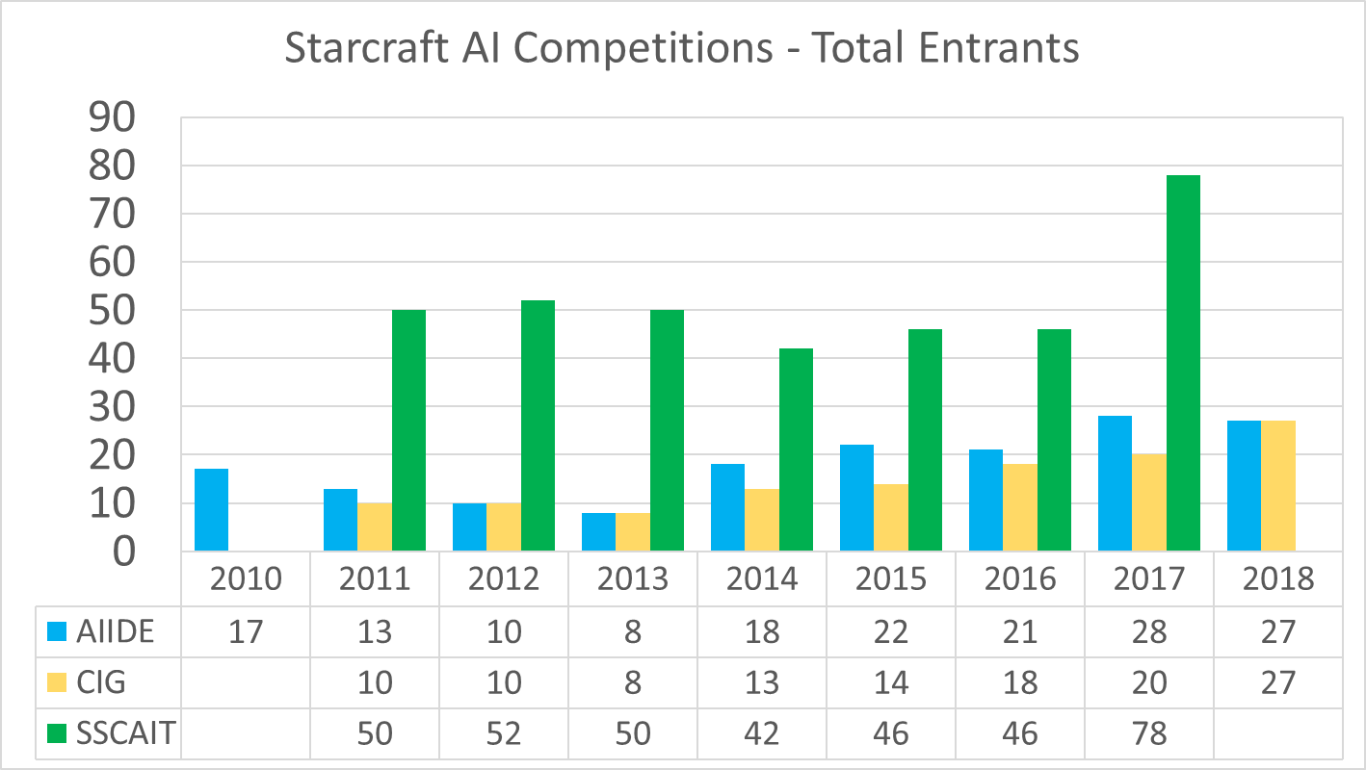

Slide 15
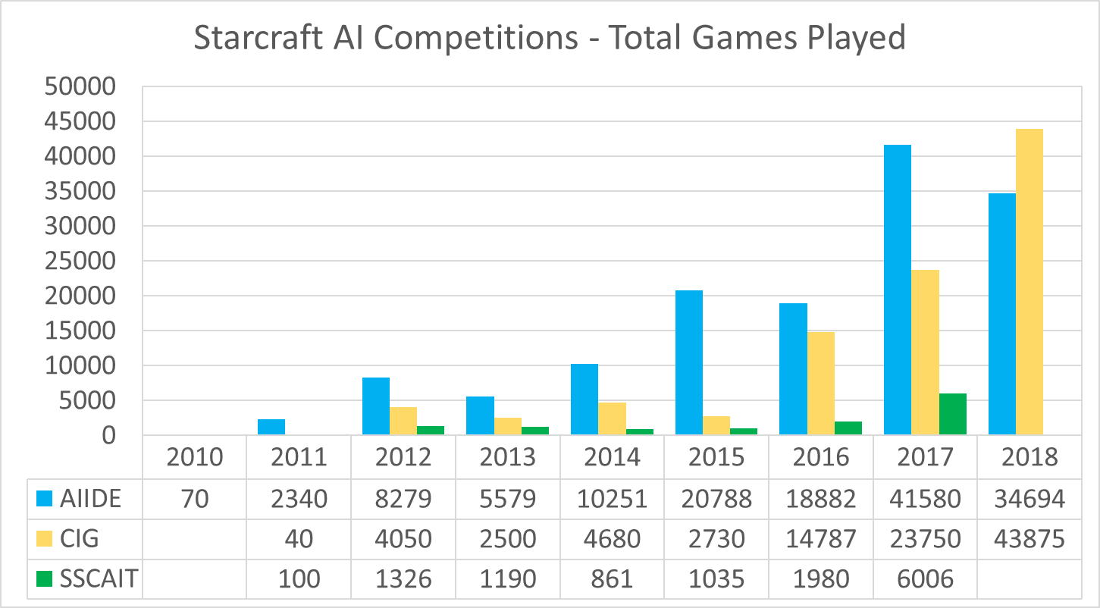

Slide 16
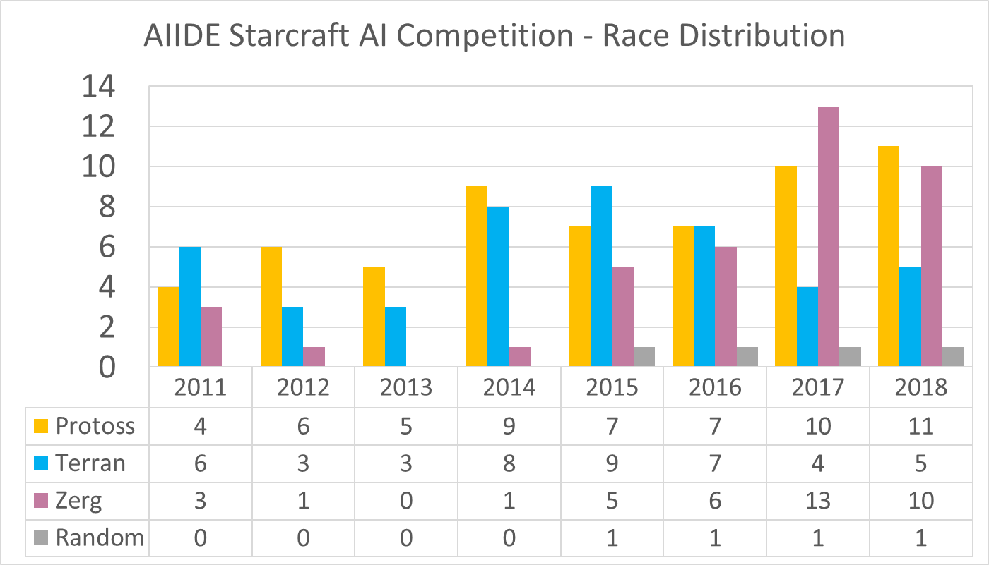

Slide 17
RESULTS

Slide 18
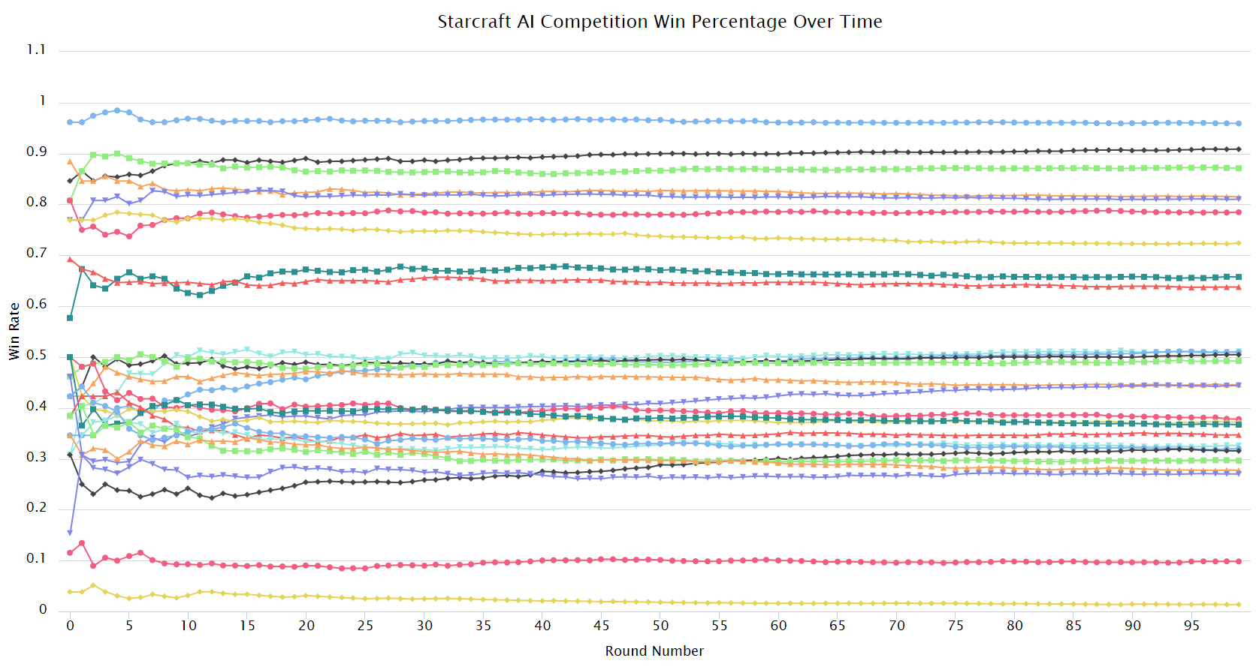

Slide 19
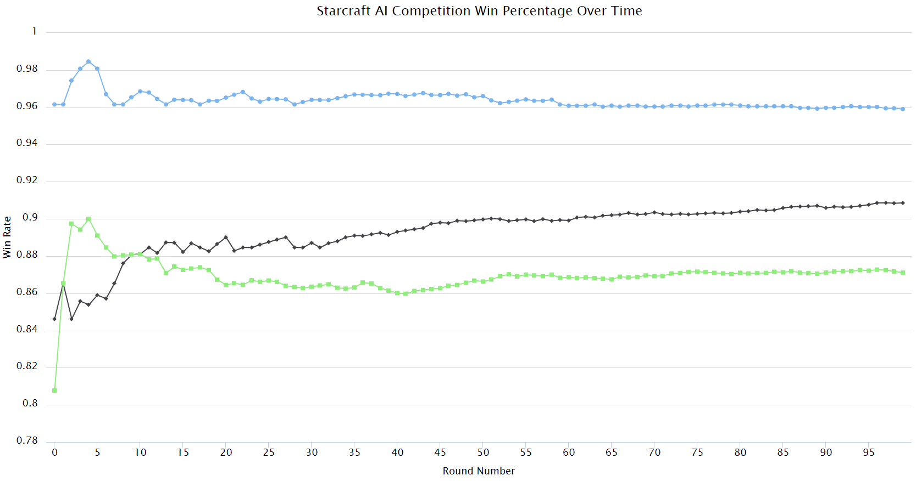

Slide 20
Rock, Paper, Scissors?
A beats B, B beats C, C beats A
Can happen with different strategies
Rush beats Expand
Expand beats Defend
Defend beats Rush
2017 Competition:
1 > 2 > 10 > 6 > 3 > 5 > 8 > 9 > 4 > 7 > 1

Slide 21
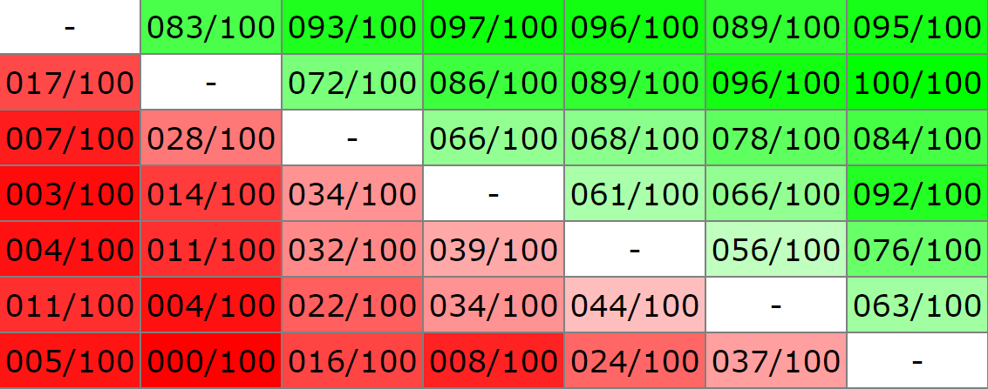
No RPS in 2018

Slide 22
 | Bot | Win % | Games | Win | 2015
1st
2nd
3rd
4th
5th

Slide 23
 | Bot | Win % | Games | Win | 2015
1st
2nd
3rd
4th
5th | Locutus | 81.01 | 2586 | 2095 | -

Slide 24
 | Bot | Win % | Games | Win | 2015
1st
2nd
3rd
4th | BlueBlueSky | 81.48 | 2586 | 2107 | -
5th | Locutus | 81.01 | 2586 | 2095 | -

Slide 25
 | Bot | Win % | Games | Win | 2015
1st
2nd
3rd | CSE | 87.11 | 2591 | 2257 | -
4th | BlueBlueSky | 81.48 | 2586 | 2107 | -
5th | Locutus | 81.01 | 2586 | 2095 | -

Slide 26
CSE
Protoss Bot
Nationality: China
Authors: Junge Zhang, Wei Guo, Qiyue Yin, Dong Zhan, Qiwei Wang, Yihui Hu, Shengqi Shen, Kaiqi Huang
No Official Affiliation
Competed as ‘cpac’ bot last year

Slide 27
CSE
Based on the bot “Locutus”
6 weeks of improvements to their code
Mainly based on hard-coded rules, with a little bit of machine learning
“We use a multilayer perception network and several rules to predict units to train when the build order queue is empty.”

Slide 28
 | Bot | Win % | Games | Win | 2015
1st
2nd | CherryPi | 90.86 | 2592 | 2355 | 6th
3rd | CSE | 87.11 | 2591 | 2257 | -
4th | BlueBlueSky | 81.48 | 2586 | 2107 | -
5th | Locutus | 81.01 | 2586 | 2095 | -

Slide 29
CherryPi
Zerg Bot
Facebook AI Research (NY, USA)
Authors: Jonas Gehring, Vegard Mella, Daniel Gant, Zeming Lin, Da Ju, Danielle Rothermel, Nicolas Carion, Nicolas Usunier, Gabriel Synnaeve

Slide 30
CherryPi
“CherryPi has 8-13 strategies per matchup. It selects one at the start of the game based on history against the current opponent, using a bandit model with time-decaying weights on previous games. Using a pre-trained model, and given the current state of the game, it estimates the expected likelihood of winning (“value”) with each of the available strategies, and under certain conditions will switch to the strategy with the highest value. This can produce “mixed” strategies by switching back and forth.”

Slide 31
CherryPi AI Techniques
Search: “We use region-level pathfinding to send units around map obstacles, and threat-aware pathfinding to kite and navigate units out of combat.”
Offline ML: A ConvNet model that places buildings based on human data from https://arxiv.org/abs/1708.02139 Also: “An LSTM model for high level strategy selection”
Offline RL: “Yes”
Online Learning: “Yes” (uses file IO) “
Map Analysis: Uses BWEM Library (Brood War Easy Map)
Analyzed matchups against bots from previous competitions in offline training stage

Slide 32
CherryPi Strengths
Efficient macro-management: Optimized harvester distribution, automatic tuning of mineral:gas ratio, building Drones in unsaturated bases, and a build queue that automatically expedites build items wherever possible eg. by inserting Hatcheries or Overlords as needed.
Strategy selection: Having a diverse set of openers and the ability to intelligently switch between them
Army positioning: Pre-positioning armies to achieve maximum surface area in combat; using threat-aware pathfinding to evacuate armies smoothly with minimized losses
Basic unit control: Distributing targets so units don't collide; controlling Hydralisks between shots

Slide 33
 | Bot | Win % | Games | Win | 2015
1st | SAIDA | 95.91 | 2590 | 2484 | -
2nd | CherryPi | 90.86 | 2592 | 2355 | 6th
3rd | CSE | 87.11 | 2591 | 2257 | -
4th | BlueBlueSky | 81.48 | 2586 | 2107 | -
5th | Locutus | 81.01 | 2586 | 2095 | -

Slide 34
SAIDA
Terran Bot
Affiliation: Samsung, South Korea
Authors: Changhyeon Bae(Leader), Iljoo Yoon, Daehun Jun, Junseung Lee, Hyunjin Choi, Hyunjae Lee, Yonghyun Jeong, Uk Jo
Also consulted with some South Korean Starcraft Progamers about the bot
https://github.com/TeamSAIDA/SAIDA

Slide 35
SAIDA
Based on source code of UAlbertaBot
“SAIDA basically plays the mechanic terran in all games. it starts with a stable defence-first strategy and after mid stage of game, it seeks the best rush timing and win the game with a powerful one-shot attack.”
“We think that the mechanic terran can cope with the most opponent's strategies and has the least weakness. That's why we chose this one.”

Slide 36
SAIDA AI Techniques
Uses UAlbertaBot’s existing techniques
“We made the CNN & Encorder-Decode that has learned progamers replays to decide when to fight. (Not in submitted version of AIIDE because of some performance issue)”
“We studied the multi-agent reinforcement learning in micro unit control in several mini-games of Starcraft. (Not in submitted version)”

Slide 37
SAIDA AI Techniques
No hard-coded map information
No online file IO / opponent learning
“We use a finite-state machine to control units and buildings. Every units and buildings has a specific state in every situation. And we use several search algorithm to find enemy base or place to build on. “

Slide 38
SAIDA
Q: Have you tested your bot against humans? If so, how did it go?
A: Yes we did several times and beat amateurs. When we tested against progamer, we couldn't win but saw the possibilities that it is not that long way to beat the progamer.

Slide 39
Conclusions
Bot strength much higher this year than previous years (previous high 89% wins)
Two major companies competing
Samsung 1st Place, Facebook 2nd Place
Samsung has Korean Progamers
Facebook has many top 3 bot authors
Can amateurs ever win again?

Slide 40
Thank You!
Twitter: @StarcraftAIComp
Email: dave.Churchill@gmail.com
www.StarCraftAICompetition.com

