Slide 1
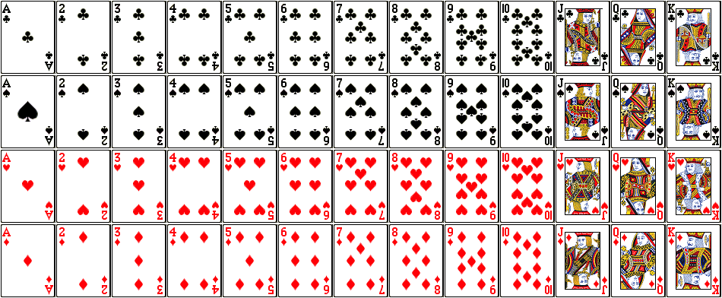
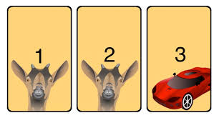
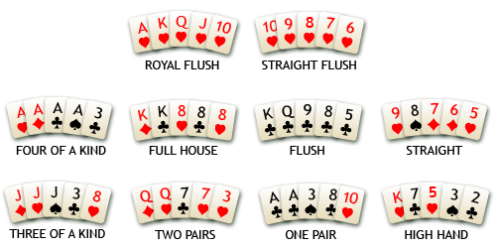
COMP 1002: tutorial 9
Probability
Probability
Nov 20, 2020
++++ ++ +++ ++ ++ ++ ++ + - ++ + - - - + + - - - -
+ - - -- - - -
- - - - - - - - - - - - - - -

Slide 2
Last lab/quiz this week
One more small summary unit with no lab/quiz left
Test 2 date suggestions
Lab 9 poll
Any questions/comments?

Slide 3
Probability
Finite probability
Experiment, sample space, outcome, event, distribution
Probability equations/inequalities from sets
Birthday paradox
Conditional probability
Monty hall puzzle
Bayes theorem
Expectation
Random variables, Bernoulli trials
Variance, deviation from the mean
Proofs with probabilitistic method
++++ ++ +++ ++ ++ ++ ++ + - ++ + - - - + + - - - -
+ - - -- - - -
- - - - - - - - - - - - - - -

Slide 4
Simpson’s paradox
When aggregate shows a different trend than individual parts

Slide 7
Conditional probability: $\operatorname{Pr}\left(A | B\right)=\frac{\operatorname{Pr}\left(A∩B \right)}{Pr⁡(B)}$
Bayes theorem: $\operatorname{Pr}\left(B | A\right)= \frac{Pr(A|B)⋅Pr\left(B\right)}{Pr⁡(A)}=\frac{Pr(A|B)⋅Pr\left(B\right)}{\operatorname{Pr}{(A|B)}\operatorname{Pr}\left(B\right)+\operatorname{Pr}{(A|\overline{B})}Pr⁡(\overline{B}) }$

Slide 9
Expected value (mean) is ${μ= Σ}_{k=1}^{n} a_{k}Pr⁡(a_{k})$
Greek letter mu $μ$
For random variable X, $E\left(X\right)= \sum_{i∈Outcomes}{X\left(i\right)∗Pr⁡(i) }$
Expected trials till success: $E\left(X\right)=Σ_{i∈ℕ} i∗\operatorname{Pr}\left(X=i\right)=\frac{1}{p}$
Variance: $V\left(X\right)=\sum_{s∈S }{{\left(X\left(s\right)−E\left(X\right)\right)}^{2}p\left(s\right)=E\left(X^{2}\right)−{\left(E\left(X\right)\right)}^{2}}$
Standard deviation (Greek letter sigma) $σ=√V\left(X\right)$

Slide 10
Expected number of inversions in a permutation

Slide 12
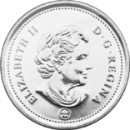
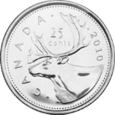
Bernoulli trials and repeated experiments
Suppose an experiment has two outcomes, 1 and 0 (success/failure), with Pr(1) = p.
Such experiment is called a Bernoulli trial.
What happens if the experiment is repeated multiple times (independently)?
A sample space after carrying out n Bernoulli trials is a set of all possible n-tuples of elements in {0,1} (or {success, fail}).
Number of n-tuples with k 1s is $\left({n \atop k}\right)$
Probability of getting 1 in any given trial is p, of getting 0 is (1-p).
Probability of getting exactly k 1s (successes) out of n trials is $\left({n \atop k}\right)p^{k}{\left(1−p\right)}^{n−k}$
Probability of getting the first success on exactly the $k^{th}$ trial is $p{\left(1−p\right)}^{k−1}$
How many trials do we need, on average, to get a success?

Slide 17
Lemma: $∀n≥1 Σ_{i=1}^{n} 2^{i}=2^{n+1}−1$
Proof: Induction on $n$

Slide 21
Any questions?

