Slide 1
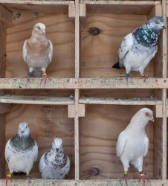
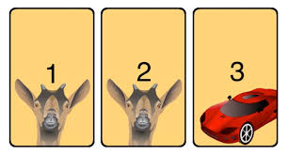
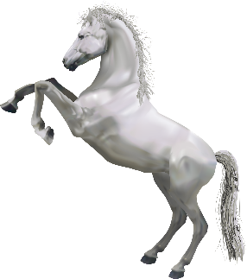
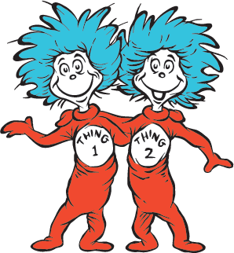
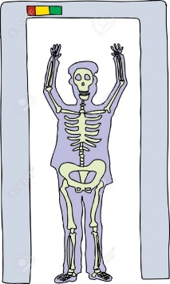

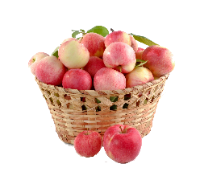
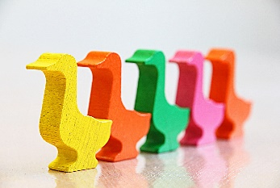
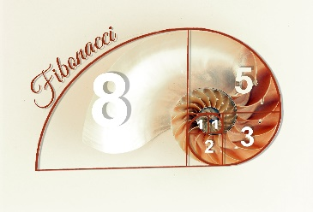



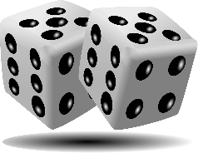
COMP 1002: tutorial 10
Review
Nov 27, 2020

Slide 2

Test 2 on Dec 2-3.
  Extra office hours? When?
No lab or quiz next week.
  Only one more drill to be posted
If I did not reply to your email, or promised to do something and didn’t, please email me again!

Slide 3
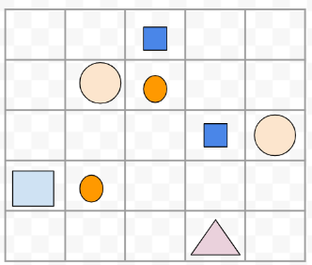
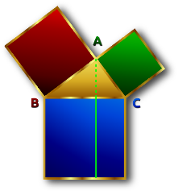
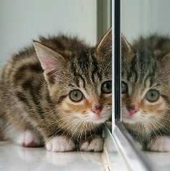
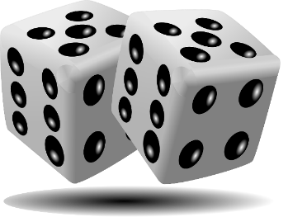
Review
Intro to language of logic
Reasoning in propositional logic
Predicate logic
Proofs
Basic structures: relations and strings
Induction
Recursive definitions
Counting
Probability
Logic for algorithms
Beth
Al
Cora
Eli
Dan

Slide 4
Questions? Comments?

Slide 10

Thank you so much!

