Slide 1


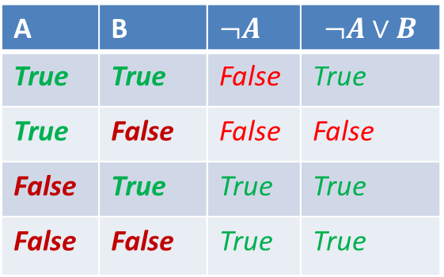
COMP 6901: tutorial 1
J
5
$$∨$$
J
2
A
$$∧$$
B
C
B
5
B
2
Sep 18, 2020
A | B | $¬A$ | $$¬A∨B$$
True | True | False | True
True | False | False | False
False | True | True | True
False | False | True | True
x
AND
y
AND
OR
z
AND

Slide 2

You only need to come to one tutorial slot (1pm or 6pm), not both
  Another one is a repeat.
Tutorial is a type of a lecture
  Covering the material of the coming week (unit 1 today).
  With some interactive component, but not like office hours,
    Though you are still welcome to ask questions!
It would be good if you could use your real names.
  So that later if you say “I talked to you in the tutorial and you told me…” I’d know who you are.
Tutorials will be recorded, and the recordings posted.
  The recordings will contain all voice, my shared screen and my video
  Not the chat or polls.
  If you ask questions by chat, it will not be recorded. Your voice will be.

Slide 3
Today: Language of logic
How to write propositional logic formulas
Truth assignments
Building a syntax tree for a formula
Evaluating a formula using a syntax tree
Truth tables
Circuits
Canonical DNF and CNF.
J
5
J
2
B
5
B
2

Slide 4



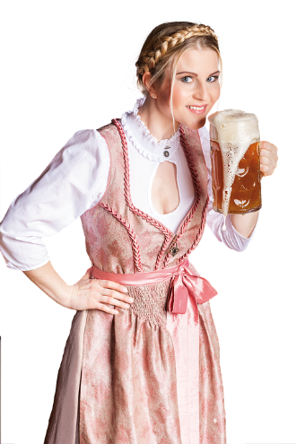

A (pre-COVID) party puzzle
Imagine that you are organizing a party at the residence
  There will be alcohol served, and some people are too young to drink
  So not to get in trouble you need to make sure that if a guest is drinking alcohol then they are old enough to drink.
  Which people below you need to approach (to see either their age or their drink, if it is not clear from the picture), to make sure you will not get in trouble?

Slide 5
A (pre-COVID) party puzzle
Imagine that you are organizing a party at the residence
  There will be alcohol served, and some people are too young to drink
  So not to get in trouble you need to make sure that if a guest is drinking alcohol then they are old enough to drink.
  Which people below you need to approach (to see either their age or their drink, if it is not clear from the picture), to make sure you will not get in trouble?
Drinking coffee
Senior
Young
Drinking beer

Slide 6
A (pre-COVID) party puzzle
Imagine that you are organizing a party at the residence
  Make sure that if a guest is drinking alcohol then they are old enough.
  Which people below you need to check (either their age or their drink, if it is not clear from the picture)?
If a card has a J on it, then it has 5 on the other side
B
5
2
J
Drinking coffee
Senior
Young
Drinking beer

Slide 7
Propositions
Give me examples of (atomic) propositions that are true
Give me examples of (atomic) propositions that are false

Slide 8
Translations
Give me a sentence involving these propositions.
Give me a formula on these variables, and we’ll translate it.

Slide 9
Shapes and colours puzzle
I like one of the shapes.
                I like one of the colours.
I like a figure if it has my favourite shape or my favourite colour.
I like . What can you say about the rest?

Slide 10
Shapes and colours puzzle
I like one of the shapes.
                I like one of the colours.
I like a figure if it has my favourite shape or my favourite colour.
I like . What can you say about the rest?
  I might like triangles, or blue things, or both.
  There is one figure I don’t like, but not enough information to say which one.
  I might still like

Slide 11

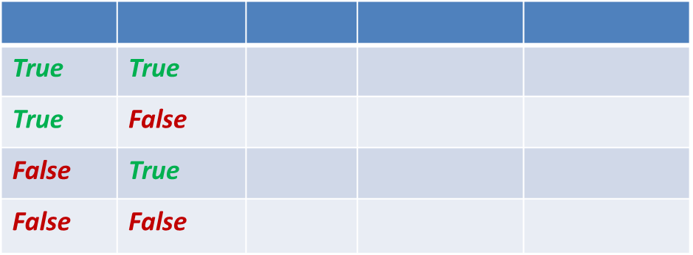

Syntax trees and truth tables
Precedence:
  Parentheses
  then $¬$ (like unary -)
  then $∧$ (like *)
  $t$hen $∨$ (like +)
  Finally $→$
  Left to right for $∨, ∧$
    right to left for $→$
Give me an example of a logic formula on two variables with three connectives.
Now give me a different formula logically equivalent to this one.
True | True
True | False
False | True
False | False

Slide 12
Syntax trees and truth tables
Precedence:
  Parentheses
  then $¬$ (like unary -)
  then $∧$ (like *)
  $t$hen $∨$ (like +)
  Finally $→$
  Left to right for $∨, ∧$
    right to left for $→$
Give me an example of a logic formula on two variables with three connectives.
Now give me a different formula logically equivalent to this one.
True | True
True | False
False | True
False | False

Slide 14








$$→$$
Long example: $A∧ ¬ B∨¬C→¬(A∨C)$
$$∨$$
$¬$
$$∧$$
$$¬$$
$∨$
A
$$¬$$
C
A
C
B
A | B | C
True | True | True
True | True | False
True | False | True
True | False | False
False | True | True
False | True | False
False | False | True
False | False | False

Slide 15

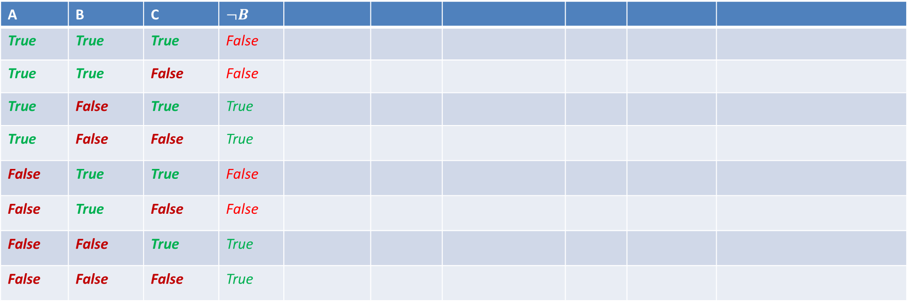
$$→$$
Example: $A∧ ¬ B∨¬C→¬(A∨C)$
$$∨$$
$¬$
$$∧$$
$$¬$$
$∨$
A
$$¬$$
C
A
C
B
A | B | C | $¬B$
True | True | True | False
True | True | False | False
True | False | True | True
True | False | False | True
False | True | True | False
False | True | False | False
False | False | True | True
False | False | False | True

Slide 16
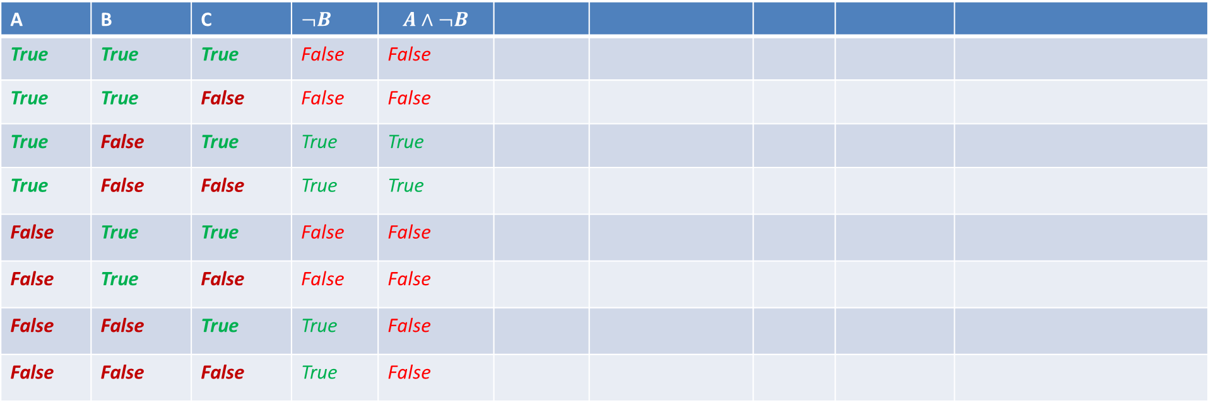
$$→$$
Example: $A∧ ¬ B∨¬C→¬(A∨C)$
$$∨$$
$¬$
$$∧$$
$$¬$$
$∨$
A
$$¬$$
C
A
C
B
A | B | C | $¬B$ | $$A∧¬B$$
True | True | True | False | False
True | True | False | False | False
True | False | True | True | True
True | False | False | True | True
False | True | True | False | False
False | True | False | False | False
False | False | True | True | False
False | False | False | True | False

Slide 17
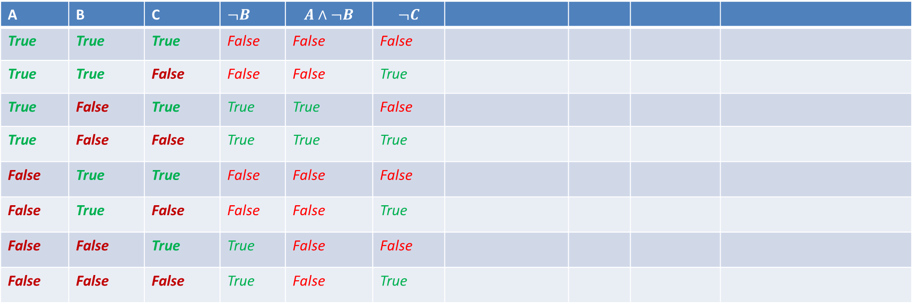
$$→$$
Example: $A∧ ¬ B∨¬C→¬(A∨C)$
$$∨$$
$¬$
$$∧$$
$$¬$$
$∨$
A
$$¬$$
C
A
C
B
A | B | C | $¬B$ | $$A∧¬B$$ | $$¬C$$
True | True | True | False | False | False
True | True | False | False | False | True
True | False | True | True | True | False
True | False | False | True | True | True
False | True | True | False | False | False
False | True | False | False | False | True
False | False | True | True | False | False
False | False | False | True | False | True

Slide 18
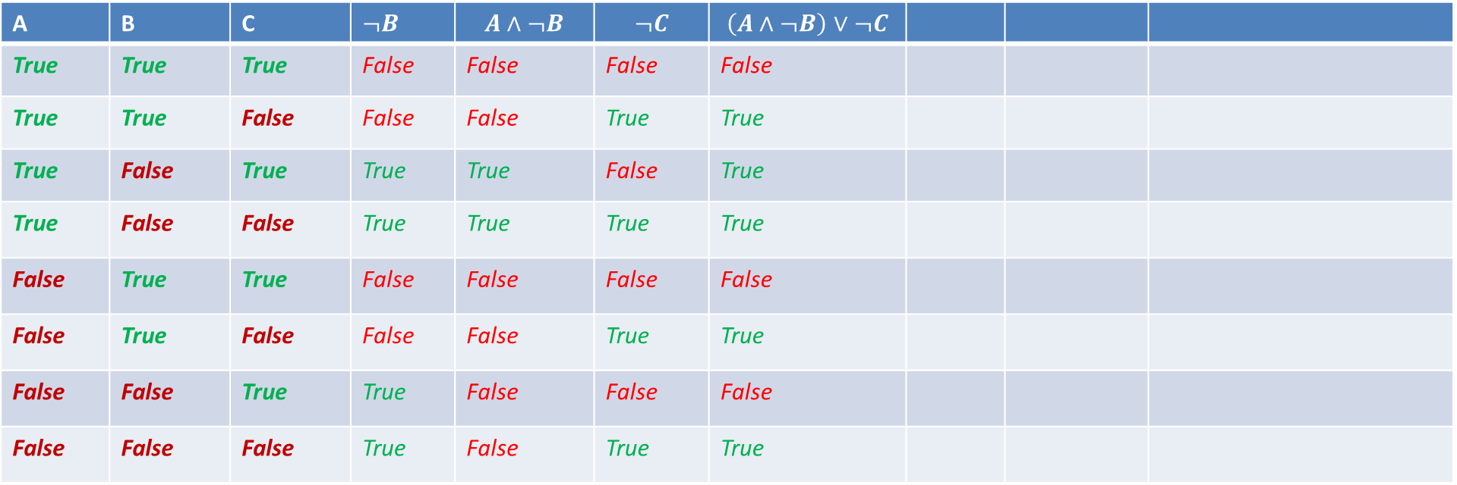
$$→$$
Example: $A∧ ¬ B∨¬C→¬(A∨C)$
$$∨$$
$¬$
$$∧$$
$$¬$$
$∨$
A
$$¬$$
C
A
C
B
A | B | C | $¬B$ | $$A∧¬B$$ | $$¬C$$ | $$\left(A∧¬B\right)∨¬C$$
True | True | True | False | False | False | False
True | True | False | False | False | True | True
True | False | True | True | True | False | True
True | False | False | True | True | True | True
False | True | True | False | False | False | False
False | True | False | False | False | True | True
False | False | True | True | False | False | False
False | False | False | True | False | True | True

Slide 19
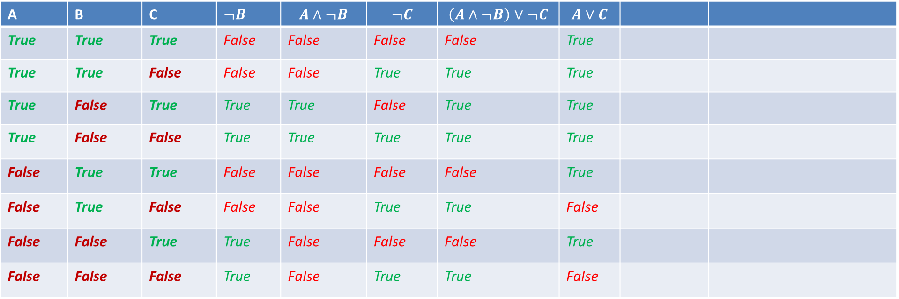
$$→$$
Example: $A∧ ¬ B∨¬C→¬(A∨C)$
$$∨$$
$¬$
$$∧$$
$$¬$$
$∨$
A
$$¬$$
C
A
C
B
A | B | C | $¬B$ | $$A∧¬B$$ | $$¬C$$ | $$\left(A∧¬B\right)∨¬C$$ | $$A∨C$$
True | True | True | False | False | False | False | True
True | True | False | False | False | True | True | True
True | False | True | True | True | False | True | True
True | False | False | True | True | True | True | True
False | True | True | False | False | False | False | True
False | True | False | False | False | True | True | False
False | False | True | True | False | False | False | True
False | False | False | True | False | True | True | False

Slide 20
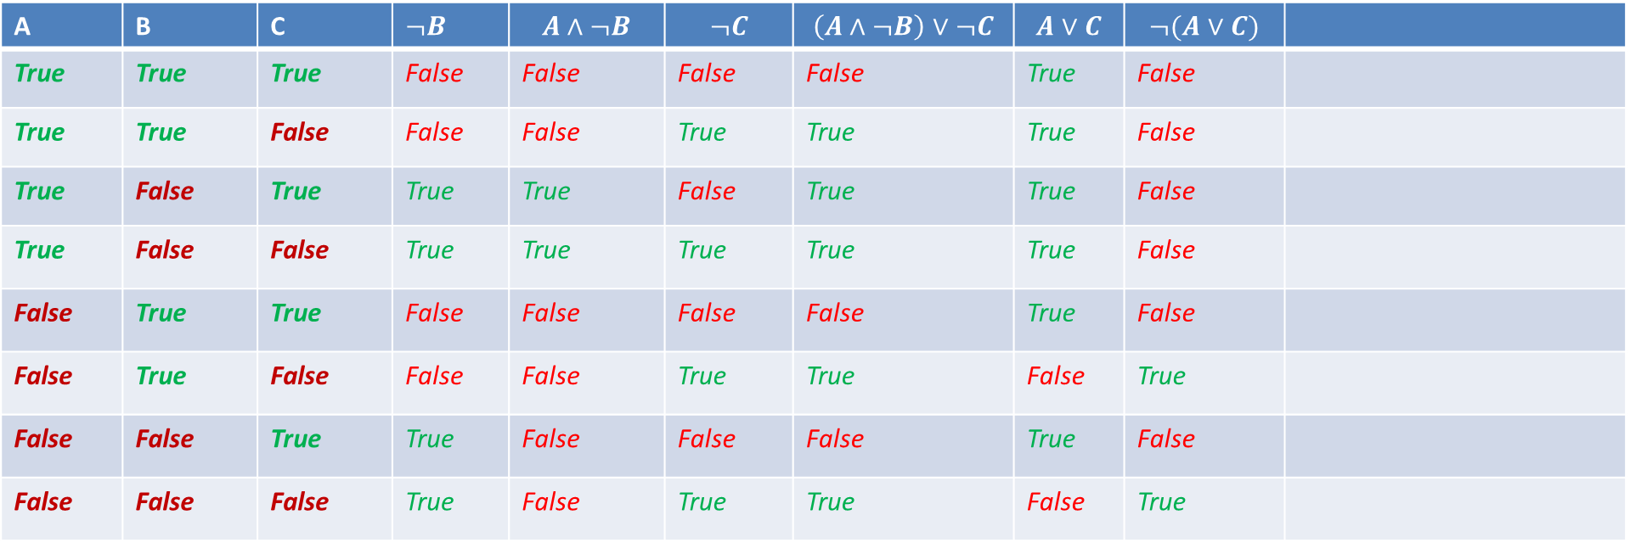
$$→$$
Example: $A∧ ¬ B∨¬C→¬(A∨C)$
$$∨$$
$¬$
$$∧$$
$$¬$$
$∨$
A
$$¬$$
C
A
C
B
A | B | C | $¬B$ | $$A∧¬B$$ | $$¬C$$ | $$\left(A∧¬B\right)∨¬C$$ | $$A∨C$$ | $$¬(A∨C)$$
True | True | True | False | False | False | False | True | False
True | True | False | False | False | True | True | True | False
True | False | True | True | True | False | True | True | False
True | False | False | True | True | True | True | True | False
False | True | True | False | False | False | False | True | False
False | True | False | False | False | True | True | False | True
False | False | True | True | False | False | False | True | False
False | False | False | True | False | True | True | False | True

Slide 21
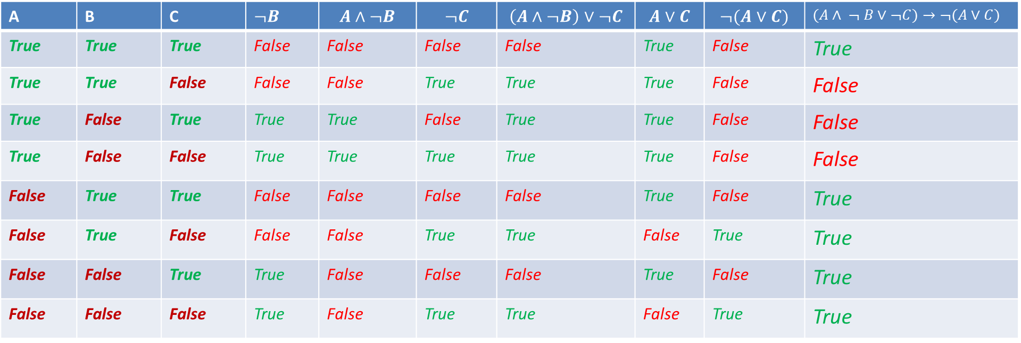
$$→$$
Example: $A∧ ¬ B∨¬C→¬(A∨C)$
$$∨$$
$¬$
$$∧$$
$$¬$$
$∨$
A
$$¬$$
C
A
C
B
A | B | C | $¬B$ | $$A∧¬B$$ | $$¬C$$ | $$\left(A∧¬B\right)∨¬C$$ | $$A∨C$$ | $$¬(A∨C)$$ | $(A∧ ¬ B∨¬C)→¬(A∨C)$
True | True | True | False | False | False | False | True | False | True
True | True | False | False | False | True | True | True | False | False
True | False | True | True | True | False | True | True | False | False
True | False | False | True | True | True | True | True | False | False
False | True | True | False | False | False | False | True | False | True
False | True | False | False | False | True | True | False | True | True
False | False | True | True | False | False | False | True | False | True
False | False | False | True | False | True | True | False | True | True

Slide 22
$$→$$
Example: $A∧ ¬ B∨¬C→¬(A∨C)$
$$∨$$
$¬$
$$∧$$
$$¬$$
$∨$
A
$$¬$$
C
A
C
B
A | B | C | $¬B$ | $$A∧¬B$$ | $$¬C$$ | $$\left(A∧¬B\right)∨¬C$$ | $$A∨C$$ | $$¬(A∨C)$$ | $(A∧ ¬ B∨¬C)→¬(A∨C)$
True | True | True | False | False | False | False | True | False | True
True | True | False | False | False | True | True | True | False | False
True | False | True | True | True | False | True | True | False | False
True | False | False | True | True | True | True | True | False | False
False | True | True | False | False | False | False | True | False | True
False | True | False | False | False | True | True | False | True | True
False | False | True | True | False | False | False | True | False | True
False | False | False | True | False | True | True | False | True | True

Slide 24


Tea or coffee puzzle
A sleepy logician walks over to the kitchen in the morning.
Her mother asks: “Tea or coffee?”
  What do you think she answers?
Yes!

Slide 25
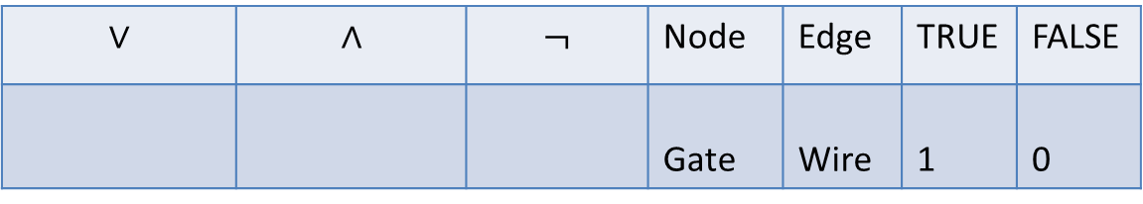
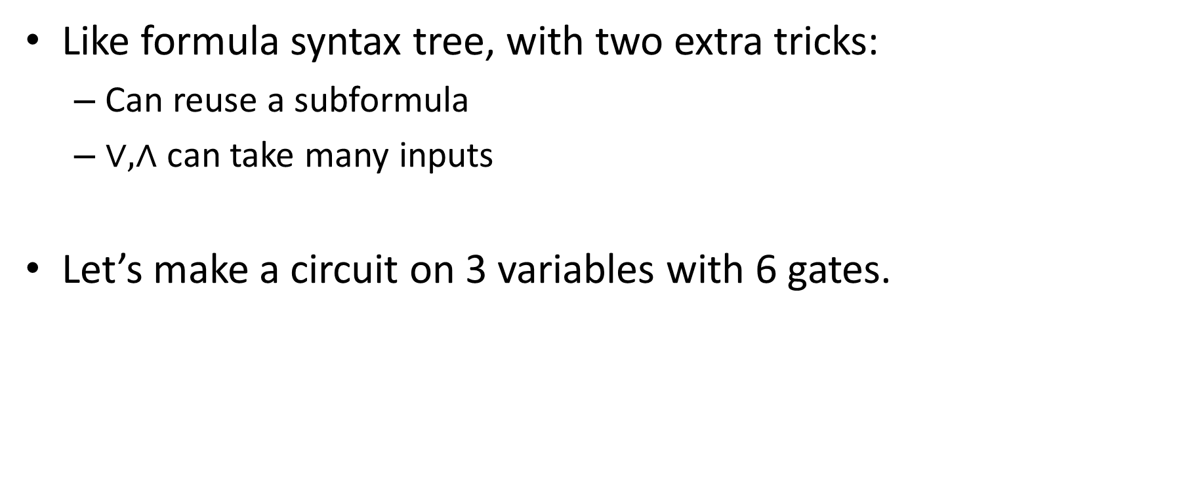
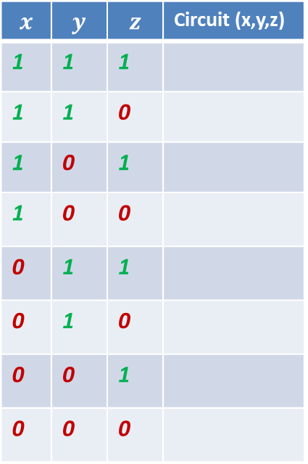
Circuits
Like formula syntax tree, with two extra tricks:
  Can reuse a subformula
  $∨, ∧$ can take many inputs
Let’s make a circuit on 3 variables with 6 gates.
$$∨$$ | $$∧$$ | $$¬$$ | Node | Edge | TRUE | FALSE
 |  |  | Gate | Wire | 1 | 0
OR
AND
NOT
$$x$$ | $$y$$ | $$z$$ | Circuit (x,y,z)
1 | 1 | 1
1 | 1 | 0
1 | 0 | 1
1 | 0 | 0
0 | 1 | 1
0 | 1 | 0
0 | 0 | 1
0 | 0 | 0
x
y
z

Slide 26
Circuits
Like formula syntax tree, with two extra tricks:
  Can reuse a subformula
  $∨, ∧$ can take many inputs
Let’s make a circuit on 3 variables with 6 gates.
$$∨$$ | $$∧$$ | $$¬$$ | Node | Edge | TRUE | FALSE
 |  |  | Gate | Wire | 1 | 0
OR
AND
NOT
$$x$$ | $$y$$ | $$z$$ | Circuit (x,y,z)
1 | 1 | 1
1 | 1 | 0
1 | 0 | 1
1 | 0 | 0
0 | 1 | 1
0 | 1 | 0
0 | 0 | 1
0 | 0 | 0
x
y
z

Slide 27







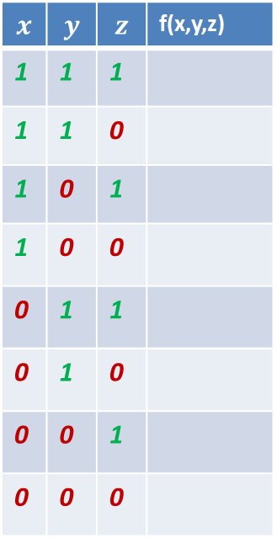











Canonical DNF and CNF
$$∨$$
$$∧$$
$$∧$$
$$∧$$
$$∨$$
$$∨$$
$$A$$
$$¬$$
$$¬$$
$$A$$
$$¬$$
$$C$$
$$A$$
$$¬$$
$$¬$$
$$A$$
$$¬$$
$$C$$
B
C
B
B
C
B
DNF (SumOfProducts): an OR of ANDs of (possibly negated) variables
CNF (ProductOfSums): an AND of ORs of (possibly negated) variables
Canonical:
  DNF: a term (AND) for every satisfying assignment
  CNF: a clause (OR) for a (negation of) every falsifying assignment.
Give me an example of a Boolean function
$$x$$ | $$y$$ | $$z$$ | f(x,y,z)
1 | 1 | 1
1 | 1 | 0
1 | 0 | 1
1 | 0 | 0
0 | 1 | 1
0 | 1 | 0
0 | 0 | 1
0 | 0 | 0

Slide 28
Canonical DNF and CNF
$$∨$$
$$∧$$
$$∧$$
$$∧$$
$$∨$$
$$∨$$
$$A$$
$$¬$$
$$¬$$
$$A$$
$$¬$$
$$C$$
$$A$$
$$¬$$
$$¬$$
$$A$$
$$¬$$
$$C$$
B
C
B
B
C
B
DNF (SumOfProducts): an OR of ANDs of (possibly negated) variables
CNF (ProductOfSums): an AND of ORs of (possibly negated) variables
Canonical:
  DNF: a term (AND) for every satisfying assignment
  CNF: a clause (OR) for a (negation of) every falsifying assignment.
Give me an example of a Boolean function
$$x$$ | $$y$$ | $$z$$ | f(x,y,z)
1 | 1 | 1
1 | 1 | 0
1 | 0 | 1
1 | 0 | 0
0 | 1 | 1
0 | 1 | 0
0 | 0 | 1
0 | 0 | 0

Slide 29
Any questions?

