Slide 1
Unit 9
Probability

Slide 2
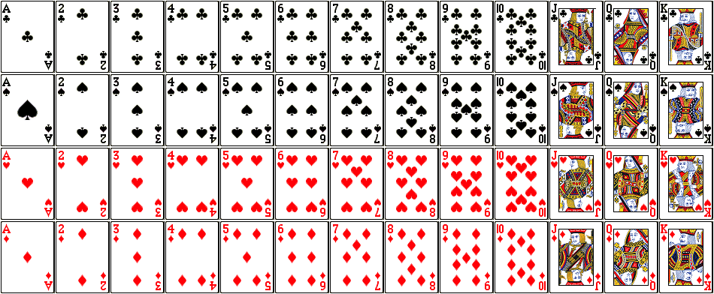
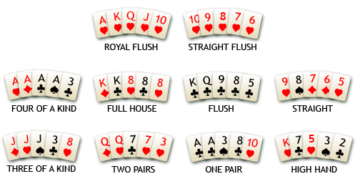
Puzzle: playing poker
There are 52 cards in a standard deck; 4 suits of 13 ranks each.
In poker, some 5-card combinations (“hands”) are special:
For example, a “three of a kind” consists of three cards with the same rank, together with two arbitrary cards.
What are the chances to get
a three of a kind hand?
A two pairs hand (5 cards with 2 same-rank pairs)?
Other hands?...

Slide 3
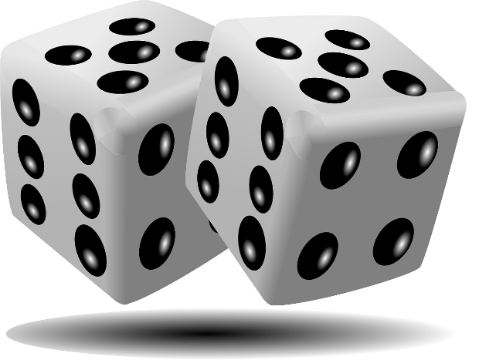
Finite probability
Experiments: producing an outcome out of possible choices
Tossing a coin: outcome can be “heads”
Getting a lottery ticket: outcome can be “win”
Sample space S: set of all possible outcomes.
{heads, tails} for a coin toss
{1,2,3,4,5,6} x {1,2,3,4,5,6} for rolling two dice
Event A $⊆S$: subset of outcomes
Both dice came up even.

Slide 4
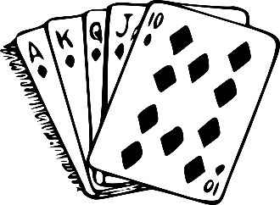
Finite probability
Probability of an event if all outcomes are equally likely:
Pr(A)= |A|/|S| (fraction of the outcomes that are in the event A).
Probability of both dice coming up even:
A={ (2,2),(2,4),(4,2),(2,6),(6,2),(4,4), (4,6), (6,4) , (6,6)}.
|A| =9, |S|=36
P(A)=9/36=1/4
Probability is always a number between 0 (event cannot happen, A=$∅$) and 1 (event always happens, A=S).
If $\operatorname{Pr}\left(A\right)=p,$ then $\operatorname{Pr}\left(\overline{A}\right)=1−p$ (that is, probability that A does not happen is 1 – probability of A.)
Let’s use combinatorics we just studied to calculate probabilities!

Slide 5
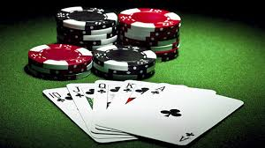
Puzzle: playing poker
There are 52 cards in a standard deck; 4 suits of 13 ranks each.
In poker, some 5-card combinations (“hands”) are special:
For example, a “three of a kind” consists of three cards with the same rank, together with two cards of other different ranks.
How many ways are there to choose (ignoring the order)
A royal flush?
a three of a kind hand?
a two pairs hand?
other hands?...

Slide 6
Puzzle: playing poker
There are 52 cards in a standard deck; 4 suits of 13 ranks each.
How many ways are there to choose a royal flush
all same suit, ranks A, K, Q, J, 10.
Pick a suit: C(4,1) = 4
How many ways to choose three of a kind?
pick the rank: 13=C(13,1)
Pick 3 out of 4 kinds of this rank: 4=C(4,3)
Pick two other ranks: C(12,2)= 66
Pick a suit of each of the other ranks: C(4,1)*C(4,1)=16
Total: 13*4*66*16=54912

Slide 7
Puzzle: playing poker
What is the probability of getting a three of a kind hand?
Experiment: drawing a hand (5 cards).
Sample space S: set of all possible hands.
Size of S is C(52, 5) = $\left({52 \atop 5}\right)=2,598,962$
Event A: getting a three of a kind hand
Size of the event A: 54,912
Probability of A (all hands are equally likely):
Pr(A) = $\frac{\left|A\right|}{\left|S\right|}=0.0211..$

Slide 8
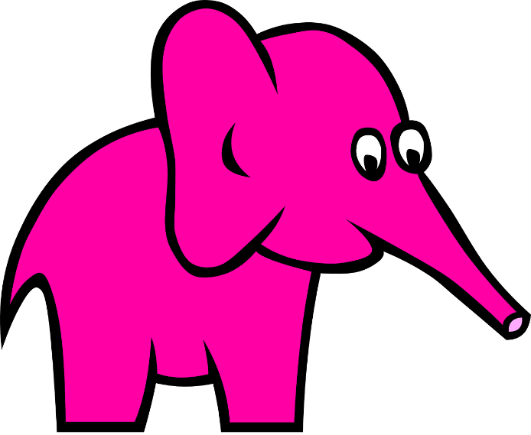
Probabilities and pink elephants
What is the probability that walking down George street you’d see a pink elephant?
Your friend says: “It is ½! You will either see the pink elephant, or not!”
Do you agree?

Slide 10
Probabilities and pink elephants
What is the probability that walking down George street you’d see a pink elephant?
Your friend says: “It is ½! You will either see the pink elephant, or not!”
Do you agree?

Slide 11
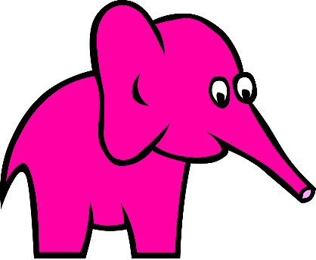
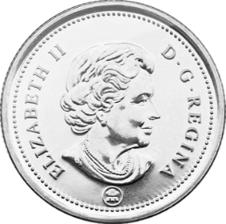
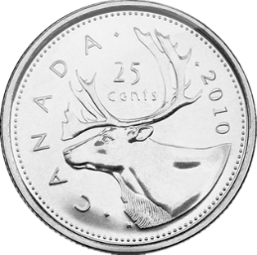
Probabilities and distributions
What if outcomes are not equally likely?
Biased coins, pink elephants, etc.
A function $Pr:S→ℝ$ is a probability distribution on (a finite set) S if $Pr$ satisfies the following:
For any outcome s$∈S,$ $0≤\operatorname{Pr}\left(s\right)≤1$
$Σ_{\left\{s∈S\right\}}\operatorname{Pr}\left(s\right)=1$
Uniform distribution: for all $s∈S,\operatorname{Pr}\left(s\right)=1/|S|$
all outcomes are equally likely
Fair coin: $\operatorname{Pr}\left(heads\right)=\operatorname{Pr}\left(tails\right)=\frac{1}{2}$

Slide 12
Biased coin
Lots of distributions other than uniform!
Biased coin: say heads twice as likely as tails.
$\operatorname{Pr}\left(heads\right)+\operatorname{Pr}\left(tails\right)=1$.
$\operatorname{Pr}\left(heads\right)=2∗\operatorname{Pr}\left(tails\right)$
So $\operatorname{Pr}\left(heads\right)=\frac{2}{3},\operatorname{Pr}\left(tails\right)=\frac{1}{3}$

Slide 13
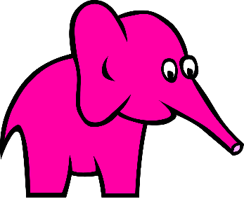
Probabilities of events
Probability of an event A is a sum of probabilities of the outcomes in A
$$Pr⁡(A)=Σ_{\left\{a∈A\right\}}\operatorname{Pr}\left(a\right)$$
Probability of A not occurring: $\operatorname{Pr}\left(\overline{A}\right)=1−Pr⁡(A)$
Probability of the union of two events (either A or B happens) is
$$\operatorname{Pr}\left(A∪B\right)=\operatorname{Pr}\left(A\right)+\operatorname{Pr}\left(B\right)−Pr⁡(A∩B)$$
By principle of inclusion-exclusion
If A and B are disjoint, $\operatorname{Pr}\left(A∩B\right)=0,$ so $\operatorname{Pr}\left(A∪B\right)=\operatorname{Pr}\left(A\right)+\operatorname{Pr}\left(B\right)$
In general, if events $A_{1}…A_{n}$are pairwise disjoint
that is, $∀i, j$if $i≠j$ then $A_{i}∩A_{j}=∅$
Then Pr($∪_{i=1}^{n} A_{i})=\operatorname{Pr}\left(A_{1}∪A_{2}∪…∪A_{n}\right)=Σ_{i=1}^{n} \operatorname{Pr}\left(A_{i}\right)$

Slide 14
Probabilities of events
Suppose a die is biased so that 3 appears twice as often as any other number (others equally likely).
Probability of 3: 2/7. Probabilities of others: 1/7
What is the probability that an odd number appears?
Event: A={1,3,5}
Pr(A) = 1/7+2/7+1/7=4/7.
What is a probability that an odd number or a number divisible by 3 appears?
A={1,3,5}, B = {3,6} , $A∩B=\left\{3\right\}$
Pr(A) = 4/7. Pr(B) = 3/7. Pr($A∩B)=2/7$
Pr($A∪B)=Pr⁡(\{1,3,5,6\})=\frac{4}{7}+\frac{3}{7}−\frac{2}{7} = \frac{1}{7}+\frac{2}{7}+\frac{1}{7}+\frac{1}{7} =\frac{5}{7}$

Slide 15
Birthday paradox
How many people have to be in the room so that probability that two of them have the same birthday is at least ½?

Slide 17
Birthday paradox
How many people have to be in the room so that probability that two of them have the same birthday is at least ½?

Slide 18
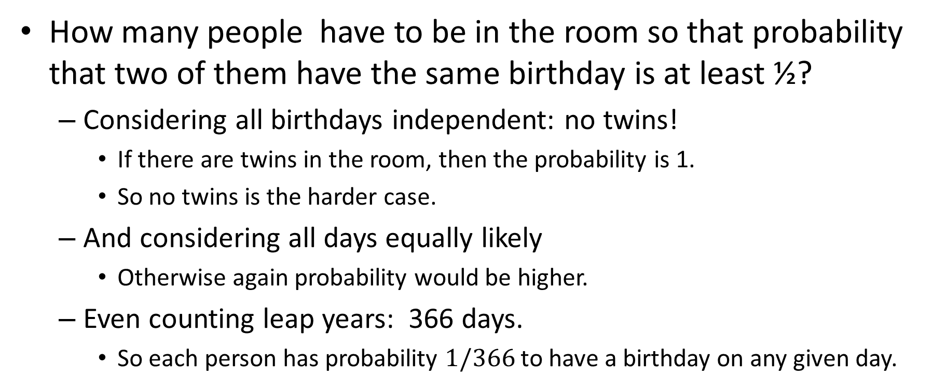
Birthday paradox
How many people have to be in the room so that probability that two of them have the same birthday is at least ½?
Considering all birthdays independent: no twins!
If there are twins in the room, then the probability is 1.
So no twins is the harder case.
And considering all days equally likely
Otherwise again probability would be higher.
Even counting leap years: 366 days.
So each person has probability $1/366$ to have a birthday on any given day.

Slide 19
Birthday paradox
Let’s look at the first two people, first three, etc.
And calculate the probabilities of them all having different birthdays.
Product rule: number of combinations of distinct birthdays of the first $i$ people is P(366,i) = 366*365*…*(366-i+1)
Probability that the first $i$ people all have different birthday is $\frac{P\left(366,i\right)}{{366}^{i}}=\frac{365}{366}\frac{364}{366}…\frac{\left(366−i+1\right)}{366}$
So with probability $1−\frac{P\left(366,i\right)}{{366}^{i}}$ at least two out of first $i$ people have birthday on the same day.
That works out to about $i=$23 people to reach ½.
Only 23! That’s why it is called a paradox.

Slide 20
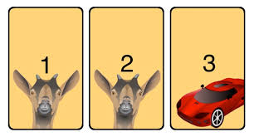
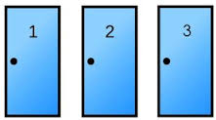
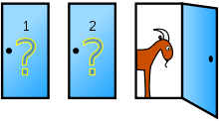
Puzzle: Monty Hall problem
Let’s make a deal!
A player picks a door.
Behind one door is a car.
Behind two others are goats.
A player chooses a door.
A host opens another door
Shows a goat behind it.
And asks the player if she wants to change her choice.
Should she switch?

Slide 22
Puzzle: Monty Hall problem
Let’s make a deal!
A player has to pick a door.
Behind one door is a car.
Behind two others are goats.
A player chooses a door.
A host opens another door
Shows a goat behind it.
And asks the player if she wants to change her choice.
Should she switch?

Slide 23
Puzzle: Monty Hall problem
A player has to pick a door. Behind one door is a car. Behind other doors are goats.
After the player chooses a door, the host opens another door, shows a goat behind it, and asks the player if she wants to change her choice.
Should she switch?
Originally, probability of picking the car is 1/3
If she first picked a door with a car: (1/3 probability)
Then she would switch to a goat.
If she first picked a door with a goat (2/3 probability)
Then she would switch to a car.
Yes, she should switch to increase her probability of getting a car!

Slide 24
Conditional probabilities
Conditional probability of an event A given event B, denoted $\operatorname{Pr}\left(A | B\right),$ is the probability of A if we know that B occurred.
Probability of rain given that it is cloudy is higher than just probability of rain.
Probability of rain is lower given that it is sunny.
In the Monty Hall puzzle
Probability of car behind door 2 is 1/3
Probability of a car behind door 2 conditional the host showing a goat behind door 3 is 2/3
It is probability of both A and B, given that B happened for sure:
$$\operatorname{Pr}\left(A | B\right)=\frac{\operatorname{Pr}\left(A∩B \right)}{Pr⁡(B)}$$
Assume that $\operatorname{Pr}\left(B\right)> 0$: after all, B did happen.

Slide 25
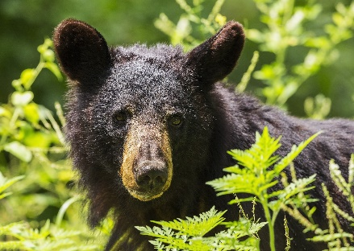
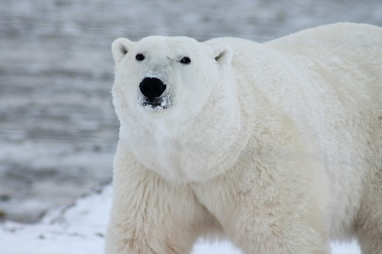
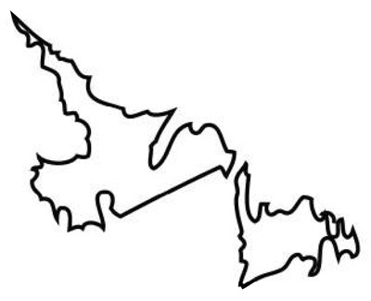
Conditional probabilities
Suppose that there are 9,000 black bears and 1000 polar bears in our province, NL. Moreover, all polar bears and 2000 of black bears are in Labrador.
Let A be an event that a bear is a polar bear.
Let B be an event that a bear is in Labrador (rather than Newfoundland).
Probability that a random bear in NL is a polar bear:
$\operatorname{Pr}\left(A\right)=\frac{1000}{1000+9000}=\frac{1}{10}$
Probability that a random bear in NL is in Labrador:
$Pr\left(B\right)=\frac{1000+2000}{1000+9000}=\frac{3}{10}$
Probability of being both a polar bear and in Labrador is $\operatorname{Pr}\left(A∩B\right)=\frac{1}{10}$
Same as probability of being a polar bear, since all polar bears are in Labrador
Probability that a random bear is a polar bear conditional on it being in Labrador:
$$\operatorname{Pr}\left(A | B\right)=\frac{\operatorname{Pr}\left(A∩B\right)}{\operatorname{Pr}\left(B\right)}=\frac{1/10}{3/10}=\frac{1}{3}=\frac{1000}{1000+2000}$$
With this data $\operatorname{Pr}\left(A | \overline{B}\right)=0$. A random bear in Newfoundland is a black bear.

Slide 26
Independent events
If knowing B gives us no information about A and vice versa, then A and B are independent events:
Then Pr(A) = Pr(A|B) = $\frac{\operatorname{Pr}\left(A∩B\right)}{\operatorname{Pr}\left(B\right)}.$
So A and B are independent iff $\operatorname{Pr}\left(A∩B\right)=\operatorname{Pr}\left(A\right)⋅\operatorname{Pr}\left(B\right).$
In general, events $A_{1}…A_{n}$ can be pairwise independent (that is, any two $A_{i}, A_{j})$are independent, or (stronger condition) mutually independent: $∀ T⊆\{A_{1},…, A_{n}\} \underset{A_{i}∈T}{Pr}\left( A_{i}\right)=\prod_{A_{i}∈T}{\operatorname{Pr}\left(A_{i}\right)}$
That is, for every subset of these events, probability of them occurring together is the product of individual probabilities.
Different coin tosses/dice rolls are usually considered independent.

Slide 28
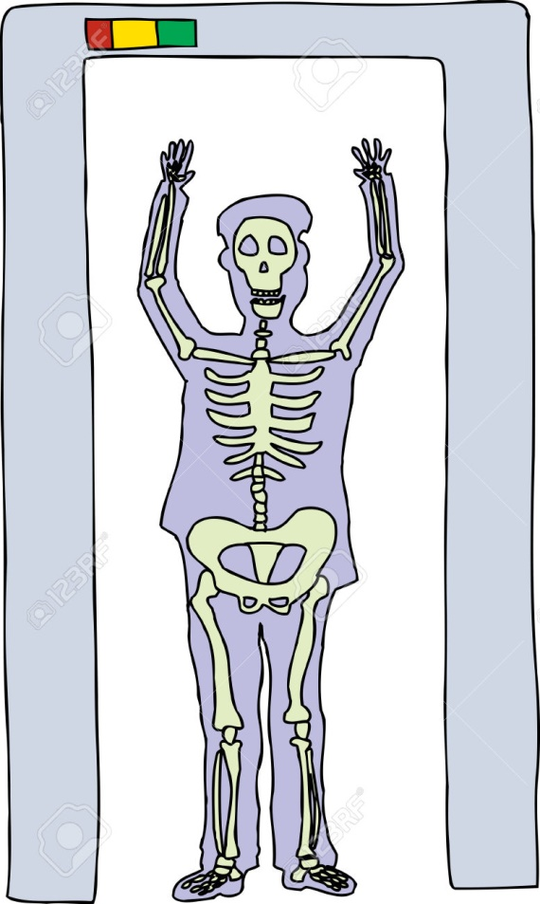
Contrapositive vs. Converse
“If a person is carrying a weapon, then the airport metal detector will ring”.
Same as “If the airport metal detector does not ring, then the person is not carrying a weapon”.
Not the same as: “If the airport metal detector rings, then the person is carrying a weapon.”
“If the person is sick, then the test is positive”.
“If he is a murderer, his fingerprints are on the knife”.

Slide 29
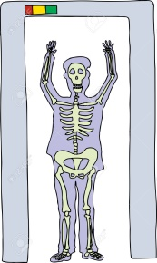
Sensitivity and specificity
Let A: “metal detector rings”, B: “person carries a weapon”,
Sensitivity:
percentage of correct positives
Pr(A|B) = $\operatorname{Pr}\left(A∩B\right)/Pr⁡(B)$
Probability that if a person has a
weapon, then detector rings
Probability that if the person is sick,
then the test is positive
Test that always says “yes” has 100% sensitivity
Specificity:
percentage of correct negatives
$Pr⁡(\overline{A}|\overline{B}$) = $\operatorname{Pr}\left(\overline{A}∩\overline{B}\right)/Pr⁡(\overline{B})$
Probability that if the detector rings,
then the person has a weapon
Probability that if the person is
not sick, then the test is negative
Test that always says “no”
has 100% specificity.

Slide 30
Sensitivity and specificity
++++ ++ +++ ++ ++ ++ ++ + - ++ + - - - + + - - - -
+ - - -- - - -
- - - - - - - - - - - - - - -
Sensitivity: percentage of correct (true) positives
Pr(A|B) = $\operatorname{Pr}\left(A∩B\right)/Pr⁡(B)$
Specificity: percentage of correct (true) negatives
$Pr⁡(\overline{A}|\overline{B}$) = $\operatorname{Pr}\left(\overline{A}∩\overline{B}\right)/Pr⁡(\overline{B})$
Let green area be what test detected as positive (red as negative)
Event A: in green area. Event B: “+”
The blue line represents correct separation between positives (+) and negatives (-)
Positive can mean “sick”, negative “healthy”
The green part under blue line is false positives.
The red part above blue line is false negatives.
24 + (positives),
30 - (negatives)
23 true positives
One false negative
22 true negatives
8 false positives
Sensitivity: 100*23/24=96%
Specificity: 100*22/30=73%

Slide 31
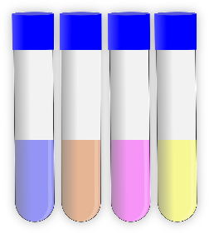
Medical test problem
Consider a medical test that checks for a disease. This test
Has false positive rate of 3% (healthy labeled as sick)
Specificity 97%
Has false negative rate of 1% (sick labeled as healthy).
Sensitivity 99%
What is the probability that a person has the disease given that the test came positive?
Let A: person tested positive, B: person is sick. $\operatorname{Pr}\left(B | A\right)$?
Pr(A|B) = 0.99, Pr($\overline{A}\left|B\right)=0.01.. .$
Not enough information!

Slide 32
Bayes theorem
Bayes theorem allows us to get $\operatorname{Pr}\left(B | A\right)$ from $\operatorname{Pr}\left(A | B\right),$ if we know probabilities of A and B:
$\operatorname{Pr}\left(B | A\right)= \frac{Pr(A|B)⋅Pr\left(B\right)}{Pr⁡(A)}=\frac{Pr(A|B)⋅Pr\left(B\right)}{\operatorname{Pr}{(A|B)}\operatorname{Pr}\left(B\right)+\operatorname{Pr}{(A|\overline{B})}Pr⁡(\overline{B}) }$
Proof:
$\operatorname{Pr}\left(A | B\right)=\frac{\operatorname{Pr}\left(A∩B\right)}{Pr⁡(B)}$. $\operatorname{Pr}\left(B | A\right)=\frac{\operatorname{Pr}\left(A∩B\right)}{Pr⁡(A)}$.
$Pr\left(A∩B\right)= Pr\left(A | B\right)\operatorname{Pr}\left(B\right)=\operatorname{Pr}\left(B | A\right)Pr⁡(A)$
So $\operatorname{Pr}\left(B | A\right)=\operatorname{Pr}\left(A | B\right)\operatorname{Pr}\left(B\right)/Pr⁡(A)$
The formula $Pr\left(A\right)= Pr{(A|B)}\operatorname{Pr}\left(B\right)+\operatorname{Pr}{(A|\overline{B})}Pr⁡(\overline{B})$comes from writing probability of A (e.g., a positive test) as sum of probabilities of A for B (sick people) and for $\overline{B}$ (healthy people).

Slide 33
$$\operatorname{Pr}\left(B | A\right)= \frac{Pr(A|B)⋅Pr\left(B\right)}{Pr⁡(A)}$$
Consider a medical test that
Has false positive rate of 3% (healthy labeled as sick).
Has false negative rate of 1% (sick labeled as healthy).
Tests for a disease that occurs in 5 in 1000 people.
What is the probability that a person is sick given that the test came positive?
Let A: person tested positive, B: person is sick. $\operatorname{Pr}\left(B | A\right)$?
Pr(A|B) = 0.99, Pr($\overline{A}\left|B\right)=0.01. \text{Pr}\text{(} \overline{A}|\overline{B}\text{) = 0.97 , }\text{Pr}\text{(}A\left|\overline{B}\right)=0.03$
$\operatorname{Pr}\left(B\right)=0.005.$
$\operatorname{Pr}\left(A\right)=\operatorname{Pr}\left(A | B\right)Pr⁡(B)+\operatorname{Pr}\left(A | \overline{B}\right)Pr⁡(\overline{B})=$0.0348
By Bayes theorem, Pr(B|A) = $\frac{\operatorname{Pr}\left(A | B\right)\operatorname{Pr}\left(B\right)}{Pr⁡(A)}$ = 0.1422
So the probability that a person who tested positive has the disease is just 0.1422, that is, 14.22%.
By a similar argument, probability that a person who tested negative does not have a disease is whopping 0.99995 = 99.995%.

Slide 34
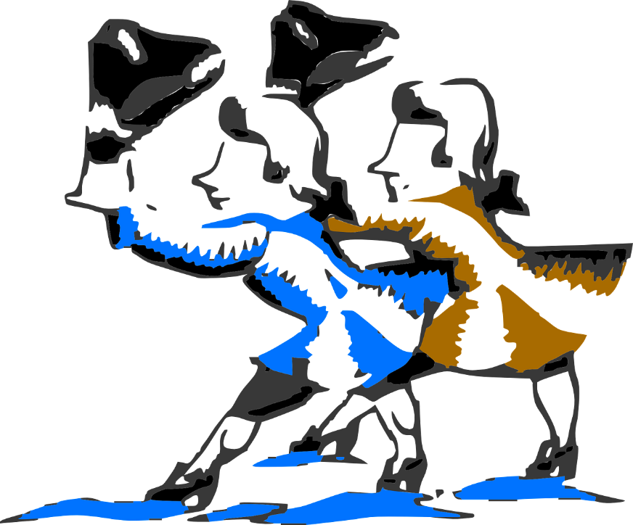
Hat check problem
In Victorian England, n men came to an event, and checked in their hats at the door.
On the way out, in a hurry, they each picked up a random hat.
On average, how many men picked their own hat?

Slide 36
Expectations
Often we are interested in what outcome we would see “on average”.
How fast does this program run “on average”?
Let possible outcomes of an experiment be numbers $a_{1},…, a_{n}$
E.g., time a program takes to sort n elements
Its expected value (mean) is $Σ_{k=1}^{n} a_{k}Pr⁡(a_{k})$
Often phrased in terms of a “random variable” X, where X is a function from outcomes to numbers.
Write E(X) to mean the expected value (mean, expectation) of X.

Slide 37
Random variables
“Random variable” X is a function from outcomes to numbers.
In Computer Science applications, usually X counts something.
Number of heads out of n coin tosses.
Number of steps a program takes on an input
An indicator random variable X takes value 0 or 1 depending on whether an event occurred or not.
Expectation of a random variable X is
$$E\left(X\right)= \sum_{i∈Outcomes}{X\left(i\right)∗Pr⁡(i) }$$

Slide 38
Expectation example
Suppose we roll two fair dice. What is the expected sum of their values?
X can take values from 2 to 12.
Pr(X=2) = Pr(X=12) = 1/36
Pr(X =3) = Pr(X =11) =2/36=1/18,
Pr(X =4) = Pr(X =10) =3/36=1/12,
Pr(X =5) = Pr(X =9) =4/36=1/9,
Pr(X =6) = Pr(X =8) =5/36,
Pr(X =7) =6/36=1/6
$$E\left(X\right)=2·\frac{1}{36}+3·\frac{1}{18}+4·\frac{1}{12}+5·\frac{1}{9}+6·\frac{5}{36}+7·\frac{1}{6}+$$
$$8·\frac{5}{36}+9·\frac{1}{9}+10·\frac{1}{12}+11·\frac{1}{18}+12·\frac{1}{36}=7$$

Slide 39
Expected win in a lottery
Rules of Lotto 6/49:
A player chooses 6 numbers, 1 to 49.
During a draw, 6 randomly generated numbers are revealed.
If all 6 numbers chosen by the player match 6 numbers in the draw, the player gets the jackpot of $5,000,000 or more.
There are also smaller prizes; let’s ignore them for simplicity.
A ticket costs $3.
According to Atlantic Lotto Corporation, chances of winning the jackpot are roughly 1/14,000,000.

Slide 40
Expected win in a lottery
What is the expected amount a player would win if the jackpot is 5,000,000?
Pr(win) = 1/14,000,000. Pr(loss)=1-Pr(win) = 13,999,999/14,000,000.
Let the random variable X encode the amount a player wins.
For all but one player, that amount is -3. So Pr(X=-3)=Pr(loss)
For the lucky one, the amount is the jackpot minus ticket price. Pr(X=4,999,997)=Pr(win)
Expected amount to win is E(X) = Pr(loss)*(-3) +Pr(win)*(5,000,000-3) = -2.64
If counting smaller prizes , just add their amount*odds to the sum, and adjust Pr(loss)
E(X)=Pr(loss)*(-3)+Pr(jackpot)*(4,999,997)+Pr(5/6+bonus)*374,997+Pr(5/6)*312,497…

Slide 41
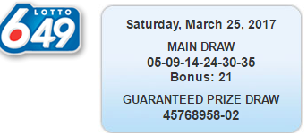
Expected win in a lottery
How large should be the jackpot so that the players expect at least to break even?
Let’s call the jackpot amount J.
Expected amount to win is E(X) = Pr(loss)*(-3) +Pr(win)*(J-3).
To break even, want E(X)=0.
J= 3+(E(X)-Pr(loss)*(-3))/Pr(win) = 42,000,000

Slide 43
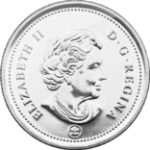
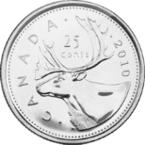
Bernoulli trials and repeated experiments
Suppose an experiment has two outcomes, 1 and 0 (success/failure), with Pr(1) = p.
Such experiment is called a Bernoulli trial.
What happens if the experiment is repeated multiple times (independently)?
A sample space after carrying out n Bernoulli trials is a set of all possible n-tuples of elements in {0,1} (or {success, fail}).
Number of n-tuples with k 1s is $\left({n \atop k}\right)$
Probability of getting 1 in any given trial is p, of getting 0 is (1-p).
Probability of getting exactly k 1s (successes) out of n trials is $\left({n \atop k}\right)p^{k}{\left(1−p\right)}^{n−k}$
Probability of getting the first success on exactly the $k^{th}$ trial is $p{\left(1−p\right)}^{k−1}$
How many trials do we need, on average, to get a success?

Slide 44
Expected number until…
Suppose that Alan insists on buying lottery tickets until he wins. If probability of winning is $p$, how many tickets in expectation (“on average”) would he have to buy?
Let X be a random variable for how many tickets he has to buy.
The probability of winning on exactly $i^{th}$ ticket is $p{\left(1−p\right)}^{i−1}$
$E\left(X\right)=Σ_{i∈ℕ} i∗\operatorname{Pr}\left(X=i\right)=\frac{1}{p}$
So for Lotto 6/49 he’d have to buy 14,000,000 tickets (and spend $42,000,000 -- that’s jackpot that would let him break even! )

Slide 45
Expected number until…
Suppose we have Bernoulli trials with success probability $p$. What is the expected number of trials to see success?
Let X be a random variable for the number of steps till success.
$E\left(X\right)=Σ_{i∈ℕ} i∗\operatorname{Pr}\left(X=i\right)=\frac{1}{p}$
Same reasoning applies to other processes, where there is a fixed probability of something happening at each experiment or time step.
A system has a 1% probability of hanging in any given hour. How long, on average, will it stay up?
100 hours: a little over 4 days.

Slide 47
Linearity of expectation
Expectation is a very well-behaved operation:
$E\left(X_{1}+X_{2}+…+X_{n}\right)=E\left(X_{1}\right)+…+E\left(X_{n}\right)$
$E\left(aX+b\right)=a E\left(X\right)+b$
Where $X_{1}…X_{n}$are random variables on some sample space S, and $a, b∈ℝ$
Proof:
$E\left(X_{1}+X_{2}\right)=Σ_{s∈S }p\left(s\right){(X}_{1}\left(s\right)+X_{2}(s))$
$= Σ_{s∈S }p\left(s\right)X_{1}\left(s\right)+{Σ_{s∈S }p\left(s\right)X}_{2}\left(s\right)=E\left(X_{1}\right)+E\left(X_{2}\right)$
Similar for $E\left(aX+b\right)=a E\left(X\right)+b$
Using the fact that $Σ_{s∈S }p\left(s\right)$ =1

Slide 48
Hat check problem
In Victorian England, n men came to an event, and checked in their hats at the door.
On the way out, in a hurry, they each picked up a random hat.
On average, how many men picked their own hat?

Slide 49
Hat check problem
In Victorian England, n men came to an event, and checked in their hats at the door.
On the way out, in a hurry, they each picked up a random hat.
On average, how many men picked their own hat?
For each man, introduce a random variable $X_{i},$ where $X_{i}=1$iff he picked his own hat
Such random variables are called indicator variables.
The quantity we want is $E(X_{1}+…+X_{n})$
Now, for each $X_{i}, E\left(X_{i}\right)=1⋅\operatorname{Pr}\left(X_{i}=1\right)=\frac{1}{n}$
By linearity of expectation, $E\left(X_{1}+…+X_{n}\right)=E\left(X_{1}\right)+…+E\left(X_{n}\right)=\frac{1}{n}+…+\frac{1}{n}=n⋅\frac{1}{n}=1$
So on average, just one man will go home with his own hat!

Slide 51
Hat check problem 2
In Victorian England, n men came to an event, and checked in their hats at the door.
On the way out, in a hurry, they each picked up a random hat.
What is the probability that at least k of them got their own hat?

Slide 52
Deviation from the expectation
“ three-quarters (73 percent) of U.S. drivers consider themselves better-than-average drivers” [AAA].
Let R be a (nonnegative) random variable. What is the probability that $R≥x?$
Markov’s inequality: $\operatorname{Pr}\left(R≥x\right)≤\frac{E\left(R\right)}{x}$
Since R is nonnegative, $E\left(R\right)≥ xPr\left(R≥x\right)+0Pr\left(R<x\right)$
So $E\left(R\right)≥xPr\left(R≥x\right).$

Slide 53
Using Markov’s inequality
Markov’s inequality: $\operatorname{Pr}\left(R≥x\right)≤\frac{E\left(R\right)}{x}$
Let’s use Markov’s inequality in the Hat Check Problem
Let $R=X_{1}+…+X_{n}$
each $X_{i}$ is an indicator variable for i^{th} man getting his hat.
By Markov’s inequality, $\operatorname{Pr}\left(R≥k\right)≤\frac{E\left(R\right)}{k}=\frac{1}{k}.$
But that’s a pretty weak bound!
Probability that everybody gets their hat is $\operatorname{Pr}\left(R≥n\right)≤\frac{1}{n}$ by Markov’s inequality
However, we can calculate that it is only $\frac{1}{n!}$

Slide 54
Variance
Let’s define the expectation of the difference from the mean.
L$et X$ be a random variable on a sample space S. Define variance of X, denoted $V\left(X\right)$ to be
$$V\left(X\right)=E_{s∈S }\left({\left(X−E\left(X\right)\right)}^{2}\right)=\sum_{s∈S}{{\left(X\left(s\right)−E\left(X\right)\right)}^{2}}⋅Pr(s)$$
A standard deviation of X, denoted $σ(X)$ where $σ$ is a Greek letter sigma, is $σ\left(X\right)=\sqrt{V(X)}$
Useful equality: $V\left(X\right)=E\left(X^{2}\right)−{\left(E\left(X\right)\right)}^{2}$
That is, the variance of X can be expressed as the difference between the expectation of $X^{2}$ and square of $E\left(X\right).$
To prove this, just open parentheses in our original definition of $V\left(X\right),$ and use the fact that $\sum_{s∈S }{Pr(s)}=1$.

Slide 55
Variance
Variance of a random variable X on a sample space S is:
$$V\left(X\right)=E_{s∈S}\left({\left(X−E\left(X\right)\right)}^{2}\right)=\sum_{s∈S}{{\left(X\left(s\right)−E\left(X\right)\right)}^{2}}⋅Pr\left(s\right)=E\left(X^{2}\right)−{\left(E\left(X\right)\right)}^{2}$$
A standard deviation of X is $σ\left(X\right)=\sqrt{V(X)}$
Example: consider again throwing a fair die
and let $X$ be a random variable for the number that comes up
So X takes values 1,2,3,4,5,6 with equal probability 1/6.
$E\left(X\right)=\sum_{r∈\left\{1,2,3,4,5,6\right\} }{r⋅\frac{1}{6}=\frac{7}{2}}$.
$E\left(X^{2}\right)= \sum_{r∈\left\{1,2,3,4,5,6\right\} }{r^{2}⋅\frac{1}{6}=\frac{1}{6}\left(1^{2}+2^{2}+…+6^{2}\right)=\frac{91}{6} }$.
$V\left(X\right)=\frac{91}{6}−{\left(\frac{7}{2}\right)}^{2}=\frac{35}{12}$. And $σ\left(X\right)= \sqrt{\frac{35}{12}}≈$1.7

Slide 56
Variance in the hat check problem
Variance of a random variable X on a sample space S is: $V\left(X\right)=E\left(X^{2}\right)−{\left(E\left(X\right)\right)}^{2}$
Example: variance in the hat check problem.
Let $R=X_{1}+…+X_{n}$ for indicator variables $X_{i}:$ man $i$ gets his hat.
$E\left(R\right)=1.$
$E\left(R^{2}\right)=E\left( {\left(\sum_{i=1}^{n}{X_{i} }\right)}^{2} \right)=E\left(\sum_{i=1}^{n}{X_{i}^{2}+}\sum_{i=1}^{n}{\sum_{\begin{aligned}j=1, \\ j≠i\end{aligned}}^{n}{X_{i}X_{j}}}\right)=E(\sum_{i=1}^{n}{X_{i}^{2})+}E(\sum_{i=1}^{n}{\sum_{\begin{aligned}j=1, \\ j≠i\end{aligned}}^{n}{X_{i}X_{j}}})$
$E\left(X_{i}^{2}\right)=1^{2}⋅\frac{1}{n}=\frac{1}{n} , so E(\sum_{i=1}^{n}{X_{i}^{2})=\sum_{i=1}^{n}{{E(X}_{i}^{2})=}1 }$
$E\left(X_{i}X_{j}\right)=\frac{1}{n(n−1)}$, so $E\left(\sum_{i=1}^{n}{\sum_{\begin{aligned}j=1, \\ j≠i\end{aligned}}^{n}{X_{i}X_{j}}}\right)={(n}^{2}−n)⋅\frac{1}{n\left(n−1\right)}=1$
So $E\left(R^{2}\right)=E\left( {\left(\sum_{i=1}^{n}{X_{i} }\right)}^{2} \right)=1+1=2.$
Finally, $V\left(R\right)=$ $E\left(R^{2}\right)−{\left(E\left(R\right)\right)}^{2}=2−{\left(1\right)}^{2}=1.$

Slide 57
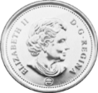
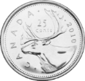
Independent random variables
Similar to independent events:
Random variables $X,Y$ are independent iff
$$∀r_{1},r_{2}∈ℝ \operatorname{Pr}\left(X=r_{1}∧Y=r_{2}\right) =\operatorname{Pr}\left(X=r_{1}\right)⋅Pr⁡(Y=r_{2})$$
Example: Suppose a pair of fair dice is thrown, with
$X_{1}$: number on the first die, $X_{2}:$ number on the second die, $Y:$ total amount
Then $\operatorname{Pr}\left(X_{1}=i∧X_{2}=j\right)=\operatorname{Pr}\left(X_{1}=i\right)⋅\operatorname{Pr}\left(X_{2}=j\right)=\frac{1}{36}$ for all $i,j∈\{1,2,3,4,5,6\}$ which are the only values $X_{1}$ and $X_{2}$ take. So $X_{1}$ and $X_{2}$ are independent.
But $X_{1}$and Y are not independent: $\operatorname{Pr}\left(X_{1}=1∧Y=12\right)=0,$ whereas
$\operatorname{Pr}\left(X_{1}=1\right)=\frac{1}{6},$ and $\operatorname{Pr}\left(Y=12\right)=\frac{1}{36},$ so $\operatorname{Pr}\left(X_{1}=1\right)⋅\operatorname{Pr}\left(Y=12\right)=\frac{1}{216}≠0.$

Slide 58
Variance of Bernoulli trials
When random variables $X, Y$ are independent, then
$E\left(XY\right)=E\left(X\right)⋅E\left(Y\right)$
V$\left(X+Y\right)=V\left(X\right)+V(Y)$
With this, we can calculate the variance of the number of successes in $n$Bernoulli trials where in each trial the probability of success is $p$.
For a single trial: let $X=1$ iff success, $X=0$ iff failure.
Then $E\left(X\right)=p$, $E\left(X^{2}\right)=p$, so $V\left(X\right)=E\left(X^{2}\right)−{\left(E\left(X\right)\right)}^{2}= p−p^{2}=p(1−p)$
Let $X_{1}…X_{n}$ be indicator variables so that $X_{i}=1$ iff $i^{th}$ trial is a success.
They are independent, so $V\left(X_{1}+…+X_{n}\right)=\sum_{i=1}^{n}{V\left(X_{i}\right) }=np(1−p)$

Slide 59
Chebyshev’s inequality
Now that we have the notion of variance, we can get a better bound on the probability of being away from the mean:
Chebyshev’s inequality: Let $x>0.$ Then
$$\operatorname{Pr}\left(|R−E\left(R\right)|≥x\right)≤\frac{V\left(R\right)}{x^{2}}$$
Proof:
$\left|R−E\left(R\right)\right|≥x$ is equivalent to ${\left(R−E\left(R\right)\right)}^{2}≥x^{2}.$
By Markov’s inequality, $\operatorname{Pr}\left({\left(R−E\left(R\right)\right)}^{2}≥x^{2}\right)≤\frac{E({\left(R−E\left(R\right)\right)}^{2})}{x^{2}}=\frac{V\left(R\right)}{x^{2}}$

Slide 60
Better estimate for Hat Check
Chebyshev’s inequality: Let $x>0.$ Then
$$\operatorname{Pr}\left(|R−E\left(R\right)|≥x\right)≤\frac{V\left(R\right)}{x^{2}}$$
Example: hat check problem again.
Let $R=X_{1}+…+X_{n}$ for indicator variables $X_{i}:$ man $i$ gets his hat.
We have shown that $E\left(R\right)=1,$and that $V\left(R\right)=1$ as well.
Let $k≥2. S$ince $R≥0,$ $\operatorname{Pr}\left(R≥k\right)=\operatorname{Pr}\left(\left|R−1\right|≥k−1\right)≤1/{\left(k−1\right)}^{2}$
This gives a tighter bound than Markov’s inequality.

Slide 61
Team selection puzzle
Imagine that your friend is a project manager, and her team consist of great programmers – if only she could get them to stop fighting among each other!
She decides to split them in two smaller teams
To minimize fighting within each team.
She knows who fights with whom (the “CONFLICT relation”), but how can she do the splitting?
And is it possible at all to eliminate at least half the conflicts? If not, why bother…
Do you think it is possible to split any group into two teams
to eliminate all conflicts?
How about eliminating half the conflicts?
How would you do the splitting?
Suppose this is the graph of the CONFLICT relation for a group.
Here, lines are double-direction arrows, since CONFLICT is symmetric.
What do you think is the best split?
Beth
Al
Cora
Eli
Dan

