Slide 1
Unit 7
Recursive definitions

Slide 2
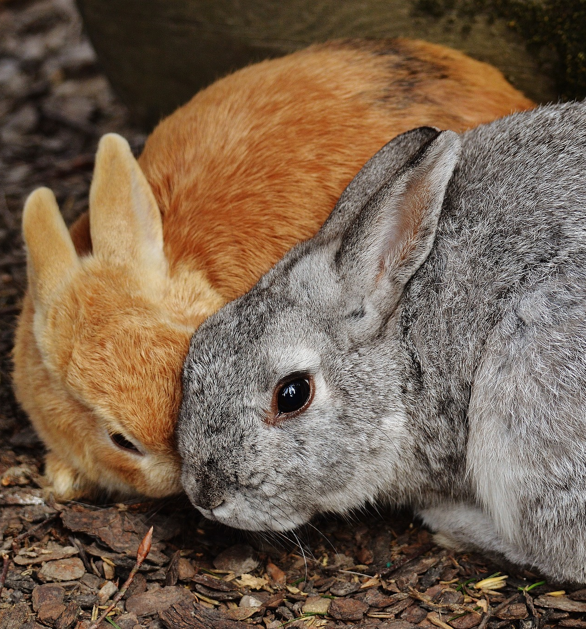
Puzzle: rabbits on an island
A ship leaves a pair of baby rabbits on an island (with a lot of food).
After a pair of rabbits reaches 2 months of age, they produce another pair of rabbits, and keep producing a pair every month thereafter.
Which in turn start reproducing every month when reaching 2 months of age…
So every pair starts reproducing at 2 months, and creates a new pair every month from then on.
How many pairs of rabbits will be on the island in $n$ months, assuming no rabbits die?

Slide 3
Fibonacci sequence
0
1
2
3
4
5
0th month: 0 pair ${ F}_{0} =0$
1st month: 1 pair ${ F}_{1} =1$
2nd month: 1 pairs $F_{2}=1$
3rd month: 2 pairs $F_{3}=2$
4th month: 3 pairs ${ F}_{4} =3$
5th month: 5 pairs ${ F}_{5} =5$
…
$n^{th}$ month: $F_{n}=F_{n−1}+F_{n−2}$
To compute how many pairs of rabbits will be there at $n^{th}$ month, add the number of pairs of rabbits at month $n−1$ and the number of pairs of rabbits at month $n−2$
Number of adult rabbit pairs = number of rabbit pairs one month ago.
All rabbits become adults in one month, and have their own babies in two months.
+ Number of baby rabbit pairs = number of rabbit pairs already born two month ago
Each of which was old enough to give birth to a pair of baby rabbits.

Slide 4
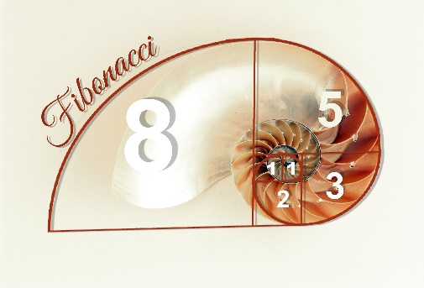
Sequences
A sequence of elements from some set S is a function $f:ℕ→S$
We usually start natural numbers with 0, but some books start with 1.
Elements (terms) of the sequence are written as $a_{0},a_{1},a_{2},…, a_{n}$
or using another letter with subscripts such as $F_{0},F_{1},…$ or $s_{0},s_{1},…,$etc.
$a_{0}$ is called an initial term of the sequence.
For every $i$ , $i^{th}$ term of a sequence is $a_{i}$, where $a_{i}=f(i)$
Fibonacci sequence from the rabbit puzzle:
0,1,1,2,3,5,8,13…
Sometimes these are also called Fibonacci numbers
$F_{0}=0, F_{1}=1, F_{2}=1, F_{3}=2, F_{4}=3, F_{5}=5,$etc

Slide 5
Arithmetic and geometric progressions
Arithmetic progression:
A sequence of the form $a, a+d, a+2d, a+3d,…$for some numbers $a,d$. Here, the initial term $=a$
Example: $a=2, d=3.$ Then $s_{0}=2, s_{1}=5, s_{2}=8, s_{3}=11, s_{4}=14…$
Geometric progression:
A sequence of the form $a, ar, ar^{2}, ar^{3},…$for some numbers $a,r$
Here, initial term is also $a$
Example: $a=2, r=3.$ Then $s_{0}=2, s_{1}=6, s_{2}=18, s_{3}=54, s_{4}=162…$

Slide 6
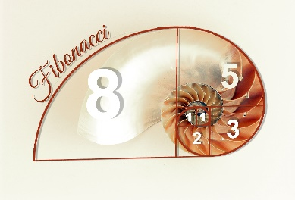
Recurrences
A sequence is often described by saying how to compute the next element from the previous ones
Fibonacci sequence: $F_{n}=F_{n−1}+F_{n−2}$
This kind of description, where $a_{n}$ is expressed as a formula dependent on values of previous elements in the sequence is called a recurrence.
Sometimes use recurrences to define functions directly, too.
A recursive definition of a sequence consists of a recurrence together with the values of the initial term (sometimes first few terms, called basis or initial condition).

Slide 7
Recurrences
A recursive definition of a sequence consists of a recurrence together with the values of the initial term (sometimes first few terms, called basis or initial condition).
Fibonacci sequence:
Basis: $F_{0}=0, F_{1}=1$
Recurrence: $F_{n}=F_{n−1}+F_{n−2}$
A sequence of powersets:
Basis: $A_{0}=∅$
Recurrence: $A_{n+1}=𝒫\left(A_{n}\right)$
Arithmetic progression:
Basis: $s_{0}=a$
Recurrence: $s_{n}=s_{n−1}+d$
Geometric progression:
Basis: $s_{0}=a$
Recurrence: $s_{n}=s_{n−1} ∗r$

Slide 8
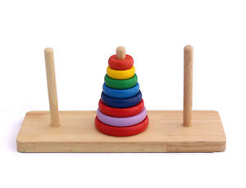
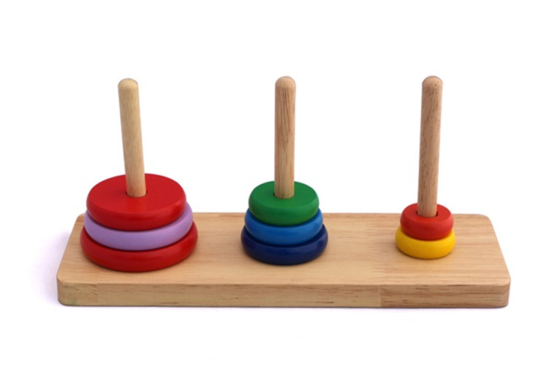
Tower of Hanoi game
Rules of the game:
Start with all disks on the first peg.
At any step, can move a disk to another peg, as long as it is not placed on top of a smaller disk.
Goal: move the whole tower onto the second peg.
Question: how many steps are needed to move the tower of 8 disks? How about $n$ disks?

Slide 10
Tower of Hanoi game
Rules of the game:
Start with all disks on the first peg.
At any step, can move a disk to another peg, as long as it is not placed on top of a smaller disk.
Goal: move the whole tower onto the second peg.
Question: how many steps are needed to move the tower of 8 disks? How about $n$ disks?

Slide 11
Tower of Hanoi game
Rules of the game:
Start with all disks on the first peg.
At any step, can move a disk to another peg, as long as it is not placed on top of a smaller disk.
Goal: move the whole tower onto the second peg.
Let us call the number of moves needed to transfer n disks H(n).
From any peg $i$ to any peg $j≠i$ would take the same number of steps.
Basis: only one disk can be transferred in one step.
So H(1) = 1
Recursion: to transfer n disks from peg 1 to peg 2.
To transfer n-1 disks from peg 1 to peg 3 need $H(n−1)$ steps.
To transfer the remaining disk to peg 2, need 1 step.
To transfer n-1 disks from peg 3 to peg 2 need H(n-1) steps again.
So H(n) = 2H(n-1)+1 (recurrence).
But how many steps does it really take?

Slide 12
Closed form of a recurrence
Tower of Hanoi for $n=8$
$H\left(8\right)=2H\left(7\right)+1=2( \left(2H\left(6\right)+1\right)+1 = 4H\left(6\right)+2+1=4H\left(6\right)+3$
$= 4\left(2H\left(5\right)+1\right)+3=8H\left(5\right)+7=16H\left(4\right)+15=32H\left(3\right)+31$
$=64H\left(2\right)+63=128H\left(1\right)+127=128∗1+127=255$
A closed form of a recurrence relation is an expression that defines an $n^{th}$ element in a sequence in terms of $n$ directly.
Often use recurrence relations and their closed forms to describe performance of (especially recursive) algorithms.
A closed form of the Tower of Hanoi recurrence is $H\left(n\right)=Σ_{i=0}^{n−1} 2^{i}=2^{n}−1$

Slide 13
Solving recurrences
Solving a recurrence: finding a closed form.
Solving the recurrence H(n)=2H(n-1)+1
H(n) $= 2⋅H\left(n−1\right)+1=2\left(2H\left(n−2\right)+1\right)+1$= $2^{2}H\left(n−2\right)+2+1$
$= 2^{3}H\left(n−3\right)+2^{2}+2+1 = 2^{4 }H\left(n−4\right)+2^{3}+2^{2}+2+1…$
Closed form of the Tower of Hanoi recurrence: $H\left(n\right)=Σ_{i=0}^{n−1} 2^{i}=2^{n}−1$
Proof by induction (using recursive definition of $H(n)).$
Base case: H(1)=1. Induction hypothesis: $H\left(k\right)=2^{k}−1$.
Induction step: $H\left(k+1\right)=2H\left(k\right)+1=2\left(2^{k}−1\right)+1=2^{k+1}−1$
Or by noticing that a binary number 111...1 (n-1 1s) plus 1 gives a binary number 10000…0 (1 followed by n-1 0s)

Slide 15
Function growth
In Tower of Hanoi, adding one more disk doubles the number of steps. $H\left(n\right)=2^{n}−1$.
We say that the function H(n) grows exponentially
What does it mean that a function “grows” at a certain rate?
Is $f(n)=100n$larger than $g\left(n\right)=n^{2}?$
Only when $n<100.$ For the remaining infinitely many values of n, $f\left(n\right)≤g(n)$
So $g(n)$ grows faster than $f(n)$
To compare functions, check which becomes larger as n increases (to infinity).
Often think of functions as describing running time of an algorithm.
For programs, performance on larger inputs matters more.
Constant factors don’t matter that much.

Slide 16
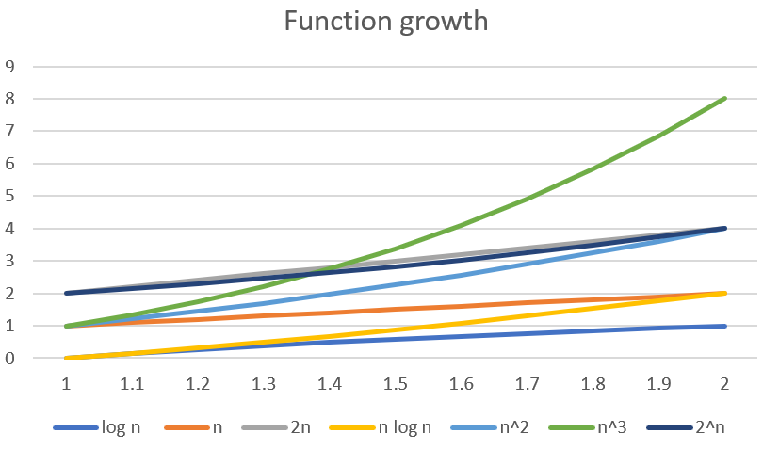
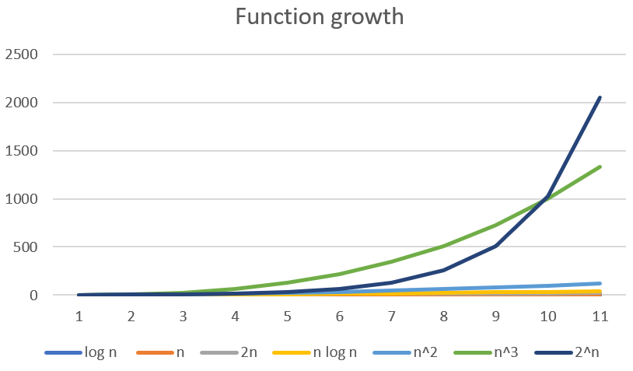
Comparing growth rate of functions
How to estimate the rate of growth of a function?
Plotting a graph?
Not quite conclusive:
How do you know what they will do past the part on the graph?

Slide 17
Big-O notation
We say that $f(n)$grows at most as fast as $g(n)$ if
There is a value $n_{0}$ such that after $n_{0}$, $f\left(n\right)$ is always at most as large as $g\left(n\right)$
Except if two functions differ by only a constant factor, consider them having the same growth rate.
So more correctly, there is a value $n_{0}$ and a constant $c$such that for all $n$ after $n_{0}$, $f\left(n\right)$ is always at most as large as $c⋅g\left(n\right)$
Denote set of all functions growing at most as fast as $g\left(n\right)$by $O\left(g\left(n\right)\right)$
Big-Oh of $g(n).$
Some books say “f is in O(g)”, others “f is O(g)”, both are OK.
g(n) is an asymptotic upper bound for f(n).
When both $f\left(n\right)∈O\left(g\left(n\right)\right)$ and $g\left(n\right)∈O\left(f\left(n\right)\right), write$ $f\left(n\right)∈Θ(g\left(n\right))$
f(n) is in big-Theta of g(n)).

Slide 18
Big-O notation
More generally, for real-valued functions$f(x)$and $g(x)$,
That is, from some point $x_{0}$on, each |$f\left(x\right)|$is less than |g(x)| (up to a fixed constant factor).
When functions describe program running times, they give the number of steps a program takes on an input of size n, making them $ℕ→ℕ$
so use $n$for $x$and ignore | |.
You will see a lot of big-O notation in COMP 2002
and possibly some in COMP 1000 and COMP 1001
$f\left(x\right)∈O\left(g\left(x\right)\right)$ iff
$$∃ x_{0}∈ℝ^{≥0} ∃c∈ℝ^{>0} ∀x≥x_{0} \left|f\left(x\right)\right|≤c⋅\left|g\left(x\right)\right|$$

Slide 19
Big-O notation examples
$f\left(n\right)∈O\left(g\left(n\right)\right)$ iff
$$∃ n_{0}∈ℕ ∃c∈ℝ^{>0} ∀n≥n_{0} f\left(n\right)≤c⋅g(n)$$
$f\left(n\right)=n^{2},$ $g\left(n\right)=2^{n}.$
Take c=1, $n_{0}=$4.
For every $n≥n_{0}, f\left(n\right)≤g\left(n\right)$
Proof by induction.
So $n^{2}∈O\left(2^{n}\right)$
$f\left(n\right)=n^{2}+100n,$ $g\left(n\right)=10n^{2}.$
Here, $f\left(n\right)∈O\left(g\left(n\right)\right)$ and also $g\left(n\right)∈O(f\left(n\right))$
So $f\left(n\right)∈Θ(g\left(n\right))$
$f\left(n\right)∈O\left(g\left(n\right)\right)$: c = 20 and/or $n_{0}=100$ work.
$g\left(n\right)∈O\left(f\left(n\right)\right):$ Take c=10, $n_{0}=1$.
Can ignore constants and look only at the leading term in a sum.
$f\left(n\right)=n^{2},$ $g\left(n\right)=10n.$
Can take $c=1, n_{0}=10$
Or take arbitrary $c$
No matter what $c$ is, when
$n>c⋅10,$ $n^{2}≥$ $c⋅10n$
So $n^{2}∉O\left(10n\right).$

Slide 20
Common computational complexity classes
As we can ignore constants and only consider leading (fastest growing) term in a sum, common classes in Computer Science are:
Logarithmic: $O(\log{n}$), where $\log{n}$ is usually $\log_{2}{n}$
The base of the log does not matter, as base change multiplies by a constant.
Linear: $O(n)$
$O(n\log{n)}$: No established name, but quite common in Computer Science
Quadratic: $O(n^{2})$
Cubic: $O(n^{3})$
Polynomial: $O(n^{k})$ for some $k∈ℕ$
Exponential: $O(2^{n}$)
Note: $2^{2n}∉O\left(2^{n}\right),$ since $2^{2n}={\left(2^{n}\right)}^{2}=2^{n}⋅2^{n}$
So a constant can only be ignored in front of the whole expression, not inside!

Slide 21
Master theorem
Solving recurrences in general might be tricky.
When the recurrence is of the form T(n)=a T(n/b)+f(n), there is a general method to estimate the growth rate of a function defined by the recurrence
This is called the Master Theorem for recurrences.

Slide 22
O-notation and computational complexity
If there is an algorithm that for every input $x$ solves the problem in at most $t\left(\left|x\right|\right)$steps for some $t:ℕ→ℕ$ such that $t\left(n\right)∈O\left(f\left(n\right)\right),$ then the problem is solvable in time $O\left(f\left(n\right)\right).$
If there are several ways to solve the problem, pick the algorithm with slowest growing t(n)
Comparing number of steps rather than actual running times to avoid having to compare different implementations running on different hardware.
Our algorithm for the Tower of Hanoi with n disks took $2^{n}−1$ steps, so complexity of Tower of Hanoi is in $O(2^{n})$

Slide 23
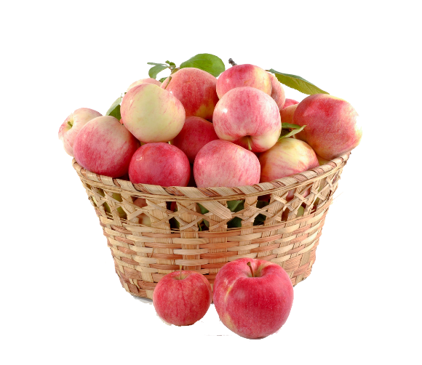
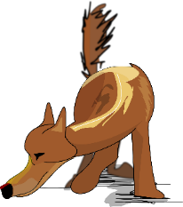
O-notation and computational complexity
Sometimes (rarely!) we can also prove that it is not possible to solve the problem faster than $c⋅f(n)$: then, we say that the problem has complexity $Θ(f(n))$
For Tower of Hanoi, any algorithm needs ${≥2}^{n}−1$ steps.
So the complexity of the Tower of Hanoi is $Θ\left(2^{n}\right)$
Proving that there is no faster way to solve a problem is harder!
To put an upper bound on complexity of a problem, enough to find one algorithm solving it in $t\left(n\right)∈O(f\left(n\right))$ steps.
To prove a lower bound $f\left(n\right)$on complexity of a problem, have to show that every algorithm solving it correctly has $f\left(n\right)∈O\left(t\left(n\right)\right)$
Notation: $t\left(n\right)∈Ω\left(f\left(n\right)\right),$ pronounced “big-omega”

Slide 25
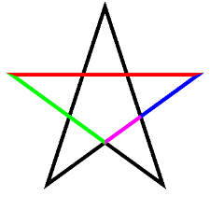
Closed form of some sequences
Arithmetic progression: $a, a+d, a+2d, a+3d,…, a+nd, …$
Closed form: $s_{n }$= $a+nd$
Geometric progression: $a,ar, ar^{2}, ar^{3},…, ar^{n}, …$
Closed form: $s_{n}=a⋅r^{n}$
Fibonacci sequence: 1,1,2,3,5,8,13, $…$
$F_{n}=F_{n−1}+F_{n−2}$, $F_{0}=0, F_{1}=1$
Closed form: $F_{n}=\frac{φ^{n}−{\left(1−φ\right)}^{n}}{√5}$
Where $φ$ (“phi”) is the “golden ratio”: a ratio such that $\frac{a+b}{a}=\frac{a}{b}$
$φ=\frac{1+\sqrt{5}}{2}$
a b
a+b

Slide 26
More examples of recursive definitions
There is much more that can be defined with recursive definitions rather than just sequences and functions.
In the following recursive definitions, we will call the recursive step “recursion” rather than “recurrence”, as we are not defining $n^{th}$ element of a sequence (or function value at n)
Recursive definition of a sum (where $n≥m)$
Basis: $\sum_{i=m }^{m}{f\left(i\right)=f(m)} \text{. }$
Recursion: $\sum_{i=m }^{n+1}{f(i)}=\left(\sum_{i=m }^{n}{f(i})\right)+f\left(n+1\right)$
Recursive definition of a product (where $n≥m)$
Basis: $\prod_{i=m}^{m}{f(i)}=f(m)\text{. }$
Recursion: $\prod_{i=m}^{n+1}{f(i)}=(\prod_{i=m}^{n+1}{f(i))}∗f\left(n+1\right)$

Slide 27
Fractals
Can use recursive definitions to define fractals
And draw them
And prove their properties.
A fractal is a self-similar object: a part looks like the whole.

Slide 28
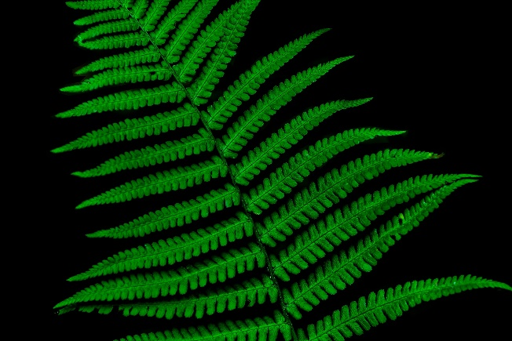
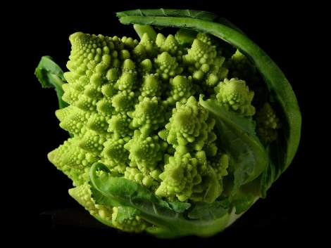
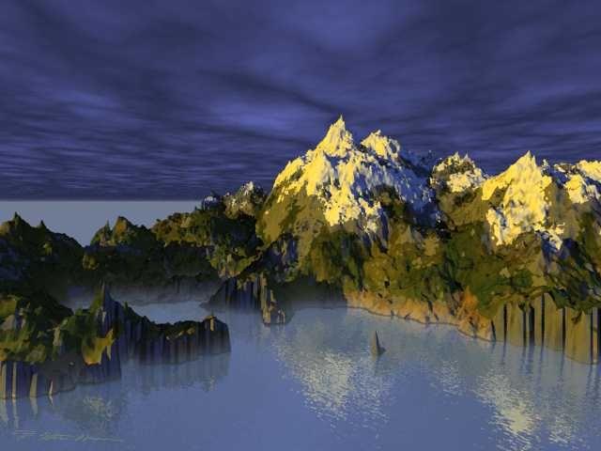
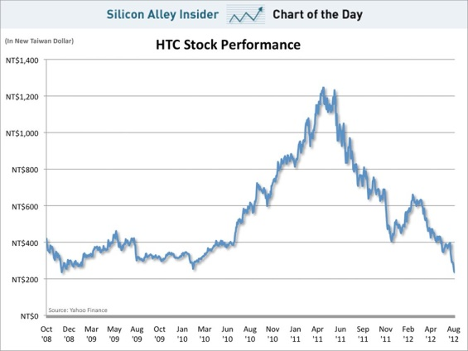
Fractals in nature
A fern leaf
Mountains
Romanesco broccoli
Stock market

Slide 30
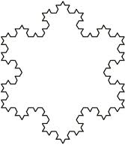
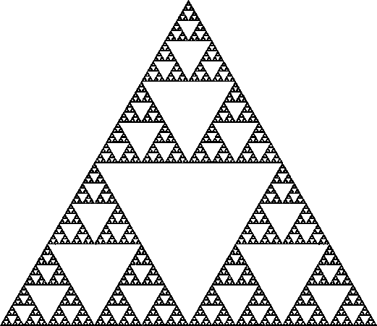
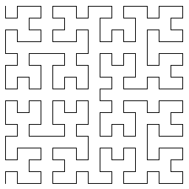
Mathematical fractals
Koch curve and snowflake
Sierpinski triangle, pyramid, carpet
Hilbert space-filling curve
Mandelbrot set

Slide 32
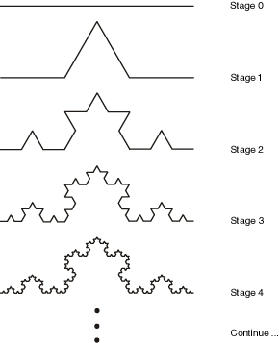
Koch curve
Recursive definition of Koch curve:
Basis: an interval
Recursion: Replace the inner third of each interval with two intervals of the same length sticking out in a triangle
That is, make a equilateral triangle on top of the middle third, then remove the middle third leaving the remaining two sides of the triangle.
Is it a line? Is it a plane? It is a fractal! Its dimension is $\log_{3}{4}$

Slide 33
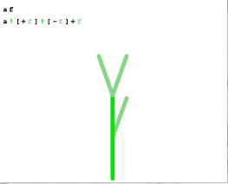
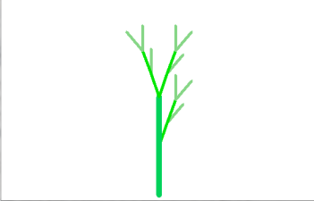
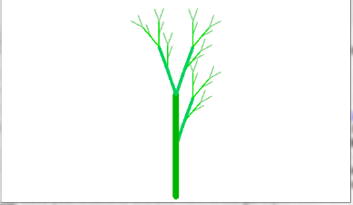
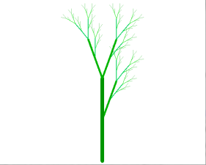
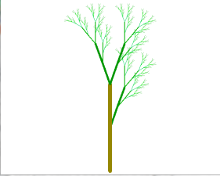
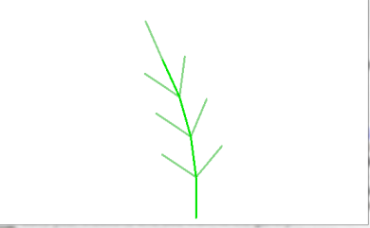
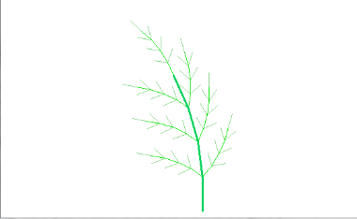
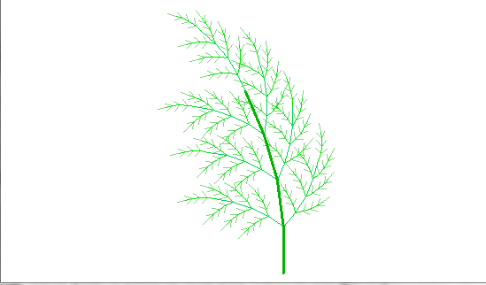
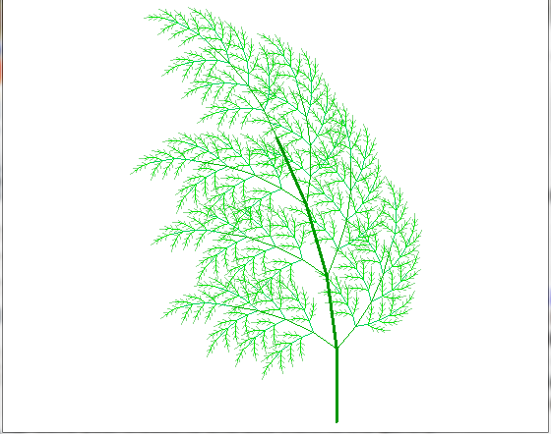
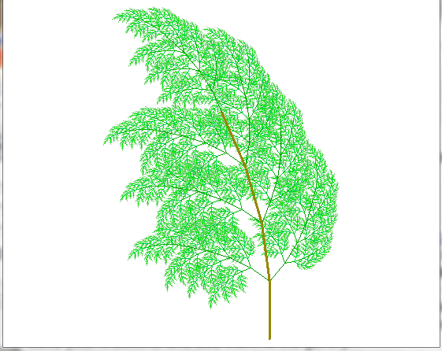
Playing with fractals
Fractal Grower by Joel Castellanos:
http://www.cs.unm.edu/~joel/PaperFoldingFractal/paper.html
Stage 0
(Basis)
Stage 1
(Do recursion once)
Stage 3
Stage 4
Stage 5
Stage 2

Slide 35
Recursive definitions of sets
So far, we talked about recursive definitions of sequences, functions, formulas and fractals. We can, in general, recursively define sets.
Recursive definition of a set S=${\left\{0,1\right\}}^{∗}$
Basis: empty string $λ$is in S.
Recursion: if $w∈S,$ then $w0∈S$ and $w1∈S$
Here, $w0$ means string w with 0 appended at the end; same for w1
If $w=011,$ then $w0=0110,$and $w1=0111$
Alternatively:
Basis: empty string $λ$, 0 and 1 are in S.
Recursion: if s and t are in S, then $st$ $∈S$
here, $st$ is concatenation: symbols of s followed by symbols of t
If s = 101 and t= 0011, then st = 1010011
We always assume that the set S contains only elements produced from basis using recursion rule.

Slide 36
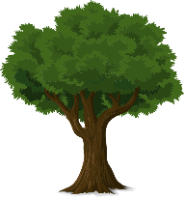
Trees
2
In computer science, a tree is an undirected graph without cycles
Undirected: all edges go both ways, no arrows.
Cycle: sequence of edges going back to the same point.
Recursive definition of trees:
Basis: A single vertex is a tree.
Recursion:
Let $T$ be a tree, and $v$ a new vertex not in $T$.
Then a new tree consist of $T, v,$and an edge (connection) between some vertex of $T$and $v.$
1
3
Undirected cycle
(not a tree)
$$v_{1}$$
$$v$$
$$v_{2}$$
$$v_{5}$$
$$v_{3}$$
$$v_{4}$$

Slide 37
Arithmetic expressions
Bool
Bool
$$+$$
Bool
Suppose you are writing a piece of code that takes an arithmetic expression (“5*3-1”, “40-(x+1)*7”, etc), checks that it is well-formed (input is correct), and evaluates it.
How to describe a well-formed arithmetic expression? Define a set of all well-formed arithmetic expressions recursively:
Basis: A number or a variable is a well-formed arithmetic expression.
5, 100, x, a
Recursion: If A and B are well-formed arithmetic expressions then so are (A), $A+B, A−B, A∗B,A$/ B.
40-(x+1)*7 is well-formed: first build 40, x, 1, 7. Then x+1. Then (x+1). Then (x+1)*7, finally 40-(x+1)*7
Caveat: how do we know the order of evaluation? On that later.

Slide 38
Formulas
Bool
Bool
$$∨$$
Bool
What is a well-formed propositional logic formula?
$\left(p∨¬q\right)∧r→\left(¬p→r\right)$
Basis: a propositional variable $p, q, r…$
Or a constant $TRUE, FALSE$
Recursion: if F and G are propositional formulas, so are $\left(F\right), ¬F, F∧G, F∨G, F→G, F↔G.$
And nothing else is a well-formed propositional logic formula.

Slide 39
Formulas
Set
element name
Formula
What is a well-formed predicate logic formula?
$$∃x∈D ∀y∈ℤ (P\left(x,y\right)∨Q\left(x,z\right))∧x=y$$
Basis: a predicate with inputs from its domain
P(x), x=y, Even(5),…
Recursion:
If F and G are predicate logic formulas, so are $\left(F\right), ¬F, F∧G, F∨G, F→G, F↔G.$
If $F$is a predicate logic formula with a free variable x, and D is the domain of $x,$ then $∃x∈D F$ and $∀x∈D F$ are predicate logic formulas.
And nothing else.
So $∃x∈People Likes\left(x,y∧x\right), Likes\left(y≠x\right)$ is not a well-formed predicate logic formula!
$$∀$$
$$Formula$$

Slide 40
Puzzle
Are the following English sentences built the same way?
Time flies like an arrow.
Fruit flies like an apple.

Slide 42
Puzzle
Are the following English sentences built the same way?
Time flies like an arrow.
Fruit flies like an apple.
Noun
Verb
Noun
Verb

Slide 43
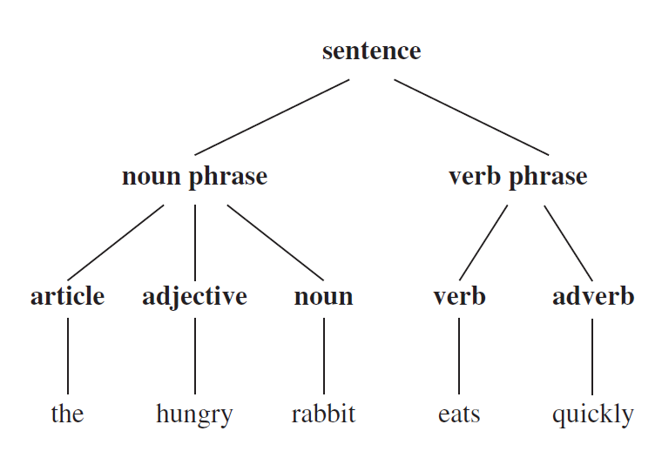
Grammars
Remember that sets of strings are called languages.
A type of recursive definition of a language is called a grammar.
Different natural languages also
have different grammars!
English: Subject/Verb/Object
Japanese: Subject/Object/Verb
Gaelic: Verb/Subject/Object
Russian: order does not matter

Slide 44
Context-free grammars
A special kind of grammars is context-free grammars, where symbols have the same meaning wherever they are.
A context-free grammar consists of
A set V of variables (using capital letters), including a start variable S.
Note: these are variables, not sets.
A set $Σ$ of terminals (disjoint from V; alphabet of the language.)
A set R of rules, where each rule consists of a variable from V, followed by $→$, followed by a string of variables and terminals.
This is not the same “$→"$as implication, a different use of the same symbol.
If several rules start with the same non-terminal such as $A→w_{1},$ $A→w_{2},$ etc, we use a shortcut “|” (means “or”) to write them as one rule: $A→w_{1}\left| w_{2}\right|…|w_{k}$

Slide 45
Context-free grammars
A context-free grammar: a set V of variables, including a start variable S, a set $Σ$ (Sigma) of terminals (alphabet) and a set R of rules of the form $A→w$, where $A∈V, w∈{\left(V∪Σ\right)}^{∗}$
If $A→w$ is a rule, we say variable $A$ yields string w.
Can use A within the rule, as many times as we want: recursion!
Different occurrences of the same variable can produce different strings.
A derivation is a sequence of strings each of which is obtained from the previous by applying some rule to its substring.
If $w=ℓAr$ and there is a rule $A→u,$ then $ℓur$ is directly derived from $w,$ written $w⇒ℓur$.
$w_{n}$ is derived from $w_{0}$ if there is a sequence $w_{0},w_{1}, …,w_{n}$ where $∀i w_{i}⇒w_{i+1}$
A language generated by a grammar consists of all strings of terminals that can be derived from the start variable S.

Slide 46
Language $L$of all strings over {0,1} with all 0s before all 1s.
Strings in $L:$ $λ,$0, 1, 11, 001, 00111, 011111, 00000000,…
Strings not in $L:$ 10, 1110, 010101, 00100000…
Recursive definition:
Basis: $λ∈L$
Recursion: if $w∈L,$ then $0w∈L$ and $w1∈L$
Grammar for L consists of 3 rules: $S→0S, S→S1, S→λ$
Shorter description of the grammar: $S→0S \left| S1 \right| λ$
Variables: S. Terminals: 0 and 1. As before, $λ$ is the empty string.
Derivation of a string 001: $S⇒0S⇒0S1⇒00S1⇒00λ1=001$
Alternative derivation of 001: $S⇒S1⇒0S1⇒00S1⇒00λ1=001$
$S→λ$
$S→0S$
$S→S1$

Slide 47
Parse trees:
Parse trees: visualizing derivations
Similar to syntax trees,
except all internal nodes are variables,
and all nodes on the bottom are terminals.
Grammar: $S→0S \left| S1 \right| λ$
Derivation of a string 001:
$$S⇒0S⇒00S⇒00S1⇒00λ1=001$$
Alternative derivation of 001:
$S⇒S1⇒0S1⇒00S1⇒00λ1=001$
S
S
0
S
S
1
0
S
0
S
S
1
0
S
$$λ$$
$$λ$$
0 0 1
0 0 1

Slide 48
Examples of context-free grammars
L contains two strings 1 and 00
$$S → 1 | 00$$
Variables: S.
Terminals: 1 and 00 (or 1 and 0).
L is strings over $\left\{a,b,c,d\right\}$ with even number of “a”s
$$S→SaSaS \left| SbS \right|ScS|SdS| λ$$
Variables: S. Terminals: a,b,c,d.
Natural numbers, start symbol N
$N→ 0 | M$
$M→1D\left|2D\right|3D|4D$
$M→5D\left|6D\right|7D\left|8D\right|9D$
$D→M|0D|λ$
Rational numbers: same as natural numbers plus a new start symbol $R,$new variable P and new rules
$R→P|$-$P$
$P→N|N$/$M$|$N.N$

Slide 49
Propositional formulas
Recursive definition:
Basis: a propositional variable $p, q, r$ or a constant $TRUE, FALSE$
Recursion: if F and G are propositional formulas, then so are $\left(F\right), ¬F, F∧G, F∨G, F→G, F↔G.$
Grammar: $F→ F∨F|F∧F|¬F|\left(F\right)|F→G|F↔G$
$$F→p \left| q \right|r \left| TRUE \right|FALSE$$
Here, the only variable is F (it is a start variable), and the set of terminals is {$∨, ∧, ¬, →, ↔, \left(, \right), p,q,r,TRUE,FALSE\}$
Deriving $\left(p∨¬q\right)∧r:$ $F⇒F∧F⇒\left(F\right)∧F⇒\left(F\right)∧r⇒$
$$⇒\left(F∨F\right)∧r⇒\left(p∨F\right)∧r⇒\left(p∨¬F\right)∧r⇒\left(p∨¬q\right)∧r$$
F
F
$$∧$$
F
(
)
$$r$$
F
F
$$∨$$
F
$$p$$
$$¬$$
F
q
$\left( p ∨ ¬ q \right) ∧ r$

Slide 50
Context-free grammars for arithmetic expressions
$EXPR→EXPR+EXPR \left| EXPR −EXPR \right| EXPR ∗EXPR$
$EXPR→ EXPR / EXPR$ |$\left(EXPR\right) \left| 0\right|NUMBER$|-NUMBER
NUMBER $→1DIGITS \left|…\right|9DIGITS$
$DIGITS → λ| NUMBER|0DIGITS$
Variables: EXPR, NUMBER, DIGITS (EXPR is starting).
Terminals: +,-,*, /, 0,…,9,(,).
Problem: this definition of arithmetic expressions (and the previous definition of propositional formulas) do not have any information about order of operations.
Grammar for natural numbers

Slide 51
Encoding order of precedence
Easier to specify in which order to process parts of the formula.
Better grammar for arithmetic expressions (for simplicity, with only x,y,z instead of numbers):
$EXPR→EXPR+TERM |EXPR−TERM| TERM$
$TERM→TERM ∗FACTOR | TERM /$ $FACTOR | FACTOR$
$FACTOR →\left(EXPR\right)$| x | y | z
Here, variables are EXPR, TERM and FACTOR (with EXPR a starting variable).
Now can encode precedence.

Slide 52
Ambiguous grammars
EXPR
A context-free grammar is ambiguous if there is some string with more than one possible parse tree.
Grammar $S→0S\left|S1\right|λ$was ambiguous
since 001 had two parse trees.
First grammar for arithmetic expressions (and grammar for propositional formulas) were ambiguous: $x+y∗z$has two parse rees.
$EXPR→EXPR+EXPR|EXPR −EXPR$
$EXPR→EXPR ∗EXPR | EXPR / EXPR$
$EXPR→ \left(EXPR\right)\left|x\right|y|z$
Second grammar for arithmetic expressions is
not ambiguous
$EXPR→EXPR+TERM |EXPR−TERM| TERM$
$TERM→TERM ∗FACTOR | TERM /$ $FACTOR | FACTOR$
$FACTOR →\left(EXPR\right)$| x | y | z
EXPR
*
EXPR
EXPR
+
EXPR
z
x
y
EXPR
EXPR
+
EXPR
x
EXPR
*
EXPR
y
z
EXPR
EXPR
EXPR
+
TERM
TERM
TERM
*
FACTOR
FACTOR
FACTOR
z
x
y

Slide 54
Recursive definitions of sets
So far, we talked about recursive definitions of sequences, functions, formulas and fractals. We can, in general, recursively define sets.
Recursive definition of a set S=${\left\{0,1\right\}}^{∗}$
Basis: empty string $λ$is in S.
Recursion: if $w∈S,$ then $w0∈S$ and $w1∈S$
Here, $w0$ means string w with 0 appended at the end; same for w1
If $w=011,$ then $w0=0110,$and $w1=0111$
Alternatively:
Basis: empty string $λ$, 0 and 1 are in S.
Recursion: if s and t are in S, then $st$ $∈S$
here, $st$ is concatenation: symbols of s followed by symbols of t
If s = 101 and t= 0011, then st = 1010011
We always assume that the set S contains only elements produced from basis using recursion rule.

Slide 55
Structural induction
Let $S⊆U$be a recursively defined set
Let F(x) be a predicate with domain $U$
Think of $F(x)$ as some property that elements of U may have.
Then
if $F\left(x\right)$ is true for all $x$in the basis of S,
and applying the recursion rules preserves F.
then all elements in S have the property F.

Slide 56
Let’s define a set S of numbers as follows.
Basis: 3 $∈S$
Recursion: if $x,y∈S,$ then $x+y∈S$
Claim: all numbers in S are divisible by 3
That is, $∀x∈S ∃ z∈ℕ x=3z.$
Proof (by structural induction).
Base case: 3 is divisible by 3 (z=1).
Recursive step:
Let $x,y∈S.$ Then $∃z, u∈ℕ x=3z∧y=3u.$ (inductive hypothesis)
Then $x+y=3z+3u=3\left(z+u\right).$ (induction step)
Therefore, $x+y$is divisible by 3.
As there are no other elements in S except for those constructed from 3 by the recursion rule, all elements in S are divisible by 3.

Slide 57
Trees
2
In computer science, a tree is an undirected graph without cycles
Undirected: all edges go both ways, no arrows.
Cycle: sequence of edges going back to the same point.
Recursive definition of trees:
Base: A single vertex is a tree.
Recursion:
Let $T$ be a tree, and $v$ a new vertex.
Then a new tree consist of $T, v,$and an edge (connection) between some vertex of $T$and $v.$
3
1
Undirected cycle
(not a tree)
$$v_{1}$$
$$v_{2}$$
$$v_{5}$$
$$v_{3}$$
$$v$$
$$v_{4}$$

Slide 58
Binary trees
Rooted trees are trees with a special vertex designated as a root.
Rooted trees are binary if every vertex has at most three edges: one going towards the root, and two going away from the root.
For a vertex in a rooted tree, its neighbour towards the root is called “parent”
And its neighbours away from the root are called “children”
Full if every vertex has either 2 or 0 edges going away from the root.
Recursive definition of full binary trees:
Basis: A single vertex is a full binary tree with that vertex as a root.
Recursion:
Let $T_{1}, T_{2}$ be full binary trees with roots $r_{1},r_{2}$, respectively. Let $v$ be a new vertex.
A new full binary tree with root $v$ is formed by connecting $r_{1}$ and $r_{2}$ to $v.$
$$v_{1}$$
$$v_{2}$$
$$v_{3}$$
$$v_{4}$$
$$v_{5}$$
$$v$$

Slide 59
Height of a full binary tree
The height of a rooted tree, $h\left(T\right),$ is the maximum number of edges to get from any vertex to the root.
Height of a tree with a single vertex is 0.
Claim: Let $n(T)$ be the number of vertices in a full binary tree T.
Then $n\left(T\right)≤2^{h\left(T\right)+1}−1$
Alternatively, height of a binary tree is at least $\log_{2}{n(T)}$
If you have a recursive program that calls itself twice
Then if this code executes n times (maybe on n different cases)
Then your program will run in time at least $\log_{2}{n},$even when cases are checked in parallel.
$$v_{1}$$
$$v_{2}$$
$$v_{3}$$
$$v_{4}$$
$$v_{5}$$
Height 2

Slide 60
Height of a full binary tree
$$v_{1}$$
$$v_{2}$$
$$v_{3}$$
$$v_{4}$$
$$v_{5}$$
Claim: Let $n(T)$ be the number of vertices in a full binary tree T.
Then $n\left(T\right)≤2^{h\left(T\right)+1}−1$, where $h\left(T\right)$ is the height of T.
Proof (by structural induction)
Base case: a tree with a single vertex has $n\left(T\right)=1$ and $h\left(T\right)=0.$
So $2^{h\left(T\right)+1}−1$ = 1 $≥1$
Recursion: Suppose $T$was built by attaching $T_{1}, T_{2}$ to a new root vertex $v.$
Number of vertices in $T$ is $n\left(T\right)=n\left(T_{1}\right)+n\left(T_{2}\right)+1$
Every vertex in $T_{1}$ or $T_{2}$ now has one extra step to get to the new root in $T.$
So $h\left(T\right)=1+max⁡(h\left(T_{1}\right), h\left(T_{2}\right))$
By the induction hypothesis, $n\left(T_{1}\right)≤$ $2^{h\left(T_{1}\right)+1}−1$ and ${n\left(T_{2}\right)≤2}^{h\left(T_{2}\right)+1}−1$
$n\left(T\right)=…$(see next page)

Slide 61
Claim: Let $n(T)$ be the number of vertices in a full binary tree T.
Then $n\left(T\right)≤2^{h\left(T\right)+1}−1$, where $h\left(T\right)$ is the height of T.
Proof (by structural induction)
Base case: holds.
Recursion: Suppose $T$was built by attaching $T_{1}, T_{2}$ to a new root vertex $v.$
Number of vertices in $T$ is $n\left(T\right)=n\left(T_{1}\right)+n\left(T_{2}\right)+1$
Every vertex in $T_{1}$ or $T_{2}$ now has one extra step to get to the new root in $T.$
So $h\left(T\right)=1+max⁡(h\left(T_{1}\right), h\left(T_{2}\right))$
By the induction hypothesis, $n\left(T_{1}\right)≤$ $2^{h\left(T_{1}\right)+1}−1$ and ${n\left(T_{2}\right)≤2}^{h\left(T_{2}\right)+1}−1$
$n\left(T\right)=n\left(T_{1}\right)+n\left(T_{2}\right)+1$
$≤1+{(2}^{h\left(T_{1}\right)+1}−1$)+($2^{h\left(T_{2}\right)+1}−1$ ) (by ind. hyp)
$≤2⋅max⁡(2^{h\left(T_{1}\right)+1}$, $2^{h\left(T_{2}\right)+1}) −1$
$≤2⋅2^{\max\left(h\left(T_{1}\right),h\left(T_{2}\right)\right)+1}−1$
$=2⋅2^{h\left(T\right)}−1=2^{h\left(T\right)+1}−1$
Therefore, the number of vertices of any binary tree $T$ is ${≤2}^{h\left(T\right)+1}−1$
$$v_{1}$$
$$v_{2}$$
$$v_{3}$$
$$v_{4}$$
$$v_{5}$$

Slide 62
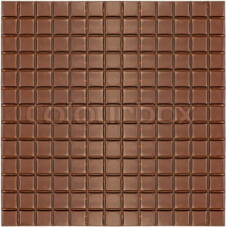
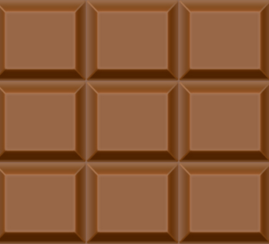
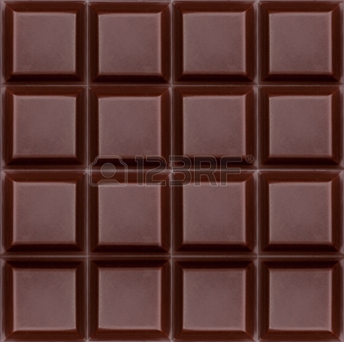
Puzzle: chocolate squares
Suppose you have a piece of chocolate like this:
How many squares are in it?
of all sizes, from single to the whole thing

