Slide 1
Unit 6
Induction

Slide 2
Order relations
3
A binary relation $R⊆A×A$is an order if R is
Reflexive, Anti-symmetric, Transitive
$R_{1}=\left\{\left(x,y\right)\right|x,y∈ℤ∧x≤y\}$
$SUBSETS=\left\{\left(A,B\right) \right| A, B are sets∧ A⊆B \}$
$DIVISORS=${(x,y)| $x,y∈ℕ∧x,y≥2 ∧∃z∈ℕ y=z⋅x\}$
An order may have minimal and maximal elements (maybe multiple)
2
1
{a,b}
{a}
{b}
$$∅$$

Slide 3
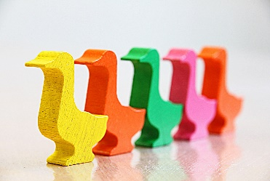
Well-ordering principle
Theorem: Any non-empty subset of natural numbers contains the minimum element
With respect to the usual total order $x≤y$
There is smallest positive even number. Smallest composite number. Smallest square…
If there is a property which is not true for some natural numbers, there is a smallest natural number for which it is not true.
Very useful for proofs!
5
4
3
2
1
0

Slide 4
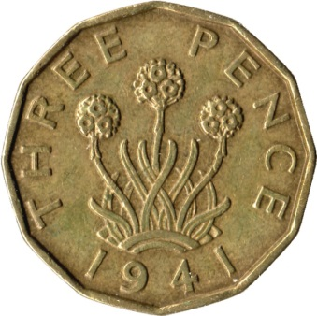
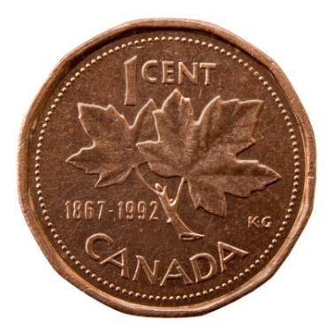
Puzzle: coins
A not-too-far-away country recently got rid of a penny coin, and now everything needs to be rounded to the nearest multiple of 5 cents…
Suppose that instead of just dropping the penny, they would introduce a 3 cent coin.
Like British three pence.
What is the largest amount that cannot be paid by using only existing coins (5, 10, 25) and a 3c coin?
7c
Any number n >7 can be paid with 3,5,10,25 coins (even just 3 and 5).

Slide 5
Well-ordering principle: Any non-empty subset of natural numbers contains the least element (with respect to $x≤y$)
Coins: $∀x∈ℕ,$if $x >7$ then $∃ y,z∈ℕ$ such that $x = 3y+5z$. So any amount >7 can be paid with 3s and 5s.
Suppose, for the sake of contradiction, that there are amounts greater than 7 which cannot be paid with 3s and 5s.
Take a set S of all such amounts. Since $S⊆ℕ,$and we assumed that $S≠∅,$ by well-ordering principle S has the least element. Call it n.
Now, look at n-3; it cannot be paid by 3s and 5s either.
Since n is the least element of S, $n−3≤7<n$
Remains to show that all possible $n−3≤7$ don’t work

Slide 6
Coins: $∀x∈ℕ,$if $x >7$ then $∃ y,z∈ℕ$ such that $x = 3y+5z$. So any amount >7 can be paid with 3s and 5s.
Suppose, for the sake of contradiction, that there are amounts greater than 7 which cannot be paid with 3s and 5s.
3 cases:
n=8. Then n=3+5.
n = 9. Then n=3*3
n = 10. Then n=10=2*5.
In all three cases, got a contradiction.
Therefore, for every $x∈ℕ$, if x >7 then x=3y+5z for some $y,z∈ℕ$.

Slide 8
Well-ordering principle
Theorem: Any non-empty subset of natural numbers contains the minimum element
With respect to the usual total order $x≤y$
There is smallest positive even number. Smallest composite number. Smallest square…
If there is a property which is not true for some natural numbers, there is a smallest natural number for which it is not true.
Very useful for proofs!
5
4
3
2
1
0

Slide 9
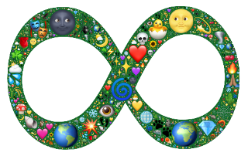
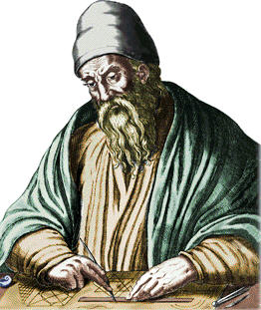
Infinitely many primes
Definition: A natural number is prime iff it is divisible only by 1 and itself. That is, $n$ is prime iff
$$∀z∈ℕ (\left(∃w∈ℕ n=zw\right)→\left(z=1∨z=n \right))$$
Theorem: There are infinitely many primes.
$$∀x∈ℕ Prime\left(x\right)→∃y∈ℕy>x∧Prime(y)$$
Proven by Euclid ~300BC
$Prime(x)$is a shorthand for $∀z∈ℕ\left(∃w∈ℕ x=zw\right)→z=1∨z=x$
To say “infinitely many” we write that no matter what element of the domain we take, there is a larger one that has the property we are interested in (in this case, a prime).

Slide 10
Theorem: There are infinitely many primes.
$$∀x∈ℕ Prime\left(x\right)→∃y∈ℕ y>x∧Prime(y)$$
Proof (by contradiction):
Assume, for the sake of contradiction, that the statement of the theorem is false:
So $∃x∈ℕ Prime\left(x\right)∧(∀y∈ℕy≤x∨¬Prime(y)$)
Call this number $n$ (universal instantiation of $∀x)$
Now consider the number $N=(2⋅3⋅…⋅n)+1$
There are 2 cases.
Either $N$ is a prime, in which case we are done since we found a prime larger than $n,$ contradicting our assumption.
or $N$is not prime.

Slide 11
Theorem: There are infinitely many primes.
$$∀x∈ℕ Prime\left(x\right)→∃y∈ℕ y>x∧Prime(y)$$
Well-ordering principle: Any non-empty subset of natural numbers contains the least element (with respect to $x≤y$)
Proof (continued):
Consider the number $N=(2⋅3⋅…⋅n)+1$
Case 2: suppose $N$is not prime, that is, for some $k,q∈ℕ$, $N=kq$, where $k≠1$and $k≠N$.
By the well-ordering principle, there is a smallest such $k.$
Let us use $k_{0}$ to refer to this smallest $k$.
S$ince N≡1 mod d$ for all $d≤n$, $k_{0}$ is not divisible by any $d≤n$, and $k_{0}>n$
S$o since k_{0}$ is the smallest factor of $N$, $k_{0}$ itself must be prime.
Therefore, there exists a prime number $y>n$ by existential generalization.

Slide 12
Theorem: There are infinitely many primes.
$$∀x∈ℕ Prime\left(x\right)→∃y∈ℕ y>x∧Prime(y)$$
Proof (continued):
We showed that both cases of $N$ being prime and not being prime give us $∃y∈ℕ y>n∧Prime(y)$
In the first case, N itself was an instantiation of $∃y$, and in the second case, it was the smallest divisor of N.
There are no more cases, so we showed that $∃y∈ℕ y>n∧Prime(y)$, contradicting the assumption for an arbitrary (prime) $n$
We showed that, for arbitrary $n$, $Prime\left(n\right)→∃y∈ℕ y>n∧Prime(y)$
By universal generalization,
$∀x∈ℕ Prime\left(x\right)→∃y∈ℕ y>x∧Prime(y)$
$□$ (Done).

Slide 14
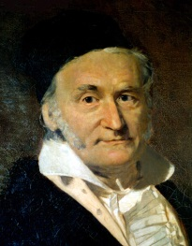
Puzzle: sum of numbers
What is the sum of the first 100 numbers?
That is, calculate
1+2+3+4+5+… +98+99+100.

Slide 15
Sums
Sum notation (“sum from 1 to n”): $\sum_{i=1 }^{n}{i}=1+2+ …+n$
Symbol $Σ$ is the capital Greek letter sigma.
If $n=3, \sum_{i=1 }^{3}{i} = 1+2+3=6.$
The name “$i“$ does not matter (usually $i,$ $j$ or $k)$:
$\sum_{i=1 }^{n}{i}=1+2+ …+n=\sum_{j=1 }^{n}{j}$
Can start with any integer $m$, not just 1: $\sum_{i=4 }^{n}{i}=4+5+ …+n$
$\sum_{i=n }^{n}{i}=n$ . If $n<m, \sum_{i=m }^{n}{i}=0.$
Can put a function of $i$ into the sum: $Σ_{i=1}^{n} i^{2}=1^{2}+2^{2}+…+n^{2}$
This function has to return a number, but not necessarily an integer:
$\sum_{i=2}^{4}{\frac{1}{i}=\frac{1}{2}+\frac{1}{3}+\frac{1}{4}=\frac{6+4+3}{12}=\frac{13}{12}}$

Slide 16
Products and factorial
Can use a similar shorthand for product of lots of values:
$Π_{i=1}^{n} i=1⋅2⋅3⋅…⋅n$
Symbol $Π$ is Greek letter capital pi
Factorial: another notation for $1⋅2⋅… ⋅n=Π_{i=1}^{n} i=n!$
“$n!"$ is pronounced “$n$ factorial”
As for sums, can start from an arbitrary integer $m,$ and have a function of $i$ in the product: $Π_{i=m}^{n} f\left(i\right)=f\left(m\right)⋅f\left(m+1\right)⋅…⋅f\left(n\right)$
For $f\left(i\right)=1/i$, $m=2, n=4, Π_{i=2}^{4} 1/i$ $=1/2⋅1/3⋅1/4 =24$
And can use another variable name.

Slide 17
Properties of sums and products
Let $f$ and $g$ be any functions with integer inputs, $r$ any number, $n,m$integers.
Can take the first or last element out of the sum by increasing m (first element) or decreasing n (last element)
$\sum_{i=m }^{n}{f\left(i\right)}$ =$f\left(m\right)+$ $\sum_{i=m+1 }^{n}{f\left(i\right)}$ = ($\sum_{i=m }^{n−1}{f\left(i\right)}$) + $f(n)$
W$hen n<m, \sum_{i=m }^{n}{f(i)}=0, and Π_{i=m}^{n} f(i)=1$
Can add two sums with the same n, m, and multiply products
$(\sum_{i=m }^{n}{f\left(i\right))}+$ $(\sum_{i=m }^{n}{g\left(i\right))}=\sum_{i=m }^{n}{(f\left(i\right)+g(i))}$
Can factor out a common factor in a sum (but not in a product)
$\sum_{i=m }^{n}{r⋅f\left(i\right)=r⋅\sum_{i=m }^{n}{f(i)}}$
Can have multiple nested sums (and products)
$\sum_{i=m_{1} }^{n_{1}}{} \sum_{j=m_{2} }^{n_{2}}{f\left(i,j\right)},$
$\sum_{i=2 }^{ 4 }{Σ_{j=10}^{11 }} i⋅j=2⋅10+2⋅11+3⋅10+3⋅11+4⋅10+4⋅11$=189

Slide 19
Puzzle: sum of numbers
What is the sum of the first 100 numbers?
That is, calculate
1+2+3+4+5+… +98+99+100.

Slide 20
Gauss’ sum of first 100 numbers
1 + 2 + … + 99 + 100
+ 100 + 99 + … + 2 + 1 =
= 101 + 101 + … + 101 + 101 = 100*101
So 1+2+ … + 99 + 100 =$\frac{100∗101}{2}$=5050
Does this work for any n, or just n=100?

Slide 21
Claim: for any n$∈ℕ$, 0+1+…+(n-1)+n=$\sum_{i=0 }^{n}{i}=\frac{n\left(n+1\right)}{2}$
Suppose not. Let S be a set of all numbers n’ such that $\sum_{i=0 }^{n^{′}}{i}≠\frac{n^{′}\left(n^{′}+1\right)}{2}$.
By the well-ordering principle, if $S≠∅$, there is the least number $k$ in S.
We will show that such k cannot exist.
By proof by cases:
$k$ is either 0, or $>0$
Case 1: k = 0
Case 2: k $>0$
Contradiction. So S is empty, thus the formula works for all $n∈ℕ.$

Slide 22
Claim: for any n$∈ℕ$, 0+1+…+(n-1)+n=$\sum_{i=0 }^{n}{i}=\frac{n\left(n+1\right)}{2}$
Suppose not. Let S be a set of all numbers n’ such that $\sum_{i=0 }^{n^{′}}{i}≠\frac{n^{′}\left(n^{′}+1\right)}{2}$.
By the well-ordering principle, if $S≠∅$, there is the least number $k$ in S.
Case 1: k=0.
But $\sum_{i=0 }^{0}{i}=0=\frac{0\left(0+1\right)}{2}$.
So formula works for k=0.
Case 2: k>0.
Contradiction. So S is empty, thus the formula works for all $n∈ℕ.$

Slide 23
Claim: for any n$∈ℕ$, 0+1+…+(n-1)+n=$\sum_{i=0 }^{n}{i}=\frac{n\left(n+1\right)}{2}$
Suppose not. Let S be a set of all numbers n’ such that $\sum_{i=0 }^{n^{′}}{i}≠\frac{n^{′}\left(n^{′}+1\right)}{2}$.
By the well-ordering principle, if $S≠∅$, there is the least number $k$ in S.
Case 1: k=0. But $\sum_{i=0 }^{0}{i}=0=\frac{0\left(0+1\right)}{2}$. So formula works for k=0.
Case 2: k>0. Then $k−1≥0.$
So $\sum_{i=0 }^{k}{i}=(\sum_{i=0 }^{k−1}{i}$) +k by definition of a sum.
As k is the smallest “bad” number, the formula works for k-1. So $\sum_{i=0 }^{k−1}{i }=\frac{\left(k−1\right)k}{2}$.
Now, $\sum_{i=0 }^{k}{i}=(\sum_{i=0 }^{k−1}{i}$) +k = $\frac{\left(k−1\right)k}{2}+k=\frac{k^{2}−k+2k}{2}=\frac{k^{2}+k}{2}=\frac{k(k+1)}{2}$
So the formula works for k>0, too.
Contradiction. So S is empty, thus the formula works for all $n∈ℕ.$

Slide 24
Structure of a proof by well-ordering principle
Want to prove: for some predicate $P$
Proof by contradiction.
Suppose that $∀x∈ℕ, P(x)$ is false.
Take a set $S=\left\{x∈ℕ \right| ¬P(x)\}$
By the well-ordering principle, there is the smallest element $k∈S$
Prove that such $k$ cannot exist, using the fact that it is smallest in S
This is where most the work is!
Often proof by cases: $k=0$ or $k>0$
Conclude that $S$ is empty, and, therefore, $∀x∈ℕ, P(x)$ is true.
Claim: $∀x∈ℕ, P(x)$
$□$ (Done).

Slide 26
Structure of a proof by well-ordering principle
Want to prove: for some predicate $P$
Proof by contradiction.
Suppose that $∀x∈ℕ, P(x)$ is false.
Take a set $S=\left\{x∈ℕ \right| ¬P(x)\}$
By the well-ordering principle, there is the smallest element $k∈S$
Prove that such $k$ cannot exist, using the fact that it is smallest in S
This is where most the work is!
Often proof by cases: $k=0$ or $k>0$
Conclude that $S$ is empty, and, therefore, $∀x∈ℕ, P(x)$ is true.
Claim: $∀x∈ℕ, P(x)$
$□$ (Done).

Slide 27
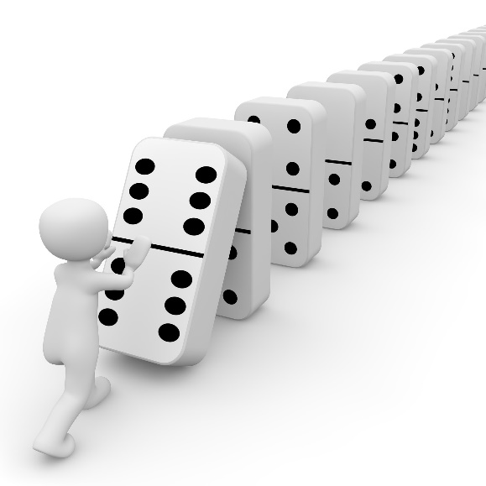
Mathematical induction
Want to prove a statement $∀x∈ℕ P\left(x\right).$
Check that $P\left(0\right)$ holds
And whenever $P\left(k\right)$ does not hold for some k, $P\left(k−1\right)$ does not hold either
Contradicting well-ordering principle.
Contrapositive:
if P(k-1) holds for arbitrary k,
then P(k) also must be true.
Conclude that $∀x∈ℕ P\left(x\right)$

Slide 28
Mathematical induction
Want to prove a statement $∀x∈ℕ P\left(x\right).$
Check that $P\left(0\right)$ holds
And whenever $P\left(k\right)$ does not hold for some k, $P\left(k−1\right)$ does not hold either
Contradicting well-ordering principle.
Contrapositive:
if P(k-1) holds for arbitrary k,
then P(k) also must be true.
Conclude that $∀x∈ℕ P\left(x\right)$
Proving that P(0) holds
is called the base case.
That P(k-1) holds is an induction hypothesis
Proving that P(k-1) $→$P(k)
Is the induction step
Mathematical Induction principle:
If $P\left(0\right)∧∀ k∈ℕ$ P(k) $→$P(k+1) then $∀x∈ℕ P(x)$

Slide 29
Claim: for any n$∈ℕ P(n)$
Proof (by induction).
Predicate $P(n)$is
Base case: $n=0.$ Then …. $P\left(0\right)$ is true.
Induction hypothesis: Assume that $P(…)$ for an arbitrary k >0
Induction step: show that P(k-1) implies P(k).
… calculations …
… by induction hypothesis..
… calculations …
By induction, therefore, P(n) holds for all $n∈ℕ.$
$□$ (Done).

Slide 30
Claim: for any n$∈ℕ$, 0+1+…+(n-1)+n=$\sum_{i=0 }^{n}{i}=\frac{n\left(n+1\right)}{2}$
Proof (by induction).
Predicate $P(n)$is
Base case: n=0. Then
Induction hypothesis: Assume that $\text{for} \text{an} \text{arbitrary} \text{k}\text{ >0}$
That is, for an arbitrary number n=k-1 $∈ℕ$
Can take k instead of k-1, but k-1 makes calculations simpler.
Induction step: show that P(k-1) implies P(k).
… calculations …
… by induction hypothesis..
… calculations …
By induction, therefore, P(n) holds for all $n∈ℕ.$
$$\sum_{i=0 }^{n}{i}=\frac{n\left(n+1\right)}{2}$$
$$\sum_{i=0 }^{0}{i}=0=\frac{0\left(0+1\right)}{2}$$
$$\sum_{i=0 }^{k−1}{i}=\frac{\left(k−1\right)k }{2}$$
$□$ (Done).

Slide 31
Claim: for any n$∈ℕ$, 0+1+…+(n-1)+n=$\sum_{i=0 }^{n}{i}=\frac{n\left(n+1\right)}{2}$
Proof (by induction).
Predicate $P(n)$is $\sum_{i=0 }^{n}{i}=\frac{n\left(n+1\right)}{2}$
Base case: n=0. Then $\sum_{i=0 }^{0}{i}=0=\frac{0\left(0+1\right)}{2}$.
Induction hypothesis: Assume that $\sum_{i=0 }^{k−1}{i}=\frac{\left(k−1\right)k }{2}$ for an arbitrary k >0
That is, for an arbitrary number n=k-1 $∈ℕ$
Can take k instead of k-1, but k-1 makes calculations simpler.
Induction step: show that P(k-1) implies P(k).
$\sum_{i=0 }^{k}{i}=(\sum_{i=0 }^{k−1}{i}$) +k.
By induction hypothesis, $\sum_{i=0 }^{k−1}{i }=\frac{\left(k−1\right)k}{2}$
Now, $\sum_{i=0 }^{k}{i}=(\sum_{i=0 }^{k−1}{i}$) +k = $\frac{\left(k−1\right)k}{2}+k=\frac{k^{2}−k+2k}{2}=\frac{k^{2}+k}{2}=\frac{k(k+1)}{2}$
By induction, therefore, P(n) holds for all $n∈ℕ.$
$□$ (Done).

Slide 32
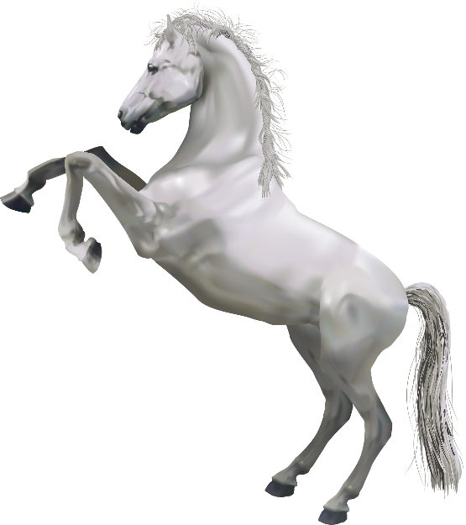
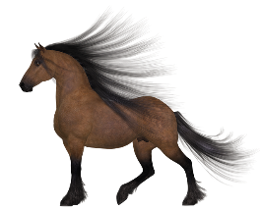
“Claim”: all horses are white.
“Proof” (by induction):
P(n): any n horses are white.
Base case: P(0) holds vacuously
Induction hypothesis: any k horses are white.
Induction step: if any k horses are white, then any k+1 horses are white.
Take an arbitrary set of k+1 horses. Take a horse out.
The remaining k horses are white by induction hypothesis.
Now put that horse back in, and take out another horse.
Remaining k horses are again white by induction hypothesis.
Therefore, all the k+1 horses in that set are white.
By induction, all horses are white.
Puzzle: What is wrong with this proof?

Slide 34
“Claim”: all horses are white.
“Proof” (by induction):
P(n): any n horses are white.
Base case: P(0) holds vacuously
Induction hypothesis: any k horses are white.
Induction step: if any k horses are white, then any k+1 horses are white.
Take an arbitrary set of k+1 horses. Take a horse out.
The remaining k horses are white by induction hypothesis.
Now put that horse back in, and take out another horse.
Remaining k horses are again white by induction hypothesis.
Therefore, all the k+1 horses in that set are white.
By induction, all horses are white.
Puzzle: What is wrong with this proof?

Slide 35
Mathematical Induction principle:
If $P\left(0\right)∧∀ k∈ℕ$ P(k) $→$P(k+1) then $∀x∈ℕ P(x)$
What if want to prove it only for $x≥a?$
Make $a$ the base case (when $a≥0)$. For the rest, assume $k≥a$.
Here, $∀x≥a P\left(x\right)$is a shorthand for $∀x∈ℕ \left(x≥a→P\left(x\right)\right)$
To prove it works, prove $P(n’)$where $n’=n−a$.
In general, let $S$be a countable set, and $f:ℕ→S$a bijection.
Then the following is equivalent to the induction principle:
$(P\left(a\right)∧∀ k≥a$ P(k) $→$P(k+1)) $→∀x≥a P(x)$
$P\left(f(0)\right)∧∀ k≥0$ $P(f\left(k\right)) → P(f\left(k+1\right))) → ∀x∈S P(x)$

Slide 36
Claim: for all $n≥4, 2^{n}≥n^{2}$
Proof (by induction with basis $a=4$):
Predicate $P\left(n\right): 2^{n}≥n^{2}$
Base case: n=4. $2^{4}=16=4^{2}$
Induction hypothesis: assume that for an arbitrary $k≥4,$ $2^{k}≥k^{2}$
Induction step: show that $2^{k}≥k^{2}$ implies $2^{k+1}≥{(k+1)}^{2}$
$2^{k+1}={2⋅2}^{k}=2^{k}+2^{k}≥k^{2}+k^{2}$ (last $≥$ by induction hypothesis).
Want: $k^{2}+k^{2}≥{\left(k+1\right)}^{2}.$ Since ${\left(k+1\right)}^{2}=k^{2}+2k+1$, need to show $k^{2}≥2k+1$
Dividing both sides of the last inequality by $k$: show that $k≥2+\frac{1}{k}$
Since k $≥4$, and $2+\frac{1}{k}≤3, 2+\frac{1}{k}≤3<4≤k$.
So $k≥2+\frac{1}{k}$and thus $k^{2}≥2k+1$
So $2^{k+1}={2⋅2}^{k}=2^{k}+2^{k}≥k^{2}+k^{2}≥k^{2}+2k+1={\left(k+1\right)}^{2}$
By induction, for all $n≥4, 2^{n}≥n^{2}$
Corollary: as input size $n$grows, an algorithm running in time $n^{2}$ will quickly start outperforming an algorithm running in time $2^{n}$

Slide 37
Claim: $∀x∈ℕ,$if x >7 then $∃ y,z∈ℕ$ such that $x = 3y+5z.$
So any amount >7 can be paid with 3s and 5s
Proof (by induction):
Predicate $P\left(n\right): ∃y,z∈ℕ$ $n=3y+5z$
Base case: $n=8.$
$P\left(8\right)$ holds with $y=1, z=1,$ since $8=3⋅1+5⋅1$
Induction hypothesis: assume that $P\left(k\right)$ holds for an arbitrary $k∈ℕ$, where k>7.
That is, $∃y, z∈ℕ$ such that $k=3y+5z$
Induction step: show that $P(k+1)$ holds
That is, show that $∃y^{′}, z^{′}∈ℕ such that k+1=3y^{′}+5z′$
Construct $y^{′}, z^{′}$from $y,z$
If $z >0, then y^{′}=y+2, z^{′}=z−1$.
$k+1=k−5+6$
If $z=0,$then $y^{′}=y−3, z’=2$
$k+1=k−9+10$
Therefore, for every $x∈ℕ$, if x >7 then $x=3y+5z$for some $y,z∈ℕ$.

Slide 39
Strong induction
In our well-ordering proof that every amount $>7$ can be paid with 3s and 5s we needed to consider k-3, and to look at three cases.
n=8, n=9, n=10.
Mathematical Induction principle:
$(P\left(0\right)∧∀ k∈ℕ$ P(k) $→$P(k+1)) $→∀x∈ℕ P(x)$
If first domino falls, and each domino falls on next, all dominos fall.
Strong Induction principle:
$\left(∃b∈ℕ ∀c∈ℕ \left(0≤c∧c≤b→ P\left(c\right)\right)\right)$
$∧∀ k>b \text{(}∀ i ∈\{0, …, k−1\} \text{P}\text{(}\text{i}\text{)) }→ \text{P}\text{(}\text{k}\text{)}$)
$→∀x∈ℕ P(x)$
If first few dominos fall, and if all preceding dominos go down then the next one falls too, then all dominos fall.

Slide 40
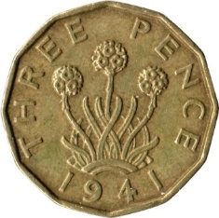
Claim: $∀x∈ℕ,$if x >7 then $∃ y,z∈ℕ$ such that $x = 3y+5z.$
So any amount >7 can be paid with 3s and 5s
Proof (by strong induction):
Predicate $P\left(n\right): ∃y,z∈ℕ$ $n=3y+5z$
Base cases: $a=8$, $b = 10$, so $c∈\left\{8,9,10\right\}$
n=8. $8=3⋅1+5⋅1,$ so y=1, z=1.
n=9. 9=3$⋅3$, y=3, z=0
n=10. 10=$5⋅2.$ y=0, z=2.
Induction hypothesis: Let k be an arbitrary natural number with $k>10.$ Assume that $∀i∈ℕ s$uch that $8≤i <k, ∃ y_{i}, z_{i}∈ℕ i=3y_{i}+5z_{i}$
Induction step: show that $P(k)$ holds
Strong Induction:
$(∃b∈ℕ ∀c∈ℕ \left(a≤c∧c≤b→ P\left(c\right)\right)$
$∧∀ k>b$($∀ i ∈\{a, …, k−1\}$ P(i)) $→$P(k))
$→∀x∈ℕ \left(x≥a→ P\left(x\right)\right)$

Slide 41
Claim: $∀x∈ℕ,$if x >7 then $∃ y,z∈ℕ$ such that $x = 3y+5z.$
So any amount >7 can be paid with 3s and 5s
Proof (by strong induction):
Predicate $P\left(n\right): ∃y,z∈ℕ$ $n=3y+5z$
Base cases: $P(8), P(9), P(10)$hold.
Induction hypothesis: Let k be an arbitrary natural number such that $k>10.$ Assume that $∀i∈ℕ s$uch that $8≤i <k, ∃ y_{i}, z_{i}∈ℕ i=3y_{i}+5z_{i}$
Induction step: show that $P(k)$ holds
Since $k≥b, k−3≥a.$
So by induction hypothesis $∃ y_{k−3}, z_{k−3}∈ℕ k−3=3y_{k−3}+5z_{k−3}.$
Now take $z=z_{k−3}$and $y = y_{k−3}+1$. Then $k = 3y+5z.$
Therefore, for every $x∈ℕ$, if $x >7$ then $x=3y+5z$for some $y,z∈ℕ$.
By strong induction, get that for all x > 7, $∃ y,z∈ℕ$ such that x = 3y+5z.
Strong Induction:
$(∃b∈ℕ ∀c∈ℕ \left(a≤c∧c≤b→ P\left(c\right)\right)$
$∧∀ k>b$($∀ i ∈\{a, …, k−1\}$ P(i)) $→$P(k))
$→∀x∈ℕ \left(x≥a→ P\left(x\right)\right)$
$□$ (Done).

Slide 43
Theorem (fundamental theorem of arithmetic):
Every natural number >1 can be uniquely written as a product of primes.
Here, assume primes are written in a specific order: say from smallest to largest.
For example, $12=2⋅2⋅3,$ $17=17$, $30=2⋅3⋅5$
We do not consider $12=2⋅3⋅2,$ because it is not in the right order.
Also do not consider $12=3⋅4,$since 4 is not a prime.
This theorem consists of two statements, which have to be proven separately.
Existence: every $n>1$ can be written as a product of primes.
We will prove this using strong induction.
Uniqueness: for every $n>1,$there cannot be two different products of primes that are both equal to $n.$
We will omit this proof here, as we need a bit more number theory to do it properly.
You can read it in textbook, chapter 4.3.

Slide 44
Theorem:$∀n∈ℕ,$ if $n>1$ then $n$ can be written as a product of primes.
Proof (by strong induction):
Predicate $P\left(n\right): ∃m∈ℕ,∃ primes p_{1}…p_{m}$ such that $n=p_{1}⋅…⋅p_{m}$
Base case: $a=b =2$
$2$ is prime, so $P(2)$holds with $m=1, p_{1}=2$
Induction hypothesis: Let k be an arbitrary natural number with $k>2.$ Assume that $∀i∈ℕ where$ $2≤i <k ∃m_{i},$ $∃$primes $p_{1,i}…p_{m_{i},i}$, such that $i=$ $p_{1,i}⋅…⋅p_{m_{i},i}$
Induction step: show that $P(k)$ holds
That is, find $m^{′},$primes $q_{1}…q_{m′}$ such that $k=q_{1}⋅…{⋅q}_{m′}$
We will prove the induction step by cases:
$k$ is prime
Easy case: $m^{′}=1, q_{1}=k.$
$k$ is not prime.
Strong Induction:
$(∃b∈ℕ ∀c∈ℕ \left(a≤c∧c≤b→ P\left(c\right)\right)$
$∧∀ k>b$($∀ i ∈\{a, …, k−1\}$ P(i)) $→$P(k))
$→∀x∈ℕ \left(x≥a→ P\left(x\right)\right)$

Slide 45
Theorem:$∀n∈ℕ,$ if $n>1$ then $n$ can be written as a product of primes.
Proof (by strong induction):
Induction hypothesis: Let k be an arbitrary natural number $>2.$ Assume that $∀i∈ℕ where$ $2≤i <k ∃m_{i},$ $∃$primes $p_{1,i}…p_{m_{i},i}$, such that $i=$ $p_{1,i}⋅…⋅p_{m_{i},i}$
Induction step: show that $P(k)$ holds
Case 1: $k$ is prime (easy case: $m^{′}=1, q_{1}=k).$
Case 2: $k$ is not prime.
Then $k=a⋅b$ for some $a,b$such that $2≤a,b<k$
By induction hypothesis, there are $m_{a}, m_{b}∈ℕ,$primes $p_{1,a},…, p_{m_{a},a}, p_{1,b},…, p_{m_{b},b}$ such that $a=p_{1,a}⋅…⋅p_{m_{a},a}$, and $b=p_{1,b}⋅…⋅p_{m_{b},b}$
Now $k=$ $p_{1,a}⋅…⋅p_{m_{a},a}⋅p_{1,b}⋅…⋅p_{m_{b},b}$, so $P(k)$ holds with $m^{′}=m_{a}+m_{b}$
Rearrange $p_{1,a},…, p_{m_{a},a}, p_{1,b},…, p_{m_{b},b}$ from smallest to largest to get $q_{1}…q_{m′}$
This completes the proof of the induction step, as there are no more cases.
By strong induction, every $n>1$ can be written as a product of primes.

Slide 46
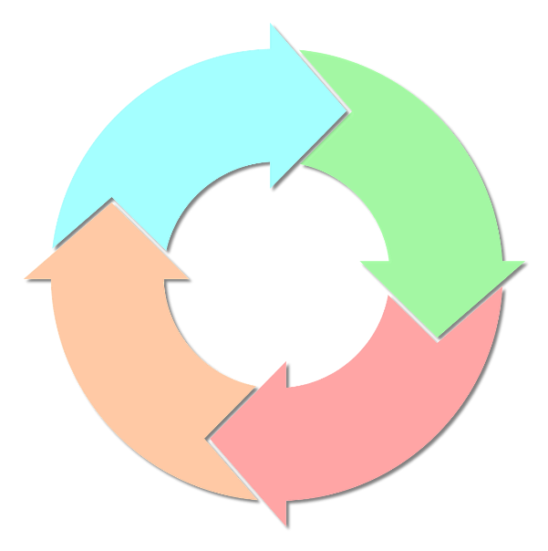
Equivalence of well-ordering, induction and strong induction
Strong induction seems stronger… but in fact, mathematical induction, strong induction and well-ordering principles are equivalent to each other.
So choose the most convenient one.
Can prove induction from well-ordering principle
Look at the smallest k such that $P(k)$ does not hold
Can prove strong induction statement by normal induction.
Prove $P^{′}\left(n\right)=∀i<n P(n)$ by induction.
Can prove well-ordering principle from strong induction.

Slide 47
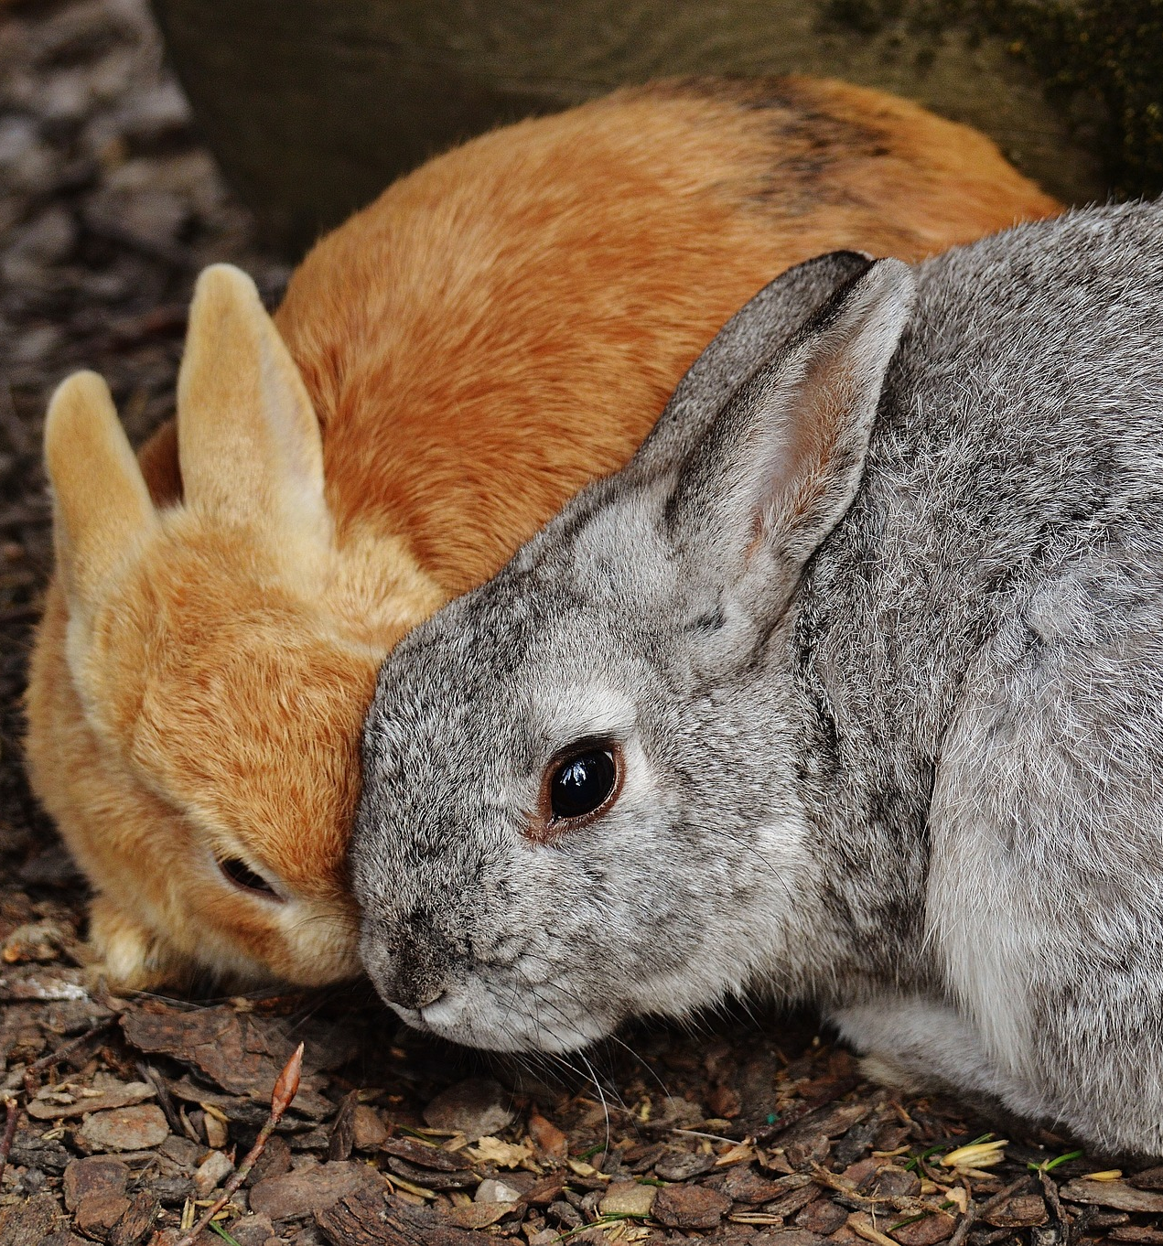
Puzzle: rabbits on an island
A ship leaves a pair of rabbits on an island (with a lot of food).
After a pair of rabbits reaches 2 months of age, they produce another pair of rabbits, and keep producing a pair every month thereafter.
Which in turn start reproducing every month when reaching 2 months of age…
So every pair starts reproducing at 2 months, and creates a new pair every month from then on.
How many pairs of rabbits will be on the island in $n$ months, assuming no rabbits die?

