Slide 1

Unit 5
Basic structures: relations and strings

Slide 2
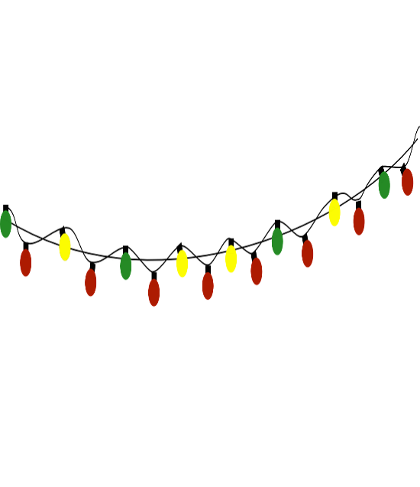

Sets and strings
How do we represent sets on a computer?
  We can list names of a set’s elements, but that would make operations with sets less efficient: even to check if an element is in a set, we’d need to scan through the whole list.
Instead, when the universe is finite (and reasonably small), we can represent a set by its characteristic string, stating whether each element of the universe is in the set or not.
  but first, let us recall and define what is a string.

Slide 3

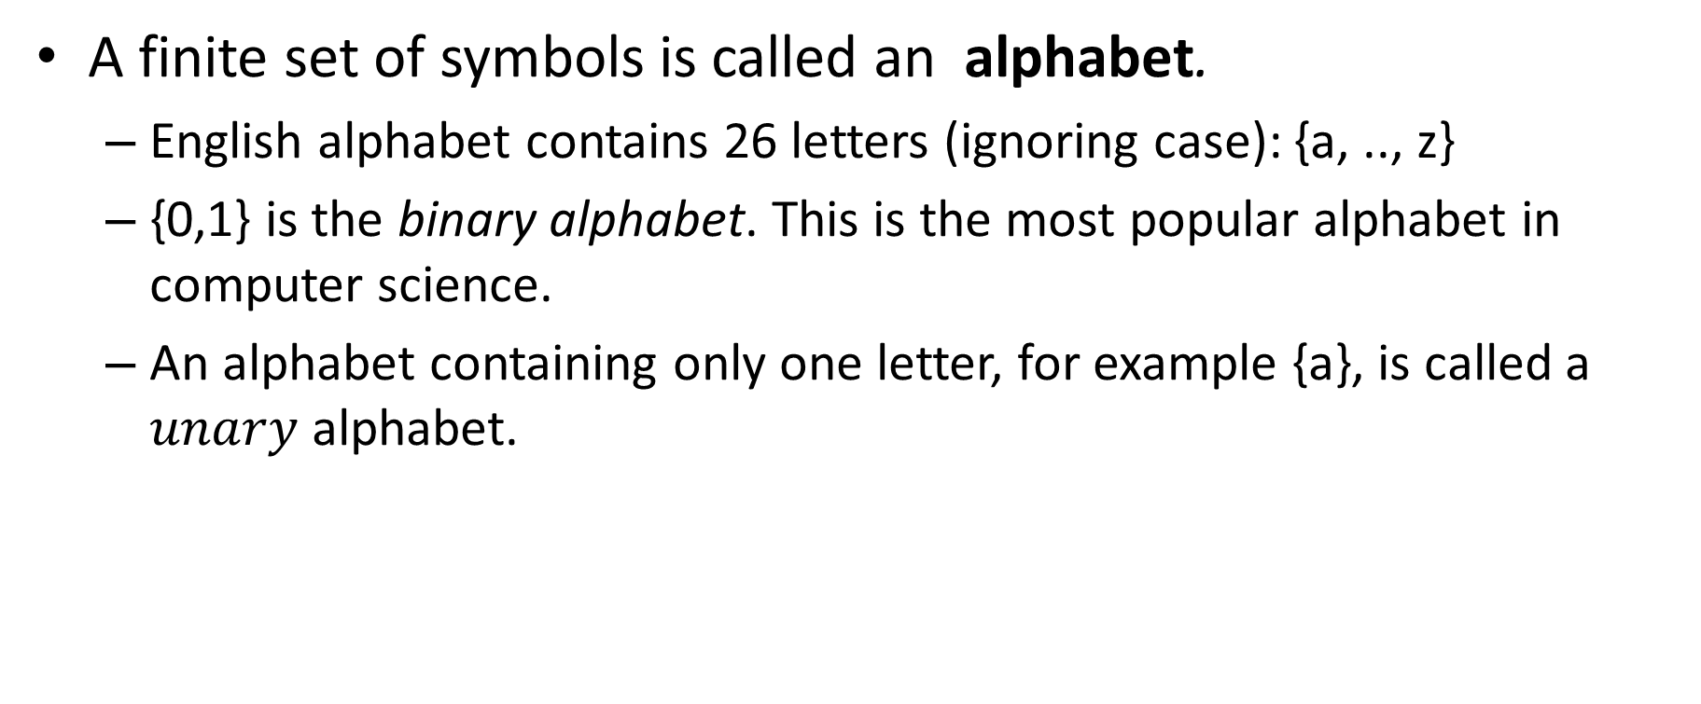
Alphabet
A finite set of symbols is called an alphabet.
  English alphabet contains 26 letters (ignoring case): {a, .., z}
  {0,1} is the binary alphabet. This is the most popular alphabet in computer science.
  An alphabet containing only one letter, for example {a}, is called a $unary$ alphabet.

Slide 4
Strings
A string (over an alphabet A) is a sequence (list) of symbols from A
  Usually with repetition; order matters.
    We will talk about 1st, 2nd, 3rd and so on symbol in a given string.
  “mun” is a string over English alphabet (lowercase). 2nd symbol in “mun” is “u”.
    English words are strings over English alphabet.
  “1002” is a string over the alphabet of digits {0,1,2}.
  A natural number is a string over the alphabet of digits {0,1,2,3,4,5,6,7,8,9}

Slide 5
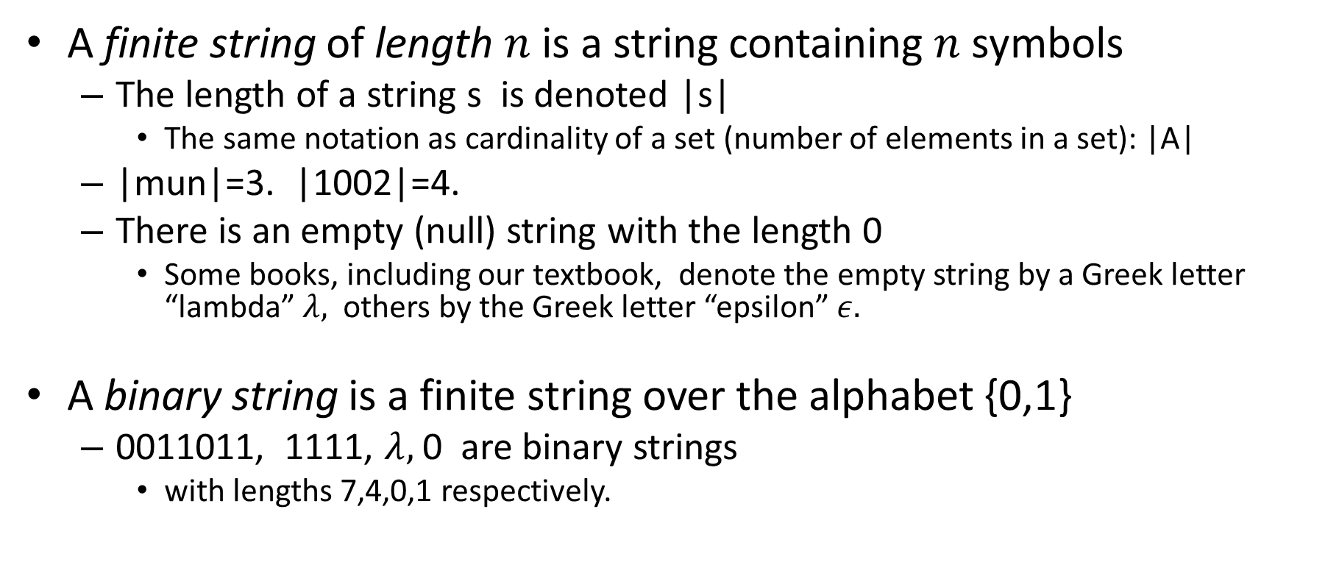
Finite strings, binary strings
A finite string of length $n$ is a string containing $n$ symbols
  The length of a string s is denoted |s|
    The same notation as cardinality of a set (number of elements in a set): |A|
  |mun|=3. |1002|=4.
  There is an empty (null) string with the length 0
    Some books, including our textbook, denote the empty string by a Greek letter “lambda” $λ,$ others by the Greek letter “epsilon” $ε.$
A binary string is a finite string over the alphabet {0,1}
  0011011, 1111, $λ,$ 0 are binary strings
    with lengths 7,4,0,1 respectively.

Slide 6
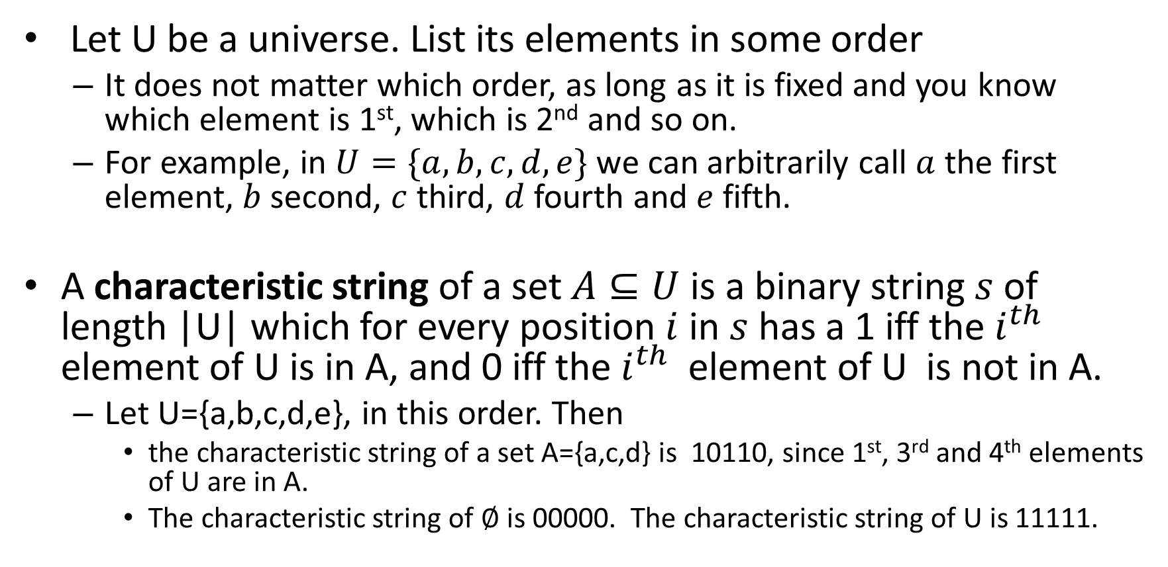
Characteristic string of a set
Let U be a universe. List its elements in some order
  It does not matter which order, as long as it is fixed and you know which element is 1st, which is 2nd and so on.
  For example, in $U=\{a,b,c,d,e\}$we can arbitrarily call $a$ the first element, $b$ second, $c$ third, $d$ fourth and $e$ fifth.
A characteristic string of a set $A⊆U$is a binary string $s$ of length |U| which for every position $i$ in $s$ has a 1 iff the $i^{th}$ element of U is in A, and 0 iff the $i^{th}$ element of U is not in A.
  Let U={a,b,c,d,e}, in this order. Then
    the characteristic string of a set A={a,c,d} is 10110, since 1st, 3rd and 4th elements of U are in A.
    The characteristic string of $∅$ is 00000. The characteristic string of U is 11111.

Slide 7


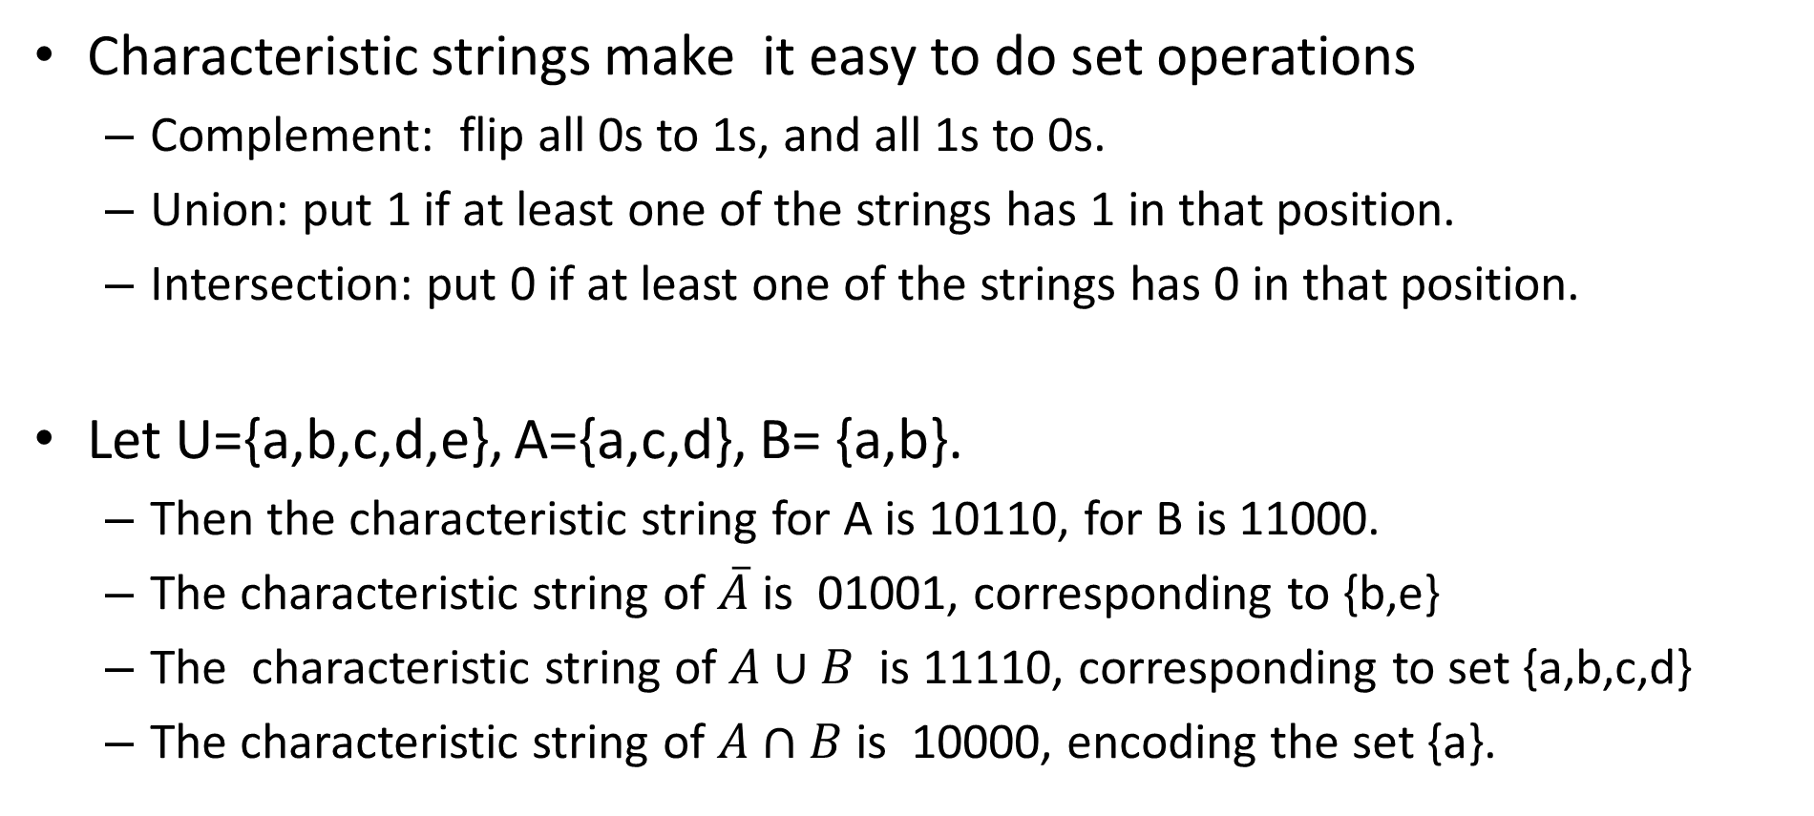
Set operations with characteristic strings
Characteristic strings make it easy to do set operations
  Complement: flip all 0s to 1s, and all 1s to 0s.
  Union: put 1 if at least one of the strings has 1 in that position.
  Intersection: put 0 if at least one of the strings has 0 in that position.
Let U={a,b,c,d,e}, A={a,c,d}, B= {a,b}.
  Then the characteristic string for A is 10110, for B is 11000.
  The characteristic string of $\overline{A}$ is 01001, corresponding to {b,e}
  The characteristic string of $A∪B$ is 11110, corresponding to set {a,b,c,d}
  The characteristic string of $A∩B$ is 10000, encoding the set {a}.
U
A
U
$$A∪B$$
U
$$A∩B$$

Slide 8

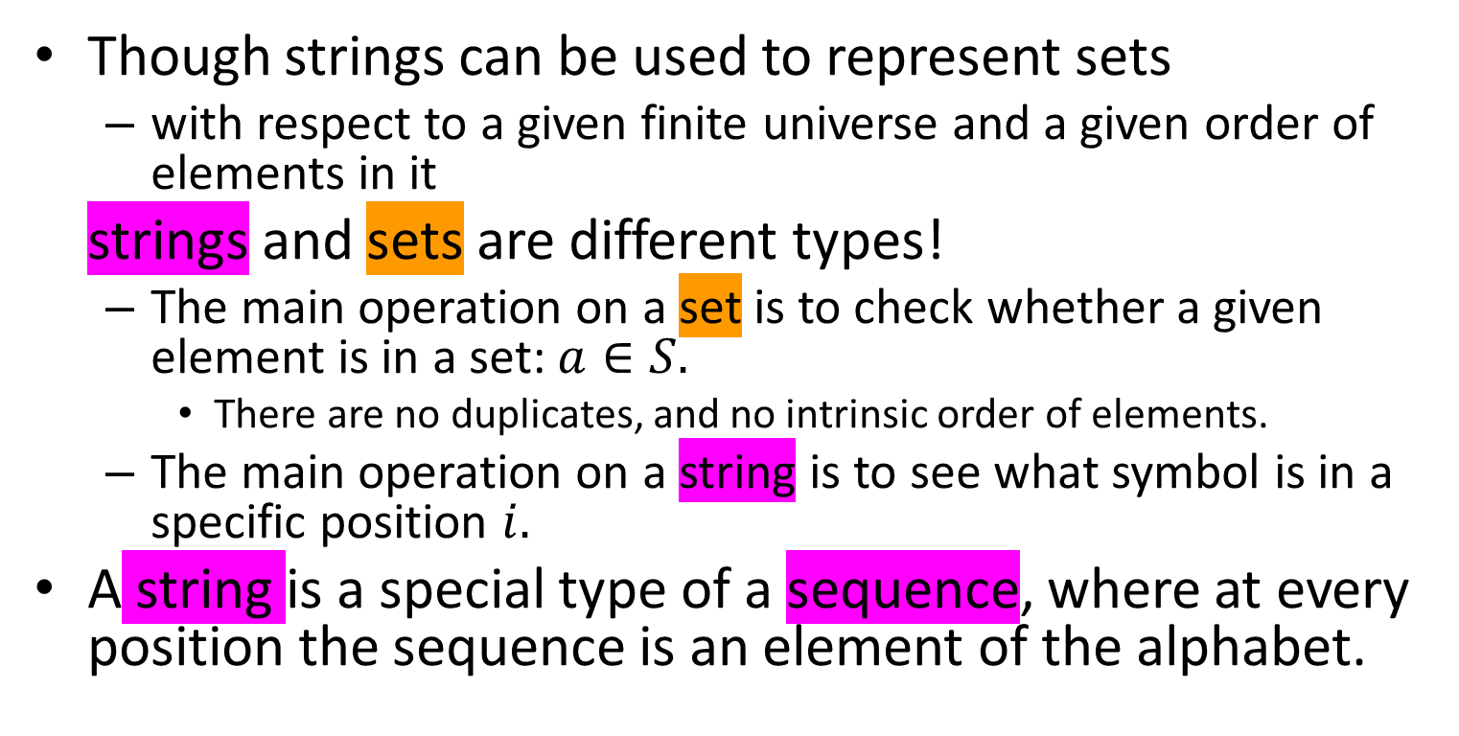
Sets and strings are different types!
Though strings can be used to represent sets
  with respect to a given finite universe and a given order of elements in it
strings and sets are different types!
  The main operation on a set is to check whether a given element is in a set: $a∈S.$
    There are no duplicates, and no intrinsic order of elements.
  The main operation on a string is to see what symbol is in a specific position $i.$
A string is a special type of a sequence, where at every position the sequence is an element of the alphabet.

Slide 10

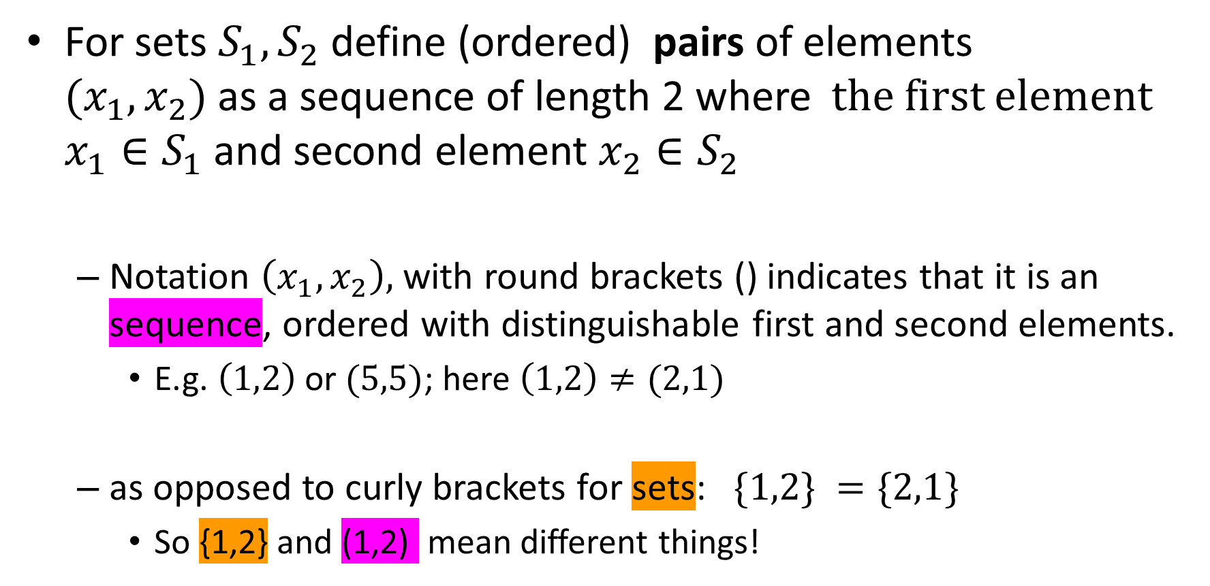
Pairs, triples, tuples
For sets $S_{1}, S_{2}$ define (ordered) pairs of elements ${(x}_{1},x_{2})$as a sequence of length 2 where the first element $x_{1}∈S_{1}$and second element $x_{2}∈S_{2}$
  Notation $\left(x_{1},x_{2}\right),$with round brackets () indicates that it is an sequence, ordered with distinguishable first and second elements.
    E.g. $\left(1,2\right)$or $(5,5)$; here $\left(1,2\right)≠(2,1)$
  as opposed to curly brackets for sets: $\{1,2\} =\{2,1\}$
    So {1,2} and (1,2) mean different things!

Slide 11
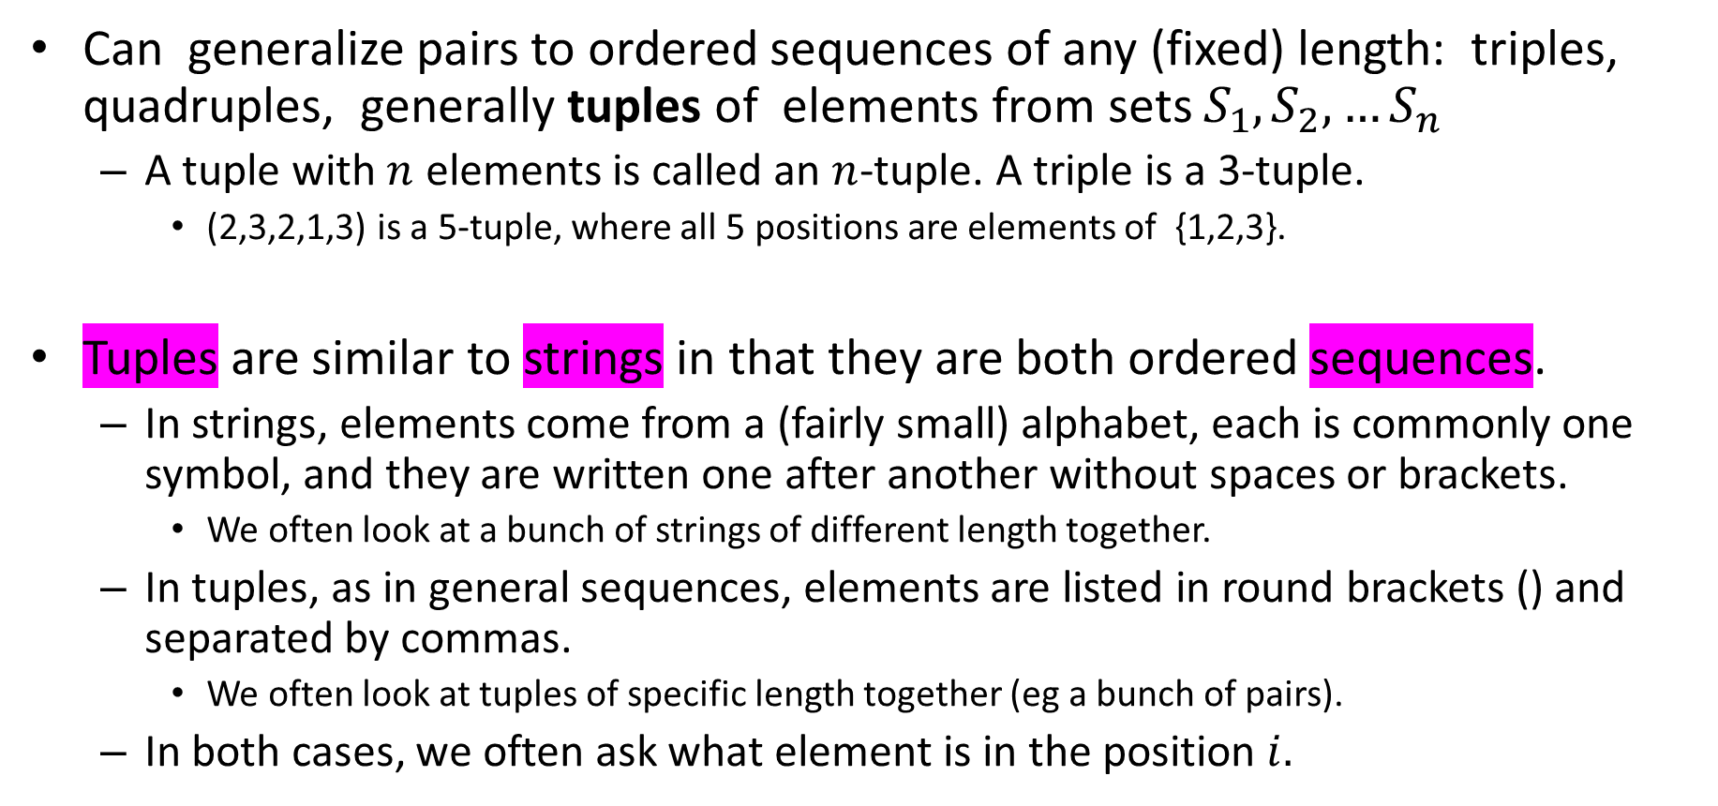
Pairs, triples, tuples
Can generalize pairs to ordered sequences of any (fixed) length: triples, quadruples, generally tuples of elements from sets $S_{1},S_{2},…S_{n}$
  A tuple with $n$ elements is called an $n$-tuple. A triple is a 3-tuple.
    (2,3,2,1,3) is a 5-tuple, where all 5 positions are elements of {1,2,3}.
Tuples are similar to strings in that they are both ordered sequences.
  In strings, elements come from a (fairly small) alphabet, each is commonly one symbol, and they are written one after another without spaces or brackets.
    We often look at a bunch of strings of different length together.
  In tuples, as in general sequences, elements are listed in round brackets () and separated by commas.
    We often look at tuples of specific length together (eg a bunch of pairs).
  In both cases, we often ask what element is in the position $i.$

Slide 12
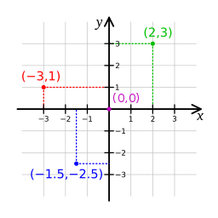
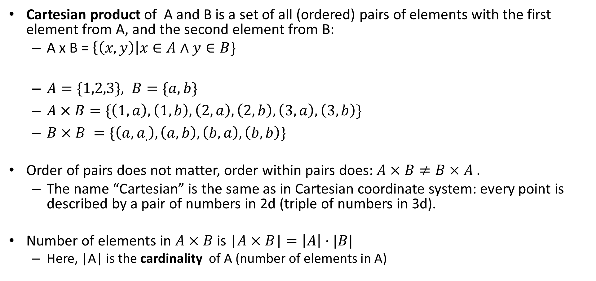
Cartesian products
Cartesian product of A and B is a set of all (ordered) pairs of elements with the first element from A, and the second element from B:
  A x B = $\left\{\left(x,y\right)\right|x∈A∧y∈B\}$
  $A=\{1,2,3\}, B=\{a,b\}$
  $A×B=\{\left(1,a\right), \left(1,b\right), \left(2,a\right), \left(2,b\right),\left(3,a\right),\left(3,b\right)\}$
  $B×B =\{\left({a,a}_{.}\right),\left(a,b\right), \left(b,a\right),\left(b,b\right)\}$
Order of pairs does not matter, order within pairs does: $A×B≠B×A .$
  The name “Cartesian” is the same as in Cartesian coordinate system: every point is described by a pair of numbers in 2d (triple of numbers in 3d).
Number of elements in $A×B$ is |$A×B$| $=\left|A\right|⋅|B|$
  Here, |A| is the cardinality of A (number of elements in A)
 | 1 | 2 | 3
a | (1,a) | (2,a) | (3,a)
b | (1,b) | (2,b) | (3,b)

Slide 13
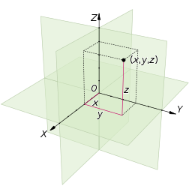
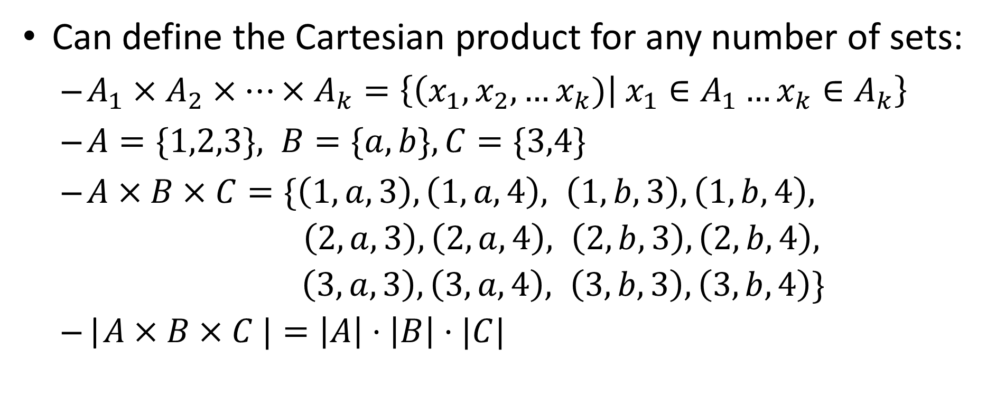
Cartesian products
Can define the Cartesian product for any number of sets:
  $A_{1}×A_{2}×…×A_{k}=\left\{\left(x_{1},x_{2},…x_{k})\right| x_{1}∈A_{1}…x_{k}∈A_{k}\right\}$
  $A=\{1,2,3\}, B=\{a,b\}, C=\{3,4\}$
  $A×B×C=\{\left(1,a,3\right), \left(1,a,4\right), \left(1,b,3\right),\left(1,b,4\right),$
  $\left(2,a,3\right), \left(2,a,4\right), \left(2,b,3\right),\left(2,b,4\right),$
  $\left(3,a,3\right), \left(3,a,4\right), \left(3,b,3\right),\left(3,b,4\right)\}$
  |$A×B×C |=\left|A\right|⋅\left|B\right|⋅|C|$

Slide 15

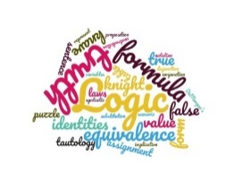
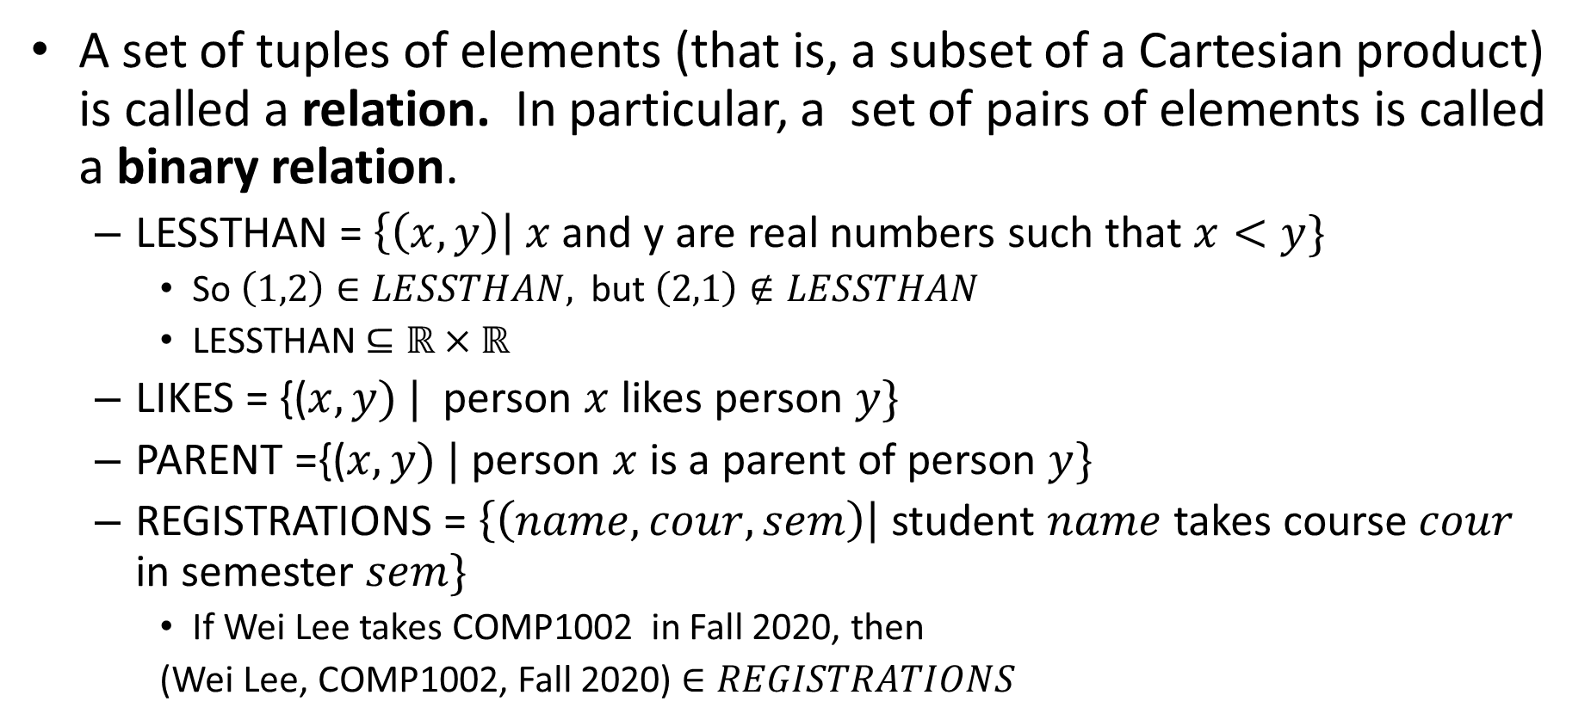
Relations
A set of tuples of elements (that is, a subset of a Cartesian product) is called a relation. In particular, a set of pairs of elements is called a binary relation.
  LESSTHAN = $\left\{\left(x,y\right)\right| x$ and y are real numbers such that $x<y\}$
    So $\left(1,2\right)∈LESSTHAN,$ but $\left(2,1\right)∉LESSTHAN$
    LESSTHAN $⊆ℝ×ℝ$
  LIKES = {($x, y) |$ person $x$likes person $y\}$
  PARENT ={($x,y) |$person $x$is a parent of person $y\}$
  REGISTRATIONS = $\left\{\left(name, cour,sem\right)\right|$ student $name$ takes course $cour$ in semester $sem\}$
    If Wei Lee takes COMP1002 in Fall 2020, then
    (Wei Lee, COMP1002, Fall 2020) $∈REGISTRATIONS$

Slide 16



Relational databases
PROFDATA = $\{(firstname, lastname, office)\}$=
COURSEDATA = $\{(course, days, time, room, instructor$)} =
In the language of databases, each tuple in a relation is called a record. Each position in the tuple called a field. And the relation itself is called a table.
Records are rows in the table, and fields are columns.
(Sharene, Bungay,ER-6032) is a record. “Office” is a field. PROFDATA is a table.
Usually, a database consists of several tables.

Slide 17
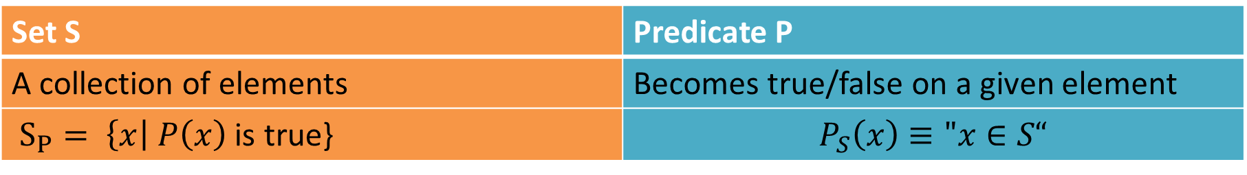

Predicates vs. sets
Predicates and sets are two sides of the same coin
  For each set S there is a predicate which is true exactly on elements of S
  For each predicate P there is a set S of values of $x$ on which P is true.
Set S | Predicate P
A collection of elements | Becomes true/false on a given element
$S_{P}= \left\{x\right| P\left(x\right)$ is true} | $$P_{S}\left(x\right)≡"x∈S“$$

Slide 18
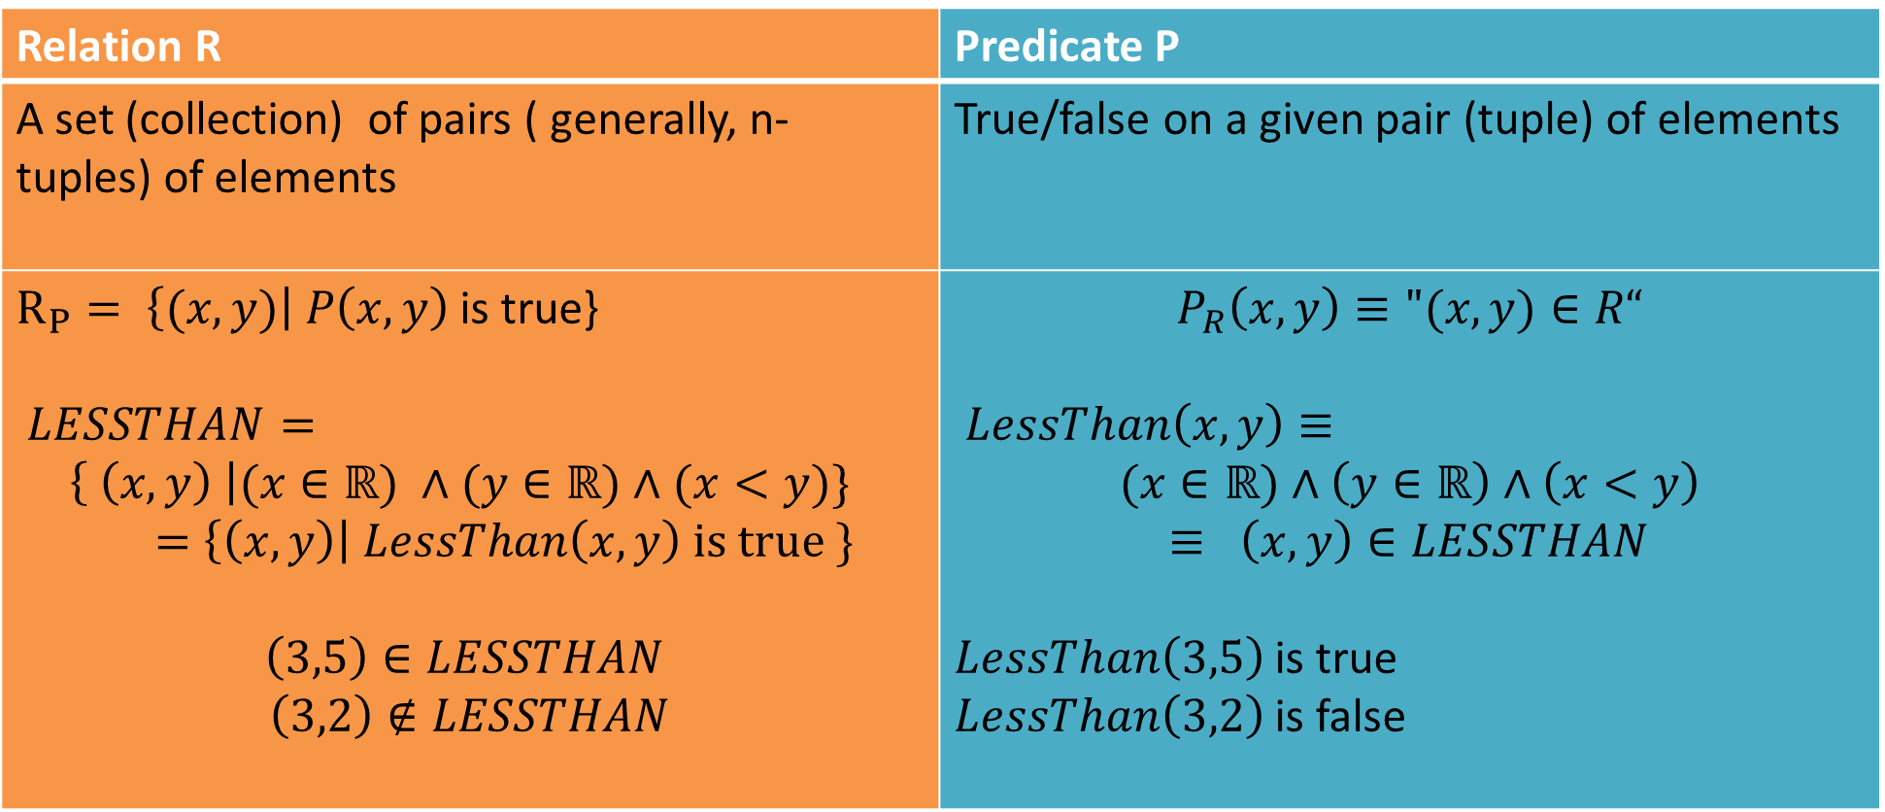
Predicates vs relations
Relation R | Predicate P
A set (collection) of pairs ( generally, n-tuples) of elements | True/false on a given pair (tuple) of elements
$R_{P}= \left\{(x,y)\right| P\left(x,y\right)$ is true} $LESSTHAN=$ $$\left\{ \left(x,y\right) \right|(x∈ℝ) ∧(y∈ℝ)∧(x<y)\}$$ $=\left\{\left(x,y\right)\right| LessThan\left(x,y\right) is true \}$ $$\left(3,5\right)∈LESSTHAN$$ $$\left(3,2\right)∉LESSTHAN$$ | $$P_{R}\left(x,y\right)≡"(x,y)∈R“$$ $LessThan\left(x,y\right)≡$ $$(x∈ℝ)∧\left(y∈ℝ\right)∧\left(x<y\right)$$ $$≡ \left(x,y\right)∈LESSTHAN$$ $LessThan\left(3,5\right)$ is true $LessThan\left(3,2\right)$ is false

Slide 20

Database queries
Predicate logic gives us a way to query relational databases!
  Using predicates for database relations.
    Then build a query as a formula.
  Input of the query:
    Can be nothing (if no free variables)
    Or specific values for its free variables.
  Output of the query:
    Either true/false
    Or a set of elements (values of its free variables) satisfying the query.

Slide 21

Database queries
PROFDATA = $\{(firstname, lastname, office)\}$=
COURSEDATA = $\{(course, days, time, room, instructor$)} =
How can we query such databases?

Slide 22

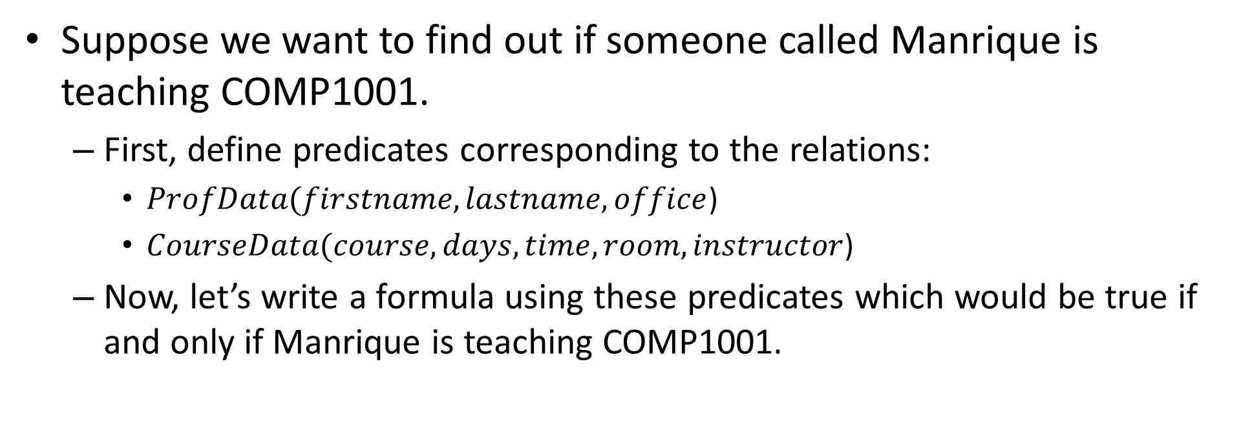
Querying databases
PROFDATA
COURSEDATA
Suppose we want to find out if someone called Manrique is teaching COMP1001.
  First, define predicates corresponding to the relations:
    $ProfData(firstname, lastname, office$)
    $CourseData(course, days, time, room, instructor$)
  Now, let’s write a formula using these predicates which would be true if and only if Manrique is teaching COMP1001.

Slide 23
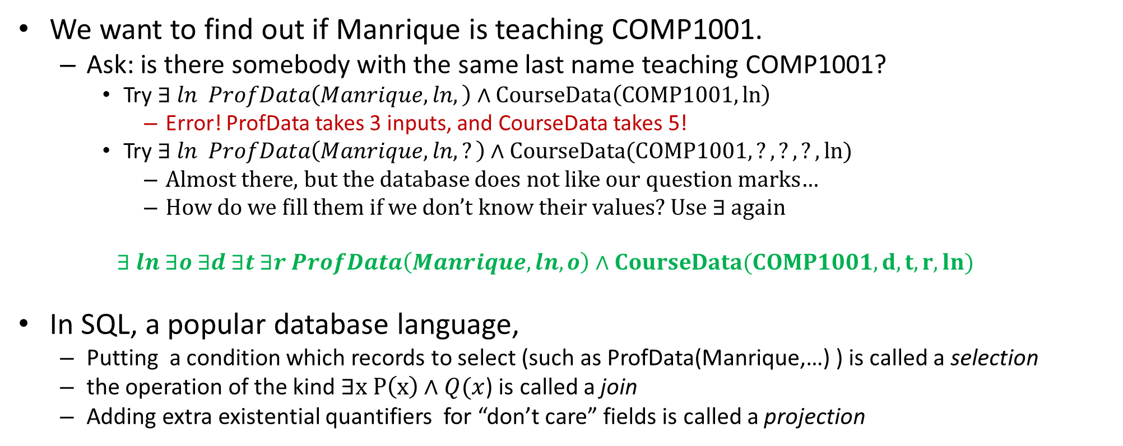
PROFDATA
COURSEDATA
We want to find out if Manrique is teaching COMP1001.
  Ask: is there somebody with the same last name teaching COMP1001?
    Try $∃ ln ProfData\left(Manrique, ln,\right)∧CourseData\left(COMP1001,ln\right)$
      Error! ProfData takes 3 inputs, and CourseData takes 5!
    Try $∃ ln ProfData\left(Manrique, ln, ?\right)∧CourseData(COMP1001,?,?,?,ln)$
      Almost there, but the database does not like our question marks…
      How do we fill them if we don’t know their values? Use $∃$ again
  $$∃ ln ∃o ∃d ∃t ∃r ProfData\left(Manrique, ln, o\right)∧CourseData(COMP1001,d,t,r,ln)$$
In SQL, a popular database language,
  Putting a condition which records to select (such as ProfData(Manrique,…) ) is called a selection
  the operation of the kind $∃x P\left(x\right)∧Q(x$) is called a join
  Adding extra existential quantifiers for “don’t care” fields is called a projection

Slide 24
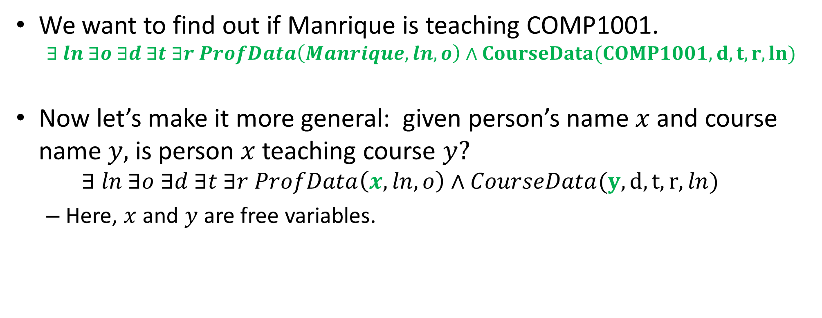
PROFDATA
COURSEDATA
We want to find out if Manrique is teaching COMP1001.
  $$∃ ln ∃o ∃d ∃t ∃r ProfData\left(Manrique, ln, o\right)∧CourseData(COMP1001,d,t,r,ln)$$
Now let’s make it more general: given person’s name $x$ and course name $y,$ is person $x$ teaching course $y?$
  $$∃ ln ∃o ∃d ∃t ∃r ProfData\left(x, ln, o\right)∧CourseData(y,d,t,r,ln)$$
  Here, $x$ and $y$ are free variables.

Slide 25
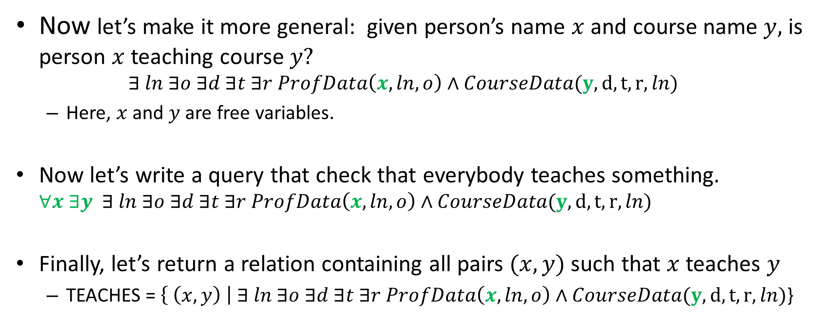
PROFDATA
COURSEDATA
Now let’s make it more general: given person’s name $x$ and course name $y,$ is person $x$ teaching course $y?$
  $$∃ ln ∃o ∃d ∃t ∃r ProfData\left(x, ln, o\right)∧CourseData(y,d,t,r,ln)$$
  Here, $x$ and $y$ are free variables.
Now let’s write a query that check that everybody teaches something. $∀x ∃y ∃ ln ∃o ∃d ∃t ∃r ProfData\left(x, ln, o\right)∧CourseData(y,d,t,r,ln)$
Finally, let’s return a relation containing all pairs $(x,y)$ such that $x$ teaches $y$
  TEACHES = $\left\{ \left(x,y\right) \right| ∃ ln ∃o ∃d ∃t ∃r ProfData\left(x, ln, o\right)∧CourseData(y,d,t,r,ln)$}

Slide 27
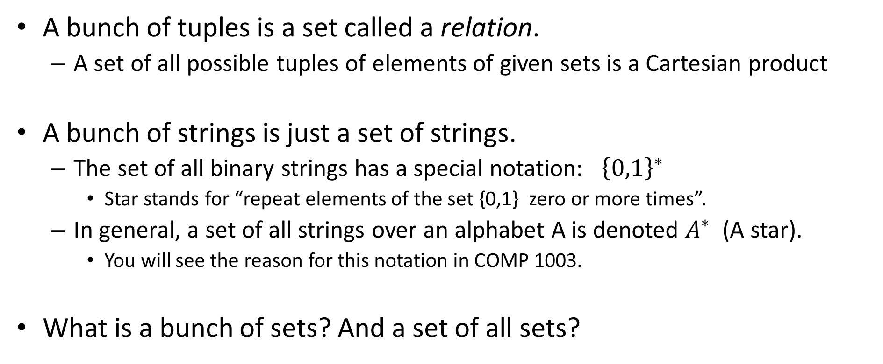
Building sets from sets (and other stuff).
A bunch of tuples is a set called a relation.
  A set of all possible tuples of elements of given sets is a Cartesian product
A bunch of strings is just a set of strings.
  The set of all binary strings has a special notation: ${\left\{0,1\right\}}^{∗}$
    Star stands for “repeat elements of the set {0,1} zero or more times”.
  In general, a set of all strings over an alphabet A is denoted $A^{∗}$ (A star).
    You will see the reason for this notation in COMP 1003.
What is a bunch of sets? And a set of all sets?

Slide 28




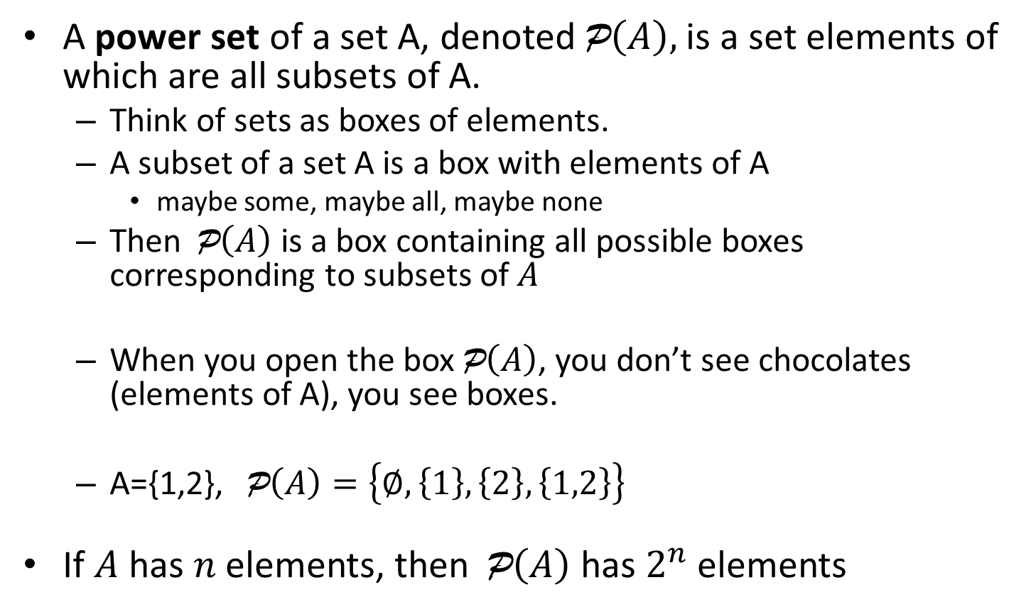

Power sets
A power set of a set A, denoted P$\left(A\right),$ is a set elements of which are all subsets of A.
  Think of sets as boxes of elements.
  A subset of a set A is a box with elements of A
    maybe some, maybe all, maybe none
  Then P$\left(A\right)$ is a box containing all possible boxes corresponding to subsets of $A$
  When you open the box P$\left(A\right)$, you don’t see chocolates (elements of A), you see boxes.
  A={1,2}, P$\left(A\right)=\left\{∅, \left\{1\right\},\left\{2\right\}, \left\{1,2\right\}\right\}$
If $A$ has $n$ elements, then P$\left(A\right)$ has $2^{n}$elements
Set A
Power set P$\left(A\right)$

Slide 29
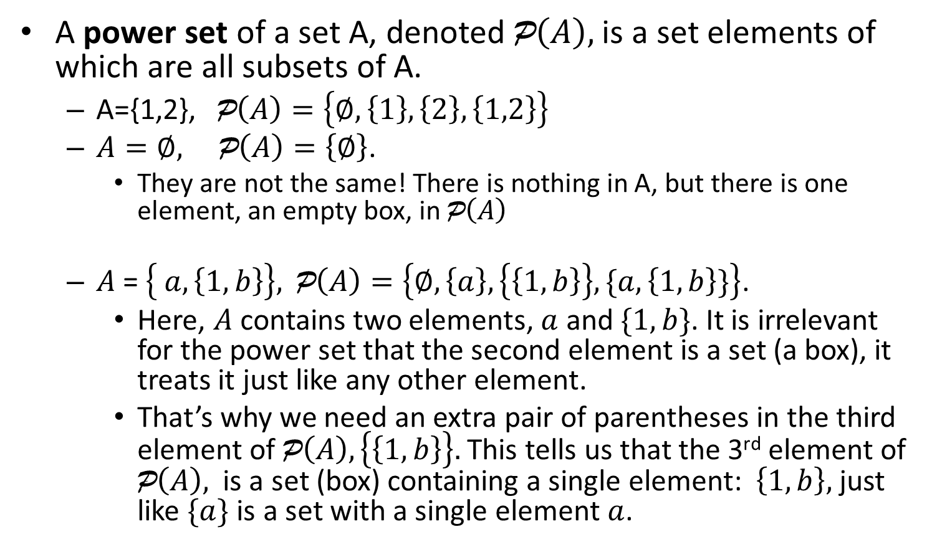

Power sets
A power set of a set A, denoted P$\left(A\right),$ is a set elements of which are all subsets of A.
  A={1,2}, P$\left(A\right)=\left\{∅, \left\{1\right\},\left\{2\right\}, \left\{1,2\right\}\right\}$
  $A=∅, \text{P}\left(A\right)=\left\{∅\right\}$.
    They are not the same! There is nothing in A, but there is one element, an empty box, in P$\left(A\right)$
  $A$ = $\left\{ a, \left\{1, b\right\}\right\}\text{, }\text{P}\left(A\right)=\left\{∅, \left\{a\right\}, \left\{\left\{1,b\right\}\right\}, \{a,\left\{1,b\right\}\}\right\}$.
    Here, $A$contains two elements, $a$ and $\{1,b\}$. It is irrelevant for the power set that the second element is a set (a box), it treats it just like any other element.
    That’s why we need an extra pair of parentheses in the third element of $\text{P}\left(A\right), \left\{\left\{1,b\right\}\right\}.$ This tells us that the 3rd element of $\text{P}\left(A\right),$ is a set (box) containing a single element: $\left\{1,b\right\},$ just like $\{a\}$ is a set with a single element $a$.
Set A
Power set P$\left(A\right)$

Slide 30
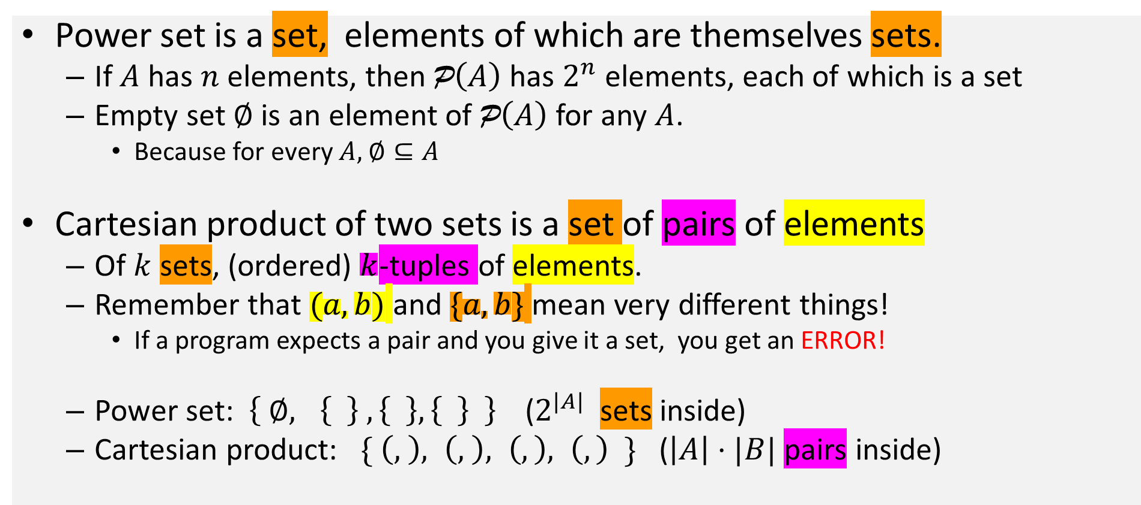
Type checking: power set and cartesian product
Power set is a set, elements of which are themselves sets.
  If $A$ has $n$ elements, then P$\left(A\right)$ has $2^{n}$ elements, each of which is a set
  Empty set $∅$ is an element of P$\left(A\right)$ for any $A$.
    Because for every $A,$ $∅⊆A$
Cartesian product of two sets is a set of pairs of elements
  Of $k$ sets, (ordered) $k$-tuples of elements.
  Remember that $(a,b)$ and $\{a,b\}$ mean very different things!
    If a program expects a pair and you give it a set, you get an ERROR!
  Power set: $\left\{ ∅, \left\{ \right\} , \left\{ \right\}, \left\{ \right\} \right\}$ ($2^{|A|}$ sets inside)
  Cartesian product: $\{ \left(, \right), \left(, \right), \left(,\right), \left(,\right) \}$ ($\left|A\right|⋅|B|$ pairs inside)

Slide 32

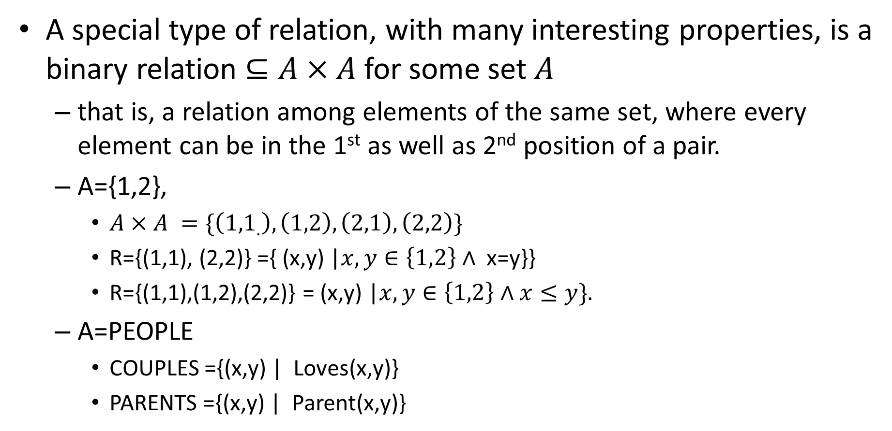
Binary relations
A special type of relation, with many interesting properties, is a binary relation $⊆A×A$for some set $A$
  that is, a relation among elements of the same set, where every element can be in the 1st as well as 2nd position of a pair.
  A={1,2},
    $A×A =\{\left({1,1}_{.}\right),\left(1,2\right), \left(2,1\right),\left(2,2\right)\}$
    R={(1,1), (2,2)} ={ (x,y) |$x,y∈\left\{1,2\right\}∧$ x=y}}
    R={(1,1),(1,2),(2,2)} = (x,y) |$x,y∈\left\{1,2\right\}∧x≤y\}.$
  A=PEOPLE
    COUPLES ={(x,y) | Loves(x,y)}
    PARENTS ={(x,y) | Parent(x,y)}

Slide 33
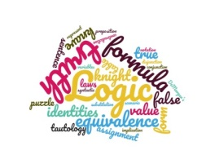

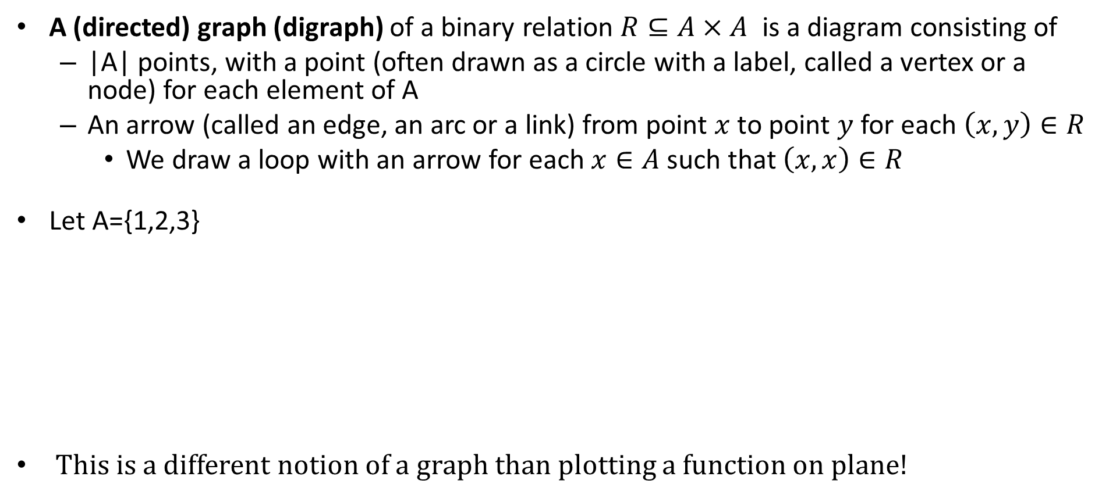



Graphs of binary relations
A (directed) graph (digraph) of a binary relation $R⊆A×A$ is a diagram consisting of
  |A| points, with a point (often drawn as a circle with a label, called a vertex or a node) for each element of A
  An arrow (called an edge, an arc or a link) from point $x$ to point $y$ for each $\left(x, y\right)∈R$
    We draw a loop with an arrow for each $x∈A$such that $\left(x,x\right)∈R$
Let A={1,2,3}
This is a different notion of a graph than plotting a function on plane!
1
2
1
2
1
2
1
2
3
3
3
3
$R=\{\left(1,1\right), \left(1,2\right), (2,2$), (3,1)}
$R=\{\left(1,2\right), \left(1,3\right), \left(3,1\right)$}
$$R=A×A$$
$$R=\{\left(1,1\right)\}$$

Slide 35

Reflexive relations
A binary relation $R⊆A×A$is reflexive if $∀x∈A, R(x,x)$
  Every x is related to itself.
    On a graph, every vertex has a loop
  E.g. A={1,2}, $R_{1}=${ (1,1), (2,2), (1,2)}
  On A = $ℤ, R_{2}=\left\{\left(x,y\right)\right|x=y\}$ is reflexive
  But not $R_{3}=\left\{\left(x,y\right)\right| x<y\}$
1
2
$$R_{1}$$
1
2
3
4
$$R_{2}$$

Slide 36

Anti-reflexive relations
A binary relation $R⊆A×A$is anti-reflexive if $∀x∈A, ¬R\left(x,x\right)$
    Graph of R has no loops.
    E.g. A={1,2}, $R_{6}=${(1,2)}
      but not $R_{1}=${ (1,1), (2,2), (1,2)} (reflexive)
      nor $R_{7}=${(1,1), (1,2)} (neither)
    For $A=ℤ, n$ot $R_{2}=\left\{\left(x,y\right)\right|x=y\}$
      Nor $R_{4}=\left\{\left(x,y\right)\right|x≡y mod 3 \}$
    But $R_{3}=\left\{\left(x,y\right)\right| x<y\}$is anti-reflexive.
      So are $R_{5}=\left\{\left(x,y\right)∈ℤ×ℤ \right| x+1=y\}$
      And PARENT = $\left\{\left(x,y\right)∈PEOPLE×PEOPLE \right|x is a parent of y\}$
  A relation R can be neither reflexive nor anti-reflexive.
1
2
$R_{6}=${(1,2)}

Slide 37

Symmetric relations
A binary relation $R⊆A×A$is symmetric iff $∀x,y∈A, \left(x,y\right)∈R↔$ $\left(y,x\right)∈R$
  For every arrow in a graph (except loops) another goes the opposite way
  $R_{1}$ and $R_{3}$ from previous slides are not symmetric. $R_{2}$is.
  $R_{8}=$ $\{\left(1,2\right),\left(2,1\right),\left(1,1\right)\}$ is symmetric
  A = $ℤ, R_{4}=\left\{\left(x,y\right)\right|x≡y mod 3 \}$ is symmetric.
1
2
$$R_{8}$$

Slide 38

Anti-symmetric relations
A binary relation $R⊆A×A$is anti-symmetric iff $∀x,y∈A, \left(x,y\right)∈R∧\left(y,x\right)∈R→x=y$
    For every arrow, there is no arrow the other way. Loops OK.
    ${R_{1},R}_{3}, R_{5}, R_{6},R_{7}, PARENT$ are anti-symmetric.
    $R_{4 }$is not.
    $R_{2}$ is both symmetric and anti-symmetric.
    $R_{9}=\left\{\left(1,2\right), \left(1,3\right), \left(3,1\right)\right\}$ is neither symmetric nor anti-symmetric.
1
2
$$R_{8}$$
1
2
$$R_{1}$$
1
2
3
$$R_{9}$$

Slide 39
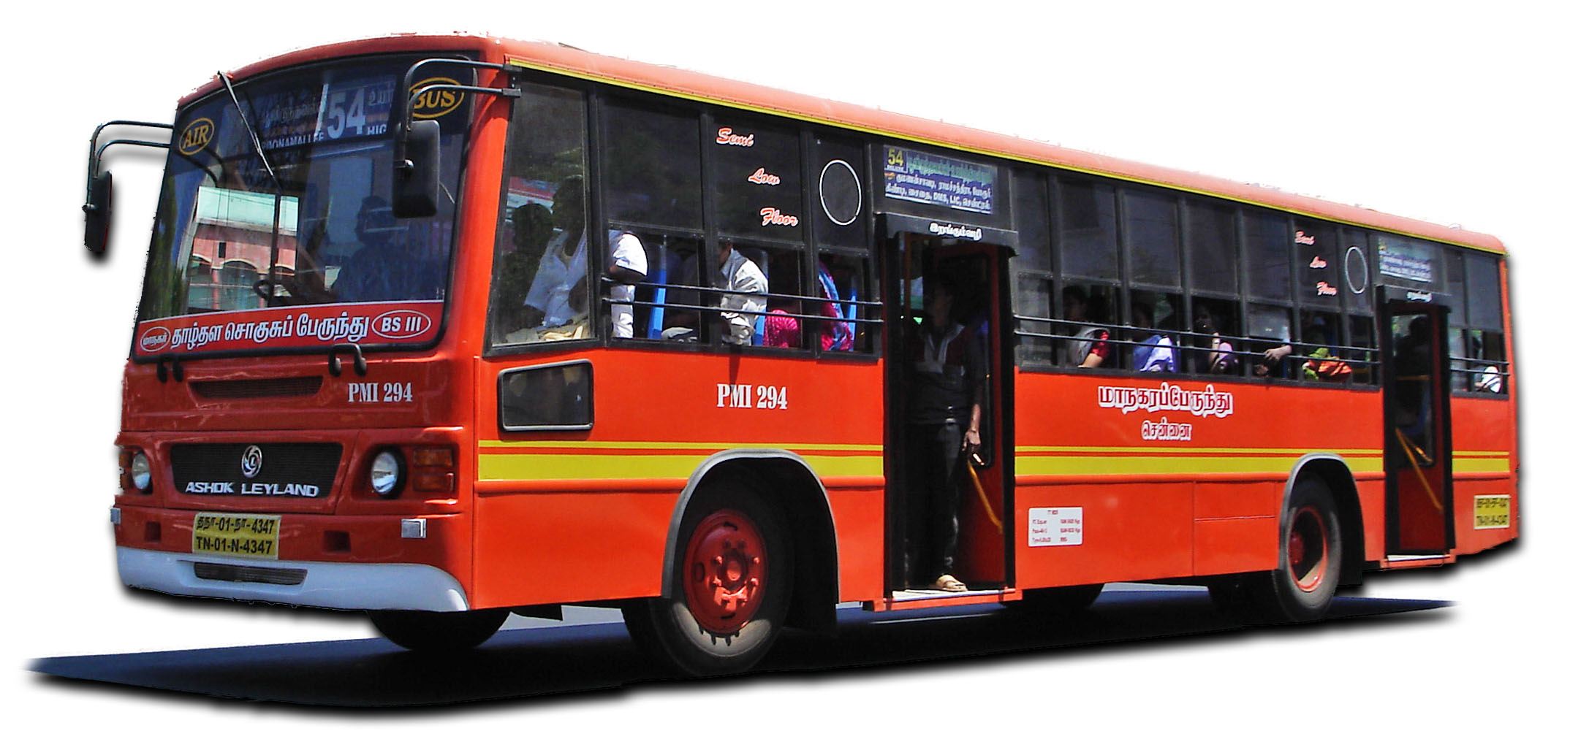
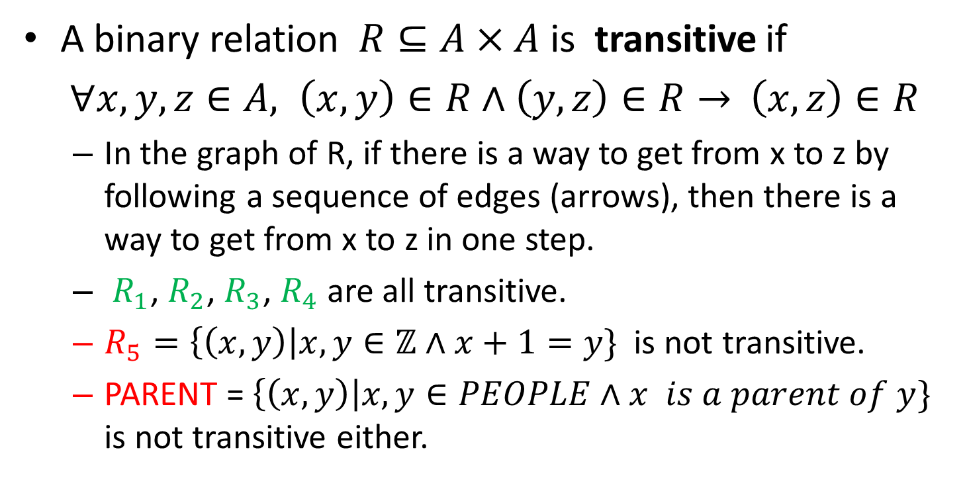
Transitive relations
A binary relation $R⊆A×A$is transitive if
$∀x,y, z∈A, \left(x,y\right)∈R∧\left(y,z\right)∈R→$ $\left(x,z\right)∈R$
  In the graph of R, if there is a way to get from x to z by following a sequence of edges (arrows), then there is a way to get from x to z in one step.
  $R_{1}$, $R_{2}$, $R_{3}$, $R_{4}$ are all transitive.
  $R_{5}=\left\{\left(x,y\right)\right|x,y∈ℤ∧x+1=y\}$ is not transitive.
  PARENT = $\left\{\left(x,y\right)\right|x, y∈PEOPLE∧x is a parent of y\}$ is not transitive either.
1
2
3
$$R=\{\left(1,2\right),\left(3,1\right),\left(3,2\right)\}$$
1
2
3
$$R=\{\left(1,2\right),\left(3,1\right)\}$$

Slide 41
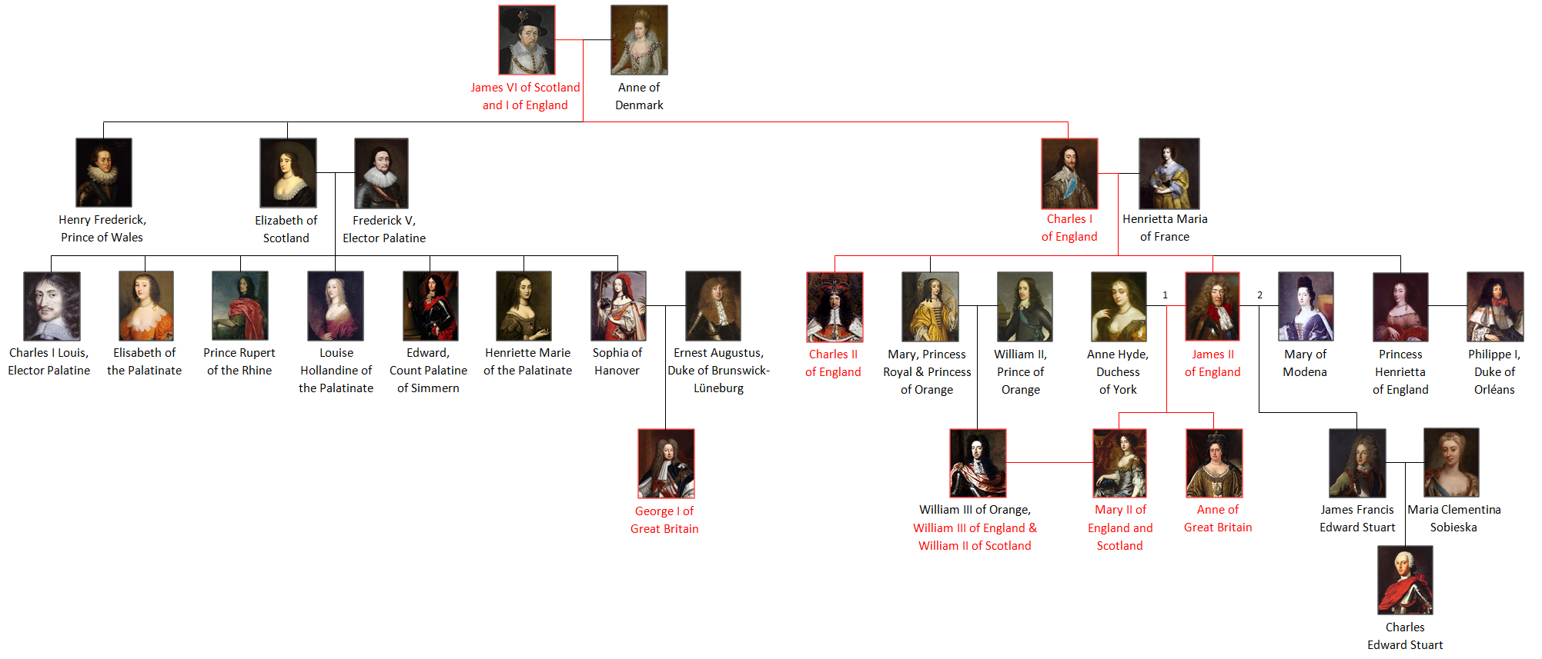
Sometimes a relation we have does not quite give us what we want:
  A$PARENT$relation is not reflexive, not transitive – we have to come up with all sorts of new formulas for grandparent/great-grandparent..
  Maybe what we want is an ANCESTOR relation:
    It is transitive and reflexive, behaves nicely…
    Though it requires more space to store than $PARENT$…
Is there a way to compute $ANCESTOR$from $PARENT$when we need it?
And how to do this in general?

Slide 42
Extending relations to have desired properties
Often, we start with a relation which is not reflexive
  Or not symmetric, or not transitive
But we’d really prefer if it were reflexive (symmetric, transitive)!
In this case, we change our relation to get a relation with the property we want.
  We always want to keep all the original edges: never lose information.
  And we want to make as few changes as possible.
If $R$ is a relation, then its transitive, reflexive or symmetric closure is the smallest transitive, reflexive or symmetric relation, respectively, containing R.

Slide 43
A reflexive closure of a relation
L$et R⊆\left\{1,2,3\right\}×\left\{1,2,3\right\},$ R={(1,1), (1,2), (2,2), (3,1)}
To compute a reflexive closure of $R,$we just need to add all missing self-loops.
  In this case, there is only one: (3,3)
  This will give us the smallest possible reflexive relation containing $R$.
So to compute a reflexive closure of a given relation, add all missing pairs $(x,x)$, and nothing else.
Another example: a reflexive closure of $R_{3}=\left\{\left(x,y\right)\right| x<y\}$ is $\left\{\left(x,y\right)\right|$ $x≤y\}$
1
2
1
2
Reflexive closure of R:
$\{\left(1,1\right), \left(1,2\right), (2,2$), (3,1), (3,3)}
$R=\{\left(1,1\right), \left(1,2\right), (2,2$), (3,1)}
3
3

Slide 44

A symmetric closure of a relation
L$et R⊆\left\{1,2,3\right\}×\left\{1,2,3\right\},$ R={(1,1), (1,2), (2,1), (2,2), (3,1)}
To compute a symmetric closure of R, check every pair $\left(x,y\right)∈R$ for which $x≠y.$ If $\left(y,x\right)∉R,$ then add $(y,x)$ to the symmetric closure of $R.$
  In this case, $\left(1,2\right)$ and $\left(2,1\right)$ are both in $R,$ but $\left(1,3\right)∉R$even though $\left(3,1\right)∈R,$ so we add $(1,3)$ to the symmetric closure of R.
  We don’t need to bother with (2,3), (3,2) since neither is in R.
  This will give us the smallest possible symmetric relation containing $R$.
Example: a symmetric closure of $R_{3}=\left\{\left(x,y\right)\right| x<y\}$ is $\left\{\left(x,y\right)\right| x≠y\}$
$R=\{\left(1,1\right), \left(1,2\right), \left(2,1\right),(2,2$), (3,1)}
1
2
1
2
Symmetric closure of R:
$\{\left(1,1\right), \left(1,2\right),$(1,3), $\left(2,1\right)(2,2$), (3,1) }
3
3

Slide 45
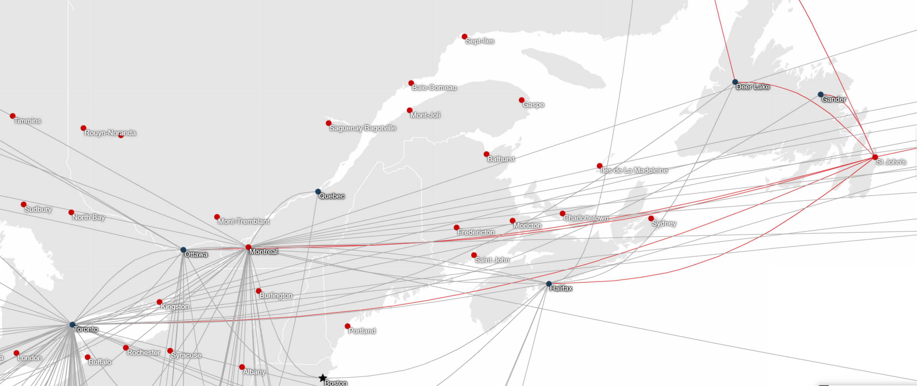
Transitive closure: routes from flights
If you are trying to get to Boston from Gander, you would be more interested in a sequence of flights that would get you there than whether there is a direct flight.
You need a transitive closure of the FLIGHT relation.

Slide 46
A transitive closure of a relation
A transitive closure of a relation $R$ is the smallest transitive relation that contains $R.$
  Add edge $(x,z)$ whenever $\left(x,y\right)∈R, \left(y,z\right)∈R,$but $\left(x,z\right)∉R$
  Keep doing it again and again, until the resulting relation is transitive
    Not enough to just go through edges once.
    There are faster ways you will learn in your algorithms course.
1
2
3
4
5
1
2
3
4
5
1
2
3
4
5
1
2
3
4
5
1
2
3
4
5
1
2
3
4
5
1
2
3
4
5
1
2
3
4
5

Slide 47
Paths in graphs
1
2
A path in a graph $G$ from a vertex $x$ to a vertex $y$ is a sequence ${(v_{0},v}_{1}),$($v_{1},v_{2}), …, \left(v_{k−1},v_{k}\right)$ of edges of $G,$ where $v_{0}=x$and $v_{k}=y$.
  If no vertex repeats, it is called a simple path.
  Number of edges $k$ is the length of the path.
  If $x=y,$ it is called a cycle.
A pair $(x,y)$, where $x≠y,$ is in the transitive closure of a relation $R$ iff there is a path from $x$ to $y$ in the graph of $R$.
  If $\left(x,y\right)$is in R, it is also in its transitive closure even if $x=y$.
4
5
3
6
Simple path
from 6 to 2
1
2
4
5
3
6
Cycle 4 to 4

Slide 48
Combining closures
To compute a closure that is both, for example, reflexive and transitive, compute one first and then the other of the result.
  The order does not matter.
For example, let $R=\left\{\left(x,y\right)\right| x+1=y\}$, for $x,y∈ℤ$.
  Transitive closure of $R$ is $\left\{\left(x,y\right)\right| x<y\}$
  Reflexive closure of $R$ is $\left\{\left(x,y\right)\right|x+1=y∨x=y\}$
  Symmetric closure of $R$ is $\left\{\left(x,y\right)\right|x+1=y∨y+1=x\}$
  Reflexive transitive closure of $R$ is $R$ is $\left\{\left(x,y\right)\right| x≤y\}$
  Symmetric transitive closure of R is $\left\{\left(x,y\right)\right| x≠y\}$
  Reflexive, symmetric, transitive closure of R is $ℤ×ℤ$

Slide 49

Transitive closure and limitations of predicate logic
One reason why computing transitive closures is so useful for databases is that it lets us circumvent a limitation of predicate logic:
  We can write a formula saying that there is a path from $x$ to $y$ of length $k$
    $Grandparent\left(x,y\right)$says that there is a path of length 2 in the graph of PARENT
  However, we need to use $k−1$ new variables for a path of length k.
There is no way to write a finite-length formula of predicate (first-order) logic saying that there is some path, of any length, from $x$ to $y$.
  Without going to second-order logic, which is beyond the scope of this course.

Slide 51
Equivalence relation
A binary relation $R⊆A×A$is an equivalence if R is reflexive, symmetric and transitive.
    E.g. A={1,2}, $R=\left\{\left(1,1\right), \left(2,2\right)\right\}$ or $R=A×A$
    Not $R_{1}=${ (1,1), (2,2), (1,2)} nor $R_{3}=\left\{\left(x,y\right)\right| x<y\}$
    On A = $ℤ, R_{2}=\left\{\left(x,y\right)\right|x=y\}$ is an equivalence
    So is $R_{4}=\left\{\left(x,y\right)\right|x≡y mod 3 \}$
      Reflexive: $∀x∈ℤ, x ≡x mod 3$
      Symmetric: $∀x, y∈ℤ, x≡y mod 3 →y≡x mod 3$
      Transitive: $∀x, y,z ∈ℤ, x≡y mod 3∧ y≡z mod 3→x≡z mod 3$
1
2
3
4

Slide 52
Equivalence classes
An equivalence relation partitions A into equivalence classes:
  Intersection of any two equivalence classes is $∅$
  Union of all equivalence classes is A.
  $R_{4}:$ $ℤ=\left\{x \right|x≡0 mod 3\}∪\{x \left| x≡1 mod 3\right\}∪\left\{x \right|x≡2 mod 3\}$
  $R=A×A$gives rise to a single equivalence class. $R=\left\{\left(1,1\right), \left(2,2\right)\right\}$ on A ={1,2} to two equivalence classes.
1
2
3
4

Slide 53
Order
A binary relation $R⊆A×A$is an order if R is reflexive, anti-symmetric and transitive.
  E.g. $R_{1}=\left\{\left(x,y\right)\right|x,y∈ℤ∧x≤y\}$. So is alphabetical order of English words.
  But not $R_{2}=\left\{\left(x,y\right)\right|x,y∈ℤ∧x<y\}$
    not reflexive, so not an order.
  $SUBSETS=\left\{\left(A,B\right) \right| A, B are sets∧ A⊆B \}$ is an order.
    Reflexive: $∀A, A⊆A$
    Anti-symmetric: $∀ A, B A⊆B∧B⊆A→A=B$
    Transitive: $∀A,B,C A⊆B∧B⊆C→A⊆C$
  $DIVISORS=${(x,y)| $x,y∈ℕ∧x,y≥2 ∧∃z∈ℕ y=z⋅x\}$ is an order.
  PARENT is not an order. But ANCESTOR would be, if defined so that each person is an ancestor of themselves.
1
2
3
1
2
3

Slide 54
Total and partial order
R is a total order if $∀x, y∈A R\left(x,y\right)∨R(y,x)$ (any two elements of A are related.)
  $R_{1}=\left\{\left(x,y\right)\right|x,y∈ℤ∧x≤y\}$is a total order
  So is alphabetical order of English words.
Otherwise, R is a partial order.
  $SUBSETS=\left\{\left(A,B\right) \right| A, B are sets∧ A⊆B \}$ is a partial order.
    Not total: if A ={1,2} and B ={1,3}, then neither $A⊆B$nor $B⊆A$
  $DIVISORS$is a partial order.
    $5$ and $7$ do not divide each other.
  ANCESTOR is a partial order
    Two people don’t necessarily have to be related.
1
2
3
Total order
1
2
3
Partial order

Slide 55
Minimal and maximal
An order may have minimal and maximal elements (maybe multiple)
  $x∈A$is minimal in R if $∀y∈A y≠x→ ¬R(y,x)$
    and maximal if $∀y∈A y≠x→¬R\left(x,y\right)$
  If there is only one minimal element, we call it a minimum
    Unique maximal element is a maximum.
  In $R_{10},$ 1 is a minimum, 3 is a maximum
  In $R_{11},$ 1 is a minimum, and both 2 and 3 are maximal
  $∅$is minimal in SUBSETS (its unique minimum); universe is maximal (its unique maximum).
  All primes are minimal in DIVISORS, and there are no maximal elements.
1
2
3
$R_{10}$
1
2
3
$$R_{11}$$

Slide 57
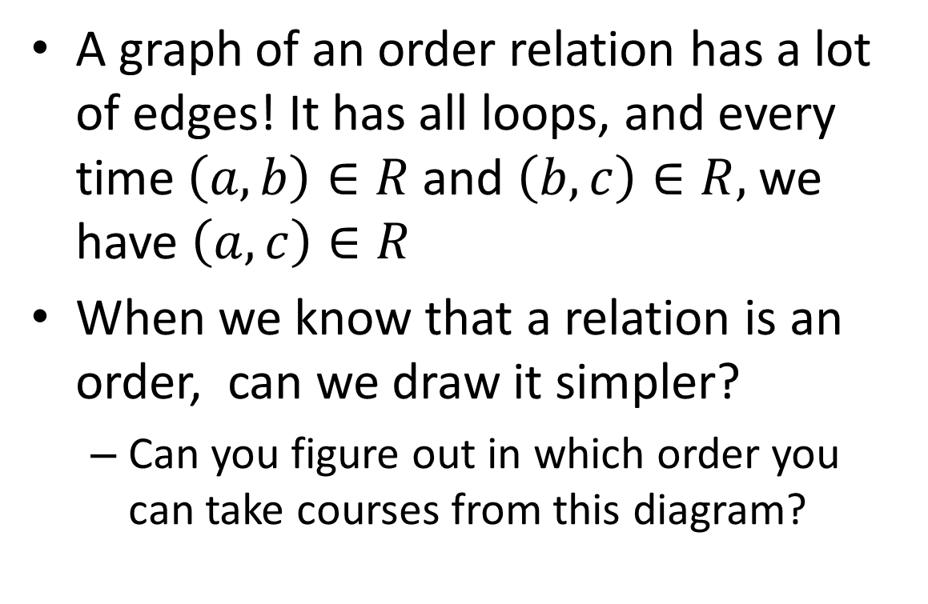
Drawing orders: diagrams
A graph of an order relation has a lot of edges! It has all loops, and every time $\left(a,b\right)∈R$and $\left(b,c\right)∈R,$we have $\left(a,c\right)∈R$
When we know that a relation is an order, can we draw it simpler?
  Can you figure out in which order you can take courses from this diagram?
2004
2005
2006
2001
2002
2003
1001
1002

Slide 58






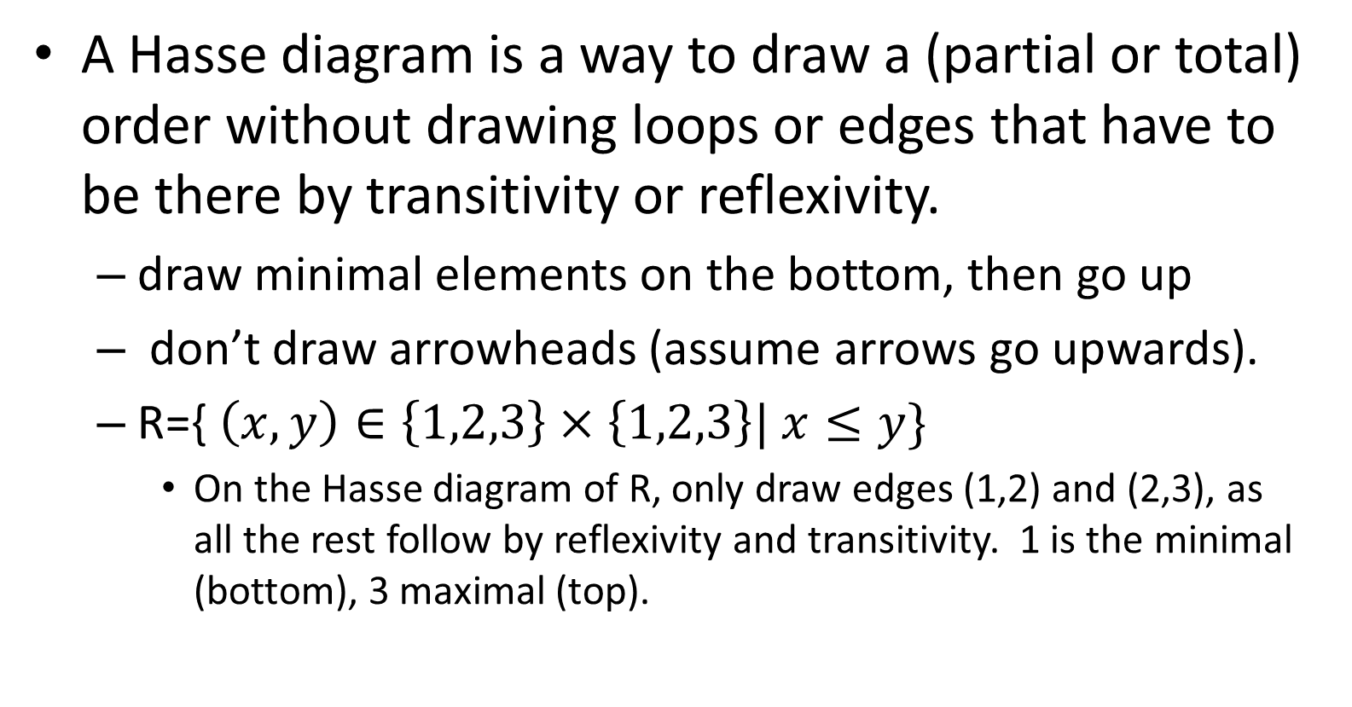


Hasse diagram
A Hasse diagram is a way to draw a (partial or total) order without drawing loops or edges that have to be there by transitivity or reflexivity.
  draw minimal elements on the bottom, then go up
  don’t draw arrowheads (assume arrows go upwards).
  R={ $\left(x,y\right)∈\left\{1,2,3\right\}×\left\{1,2,3\right\}| x≤y\}$
    On the Hasse diagram of R, only draw edges (1,2) and (2,3), as all the rest follow by reflexivity and transitivity. 1 is the minimal (bottom), 3 maximal (top).
1
2
3
R
3
Hasse
diagram
of R
2
1
$$\{1,2,3\}$$
$$\{1,2\}$$
$$\{1,3\}$$
$$\{2,3\}$$
$$\{1\}$$
$$\{2\}$$
$$\{3\}$$
$$∅$$
Hasse diagram of
SUBSETS on {1,2,3}

Slide 59
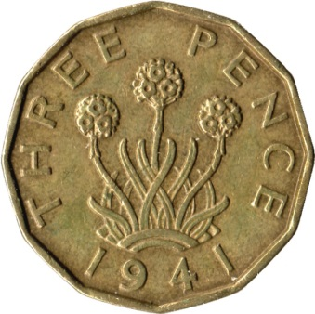
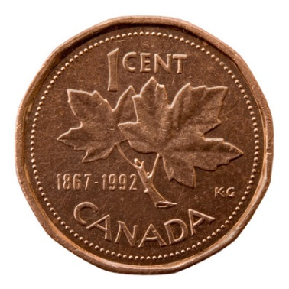
Puzzle: coins
A not-too-far-away country recently got rid of a penny coin, and now everything needs to be rounded to the nearest multiple of 5 cents…
  Suppose that instead of just dropping the penny, they would introduce a 3 cent coin.
    Like British three pence.
  What is the largest amount that cannot be paid by using only existing coins (5, 10, 25) and a 3c coin?

