Slide 1
Unit 4
Proofs

Slide 2
Proofs
What is a theorem?
Lemma, claim, etc
What is a proof?
Where do we start?
Where do we stop?
What steps do we take?
How much detail is needed?

Slide 3
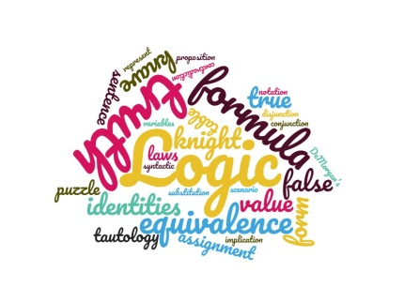
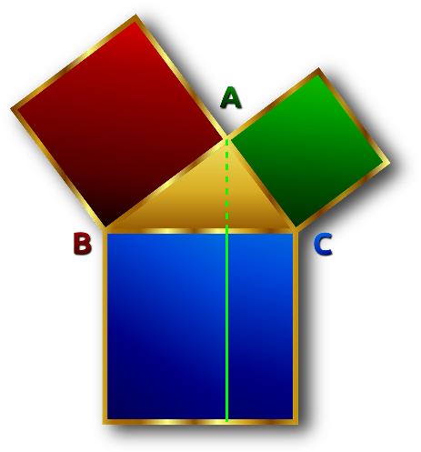
Theories and theorems
Theory: axioms + everything derived from them using rules of inference
Euclidean geometry, set theory, theory of reals, theory of integers, Boolean algebra…
In verification: theory of arrays.
Theorem: a true statement in a theory
Proved from axioms (usually, from already proven theorems)
A statement can be a theorem in one theory and false in another!
Between any two different numbers there is another number.
A theorem for real numbers. False for integers!

Slide 4
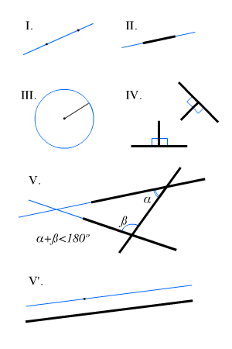
Axioms of geometry: Euclid’s postulates
Through 2 points a line segment can be drawn
A line segment can be extended to a straight line indefinitely
Given a line segment, a circle can be drawn with it as a radius and one endpoint as a centre
All right angles are congruent
Parallel postulate

Slide 5
Axioms of propositional logic
For any logic formulas A, B, C,
like in arithmetic (with $∨$ as +, $∧$as *)
$A∨B≡B∨A$ $A∧B≡B∧A$
$\left(A∨B\right)∨C≡A∨\left(B∨C\right) \left(A∧B\right)∧C≡A∧\left(B∧C\right)$
$\left(A∨B\right)∧C≡\left(A∧C\right)∨\left(B∧C\right)$
And unlike arithmetic $\left(A∧B \right)∨C≡ \left(A∨C\right)∧(B∨C)$
Properties of $TRUE$ and $FALSE$
$TRUE∨A≡TRUE. TRUE∧A≡A$
$FALSE ∨A≡A. FALSE∧A≡FALSE$
$A∨¬A ≡TRUE$ $A∧¬A≡ FALSE$
Commutativity
Associativity
Distributivity (2)
Double negation: $¬¬A≡A$
De Morgan’s laws:
$¬\left(A∨B\right)≡¬A∧¬B$
$$¬\left(A∧B\right)≡¬A∨¬B$$

Slide 6
Proofs in real life
You will pretty much never see a proof with all the rules and axioms spelled out!
If you are reading a proof, if you are not sure why a certain step is valid, work it out from what you know.
If you are writing a proof, put enough details to make it clear why each step is valid.
But here we will start by identifying the logic behind proofs.

Slide 8
Proofs
What is a theorem?
Lemma, claim, etc
What is a proof?
Where do we start?
Where do we stop?
What steps do we take?
How much detail is needed?

Slide 9
Constructive proofs
$Theorem: ∃x∈ℕ Even\left(x\right)∧Prime(x)$
Proof:
Let x=2.
Even(2) is true.
Prime(2) is true.
Therefore, $Even\left(2\right)∧Prime(2)$ holds.
We found a witness for $∃x$
Done.
To prove an existential statement$∃x F\left(x\right),$find a witness for x and show that it works.
This proof is constructive, because we constructed an x which makes the formula $Even\left(x\right)∧Prime(x)$ true.
Rule of inference

Slide 10
Counterexamples
To disprove a statement, enough to give a counterexample: a scenario where it is false
To disprove that $A→B≡B→A$
Take $A=true, B=false,$
Then $A→B$ is false, but $B→A$is true.
Hidden universal quantifier: for all truth assignments
Disproving a statement is the same as proving its negation.
To disprove $∀x F\left(x\right),$ give a constructive proof for $∃x ¬F(x)$
All birds can fly

Slide 11
Counterexamples
Statement: “For any predicate $P(x,y)$ on any domain S, if $∀x∈S ∃ y∈S P\left(x,y\right),$ then $∃y∈S ∀x∈S P\left(x,y\right)“$
Let’s disprove it by constructing a counterexample!
Let $S=\left\{0,1\right\}$ and let interpretation of P on S be:
P(0,0), P(1,1) are true, and P(0,1), P(1,0) are false. (So P(x,y) is $x=y$)
Then $∀x ∃ y P\left(x,y\right)$ is true, but $∃y ∀x P\left(x,y\right)$ is false.
Because $\left(P\left(0,0\right)∨P\left(0,1\right)\right)∧\left(P\left(1,0\right)∨P\left(1,1\right)\right)$ is true,
But $(P\left(0,0\right)∧P(1,0))∨(P\left(0,1\right)∧P(1,1))$ is false.
Our counterexample consists of $domains$ for $x$ and $y$ (they don’t have to be equal), and an interpretation of the predicate $P(x,y)$over these domains.

Slide 12
Proving universal statements
To prove that something of the form $∀x F\left(x\right)$ is true:
Make sure it holds in every scenario (method of exhaustion)
For all values of A and B, $¬B→¬A ≡A→B,$ by truth table.
But there can be too many scenarios!
For any integer, there is a larger integer which is a prime.
For any two reals, there is a real between them.
In the next several lectures, we will study how to use axioms and rules of inference to be able to prove such statements.

Slide 13
Vacuous puzzle
Let $S=\left\{x∈ℕ \right| x is even∧ x is odd\}$
Prove or disprove:
$$∀x∈S, x does not divide x^{2}$$

Slide 15
Vacuous puzzle
Let $S=\left\{x∈ℕ \right| x is even∧ x is odd\}$
Prove or disprove:
$$∀x∈S, x does not divide x^{2}$$

Slide 16
Vacuous puzzle
Let $S=\left\{x∈ℕ \right| x is even\}∩\left\{x∈ℕ\right|x is odd\}$
But there are no natural numbers that are both even and odd! So S = $∅$
Prove or disprove: $∀x∈S, x does not divide x^{2}$
Let P(x)= “$x does not divide x^{2}$”
To disprove, can give a counterexample
Find an element in S such that P(x) is false… But there is nothing in S!
Another way: Since S is defined as a subset of natural numbers, can read $∀x∈S P\left(x\right)$ as $∀x∈ℕ \left(x∈S→P\left(x\right)\right).$
Since “$x∈S"$is always false, $x∈S→P\left(x\right)$ is true for every $x∈ℕ$
Call a statement $∀x∈∅ P\left(x\right)$ vacuously true.

Slide 17
Inference rules with quantifiers
Instantiation: taking a specific instance (value) of a variable
Can be just giving this variable a name
$Even(2)$, $Even(k)$
Generalization: replacing a value with a quantified variable
Have $Even(2)$
Get $∃x Even(x)$

Slide 18
Existential generalization
$F\left(a\right)$ is true for some $a∈S$
------------------------------------
Therefore, $∃x∈S F\left(x\right)$
$Even\left(2\right)$
------------------------------------
Therefore, $∃x∈ℤ, Even(x)$
Penguins do not fly
------------------------------------
$∴∃x∈BIRDS ¬Fly\left(x\right)$
$Loves(Jane, Jim)$
------------------------------------
$∴∃x∈PEOPLE Loves\left(x,Jim\right)$
$∃x∈PEOPLE Loves\left(x,Jim\right)$
------------------------------------
$∴∃y ∃x Loves(x,y)$

Slide 19
Existential instantiation
If $∃ x∈S F\left(x\right)$ is true$,$ then you can give that element of $S$ for which $F\left(x\right)$ is true a name, as long as that name has not been used elsewhere.
“Let n be an even number. Then n=2k for some k”.
$∀x∈ℕ Even\left(x\right)→ ∃ y∈ℕ \left(x=2∗y\right)$
Important to have a new name every time the rule is applied!
“Let n and m be two even numbers. Then n=2k and m=2k” is wrong!
$∀x_{1}, x_{2} ∈ℕ Even\left(x_{1}\right)∧Even\left(x_{2}\right)→$
$$∃ y_{1, }y_{2}∈ℕ \left(x_{1}=2∗y_{1}\right)∧\left(x_{2}=2∗y_{2}\right)$$
“Let n and m be two even numbers. Then n=2k and m=2$ℓ$”

Slide 20
Universal instantiation
In general, if $∀ x∈S F\left(x\right)$ is true for some formula $F\left(x\right),$ if you take any specific element $a∈S,$ then $F\left(a\right)$ must be true.
This is called the universal instantiation rule.
$∀x∈ℕ \left(x>−1\right)$
$∴ 5>−1$
In proofs, most often take $a$ to be an arbitrary element of $S$
This just gives that element a name!
And allows us to say things like “$a≥0$ or $a<0“$, and consider these cases separately.

Slide 21
Universal generalization
Let $a$ be an arbitrary element of $S$
If you prove $F\left(a\right)$ without any assumptions about $a$other than $a∈S,$ then $∀x∈S, F\left(x\right)$
This is called universal generalization.
For an arbitrary $k∈ℤ$, $Even\left(k\right)∨Odd\left(k\right)$
Therefore, $∀x∈ℤ, Even\left(x\right)∨Odd(x)$

Slide 22
Theorem:
For any propositional formulas A,B, $¬B→¬A≡A→B$
Proof: let’s use axioms and definitions of logic to prove it.
Let A and B be arbitrary universal instantiation
propositional formulas
$¬B→¬A≡ ¬¬B∨¬A$ by definition of $F→G$
$≡B∨¬ A$ by the double negation axiom $¬¬F≡F$
$≡¬A∨B$ by the axiom $F∨G≡G∨F$
$≡A→B$ by definition of $F→G$
Therefore, for any formulas $A, B by \text{universal} \text{generalization}$
$¬B→¬A≡A→B$

Slide 24
Rules of inference in predicate logic
Combine universal and existential instantiations and generalizations with the rules of inference from propositional logic.
Modus ponens and friends,
Resolution and friends, etc..

Slide 25
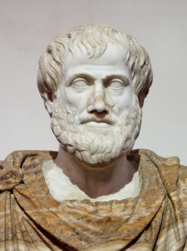
Universal Modus Ponens
All men are mortal
Socrates is a man
Therefore, Socrates is mortal
All cats like fish
Molly likes fish
Therefore, Molly is a cat
$\left(∀x\right) Cat\left(x\right)→like_fish\left(x\right)$
$like_fish\left(Molly\right)$
_________________________
$∴$Cat(Molly) X
$∀x Man\left(x\right)→Mortal\left(x\right)$
$Man\left(Socrates\right)→Mortal(Socrates)$
Man(Socrates)
--------------------------------------
$∴$ $Mortal(Socrates)$
Mortal
Men
Like fish
cats

Slide 26
Universal Modus Ponens
Q
$∀x, P\left(x\right) →Q\left(x\right)$
$P\left(a\right)$
-------------------------
$Q\left(a\right)$
All men are mortal $(∀x, Man\left(x\right)→Mortal\left(x\right))$
Socrates is a man $(Man\left(Socrates\right))$
Therefore, Socrates is mortal ($Mortal(Socrates)$
All integers are either odd or even
2 is an integer
Therefore, 2 is either odd or even.
P
Drop leaves
Trees
All trees drop leaves
Pine does not drop leaves
Therefore, pine is not a tree

Slide 27
Other inference rules
Combining universal instantiation and generalization with tautologies, get other types of arguments:
(This particular rule is called “transitivity”)
$$p→q$$
$$q→r$$
_____ $∴p→r$
$∀x P\left(x\right)→Q\left(x\right)$
$∀x Q\left(x\right)→R\left(x\right)$
________________ $∴∀x P\left(x\right)→R\left(x\right)$
For any x, if $x>3$, then $x>2$
For any x, if $x>2,$then $x≠1$
________________
$$∴\text{For} \text{any} \text{x}\text{, }\text{if} x>3 \text{, }\text{then} x≠1$$

Slide 29
Types of proofs
We are not studying these proofs for the sake of proving these theorems.
We are using them as examples of underlying proof types.
When reading proofs, note where universal and existential instantiation/ generalization are used.
And what logic is used to derive each step.

Slide 30
Proof example
Theorem:
For any propositional formulas A,B, $¬B→¬A≡A→B$
Proof:
Let $A$ and $B$ be arbitrary propositional formulas universal instantiation
$¬B→¬A≡ ¬¬B∨¬A$ by definition of $F→G$
$≡B∨¬ A$ by the double negation axiom $¬¬F≡F$
$≡¬A∨B$ by the axiom $F∨G≡G∨F$
$≡A→B$ by definition of $F→G$
And, therefore, for any formulas $A, B , ¬B→¬A≡A→B$
universal generalization

Slide 31
Direct proof
Direct proof of $∀x∈S F\left(x\right): s$how directly that $F\left(x\right)$ holds for an arbitrary n $∈S$, then use universal generalization.
Universal instantiation: “let n be an arbitrary element of $S$”
Show that $F(n)$is true from axioms, definitions, previous theorems…
Finally use universal generalization to conclude that $∀x F\left(x\right)$ is true.
$□$ (Done).

Slide 32
Direct proof
Direct proof of $∀x∈S F\left(x\right): s$how directly that $F\left(x\right)$ holds for an arbitrary n $∈S$, then use universal generalization.
When $F\left(x\right)$ is of the form $G\left(x\right)→H(x)$, assume $G(n)$ is true, and from that (and axioms, etc) derive $H(n).$That proves $G\left(n\right)→H\left(n\right)$
Notice: we are skipping a step here! Here it is:
Let $n$ be an arbitrary element of S.
If $G\left(n\right)$is false, done (since $false→H(n)$ is true, so $F(n)$ is true for this $n$)
Otherwise let $n$ be such that $G(n)$ holds
But since when $G(n)$ is false $F(x)$ holds for a trivial reason, it is more common to see just “Let $n$ be arbitrary element of S such that $G(n)$ holds.”
$□$ (Done).

Slide 33
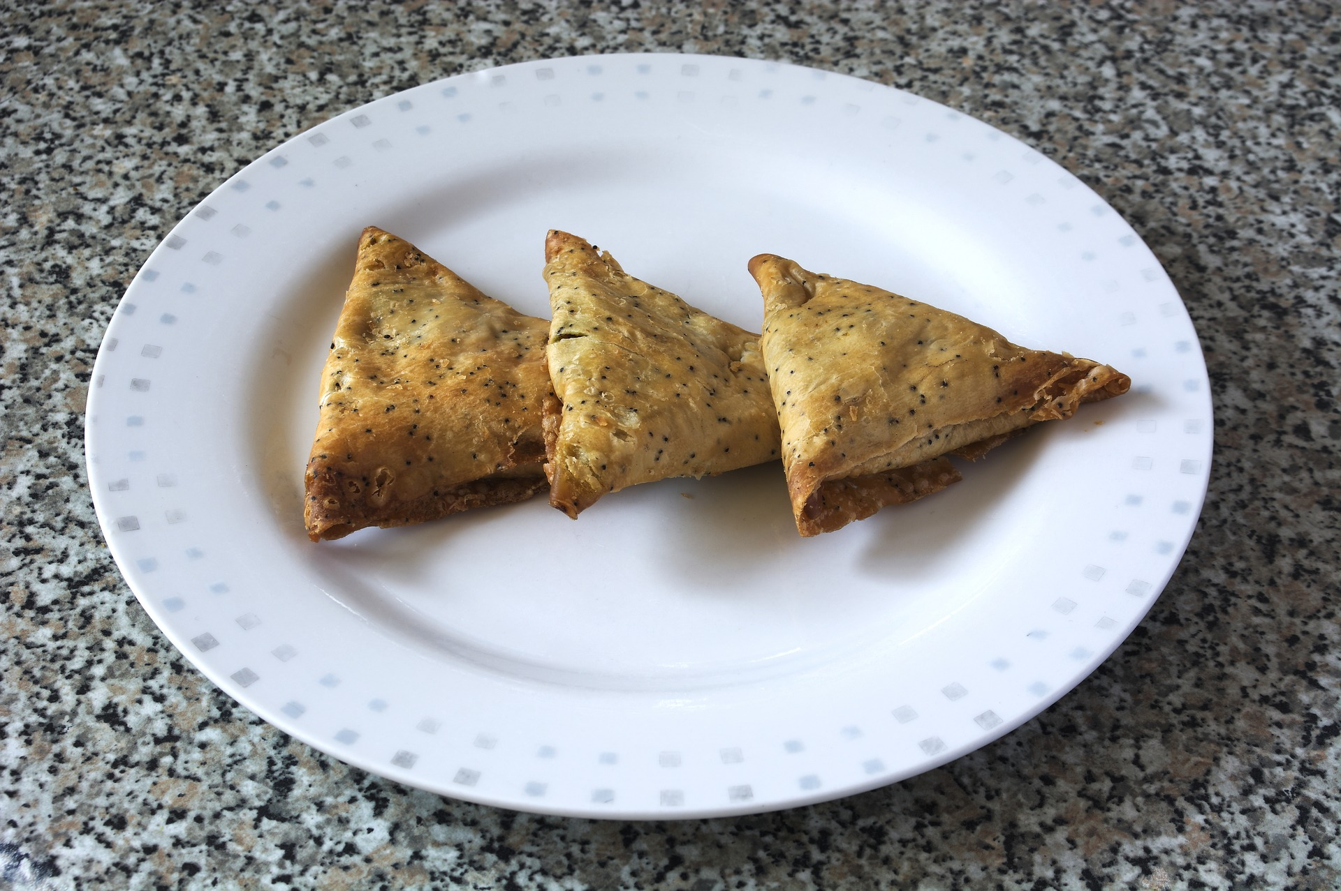
Definitions
Informally, a definition is a sentence giving a name to an object with some properties.
Introducing a shorthand for a formula
$n$ is even if and only if it is divisible by 2
$n$ is even iff $∃k∈ℤ n=2k$
You will see a lot of definitions in your computer science career!
And will be asked to implement those things
Samosa:
a triangular savory pastry fried in ghee or oil, containing spiced vegetables or meat.
Source: Oxford dictionary

Slide 34
Theorem: Sum of two even integers is even. $$∀x, y∈ℤ Even\left(x\right)∧Even\left(y\right)→Even\left(x+y\right).$$
Definition (of even integers):
An integer $n$ is even iff $∃k∈ℤ, n=2⋅k.$
Proof:
Suppose m and n are arbitrary even integers.
Then $∃k∈ℤ, n=2k$ and $∃l∈ℤ, m=2l.$
$m+n=2k+2l=2(k+l)$
$m+n=2\left(k+l\right)$, so $m+n$ is even
Since m and n were arbitrary, we have shown
$∀x, y∈ℤ, Even\left(x\right)∧Even\left(y\right)→Even\left(x+y\right).$
$□$ (Done).

Slide 35
Theorem: Sum of two even integers is even. $$∀x, y∈ℤ Even\left(x\right)∧Even\left(y\right)→Even\left(x+y\right).$$
Proof:
Suppose m and n are arbitrary even integers.
Then $∃k∈ℤ, n=2k$ and $∃l∈ℤ, m=2l.$
$m+n=2k+2l=2(k+l)$
$m+n=2\left(k+l\right)$, so $m+n$ is even
Since m and n were arbitrary, we have shown
$∀x, y∈ℤ, Even\left(x\right)∧Even\left(y\right)→Even\left(x+y\right).$
Definition (of even integers):
An integer $n$ is even iff $∃k∈ℤ, n=2⋅k.$
By universal instantiation.
By definition: note different variables.
By existential instantiation, substitution
and axioms of theory of integers (algebra).
By definition (other direction of iff) and
existential generalization
By universal generalization
$□$ (Done).

Slide 36
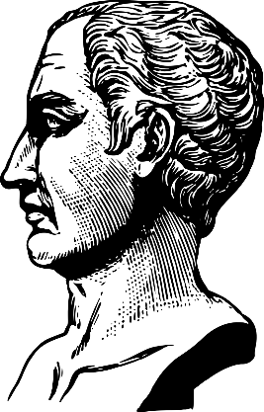
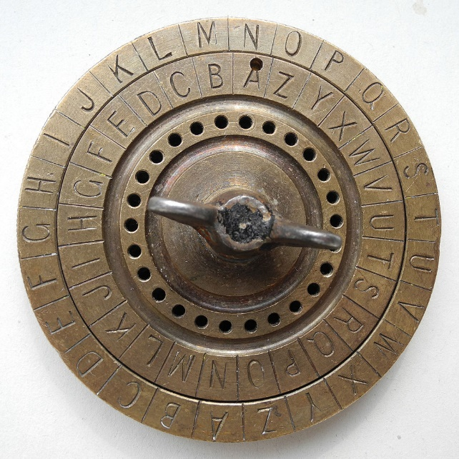
Puzzle: Caesar cipher
The Roman dictator Julius Caesar encrypted his personal correspondence using the following code.
Number letters of the alphabet: A=0, B=1,… Z=25.
To encode a message, replace every letter by a letter three positions before that (wrapping around at the beginning of the alphabet).
For example, F would be replaced by C, and A by X
Suppose he sent the following message.
QEB QOBXPROB FP RKABO QEB CIXD
What does it say?

Slide 38
Puzzle: Caesar cipher
The Roman dictator Julius Caesar encrypted his personal correspondence using the following code.
Number letters of the alphabet: A=0, B=1,… Z=25.
To encode a message, replace every letter by a letter three positions before that (wrapping around at the beginning of the alphabet).
For example, F would be replaced by C, and A by X
Suppose he sent the following message.
QEB QOBXPROB FP RKABO QEB CIXD
What does it say?

Slide 39
Modular arithmetic
Quotient-remainder theorem: for any integer n and a positive integer d, there exist unique integers q (quotient) and r (reminder) such that: $n=dq+r$ and $0≤r<d$
16 = 3*5+1, 11 = 2*4+3…
Definition: $n≡m (mod d)$, pronounced “n is congruent to m mod d”, means that n and m have the same remainder when divided by d. That is, $n=dq_{1}+r$ and $m=dq_{2}+r,$ for the same r.
In some programming languages, there is an operator mod, so you might see “n mod d”, which would return r .
In Python, it is n % d.
$n≡m \left(mod d\right)$ and $m=n mod d$ are not the same:
$10≡16 \left(mod 3\right),$ is true, but $16 mod 3=1$0 is false ($16 mod 3=1)$
Operator div, “n div d” is sometimes used to compute q.
In Python, integer division (or //) does it.

Slide 40
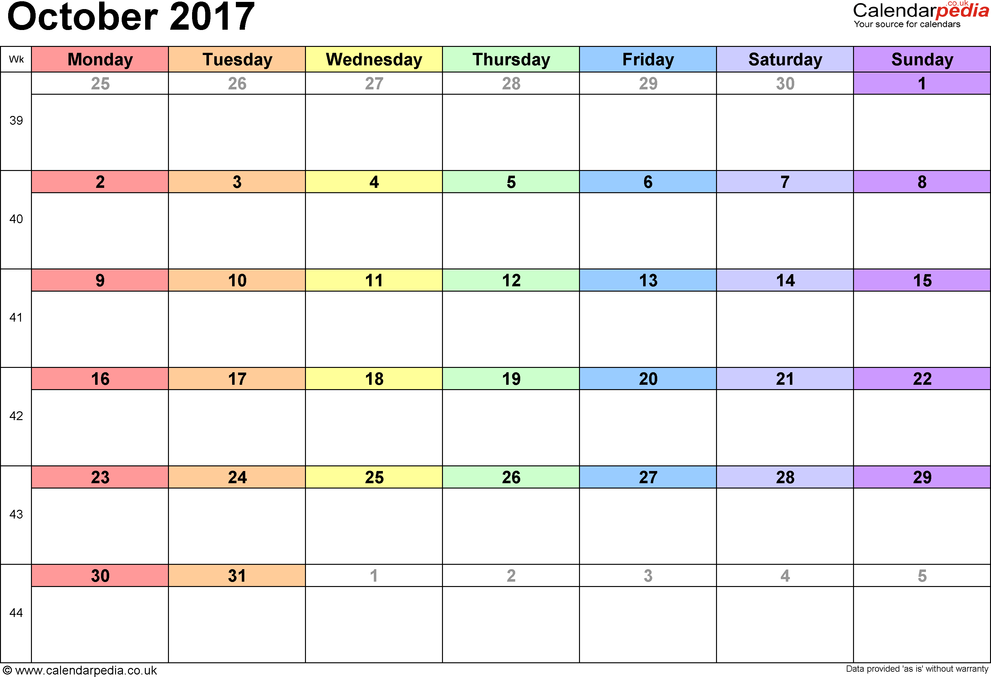
Calendars as modular arithmetic
Wednesdays are
day = 3 (mod 7)
Wednesdays are
day = 4 (mod 7)

Slide 41
Calendars vs mod
Wednesdays are
day = 3 (mod 7)
Orange stickers are
number = 3 (mod 8)

Slide 42
Modular arithmetic in computer science
Example: day of the week.
Feb 1st and Feb 15th are both on Wednesday: $1≡15 (mod 7)$
Hash: distribute random data evenly among memory locations
Often take h(k) = k mod p for some prime p.
Cryptography:
Parity checks in credit cards, codes, ISBNs, etc.
Look at combination of digits mod 10 to check if a credit card number is valid.
Google Luhn formula for details.
Public key crypto, RSA….

Slide 43
Theorem: for all integers n,m and d, where $d>0,$if $n≡m \left(mod d\right)$ then there exists an integer k such that n$=m+kd$
$∀x,y, z (z>0∧ x≡y \left(mod z\right))→∃u x=y+uz$
Proof:
Let n, m, d be arbitrary integers such that $d>0$ and $n≡m \left(mod d\right)$
Universal instantiation and assuming the premise
Then there are integers $q_{1},q_{2},r with$ $0≤r<d$such that $n=dq_{1}+r$ and $m=dq_{2}+r.$
By existential instantiation of quotient-remainder theorem and definition of congruence.
Now, n$−m=\left(dq_{1}+r\right)−\left(dq_{2}+r\right)=d\left(q_{1}−q_{2}\right)$
Substitution and algebra.
Set k = $q_{1}−q_{2}$. For this k, $n=m+kd.$ Therefore, $∃u n=m+ud$
By existential generalization
Since n, m, d were arbitrary integers with $d>0$ and $n≡m \left(mod d\right),$
$∀x,y, z (z>0∧ x≡y \left(mod z\right))→∃u x=y+uz$
By universal generalization.
$□$ (Done).

Slide 45
Direct proof
To prove $∀x∈S F\left(x\right): s$how directly that $F\left(x\right)$ holds for an arbitrary n $∈S$, then use universal generalization.
Universal instantiation: for arbitrary $n∈S$
Show $F(n)$ using axioms, definitions, etc…
Universal generalization.
If $F\left(x\right)$ is of the form $G\left(x\right)→H\left(x\right)$
Universal instantiation + assume $G(n)$ is true.
If $G\left(n\right)$ is false, $G\left(n\right)→H\left(n\right)$ true no matter what $H(n)$ is: vacuous proof
Derive $H(n)$ from $G(n)$ using axioms, definitions, etc.
Universal generalization.
$□$ (Done).

Slide 46
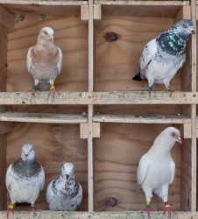
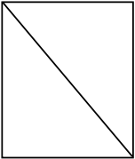
Tricks to make proofs easier
Idea: to prove $∀x∈S F\left(x\right),$ replace $F\left(x\right)$ with an equivalent formula that is easier to prove.
Proof by contraposition:
to prove $∀x∈S G\left(x\right)→H\left(x\right),$ prove $∀x∈S ¬H\left(x\right)→¬G(x)$
Proof by contradiction:
No matter what $F(x)$ is, $F\left(x\right)≡TRUE→F\left(x\right)≡¬F\left(x\right)→FALSE$
So to prove $∀x∈S F\left(x\right),$ prove $∀x∈S ¬F\left(x\right)→FALSE$

Slide 47
Tricks to make proofs easier
Proof by cases:
When $F(x)$ is of the form $\left(G_{1}\left(x\right)∨G_{2}\left(x\right)\right)→H\left(x\right),$ prove $∀x F(x)$ by proving $∀x∈S \left(G_{1}\left(x\right)→H\left(x\right)\right)∧\left(G_{2}\left(x\right)→H\left(x\right)\right)$
Since $F\left(x\right)≡TRUE→F\left(x\right)$, can choose formulas $G_{1}\left(x\right), G_{2}(x)$ so that $∀x∈S (G_{1}\left(x\right)∨G_{2}\left(x\right))$ is true,
Then prove $∀x∈S \left(G_{1}\left(x\right)→F\left(x\right)\right)∧\left(G_{2}\left(x\right)→F\left(x\right)\right)$ instead of proving $∀x∈S F\left(x\right)$ directly.
These generalize to as many cases (as many $G_{i}(x)$ in this OR) as you need.

Slide 49
Proof by contraposition
To prove $∀x∈S (G\left(x\right)→H(x)$), prove its contrapositive $∀x∈S (¬H\left(x\right)→¬G(x)$)
Universal instantiation: “let n be an arbitrary element of S”
Suppose that $¬H(n)$ is true.
Derive that $¬G(n)$ is true.
Conclude that $¬H\left(n\right)→¬G(n)$ is true.
Now use universal generalization to conclude that $∀x F\left(x\right)$ is true.
$□$ (Done).

Slide 50
Theorem: If a square of an integer is even, that integer is even.
$∀x∈ℤ Even\left(x^{2}\right)→Even(x).$
Proof:
We will show that for all $x$ the contrapositive of $F(x)$ holds:
$∀x∈ℤ ¬Even\left(x\right)→¬Even\left(x^{2}\right) .$
By the lemma, this is equivalent to $∀x∈ℤ Odd\left(x\right)→Odd\left(x^{2}\right)$
Let n be an arbitrary odd integer. By definition, $n=2k+1$ for some integer k.
Then $n^{2}={\left(2k+1\right)}^{2}=4k^{2}+4k+1=2\left(2k^{2}+2k\right)+1$
So $n^{2}=2m+1$ for m= $2k^{2}+2k, { thus n}^{2}$ is odd by definition.
By universal generalization, get $∀x∈ℤ Odd\left(x\right)→Odd\left(x^{2}\right)$
By the lemma, this is equivalent to $∀x∈ℤ ¬Even\left(x\right)→¬Even\left(x^{2}\right)$
Since the formula under $∀x$ is a contrapositive of the original $F(x)$, done.
Lemma: Every integer is odd iff it is not even.
Definition: An integer $n$ is odd iff $∃k∈ℤ, n=2⋅k+1.$
$□$ (Done).

Slide 51
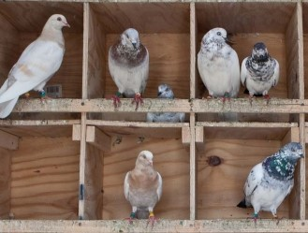
Theorem (PigeonHolePrinciple): For any n, if there are n+1 pigeons and n holes, then if every pigeon sits in some hole, then there is a hole with at least two pigeons.
Proof:
Suppose n is an arbitrary integer.
We show the contrapositive: if every hole has at most one pigeon, then some pigeon is not sitting in any hole.
If every hole has at most one pigeon, then there are at most $1∗n=n$ pigeons sitting in holes.
Then there is $(n+1)−n=1$ pigeon that is not sitting in a hole, proving the contrapositive.
Therefore, if every pigeon sits in a hole, and there are more than n pigeons, then two pigeons sit in the same hole.
By universal generalization, done.
$□$ (Done).

Slide 53
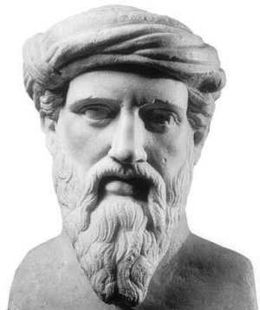
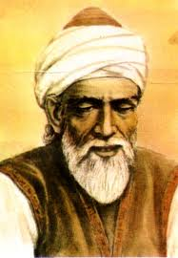
Square root of 2
What is the length of a diagonal of a square with side 1?
By Pythagoras’ theorem, $1^{2}+1^{2}=2,$ so it would have to be$√2$.
Is it at least possible to represent $√2$ as a ratio of two integers?...
Pythagoras and others tried…

Slide 54
Rational and irrational numbers
The numbers that are representable as a ratio of two integers are rational numbers. Set of all rational numbers is $ℚ$.
Numbers that are not rational are irrational.
Rational and irrational numbers together form the set of all real numbers.
Any sequence of digits, potentially infinite after a decimal point, is a real number. Any point on a line.
Irrationality of $\sqrt{2}$ is a classic proof by contradiction.
Pythagoras figured out that the diagonal of a square is not comparable to the sides, but did not think of it as a number.
More like something weird.
Irrational numbers started being treated as numbers in 9th century in the Middle East.
Starting with a Persian mathematician and astronomer Abu-Abdullah Muhammad ibn Īsa Māhānī (Al-Mahani).

Slide 55
Proof by contradiction
To prove $∀x F(x)$, prove $∀x ¬F\left(x\right)→FALSE$
Universal instantiation: “let n be an arbitrary element of the domain $S$ of $∀x$”
Suppose that $¬F(n)$ is true.
Derive a contradiction.
Conclude that $F(n)$ is true.
By universal generalization, $∀x F\left(x\right)$ is true.
$□$ (Done).

Slide 56
Definition of rational
We need a slightly more precise definition of rational numbers for our proof that $\sqrt{2}$is irrational.
Definition (of rational and irrational numbers):
A real number $r$is rational iff $∃m,n∈ℤ, n≠0∧\gcd\left(m,n\right)=1 ∧ r=\frac{m}{n}.$
Reminder: greatest common divisor gcd(m,n) is the largest integer which divides both m and n. When $d=1$, m and n are relatively prime.
Any fraction can be simplified until the numerator and denominator are relatively prime, so it is not a restriction
A real number which is not rational is called irrational.

Slide 57
Definition (of rational and irrational numbers):
A real number $r$is rational iff
$$∃m,n∈ℤ, n≠0∧\gcd\left(m,n\right)=1 ∧ r=\frac{m}{n}.$$
Definition (of greatest common divisor):
A positive integer $d$ is the greatest common divisor of integers $m$ and $n$ if $n$ is divisible by $d,$ and $m$ is divisible by $d,$ and for any $c$ if both $n$ and $m$ are divisible by $c$then $d≥c.$
$$d>0∧∃k_{1} ∃k_{2} n=k_{1}d∧ m=k_{2}d$$
$$∧∀c \left(∃l_{1} ∃l_{2} n=l_{1}c∧ m=l_{2}c \right)→c≤d$$
Theorem: Square root of 2 is irrational.

Slide 58
Theorem: Square root of 2 is irrational.
Proof:
Suppose, for the sake of contradiction, that $\sqrt{2}$ is rational. Then there exist relatively prime m, n $∈ℤ, n≠0$ such that $\sqrt{2}=\frac{m}{n}.$ (definition and existential instantiation)
By algebra, squaring both sides we get $2=\frac{m^{2}}{n^{2}}.$
Thus $m^{2}$is even (by definition), and by the theorem we just proved, then m is even. So $m=2k$for some k. (definition and existential instantiation)
$2n^{2}=4 k^{2},$ so $n^{2}=2k^{2},$ and by the same argument n is even.
This contradicts our assumption that $m$ and $n$ are relatively prime. Therefore, such $m$ and $n$cannot exist, and so $\sqrt{2}$ is not rational.

Slide 60
Proof by cases
If $∀x∈S F\left(x\right)$ is $∀x(G_{1}\left(x\right)∨G_{2}\left(x\right))→H(x)$, prove $∀x \left(G_{1}\left(x\right)→H\left(x\right)\right)∧{(G}_{2}\left(x\right)→H\left(x\right))$.
Use the tautology $\left(p_{1}∨p_{2}\right)∧\left(p_{1}→q\right)∧\left(p_{2}→q\right)→q$
Proof structure:
Universal instantiation: “let n be an arbitrary element of $S$”
Case 1: Prove $G_{1}\left(n\right)→H(n)$
Case 2: Prove $G_{2}\left(n\right)→H(n)$
Therefore, ${(G}_{1}\left(n\right)∨G_{2}\left(n\right))→H(n)$,
Now use universal generalization to conclude that $∀x F\left(x\right)$ is true.
This generalizes for any number of cases $≥2$.

Slide 61
Theorem: Sum of an integer with a consecutive integer is odd. $$∀x∈ℤ Odd(x+\left(x+1\right)).$$
Proof:
Suppose n is an arbitrary integer.
Case 1: n is even.
So n=2k for some k (by definition and existential instantiation).
Its consecutive integer is n+1 = 2k+1. Their sum is (n+(n+1))= 2k + (2k+1) = 4k+1. (axioms).
Let $l=2k$. Then $4k+1=2l+1$ is an odd number (by definition and existential generalization).
So in this case, n+(n+1) is odd.
Case 2: n is odd.
So n=2k+1 for some k (by definition and existential instantiation).
Its consecutive integer is n+1 = 2k+2. Their sum is (n+(n+1))= (2k+1) + (2k+2) = 2(2k+1)+1. (axioms).
Let $l=2k+1.$ Then n+(n+1) = 2(2k+1)+1$=2l+1$, which is an odd number (by definition and existential generalization). So in this case, n+(n+1) is also odd.
Since in both cases n+(n+1) is odd, it is odd without additional assumptions.
Therefore, by universal generalization, get $∀x∈ℤ Odd(x+\left(x+1\right)).$
Definition (of odd integers):
An integer $n$ is odd iff $∃k∈ℤ, n=2⋅k+1.$
$□$ (Done).

Slide 62
Theorem: An absolute value of a product of real numbers is equal to the product of their absolute values. $∀x,y∈ℝ \left|xy\right|=\left|x\right|⋅|y|$
Let’s try to understand this definition:
Definition (of absolute value):
An absolute value of a real number r, denoted |r|, is equal to r if $r≥0,$ and to $−r$ otherwise (that is, for $r<0)$.
$□$ (Done).

Slide 63
Theorem: An absolute value of a product of real numbers is equal to the product of their absolute values. $∀x,y∈ℝ \left|xy\right|=\left|x\right|⋅|y|$
Proof:
Let $x$ and $y$ be arbitrary real numbers.
Case 1: Both $x≥0$ and $y≥0$
Case 2: $x≥0$and $y<0$
Case 3: $x<0$ and $y≥0$
Case 4: Both $x<0$ and $y<0$
By universal generalization, $∀x,y∈ℝ \left|xy\right|=\left|x\right|⋅|y|$
Definition (of absolute value):
An absolute value of a real number r, denoted |r|, is equal to r if $r≥0,$ and to $−r$ otherwise (that is, for $r<0)$.
$□$ (Done).

Slide 64
Theorem: An absolute value of a product of real numbers is equal to the product of their absolute values. $∀x,y∈ℝ \left|xy\right|=\left|x\right|⋅|y|$
Proof:
Let $x$ and $y$ be arbitrary real numbers.
Case 1: Both $x≥0$ and $y≥0$
By definition of the absolute value, $\left|x\right|=x$ and $\left|y\right|=y.$
So $\left|x\right|⋅\left|y\right|=xy=|xy|$, since $xy≥0.$
Case 2: $x≥0$and $y<0$
Then $\left|x\right|=x,$ $\left|y\right|=−y.$ So $\left|x\right|⋅\left|y\right|=−xy$.
Since $xy≤0, \left|xy\right|=−xy$ too. So $\left|x\right|⋅\left|y\right|=−xy=|xy|$
Case 3: $x<0$ and $y≥0$
Same as Case 2, interchanging $x$ and $y$
Case 4: Both $x<0$ and $y<0$
Since product of negative numbers is positive, $\left|xy\right|=xy.$
On the other hand, $\left|x\right|⋅\left|y\right|=\left(−x\right)⋅\left(−y\right)=xy.$ So $\left|x\right|⋅\left|y\right|=xy=|xy|$
By universal generalization, $∀x,y∈ℝ \left|xy\right|=\left|x\right|⋅|y|$
Definition (of absolute value):
An absolute value of a real number r, denoted |r|, is equal to r if $r≥0,$ and to $−r$ otherwise (that is, for $r<0)$.
$□$ (Done).

Slide 65
Without loss of generality
Proof:
…..
Case 2: $x≥0$and $y<0$
Then $\left|x\right|=x,$ $\left|y\right|=−y.$ So $\left|x\right|⋅\left|y\right|=−xy$.
Since $xy<0, \left|xy\right|=−xy$ too. So $\left|x\right|⋅\left|y\right|=−xy=|xy|$
Case 3: $x<0$ and $y≥0$
Same as Case 2, interchanging $x$ and $y$
…..
We did not need a separate proof for Case 3, since it was essentially identical to case 2, with roles of x and y exchanged.
There, we could use the phrase “without loss of generality” (abbreviated “wlog”), and combine cases 2 and 3: “Case 2: one of the numbers is nonnegative and the other negative. Without loss of generality, let x be nonnegative, y negative. “
This can be used when one case follows from another in very few simple steps, or the proof is the same.

Slide 67
Summary: proof techniques
Proving an existential statement $∃x∈S F(x)$:
If possible, give a constructive proof by constructing a witness
When does not work, can try to prove that $∀x ¬F\left(x\right)→FALSE$
Proving a universal statement $∀x∈S F(x)$:
Start with universal instantiation: take an arbitrary $n∈S$
Use definitions, axioms, etc to prove $F(n)$
If $F\left(n\right)$ is $G\left(n\right)→H\left(n\right),$ assume $G\left(n\right)$ and derive $H(n)$
Use existential instantiation/generalization for $∃x$in definitions
Replacing $F\left(x\right)$ with an equivalent formula that’s easier to prove
Before or after the universal instantiation.
Common tricks: proof by contraposition, by contradiction, by cases.
Finish with universal generalization.
We will see a few other methods, in particular, proof by induction.

Slide 68
Proofs for other types of statements
“The following are equivalent” $∀x∈S G\left(x\right)↔H\left(x\right)$
prove $∀x∈S \left(G\left(x\right)→H\left(x\right)\right)∧(H\left(x\right)→G(x))$
When more than two formulas, can prove a chain of implications:
To show that $F\left(n\right), G\left(n\right), H\left(n\right),…$are equivalent, prove $\left(F\left(n\right)→G\left(n\right)\right)∧(G\left(n\right)→H\left(n\right))∧(H\left(n\right)→F\left(n\right))$, in whichever order is most convenient.
“There is a unique $x"…$ $∃x F\left(x\right)∧∀y≠x ¬F\left(x\right)$
Sometimes written $∃!x F(x)$
Note a shorthand: $∀y≠x ¬F\left(x\right)$ means $∀y (y≠x→¬F\left(x\right))$

Slide 69
Language of proofs: Theorems, lemmas, claims…
Theorem: usually a major result, often requiring a long proof.
Though technically any statement true in a theory is a theorem .
Lemma: a technical statement used in a proof of a theorem
Some lemmas are more famous than theorems they were designed to prove!
Claim/fact/observation: An easily provable statement used in subsequent proofs.
Often stated without a proof.
Corollary: A statement that easily follows from a theorem/lemma or their proofs.
Conjecture: A statement that has not been proven, usually believed to be true
Example: Goldbach’s conjecture states that every even integer $>2$is a sum of two primes.

Slide 70
Proofs are an art!
As with art, to learn to do proofs look at examples
See if an existing proof can be modified to prove what you need.
Can a proof that $√2$ is irrational be changed into a proof that $√3$ is irrational?
Often, the same statement can be proven many different ways.
There are no precise rules for when to use which trick – try whichever one you like, and if you cannot get it to work, try another.
Often choose whichever way the proof is most beautiful.
And as with any art – the more you practice, the better you become!

