Slide 2
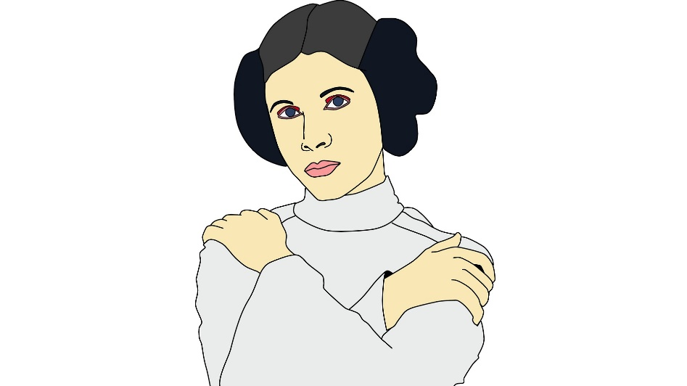
Stereotypes puzzle
Susan is 28 years old, single, outspoken, and very bright. She majored in philosophy. As a student she was deeply concerned with issues of discrimination and social justice and also participated in anti-pipeline demonstrations. Please rank the following possibilities by how likely they are. List them from least likely to most likely. Susan is:
a kindergarten teacher
works in a bookstore and takes yoga classes
an active feminist
a psychiatric social worker
a member of an outdoors club
a bank teller
an insurance salesperson
a bank teller and an active feminist

Slide 3
Stereotypes puzzle
Susan is 28 years old, single, outspoken, and very bright. She majored in philosophy. As a student she was deeply concerned with issues of discrimination and social justice and also participated in anti-pipeline demonstrations. Please rank the following possibilities by how likely they are. List them from least likely to most likely. Susan is:
a kindergarden teacher
works in a bookstore and takes yoga classes
an active feminist
a psychiatric social worker
a member of an outdoors club
a bank teller
an insurance salesperson
a bank teller and an active feminist
Bank tellers
Feminists

Slide 4
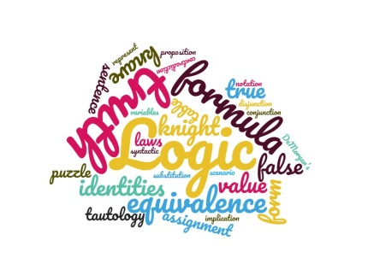
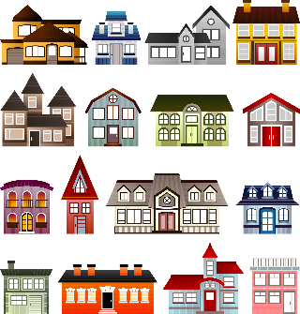
Scenarios and sets
Want to reason about more general scenarios
Rather than just true/false, vary over objects:
even numbers, integers, primes
people that are and are not bank tellers,
pairs of animals in the same ecosystem...
Want multiple properties of these objects:
an even number that is divisible by 4 and > 10,
a person that is also a bank teller...

Slide 6
Sets
A set is a collection of objects.
The order of elements does not matter.
There are no duplicates.
$S_{1}$={1, 2, 3},
$S_{2}$ = {Cathy, Alaa, Keiko, Daniela}
Can define a set of all elements satisfying some condition:
{x | such that x ... } is called set builder notation
$S_{3}=\left\{ x \right| x$is an even number }
PEOPLE = {x | x is a person living on Earth now}
BANKTELLERS = { x | x is a person who is a bank teller}

Slide 7
Special sets
Notation for some special sets:
Empty set $∅$ (set with no elements in it)
Natural numbers $ℕ=\left\{1, 2, 3,…\right\}$
Sometimes start with 0.
Integers $ℤ=\left\{ …−2, −1, 0, 1, 2, …\right\}$
Rational numbers $ℚ= \left\{\frac{m}{n} \right| m, n integers, n≠0\}$
Real numbers $ℝ$
Binary strings ${\left\{0,1\right\}}^{∗}$

Slide 8
Set elements
Notation $a∈S$ (“a in S”) means that an element $a$ belongs to the set S, and $a∉S$ states that $a$ is not in S
Susan $∈$ PEOPLE. Susan $∉$ BANKTELLERS
$0.5∈ℝ. 0.5∉ℤ$
Also, can write $x∈S$for a variable x (in particular in set builder notation)
BANKTELLERS = { $x∈PEOPLE$ | x is a bank teller}
EVEN = $\left\{ x∈ℤ\right| x$is divisible by 2 }
PEOPLE
Bank tellers
Feminists

Slide 9
Subsets and equality
When all elements of a set $S_{1}$ are also elements of a set $S_{2}$, we say that $S_{1}$ is a subset of $S_{2},$ written $S_{1}⊆S_{2}$
BANKTELLERS $⊆$ PEOPLE
$EVEN⊆ℤ$
$ℕ⊆\left\{x∈ℤ \right|$ $x≥1 \}$
$S_{1}=S_{2}$ when $S_{1}⊆S_{2}$ and $S_{2}⊆S_{1}$
$ℕ=\left\{x∈ℤ \right|$ $x≥1 \}$
$S_{1}$ is a proper subset of a $S_{2}$, written $S_{1}⊂S_{2}$ when $S_{1}⊆S_{2},$but $S_{1}≠S_{2}$
BANKTELLERS $⊂$ PEOPLE, $EVEN⊂ℤ$.
PEOPLE
Bank tellers
Feminists

Slide 10
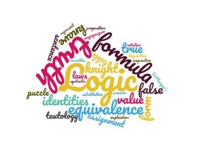
Venn diagrams
Circles are sets
BANKTELLERS, FEMINISTS, DOGS, MAMMALS, BIRDS, EVEN
Square is the universe
PEOPLE, ANIMALS,$ℝ$
Dots are elements
Susan,0.5
A circle for one set inside another means subset
DOGS $⊆$MAMMALS
Circles not overlapping indicates there are no common elements (they are disjoint)
MAMMALS is disjoint from BIRDS
PEOPLE
BANK
TELLERS
FEMINISTS
ANIMALS
MAMMALS
DOGS
How can we do logic with sets?
BIRDS

Slide 12
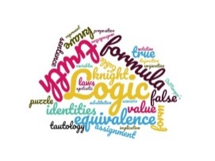
Predicates
A predicate $P(x)$ is a “proposition with a variable”. Here, $x$ is a variable that can take values from a set $D$ called the domain or universe of $P\left(x\right).$
Variable names are usually $x,y,z$, or words like $name,$ usually lowercase.
Predicate names are usually P(), $Q\left(\right),$and capitalized words:
$P\left(y\right), Q\left(z\right), P\left(name\right)$, Even(x)
Examples: Feminist(x), Bankteller(person), P(y).
In the first two cases, D is PEOPLE.
$x∈S$is also a predicate for a specific $S$with the variable $x$
Here, D is the universe to which elements of S belong.

Slide 13
Instantiation of predicates
When $x$in $P\left(x\right)$ is replaced with a specific element of D (instantiated), the predicate becomes a proposition.
Even(3), Feminist(Susan)
After instantiation, the predicate gets a specific truth value true or false.
Even(3) is false. Feminist(Susan) is true.
$P\left(x\right)$ may be true for some values of $x∈D,$ and false for other.
$Even(x)$is true for even numbers $x∈ℤ,$ but false for odd integers.
$Feminist(y)$ is true for some $y∈PEOPLE$, and false for others...
Here, domain of $x$ is $ℤ,$ and domain of $y$ is $PEOPLE$
$Even(y)$is not defined for $y∈PEOPLE$, only for elements of $ℤ.$

Slide 14
Predicates vs. sets
Predicates and sets are two sides of the same coin
For each set S there is a predicate which is true exactly on elements of S
For each predicate P there is a set S of values of $x$ on which P is true.
To write formulas, need something that is true/false: predicates!
Set S | Predicate P
A collection of elements | Becomes true/false on a given element
$S_{P}= \left\{x\right| P\left(x\right)$ is true} | $$P_{S}\left(x\right)≡"x∈S“$$

Slide 15
Predicate logic
We can make formulas out of predicates the same way as we did for propositions, but now our formulas have free variables:
$Even\left(x\right)∨DivisibleByThree(x)→¬Prime\left(x\right)$
$Feminist\left(x\right)∧Bankteller\left(x\right)$
Now scenarios can correspond to values of x.
The first formula is false for x=2 since $Even\left(2\right)=true,$ but $¬Prime\left(2\right)=false.$
This is called predicate logic (or first-order logic), as opposed to propositional logic we did so far.

Slide 16
Set operations as formulas
U
A
B
Let A and B be sets with predicates $x∈A,$ $x∈B$
Such as A={1,2,3} and B={ 2,3,4}
Intersection $A∩B=\left\{ x \right| x∈A∧x∈B\}$
The green part of top picture
$A∩B=\{2,3\}$
Difference $A −B=\left\{x \right| x∈A∧¬(x∈B)\}$
The yellow part in the top picture.
$A−B=\left\{1\right\}$
Complement $\overline{A}$ $=\left\{x∈U \right| ¬(x∈A)\}$
The blue part on the Venn diagram
If universe U = $ℕ, \overline{A} =\left\{x∈ℕ \right|x∉\left\{1,2,3\right\} \}$
Union
$A∪B=\left\{ x \right|x∈A∨x∈B\}$
The coloured part in the top picture.
$A∪B=\left\{1,2,3,4\right\}$
Symmetric difference
$A Δ B=\left(A−B\right)∪(B−A)$
The yellow and blue parts of the top picture.
$AΔB=\left\{1,4\right\}$
U
$$A∩B$$
U
$$A∪B$$
U
A-B
U
A
U
$$AΔB$$

Slide 17
Predicates with several variables
Sometimes, want a predicate that depends on more than one variable
$LessThan(x,y),$for $x, y∈ℝ$, is true if and only if $x<y$
Alternatively, can just write $x<y$ to mean $LessThan\left(x,y\right)$
$Divides\left(x,y\right),\text{for} x, y∈ℤ\text{, }\text{is} \text{true} \text{if} \text{and} \text{only} \text{if}$ $x$is a divisor of $y$
$Divides\left(3,6\right)$ is true. $Divides\left(12,4\right)$ is false.
A predicate $P(x_{1},…, x_{n})$ is a “proposition with variables”, where values of the variables $x_{1},…, x_{n}$ come from some sets $S_{1},…, S_{n}$, called their domains or universes.
Sometimes the domains of its variables are the same, other times different.
Order of variables matters.
For any specific tuple of elements (instantiation of $x_{1},…, x_{n}),$ a predicate $P(x_{1},…, x_{n})$ is either true or false.
For any pair of numbers, $\text{x}\text{ < }\text{y}$can be either true or false:
LessThan(1,2), that is $1<2$is true, whereas LessThan(2,1) $is false$

Slide 18
Predicates: arity
A predicate on one variable is called “unary”, on two “binary”, on three variables “ternary”
in general a predicate on $n$ variables is called $n$-ary predicate.
Number of variables a predicate takes as input is called its $arity$.
Parent(x,y) is true when the person $x$ is a parent of the person $y$
$Parent($King George VI, Queen Elizabeth II) is true
This is a binary predicate
Ternary predicates examples:
$Sum(x,y,z)$ which is true when $x+y=z.$
$Between(x,y,z)$ which is true when y$≤x$ and $x≤z$
For both of them, can take the domain to be $ℝ$
$Registrations(name, cour,sem)$ which is true when $name$ is the name of a student who takes the course $cour$ in semester $sem$.

Slide 20
Quantifiers
A formula of predicate logic can be evaluated when the values of all variables are known.
Alternatively, we might want the formula to hold no matter what the values are.
Or wonder if there is any value that makes it true

Slide 21
Universal quantifier
$∀x∈S F\left(x\right)$
(pronounced “forall”)
is true when
for all possible values $x$ can take in $S$
the formula $F(x)$ is true.
If there is a quantifier over a variable, such variable is not free anymore.
If there are no free variables, the whole formula evaluates to either true or false.

Slide 22
Quantifiers: universal ($∀$)
Theorems often look like this: “For all x the following is true”, and then a formula with x as a free variable.
For all $x∈ℤ$ $DivisibleBySix\left(x\right)→DivisibleByThree(x)$
For all $n∈ℕ if n>4, then 2^{n }>n^{2}$
We write this in predicate logic using the universal quantifier $∀$
$∀x∈ℤ DivisibleBySix\left(x\right)→DivisibleByThree(x)$
$∀n∈ℕ n>4→ 2^{n }>n^{2}$
Some textbooks put a comma after the quantifier, some period, others nothing.
Some insist that the formula must be in parentheses if it is more than one predicate.
When in doubt, use parentheses.

Slide 23
Examples with universal quantifier
“Every bird can fly”
Domain $BIRD$
Predicate $CanFly(x)$
$∀x∈BIRD CanFly(x)$
Not true: penguins
“I work each day of the week! ☹ “
Domain DAYS = {Mon, Tue, Wed, Thu, Fri, Sat, Sun}
Predicate Work(x), where $x∈DAYS$
$∀x∈DAYS Work\left(x\right)$
“Any two people are related”
Domain $PEOPLE$
Predicate $Related\left(x,y\right)$
$$∀x∈PEOPLE ∀ y∈PEOPLE Related \left(x,y\right)$$
Can shorten this as
$$∀x, y ∈PEOPLE Related\left(x,y\right)$$

Slide 24
Examples with universal quantifier
“Every integer is either even or odd.”
Domain $ℤ$
Predicates $Even(x)$ and $Odd(x)$
$∀x∈ℤ Even\left(x\right)∨Odd\left(x\right)$
This is true: every integer is even or odd.
“Adding 1 to any odd integer results in an even number”
$∀x∈ℤ Odd\left(x\right)→ Even\left(x+1\right)$
This is also true.
“Every odd integer is prime”
Domain $ℤ$
Predicates $Prime(x)$ and $Odd(x$)
$∀x∈ℤ Odd\left(x\right)→Prime\left(x\right)$
False: for example 9 is odd but not prime.
“For every two numbers one is less than the other”
Domain $ℝ$
Predicate $LessThan(x,y$)
Can just write it as $x<y$
$∀x∈ℝ ∀y∈ℝ x<y∨y<x$
False: x and y may take the same value

Slide 26
Universal quantifier and truth
For every formula F of predicate logic with a free variable x, we can write $∀x∈S F\left(x\right)$
Where $F\left(a\right)$ can have quantifiers, too.
We call a sentence of the form $∀x∈S F\left(x\right)$ a universal statement
The formula “$∀x∈S F\left(x\right)"$ is true i$ff F\left(a\right)$ is true for every $a∈S.$
That is, if $a_{1},a_{2},…, a_{n}, …$ is a list of all elements of S, then
$"∀x∈S F\left(x\right)"$is true i$ff "F\left(a_{1}\right)∧F\left(a_{2}\right)∧…∧F\left(a_{n}\right)∧…$” is true.
To evaluate a universally quantified formula $∀x∈S F\left(x\right)$, check that for each $a∈S,$ $F(a)$ is true.

Slide 27
Evaluating universally quantified formulas
Take the domain $D=\left\{0,1,2\right\},$predicates $x≤y$and $x≥y$
$"∀x∈\left\{0,1,2\right\}$ $x≥0"$is true for all instantiations of $x≥0:$
$x ≥0$ true for $0, and 1,$and $2$ substituted for x in the formula.
So $0≥0$ is true, and $1≥0$is true, and $2≥0$ is also true.
That is, when $0≥0 ∧$ $1≥0$ $∧$ $2≥0$ is true.
Which happens to be the case.
$"∀x∈\left\{0,1,2\right\}$ $x≥0 ∧x≤2"$is true when
$\left(0≥0∧0≤2\right)∧\left(1≥0∧1≤2\right)∧(2≥0∧2≤2)$ is true.

Slide 28
Evaluating universally quantified formulas
Take the domain $D=\left\{0,1,2\right\},$predicates $x≤y$and $x≥y$
Let’s evaluate $∀x∈D ∀y∈D x≤y$
Now we have two variables, so let’s do it one quantifier at a time.
First, let’s try all values for $x$ then AND the resulting formulas together:
$∀x∈D ∀y∈D x≤y≡$ ($∀y ∈D 0≤y)∧$ ($∀y ∈D 1≤y)∧$($∀y ∈D 2≤y)$
Now, for each formula in parentheses, try all values of $y$:
$∀y ∈D 0≤y≡$ $\left(0≤0\right)∧\left(0≤1\right)∧\left(0≤2\right)$ true
$∀y ∈D 1≤y≡\left(1≤0\right)∧\left(1≤1\right)∧\left(1≤2\right)$ false
$∀y ∈D 2≤y≡$ $\left(2≤0\right)∧\left(2≤1\right)∧\left(2≤2\right)$ false
Finally, putting it all together, $∀x∈D ∀y∈D x≤y$ becomes
$\left(\left(0≤0\right)∧\left(0≤1\right)∧\left(0≤2\right)\right) ∧\left(\left(1≤0\right)∧\left(1≤1\right)∧\left(1≤2\right)\right)$ $∧(\left(2≤0\right)∧\left(2≤1\right)∧\left(2≤2\right)$)
Now we see that $∀x∈D ∀y∈D x≤y$ is false
Evaluating predicates with infinite domains is harder, need proofs.

Slide 30
Quantifiers and conditionals
Which of these are true? How can we write them as formulas?
All squares are white. All white shapes are squares
All circles are blue. All blue shapes are circles.

Slide 31
Quantifiers and conditionals
Which of these are true? How can we write them as formulas?
All squares are white. All white shapes are squares
All circles are blue. All blue shapes are circles.
They all have the structure $∀x∈S, P\left(x\right)→Q\left(x\right)$

Slide 32
Quantifiers and conditionals
Which of these are true? How can we write them as formulas?
All squares are white. All white shapes are squares
All circles are blue. All blue shapes are circles.
They all have the structure $∀x∈S, P\left(x\right)→Q\left(x\right)$
All squares are white: for all shapes, if it is a square, then it is white
$∀x∈SHAPES, Square\left(x\right)→White\left(x\right)$
Different from “All white objects are squares”:
$∀x∈SHAPES, White\left(x\right)→Square\left(x\right)$

Slide 33
Subsets and implication
When all elements of a set $S_{1}$ are also elements of a set $S_{2}$, we say that $S_{1}$ is a subset of $S_{2},$ written $S_{1}⊆S_{2}$
Treat $x∈S$as a predicate. Let $U$ be the universe.
$S_{1}⊆S_{2}$iff $∀x∈U$ $x∈S_{1}→{x∈S}_{2}$
$EVEN⊆ℤ, ℕ⊆\left\{x∈ℤ \right|$ $x≥1 \}$, DOGS $⊆$ MAMMALS
$S_{1}=S_{2}$ when $S_{1}⊆S_{2}$ and $S_{2}⊆S_{1}$
$∀x∈U x∈S_{1}↔{x∈S}_{2}$
$ℕ=\left\{x∈ℤ \right|$ $x≥1 \}$
ANIMALS
MAMMALS
DOGS

Slide 34
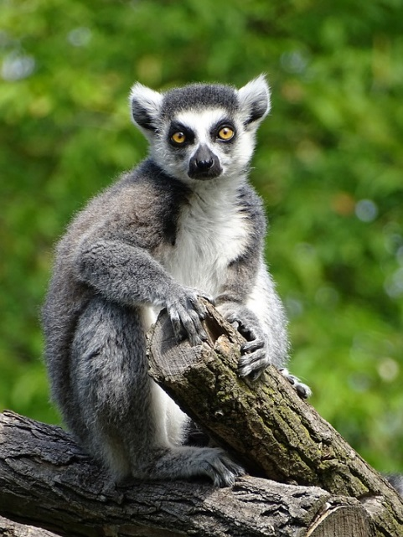
Quantifiers and conditionals
All squares are white.
$∀x∈SHAPES Square\left(x\right)→White\left(x\right).$False!
All white shapes are squares
$∀x∈SHAPES White\left(x\right)→Square\left(x\right)$True!
All circles are blue.
$∀x∈SHAPES Circle\left(x\right)→Blue\left(x\right).$
All blue shapes are circles.
$∀x∈SHAPES Blue\left(x\right)→Circle\left(x\right).$
All lemurs live in the trees.
$∀x∈ANIMALS Lemur\left(x\right)→LivesIn Trees\left(x\right)$
All animals living in the trees are lemurs.
$∀x∈ANIMALS LivesIn Trees\left(x\right)→Lemur\left(x\right)$

Slide 35
Quantifiers and conditionals
Why don’t we write them as $∀x∈SQUARES White\left(x\right) ?$
Sometimes we can, but the first form is easier to reason about.
Besides, the predicate $White(x)$ is more useful when defined for any shapes, rather than only squares!
More commonly, we use a shorthand called restricted quantifiers (or quantifiers with restricted domain):
$∀x≥0 Even\left(x\right)$ is a shorthand for $∀x (x≥0→Even\left(x\right)$)
Why do we write $→$ rather than $∧ ?$
$∀x x≥0∧Even\left(x\right)$ is immediately false in $ℤ$ since some integers are $<0.$

Slide 36
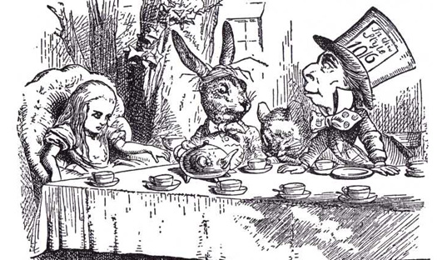
Then you should say what you mean,’ the March Hare went on.
`I do,’ Alice hastily replied; `at least–at least I mean what I say–that’s the same thing, you know.’
`Not the same thing a bit!’ said the Hatter. `You might just as well say that “I see what I eat” is the same thing as “I eat what I see”!’
`You might just as well say,’ added the March Hare, `that “I like what I get” is the same thing as “I get what I like”!’
`You might just as well say,’ added the Dormouse, who seemed to be talking in his sleep, `that “I breathe when I sleep” is the same thing as “I sleep when I breathe”!’
“Alice’s Adventures in Wonderland”
by Lewis Carroll

Slide 38
Formulas: computational view
As you are building a formula, think like a computer scientist:
What would a program (machine) that computes its value look like?
What are that program’s inputs and outputs
and what are their types?
When would this program output an error?
Think of operations in the formula computationally.

Slide 39
Type checking
A formula consists of pieces of different types
Boolean: taking values true/false
Predicates, formulas
Can use operations $¬, ∨, ∧, →$
Elements
Variables and fixed elements (constants) from the domain.
Occur as inputs to predicates and in quantifiers such as $∀x∈S$
Can use operations (functions) from the domain:
If elements are numbers, can use $x+y, x⋅y,$ etc
Sets of elements
Used for domains: only occurs in quantifiers such as $∀x∈S$

Slide 40
Type checking
A formula consists of pieces of different types
Boolean: taking values true/false
Elements: e.g. numbers
Sets of elements
$∀x∈ℤ, Even\left(x\right)∨Odd\left(x\right)$

Slide 41
Type checking
A formula consists of pieces of different types
Boolean: taking values true/false
Elements: e.g. numbers
Sets of elements
$∀x∈ℤ, Even\left(x\right)∨Odd\left(x\right)$

Slide 42
Propositional variables and formulas are of type Boolean
that is, they take values in the set $\{true, false\}$
To evaluate a propositional variable, return its truth value.
Now, treat connectives as machines with inputs and outputs.
They take Boolean inputs, and return Boolean outputs.
Bool
$$∨$$
Bool
true
$$∨$$
false
$$∨$$
$$∨$$
Bool
true

Slide 43
To evaluate a propositional formula, go up its syntax tree:
If the formula (node in the tree) is just one variable, return its value
If a formula (node) is an operation, apply the respective “evaluation machine”:
Machines for $∨, ∧, →, ↔$ want two Boolean inputs
Machine for $¬$ wants one Boolean input
Each machine outputs a single Boolean value.
Bool
$$∨$$
Bool
true
$$∨$$
false
$$∨$$
$$∨$$
Bool
true

Slide 44
Propositional variables and formulas are of type Boolean
that is, they take values in the set $\{true, false\}$
If $F, G$ are propositional formulas, then so are$¬F, F∧G, F ∨G, F→G$
So, operations $∨, ∧, →, ↔$ need to have Boolean type on both sides
And $¬$has to have a Boolean type following it.
The result of all of these operations is also of Boolean type.
Bool
Bool
p
$$¬q∧r$$
$$∨$$
$$∨$$
Bool
$$p∨(¬q∧r)$$

Slide 45
Predicate logic formulas
A predicate logic formula consists of different types
Boolean: taking values true/false
Elements: e.g. numbers
Sets of elements
We still can use $∨, ∧, →,↔, ¬$machines, both for constructing and for evaluating formulas
As formulas are of type Boolean
Also need machines for predicates and quantifiers.

Slide 46
Computational view of predicates
Predicate machines take elements as inputs and return Boolean
Different inputs may be elements from different sets
The number of inputs depends on a predicate
Boolean
Element
Element
4
2
Set
$$P$$
$$≤$$
Element
Bool
false

Slide 47
Predicate machines take a list of variables or actual elements of their domain of type element as inputs and return a formula of the form
$Predicate(elem_{1}, elem_{2}, .., )$
If there are two inputs, the form such as $elem_{1}≤elem_{2}$ is also OK
Boolean
$$elem_{1}$$
$$elem_{2}$$
$$x$$
$y$
Set
$$P$$
$$≤$$
Element
$$P(elem_{1}, elem_{2})$$
$$x≤y$$

Slide 48
To construct a predicate correctly, its inputs must take values from corresponding domains
Inputs to predicates can be functions, as long as output of the function is from the correct domain: so if the predicate P takes an integer as its input, and $x$ takes integer values, then $P(x+1)$ is OK.
Boolean
$$elem_{1}$$
$$elem_{2}$$
$$x$$
$y$
Set
$$P$$
$$≤$$
Element
$$P(elem_{1}, elem_{2})$$
$$x≤y$$

Slide 49
Computational view of quantifiers
Inputs to quantifier machines are a set, a name of a variable of type element of that set, and a formula with that variable free.
Quantifier machines also return Boolean
Set
Boolean
Element
name
Bool
$$ℤ$$
$x$
$$Even\left(x\right)∨Odd(x)$$
Set
$$∀$$
$$∀$$
Element
Bool
true

Slide 50
Universal quantifier constructing machine takes a variable name, a set and a formula, and return a new formula of the form
$∀name∈Set Formula\left(name\right)$
Boolean
Set
Set
element name
Formula
$$ℤ$$
$$x$$
$$Even\left(x\right)∨Odd(x)$$
Element
$$∀$$
$$∀$$
$$∀ name∈Set Formula(name)$$
$∀x∈ℤ (Even\left(x\right)∨Odd(x)$)

Slide 51
Liars paradox puzzle
The first formulation of the famous liar’s paradox, attributed to a Cretan philosopher Epimenides, stated
“All Cretans are liars”.
Is this really a paradox?

Slide 53
Liars paradox puzzle
The first formulation of the famous liar’s paradox, attributed to a Cretan philosopher Epimenides, stated
“All Cretans are liars”.
Is this really a paradox?

Slide 54
Liars paradox puzzle
The first formulation of the famous liar’s paradox, attributed to a Cretan philosopher Epimenides, stated
“All Cretans are liars”.
Is this really a paradox?
If “all” is not true, that means that there is a counterexample: a Cretan that does not lie.
So if Epimenides lied, what is true is that there are some truth-tellers on Crete (and potentially some liars, too)
And Epimenides is one of the liars.
However, “I am lying” would be a paradox.

Slide 55
Counterexamples
How to prove that a statement “$∀x∈S, F\left(x\right)“$ is false?
All girls hate math.
No!
I don’t hate math ☺
Everybody in O’Brian family is tall
No, Jenny is O’Brian and she is quite short.
It is foggy all the time, every day in St. John’s
No, sometimes it is not foggy (like today).
Counterexample:
Element of S for which the formula is false.
One is enough, though more than one is OK.

Slide 56
Negation of a universal statement
What is the negation of “All”, that is, what statement is true whenever “$∀x∈S, F\left(x\right)“$ is false?
All girls hate math.
No!
All girls love math?
Some girls do not hate math! I don’t.
Everybody in O’Brian family is tall
No, there is someone (Jenny) who is O’Brian and short.
It is foggy all the time, every day in St. John’s
No, sometimes it is not foggy (like today).
“Not All “ $≡$ “Some not”
As there is a quantifier $∀$for “all”, there is also a quantifier for “some”: $∃,$ called
existential quantifier.

Slide 57
Existential quantifier
$∃x∈S F\left(x\right)$
(pronounced “exists”)
is true when there is some value a for $x$in $S$ for which $F(x)$ is true.
This $a∈S$is called a witness.
$¬\left(∀x∈S F\left(x\right)\right) ≡ ∃x∈S ¬F\left(x\right)$
$∀x∈S F\left(x\right)$ is false iff there exists $\left(∃\right)$a counterexample: an element $a∈$ S such that $¬F(a)$ is true.

Slide 58
Examples with existential quantifier
“There exists an even prime number.”
Domain $ℤ$
Predicates $Even(x)$ and $Prime(x)$
$∃x∈ℤ, Even\left(x\right)∧Prime\left(x\right)$
This is true: 2 is both even and prime.
“There is some number between 0 and 1”
Domain $ℝ, p$redicate $<$
$∃x∈ℝ, (0<x)∧(x<1)$
True when the domain is $ℝ$
There is not just one, but lots of real numbers between 0 and 1
Would be false if we change the domain to $ℤ$
“$n$ is divisible by $m$ if there is an integer which when multiplied by $m$ gives $n$”
Domain $ℤ$, Predicate $\text{=}$
$∃z∈ℤ, n=mz$
True for n$=6, m=3$; in this case, z = 2
False when eg $n=3, m=2$
Here, $n$ and $m$ are still free variables, whereas $z$ is bound by the quantifier.

Slide 59
Quantifier constructing machines take a variable name, a set and a formula, and return a new formula of the form
$∀name∈Set Formula\left(name\right)$
$∃name∈Set Formula(name)$
Boolean
Set
Set
element name
Formula
$$ℤ$$
$$x$$
$$Even\left(x\right)∨Odd(x)$$
Element
$$∃$$
$$∃$$
$$∃ name∈Set Formula(name)$$
$∃x∈ℤ (Even\left(x\right)∨Odd(x)$)

Slide 60
Truth of existential statements
$∃x∈S F\left(x\right)$ is true when $F\left(a\right)$ is true for some $a∈S$
“I am teaching some course” is true because I am teaching COMP 1002
Here, COMP 1002 is the witness for the truth of “I am teaching some course”
That is, when $F\left(a_{1}\right)∨F\left(a_{2}\right)∨…∨F\left(a_{n}\right)∨…$ is true, where $a_{1},a_{2},…$is a list of all elements of $S$
Enough to find a single witness $a∈S$ with $F\left(a\right)$ true to prove $∃x∈S F\left(x\right)$.
To show that $∃x∈S F\left(x\right)$is false, show that for all $a ∈S,$ $F\left(a\right)$is false
That is because $¬ \left(∃x∈S F\left(x\right)\right)≡ ∀x∈S ¬F\left(x\right)$

Slide 61
Quantifiers in English
Universal quantifier: usually “every”, “all”, “each”, “any”.
Every day it is foggy. Each number is divisible by 1.
“None”, “no”, “nobody”, “nothing” also translate as universal quantifier
Nobody works on Sundays $≡$Everybody does not work on Sundays
Existential quantifier: “some”, “a”, “exists”
Some students got 100% on the first lab.
There exists a prime number greater than 100.
The word “any” can mean either!

Slide 62
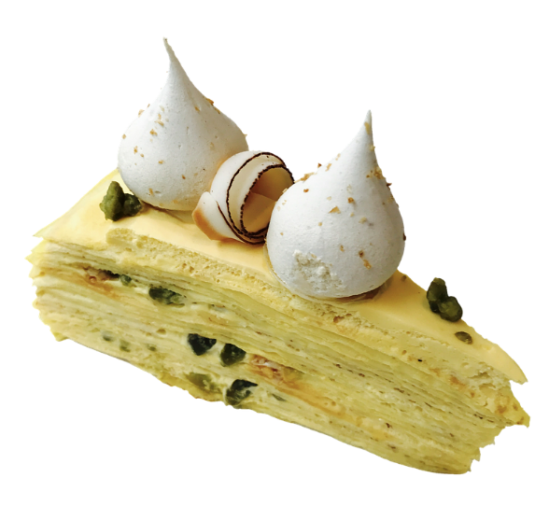
Quantifiers in English: “any”
“Any” can have different meanings depending on the context:
Any = some
Can I have any (piece of the) pie?
Can I have some (piece of the) pie?
Any = all
Any student knows this.
Every student knows this.
Any student can get an A
Would any student get an A?

Slide 64
When negating a quantified formula, the domain always stays the same.
Quantifiers flip
$(∀$ becomes $∃,$ $∃$ becomes $∀)$
The formula under quantifiers gets a $¬$ in front, and can be simplified further, treating logical connectives the same way as in propositional logic, and predicates as propositions.
$¬\left(∀x∈S F\left(x\right)\right)≡∃x∈S ¬F(x)$
$¬(∃x∈S F\left(x\right))≡∀x∈S ¬F(x)$

Slide 65
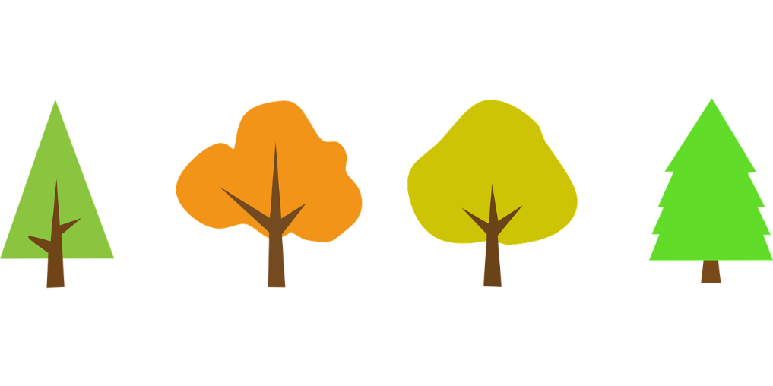
When negating a quantified formula, the domain stays the same.
Quantifiers flip $(∀$ becomes $∃,$ $∃$ becomes $∀)$
The formula under quantifiers gets a $¬$ in front, and can be simplified further
Not all integers are even $≡$ Some integers are not even
$¬\left(∀x∈ℤ Even\left(x\right)\right) ≡∃x∈ℤ ¬Even\left(x\right)$
Some integers are both even and prime – no,
none of the integers is both even and prime
each integer is not even or not prime
$¬\left(∃x∈ℤ, Even\left(x\right)∧Prime \left(x\right)\right)≡∀x∈ℤ, ¬Even\left(x\right)∨¬Prime\left(x\right)$
As in propositional case, push negations inside the formula, onto predicates.
“NOT (ALL trees have leaves)” is more confusing than “some trees do not have leaves” or “some trees have something other than leaves (e.g., needles).

Slide 66
“NOT” is for predicates, not domains!
For any formula $F$ we can write $¬F$ to denote a formula which is true if and only if $F$ is false, just like in propositional logic
$F=$“All trees have leaves”
Is $¬F$ “non-trees have non-leaves”?...
No! What is a non-tree and a non-leaf, anyway?
$¬F$ is “Not all trees have leaves”
which is the same as “Some trees do not have leaves”
we are still talking about trees!
When simplifying a negated formula, we flip quantifiers and negate subformulas as we would in propositional logic
But we never change the domain!

Slide 67
A negation machine takes a Boolean, and outputs a Boolean.
If you give something non-Boolean to a negation machine, it will give you an error!
Boolean
Set
Element
Bool
Element
$$¬$$
$$¬$$
ERROR
Bool

Slide 68
A negation machine takes a Boolean, and outputs a Boolean.
If you give something non-Boolean to a negation machine, it will give an error!
Boolean
Set
Element
$$x$$
$$F(x)$$
$$¬$$
$$¬$$
ERROR
$$¬F(x)$$

Slide 70
$$∃$$
$$∀$$
We can mix both types of quantifiers in a formula.
But the order matters!

Slide 71
Predicate: $Loves(x,y),$true when x loves y. Domain: people.
$∀$x $∃$y Loves(x,y)
Everybody loves somebody
$∃x$ $∀y$ Loves(x,y)
Somebody loves everybody
$∀$x $∃$y Loves(y,x)
Everybody is loved by somebody
$∃x$ $∀y$ Loves(y,x)
Somebody is loved by everybody

Slide 72
Nested quantifiers
Order of variables under different quantifiers, the order of quantifiers themselves, matters.
Everybody loves somebody is true for people in general
Whereas somebody loves everybody is rare (only the sun shines on everyone)
Order in a predicate matters.
To love is is not the same as to be loved.
Everyone is loved by their mother
yet it is rare to be loved by everyone (except maybe Elvis)

Slide 73
Nested quantifiers
Names of variables don’t matter
Everybody loves somebody:
$∀$x $∃$y Loves(x,y) same as $∀y$ $∃x$ Loves(y,x) same as $∀p_{1}$ $∃p_{2} Loves\left(p_{1},p_{2}\right)$
Somebody is loved by everybody:
$∃\text{x} ∀y$ Loves(y,x) same as $∃y$ $∀x$ Loves(x,y) same as $∃p_{1}∀p_{2}Loves\left(p_{2},p_{1}\right)$

Slide 74
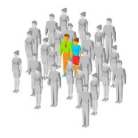
Nested quantifiers
When quantifiers of the same time are next to each other, their order does not matter.
First says that every two people love each other: eg when the domain is a happy family
Second says that somewhere there is a person who feels love (to someone else, or maybe to themselves)
However, in $∃x ∀y ∃z F(x,y,z)$ you cannot exchange $x$ with $z$:
$z$might be different for each different $y,$ but the same $x$ should work for all of them!
Can ignore order only for quantifiers of the same type right next to each other
$∀$x $∀y$ Loves(x,y)
Everybody loves everybody
$∃x$ $∃$y Loves(x,y)
Somebody loves somebody

Slide 75
$∀$x $∃$y Loves(x,y) Everybody loves somebody
$∀$x $∃$y Loves(y,x) Everybody is loved by somebody
$∀$x $∀y$ Loves(x,y) Everybody loves everybody
$∃x$ $∀y$ Loves(x,y) Somebody loves everybody
$∃x$ $∀y$ Loves(y,x) Somebody is loved by everybody
$∃x$ $∃$y Loves(x,y) Somebody loves somebody

Slide 77
Evaluating sentences with nested quantifiers
$$∀$$
Take a formula with no free variables: a sentence
How do we find out if it is true or false? Play a game!
Two players, taking turns in order of quantifiers
The red player holding $∀$ suggests counterexamples
The green player holding $∃$ suggests witnesses.
If the red player has a way to win no matter what the green player does, then the formula is false
If the green player has a way to win no matter what the red player does, then the formula is true.
The sentence is always either true or false, so one of them can always win.
I want it false!
I want it true!
$$∃$$

Slide 78
$$∀x ∈ℤ ∃y∈ℤ ∀z∈ℤ x≠yz$$
Let’s first read the formula. It says that no matter what integer $x$ you pick, there is some integer $y$ that does not divide $x$(does not give $x$ no matter what $z$ you multiply it by).
Do you think it is true? Let’s play the game!
The formula starts with $∀,$so goes first. After that chooses $y$, then it is again
$$∀$$
$$∀$$
$$∃$$

Slide 79
$$∀x ∈ℤ ∃y∈ℤ ∀z∈ℤ x≠yz$$
$$∀$$
Let’s first read the formula. It says that no matter what integer $x$ you pick, there is some integer $y$ that does not divide $x$(does not give $x$ no matter what $z$ you multiply it by).
Do you think it is true? Let’s play the game!
The formula starts with $∀,$so goes first. After that chooses $y$, then it is again
$x=0$Beat that!
$$∀$$
$$∀$$
$$∃$$

Slide 80
$$∀x ∈ℤ ∃y∈ℤ ∀z∈ℤ x≠yz$$
$$∀$$
Let’s first read the formula. It says that no matter what integer $x$ you pick, there is some integer $y$ that does not divide $x$(does not give $x$ no matter what $z$ you multiply it by).
Do you think it is true? Let’s play the game!
The formula starts with $∀,$so goes first. After that chooses $y$, then it is again
$x=0$Beat that!
uhm, $y=1$?
$$∃$$
$$∀$$
$$∀$$
$$∃$$

Slide 81
$$∀x ∈ℤ ∃y∈ℤ ∀z∈ℤ x≠yz$$
$$∀$$
Let’s first read the formula. It says that no matter what integer $x$ you pick, there is some integer $y$ that does not divide $x$(does not give $x$ no matter what $z$ you multiply it by).
Do you think it is true? Let’s play the game!
The formula starts with $∀,$so goes first. After that chooses $y$, then it is again
$x=0$Beat that!
uhm, $y=1$?
Nope! Set $z=0$
and now $0=1⋅0$
The formula is false!
Mwahahaha!
$$∃$$
$$∀$$
$$∀$$
$$∀$$
$$∃$$

Slide 82
$$∀x ∈\{1,2,3\} ∃y∈ℤ ∀z∈ℤ x≠yz$$
$$∀$$
Now we changed the domain of $x$, so $x$can only take values $1, 2$ or 3.
Do you think it is true now? Let’s play the game and find out!
So the formula is true.
No matter what $x$ among allowed 1$,2,3$he takes, she can reply with $y=x+1$ and win.
Note that her choice of $y$ depends on what value of $x$ he picks.
But since he has to choose $x$ before she chooses $y,$ it is OK, as she would know his choice for the value of $x$. The order of quantifiers matters!
Say $x=2$
Then let $y=3$?
Say $z=0?..$
But $2≠0⋅3$
I give up. No matter
what $z$ I try, $2≠z⋅3$
You win ☹ Arrrgh!
$$∃$$
$$∀$$

Slide 83
$$∀x ∈ℤ (x=0∨∃y∈ℤ ∀z∈ℤ x≠yz)$$
$$∀$$
Now let’s try a more complex formula, which says that for every integer $x$ either $x=0$ or there is an integer $y$that does not divide $x$
After the first step where sets $x,$ the formula under $∀x$ splits into $∨$ of two.
The first, $x=0,$ can be evaluated right away
He’d lose immediately if he sets $x$ to be 0
So he’d better choose a non-zero value for $x$
Still, no matter what $x$ he takes, she can always reply with $y=x+1$ (if $x<0,$ then $y=x−1)$ and win
Say $x=5$
Then let $y=6$?
Say $z=0?..$
But $5≠0⋅6$
I give up. No matter
what $z$ I try, $5≠z⋅6$
You win ☹ Arrrgh!
$$∀$$
$$∃$$
$$∀$$

Slide 84
$$∀x ∈ℤ ∀y∈Z ∃z∈ℤ xz= yz)$$
$$∀$$
If there are several quantifiers of the same type, the corresponding player keeps getting a turn
Here, the formula starts with two $∀$
So gets to go twice, setting both x and y.
Only then gets her turn to set z.
Say $x=2$
Say $y=3$
Take$z=0$
It works ☺
$$∀$$
$$∀$$
$$∃$$
$$∃$$

Slide 86
$$∃$$
$$∀$$
General rules for building predicate logic formulas

Slide 87
Variables and terms
Boolean
Set
Element
Simplest formulas are p$redicates:P\left(x,y\right), x_{1}=x_{2}, Even(num)$
Here, $x, y, x_{1},x_{2},num$are variables, that is, placeholders for elements in the domains of the predicates.
Instead of a variable, can have an expression (also called a function or a term), which takes values of variables and returns a value in the domain:
$x+1,$ $x⋅y$ are terms
Can now use them in $Even\left(x+1\right)$, or in $x⋅y=z$
E.g. if the domain of $Even\left(\right) and=is ℤ,$then $x, y, z$ take values in $ℤ,$ so the value of $x+1∈ℤ,$and the value of $x⋅y∈ℤ$ no matter what values $x,y,z$take.
If the formula is a predicate, then all the variables it takes are free.
Including all variables mentioned in the terms, as $x, y, z$ in $x ⋅y=z$

Slide 88
Naming conventions
Names of variables do not matter, as long as you use the same name every time you refer to a specific placeholder in a formula.
$∀x∈ℤ (Even\left(x\right)∨Odd(x))$ is the same as $∀y∈ℤ (Even\left(y\right)∨Odd\left(y\right))$
The convention is to use either lowercase letters, usually at the end of the alphabet ($x,y,z, w, x_{1},x_{2})$ or lowercase words ($num$ for number) for variables
Just like unknowns in arithmetic equations
Letters $a,b,c$more often used for specific elements.
Use capitalized words $(Even, LessThan)$ or $P, Q$ for predicates.
Often use $P, Q$when the interpretation of the predicate is not specified

Slide 89
Prenex normal form
Better to avoid using same names for different variables – it is confusing.
$∀x \left(∃y P\left(x,y \right)\right)∧\left(∃y Q\left(x,y\right)\right) ≡ ∀x \left(∃ y P\left(x,y\right)\right)∧\left(∃z Q\left(x,z\right)\right)$
$≡ ∀x ∃y ∃z P\left(x,y\right)∧Q\left(x,z\right)$
The final line is an example of a special form of a predicate logic formula with all quantifiers in front followed by a formula without quantifiers, called prenex normal form.
Here, the names must be different to differentiate variables, as they all have the same scope: the whole formula.

Slide 90
Constructing predicate logic formulas
A single predicate is a predicate logic formula
$P\left(x,y\right), x_{1}=x_{2}, Even(num)$
In these formulas, $x, y, x_{1},x_{2},num$ are free variables
If $F$ and $G$ are predicate logic formulas, then so are
$F∧G$ $F∨G F→G F↔G ¬F$
If $F\left(x\right)$ is a predicate logic formula with a free variable $x$ from the domain S, then so are $∀x∈S F\left(x\right)$ as well as $∃x∈S F(x)$
Here $x$is no longer a free variable, it gets bound by the quantifier.
When the domain is clear, just write $∀x F\left(x\right)$ (respectively, $∃x F(x)$ )
Use parentheses to avoid ambiguity: $∀x (G\left(x\right)→H)$ is not equivalent to $(∀x G\left(x\right))→H$

Slide 91
Make sure to type-check!
Always think which types can be combined with which operations,
and what the result looks like!
Remember that if you give an evaluation machine incorrectly formatted input, it will give you an error.
“$Even\left(x\right), Odd(x)"$ ERROR!
“$∃ Even "$ERROR!
“$Even(x=y)"$ERROR!
“$∀x∈ℤ ¬x" ERROR!$
$$¬$$
Bool
Boolean
Set
$$¬$$
Bool
Element

