Slide 1
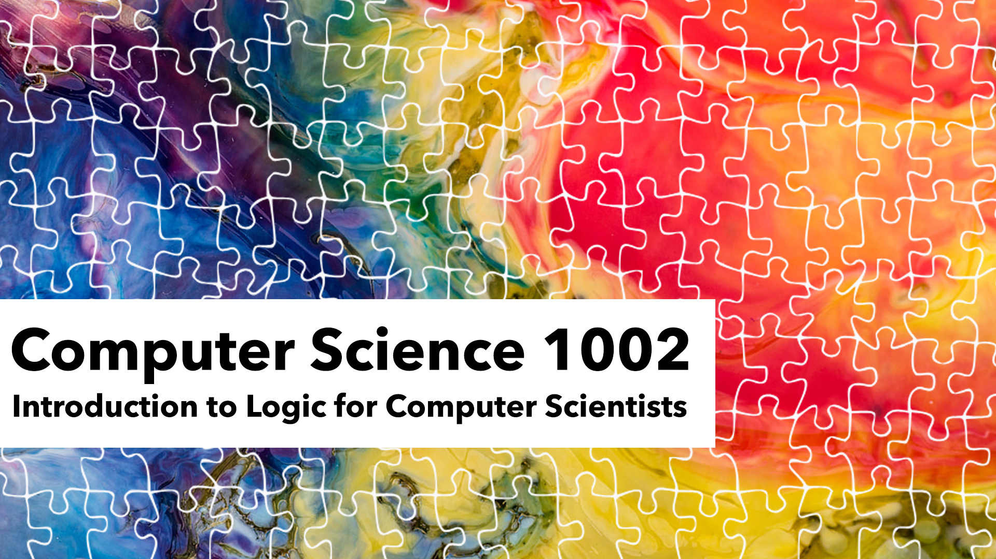
Unit 2
Reasoning in propositional logic

Slide 2
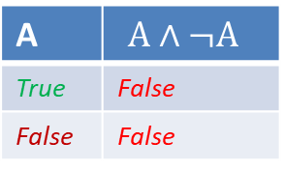
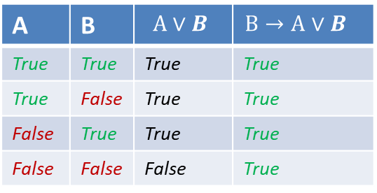
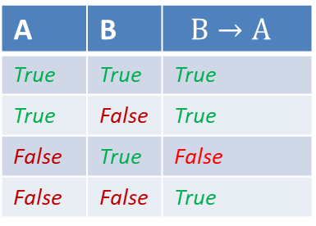
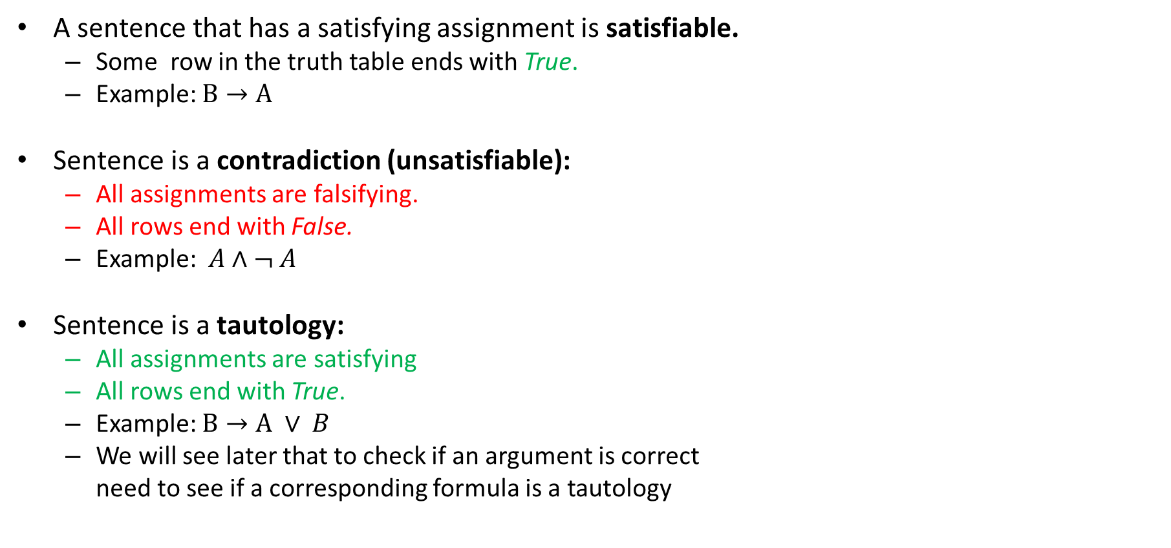
Special types of sentences
A | B | $$B→A$$
True | True | True
True | False | True
False | True | False
False | False | True
A sentence that has a satisfying assignment is satisfiable.
  Some row in the truth table ends with True.
  Example: $B→A$
Sentence is a contradiction (unsatisfiable):
  All assignments are falsifying.
  All rows end with False.
  Example: $A∧¬ A$
Sentence is a tautology:
  All assignments are satisfying
  All rows end with True.
  Example: $B→A ∨ B$
  We will see later that to check if an argument is correct
  need to see if a corresponding formula is a tautology
A | $$A∧¬A$$
True | False
False | False
A | B | $$A∨B$$ | $$B→A∨B$$
True | True | True | True
True | False | True | True
False | True | True | True
False | False | False | True

Slide 3

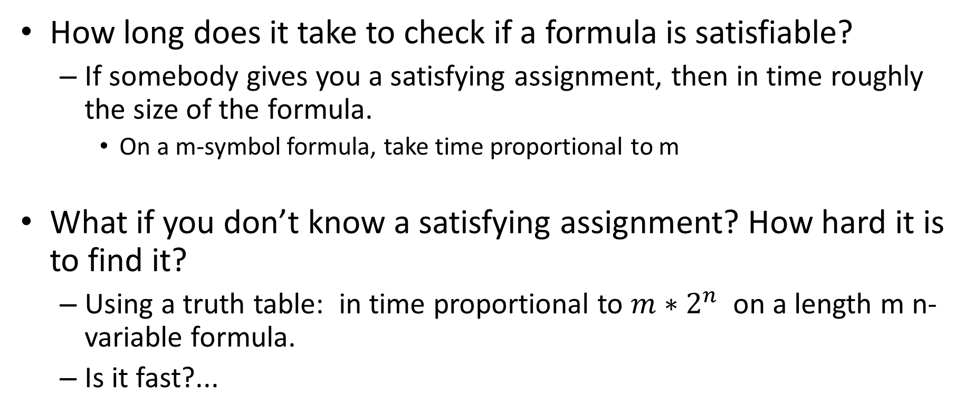
Determining formula type
How long does it take to check if a formula is satisfiable?
  If somebody gives you a satisfying assignment, then in time roughly the size of the formula.
    On a m-symbol formula, take time proportional to m
What if you don’t know a satisfying assignment? How hard it is to find it?
  Using a truth table: in time proportional to $m∗2^{n}$ on a length m n-variable formula.
  Is it fast?...

Slide 5

Complexity of computation
Would you still consider a problem really solvable if it takes a very long time?
  Say 10^{n} steps on an n-symbol string?
  At a billion (10⁹) steps per second (~1GHz)?
  To process a string of length 100…
  will take 10¹⁰⁰/10⁹ seconds, or ~3x10⁷² centuries.
  Age of the universe: about 1.38x10¹⁰ years.
  Atoms in the observable universe: 10⁷⁸-10⁸².

Slide 6

Complexity of computation
What strings do we work with in real life?
  Human DNA has about 3.2 ×10⁹ base pairs
  A secure key in cryptography: 256 bits
  Number of Walmart transactions per day: 10⁹.
  URLs searched by Google in 2012: 3x10¹² with 3.5x10⁹ searches per day now

Slide 7
Determining formula type
How long does it take to check if a formula is satisfiable?
  Using a truth table: about $m∗2^{n}$ steps
  Is it efficient?
    Not really! Formula with 100 variables is already too big!
    In software verification: millions of variables!
  Can we do better?
A million-dollar question!

Slide 9

The million dollar question
In Russian, called “perebor” (перебор) problem.
  “perebor” translates as “exhaustive search”.
  Question: is it always possible to avoid looking through nearly all potential solutions to find an answer?
    Such as all truth assignments for a formula with a truth table.
  Are there situations when exhaustive search is unavoidable?

Slide 10
The million dollar question
In English, known as “P vs. NP” problem
  P stands for “polynomial time” (efficiently) computable”.
  NP is “polynomial time checkable”
    non-deterministic polynomial-time computable
  Question: is everything efficiently checkable also efficiently computable?
    Or do we need to go through nearly all potential solutions?

Slide 11

Why call it a million dollar question?
There is a million dollar prize for solving it!

Slide 12
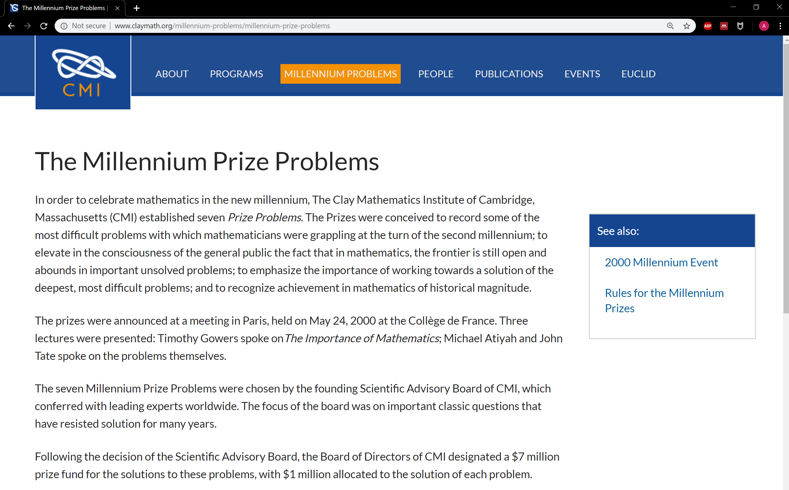

Slide 13
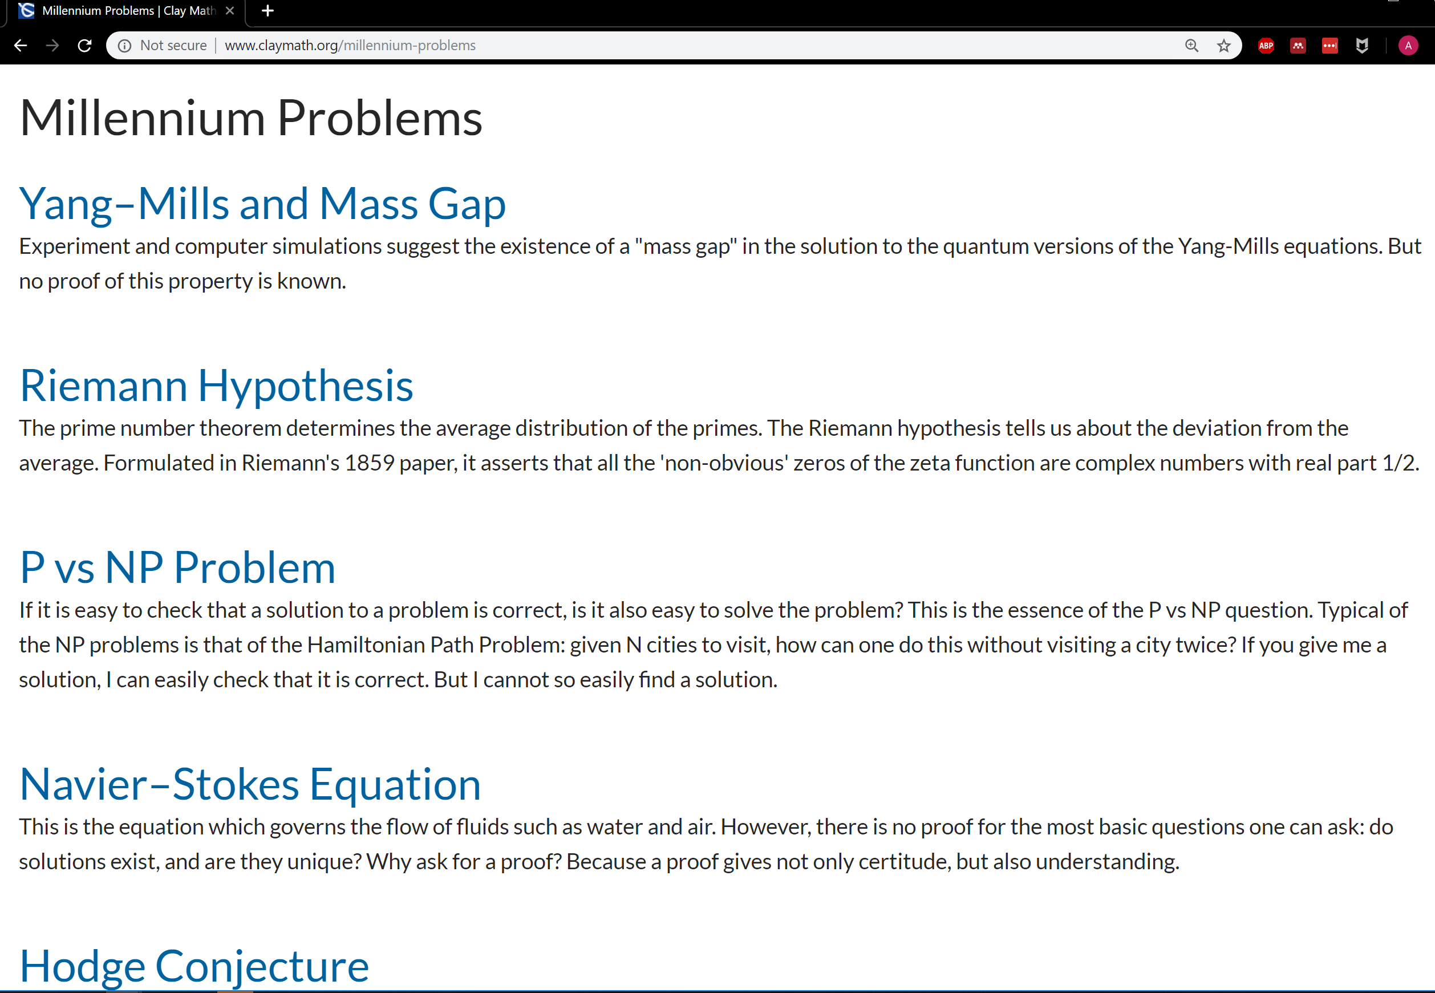

Slide 14
NP-completeness:
To solve P vs NP, enough to find a way to check if formulas are satisfiable that always works (significantly) faster than truth tables!
Or show that it is impossible.

Slide 15
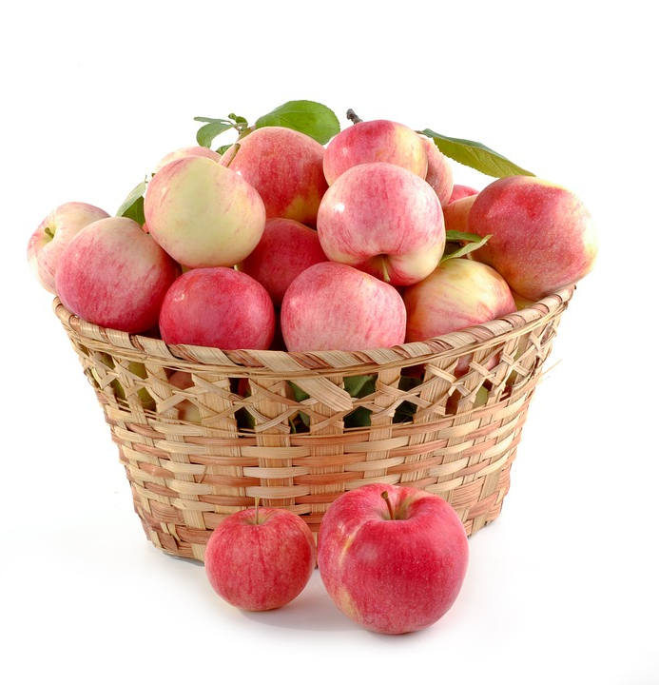
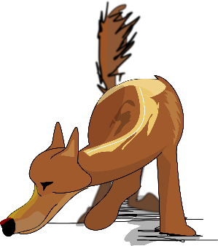
A formula is like a basket of apples.
  formula is a tautology
  =
  All apples in the basket are good.
Can you check that all apples in a basket are good without looking at every single one?
Can you do it for every possible basket of apples?
Smell test?

Slide 16

P vs NP: the million dollar problem.
To show that P=NP, just need to find a smell test for satisfiability.

Slide 18
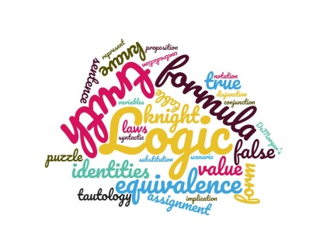
Logical equivalence
Two formulas F and G are logically equivalent ($F⇔G$ or $F≡G)$ if they have the same value for every row in the truth table on their variables.
  $A∧¬A≡FALSE$
    (same as saying it is a contradiction)
  $\left(¬A∨B\right)≡(A→B )$
  $\left(A↔B\right)≡\left(A→B\right)∧\left( B→A\right)$
Useful fact: to prove $F≡G,$prove that $F↔G$ is a tautology
A | B | $$¬A∨B$$ | $$A→B$$
True | True | True | True
True | False | False | False
False | True | True | True
False | False | True | True

Slide 19
Logical equivalence
Even more useful fact:
If $F≡G,$ and $F$ is a subformula of $H,$ then replacing $F$ with $G$ in $H$ results in a formula logically equivalent to $H$.
  Recall that a subformula corresponds to a node in a syntax tree.
    So we can replace a subtree with another for a logically equivalent formula without changing the value of the whole formula.
  $B∧\left(A→B\right)∨C ≡B∧\left(¬A∨B\right)∨C,$
    because $\left(¬A∨B\right)≡(A→B )$
  $\left(B∧A→C\right)∨A≡ \left(¬\left(B∧A\right)∨C\right)∨A$
    Do two replacements: one is renaming variables in $\left(¬A∨B\right)≡(A→B )$ to some other names (say $\left(¬F∨G\right)≡\left(F→G\right)$ )
    And the other putting $B∧A$ instead of $F,$ and $C$ instead of G.

Slide 20


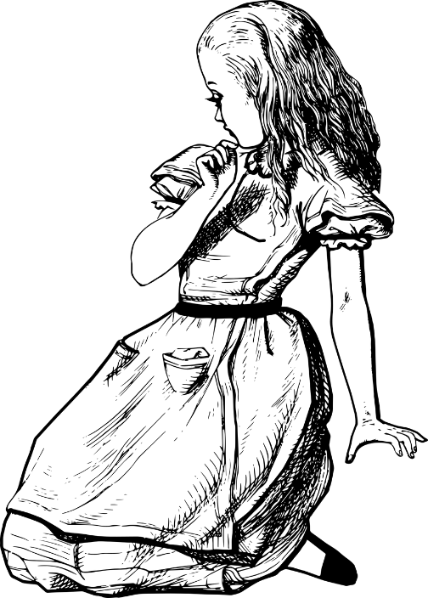
Smoking ban puzzle
“I refuse to vote against repealing the ban on smoking in public. “
Alice says:
Does Alice like smoking or hate it?

Slide 22
Smoking ban puzzle
$$¬$$
$$¬$$
“I refuse to vote against repealing the ban on smoking in public. “
$$¬$$
$$¬$$
Alice says:
Does Alice like smoking or hate it?

Slide 23


Negating a formula
Often given a formula $A$ we want to say that it is not true, that is, write a formula equivalent to $¬A$
  “It’s sunny and cold today”! -- No, it’s not!
For our brain, hard to understand multiple negations:
  “I refuse to vote against repealing the ban on smoking in public. “
How can we simplify such formulas with nested negations?

Slide 24


Double negation
Double negations cancel each other: Law of Excluded Middle.
  $¬¬A≡A$
  “I do not disagree with you” = “I agree with you”
$$¬¬$$
$$≡ ¬$$
$$≡$$
$$¬¬$$
$$≡ ¬$$
$$≡$$

Slide 25
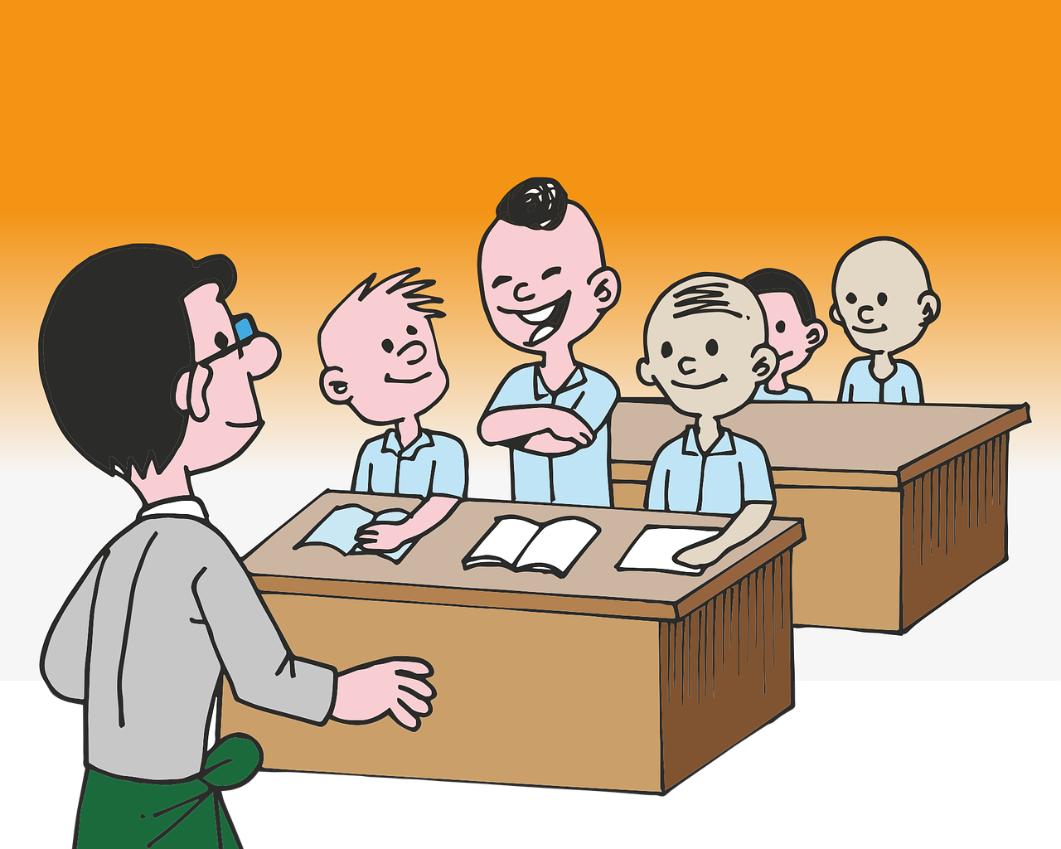
A double negative gives a positive.
But double positive is not a negative!
Yeah, right…

Slide 27
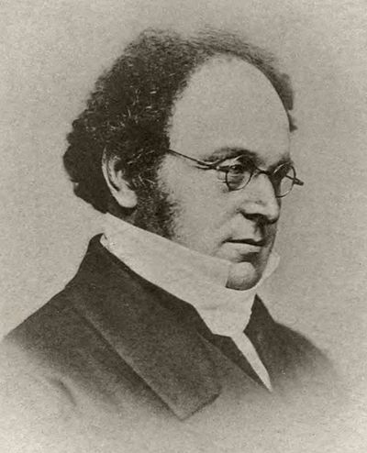
De Morgan’s Laws
De Morgan’s law for AND:
$¬ \left(A∧B\right)$ is equivalent to $\left(¬A∨¬B\right)$
De Morgan’s law for OR:
$¬ \left(A∨B\right)$ is equivalent to $\left(¬A∧¬B\right)$

Slide 28


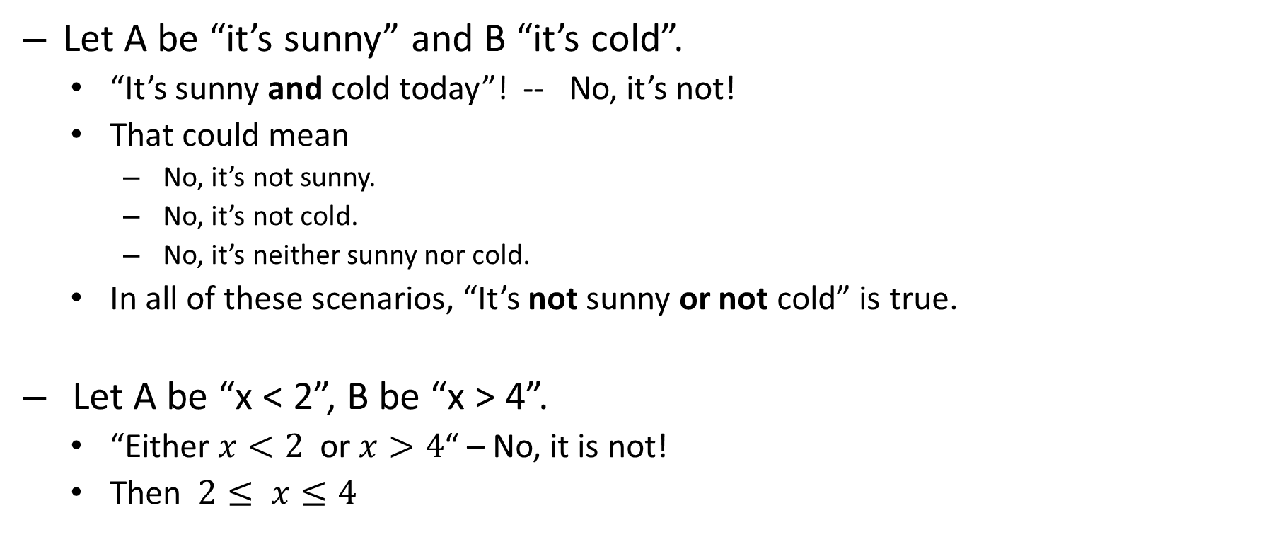
De Morgan’s laws: examples
  Let A be “it’s sunny” and B “it’s cold”.
    “It’s sunny and cold today”! -- No, it’s not!
    That could mean
      No, it’s not sunny.
      No, it’s not cold.
      No, it’s neither sunny nor cold.
    In all of these scenarios, “It’s not sunny or not cold” is true.
  Let A be “x < 2”, B be “x > 4”.
    “Either $x<2$ or $x>4$“ – No, it is not!
    Then $2≤ x≤4$
0 1 2 3 4 5 6

Slide 29

Negating “if .. then”
  Let A be “I play” and B “I win”.
    $A→B$: “If I play, then I win”
    Equivalent to $¬A∨B:$ “Either I do not play, or I win”.
  Negation: $¬(A→B)$: “It is not so that if I play then I win”.
    By de Morgan’s law: $¬\left(¬A∨B\right)≡\left(¬¬A∧¬B\right)$
    By double negation: $\left(¬¬A∧¬B\right)≡(A∧¬B)$
    So negation of “If I play then I win” is “I play and I don’t win”.

Slide 30
Negation rules
$¬$
$¬$
$¬$
$¬$
$$∧$$
$$∨$$
$$→$$
$$¬$$
De Morgan
$∨$
$∧$
$∧$
$$¬$$
$$¬$$
$$¬$$
$$¬$$
$$¬$$
Double negation

Slide 32
Negating long formulas.
  Start with the syntax tree.
  Starting from the top, keep applying De Morgan’s laws and double negation rules.
  Stop when all negations are on variables.
  $¬ ( \left(A∨¬B\right)→ \left(¬A∧C\right))$
$¬$
$$→$$
$$∨$$
$∧$
$$A$$
$$¬$$
$¬$
C
B
A

Slide 33
Negating long formulas.
  Start with the syntax tree.
  Starting from the top, keep applying De Morgan’s laws and double negation rules.
  Stop when all negations are on variables.
  $¬ ( \left(A∨¬B\right)→ \left(¬A∧C\right))$
    $\left(A∨¬B\right)∧¬\left(¬A∧C\right)$ (negating $→)$
$∧$
$$¬$$
$$∨$$
$∧$
$$A$$
$$¬$$
$¬$
C
B
A

Slide 34
Negating long formulas.
  Start with the syntax tree.
  Starting from the top, keep applying De Morgan’s laws and double negation rules.
  Stop when all negations are on variables.
  $¬ ( \left(A∨¬B\right)→ \left(¬A∧C\right))$
    $\left(A∨¬B\right)∧¬\left(¬A∧C\right)$ (negating $→)$
    $\left(A∨¬B\right)∧\left(¬¬A∨¬C\right)$ (de Morgan)
$∧$
$$∨$$
$$∨$$
$¬$
$¬$
$$A$$
$$¬$$
$¬$
C
B
A

Slide 35
Negating long formulas.
  Start with the syntax tree.
  Starting from the top, keep applying De Morgan’s laws and double negation rules.
  Stop when all negations are on variables.
  $¬ ( \left(A∨¬B\right)→ \left(¬A∧C\right))$
    $\left(A∨¬B\right)∧¬\left(¬A∧C\right)$ (negating $→)$
    $\left(A∨¬B\right)∧\left(¬¬A∨¬C\right)$ (de Morgan)
$∧$
$$∨$$
$$∨$$
$¬$
$¬$
$$A$$
$$¬$$
$¬$
C
B
A

Slide 36
Negating long formulas.
  Start with the syntax tree.
  Starting from the top, keep applying De Morgan’s laws and double negation rules.
  Stop when all negations are on variables.
  $¬ ( \left(A∨¬B\right)→ \left(¬A∧C\right))$
    $\left(A∨¬B\right)∧¬\left(¬A∧C\right)$ (negating $→)$
    $\left(A∨¬B\right)∧\left(¬¬A∨¬C\right)$ (de Morgan)
    $\left(A∨¬B\right)∧\left(A∨¬C\right)$(removing $¬¬)$
$∧$
$$∨$$
$$∨$$
A
$¬$
$$A$$
$$¬$$
C
B

Slide 37
Negating long formulas.
  Start with the syntax tree.
  Starting from the top, keep applying De Morgan’s laws and double negation rules.
  Stop when all negations are on variables.
  $¬ ( \left(A∨¬B\right)→ \left(¬A∧C\right))$
    $\left(A∨¬B\right)∧¬\left(¬A∧C\right)$ (negating $→)$
    $\left(A∨¬B\right)∧\left(¬¬A∨¬C\right)$ (de Morgan)
    $\left(A∨¬B\right)∧\left(A∨¬C\right)$(removing $¬¬)$
$∧$
$$∨$$
$$∨$$
A
$¬$
$$A$$
$$¬$$
C
B

Slide 38
Negation rules
$¬$
$¬$
$¬$
$¬$
$$∧$$
$$∨$$
$$→$$
$$¬$$
De Morgan
$∨$
$∧$
$∧$
$$¬$$
$$¬$$
$$¬$$
$$¬$$
$$¬$$
Double negation

Slide 39


Knights and knaves again
On a mystical island, there are two kinds of people: knights and knaves. Knights always tell the truth. Knaves always lie.
Puzzle: You see three islanders talking to each other, Arnold, Bob and Charlie.
  You ask Arnold “Are you a knight?”, but can’t hear what he answered.
  Bob pitches in: “Arnold said that he is a knave!”
  and Charlie interjects “Don’t believe Bob, he’s lying”.
  Out of Bob and Charlie, who is a knight/knave?

Slide 41
Knights and knaves again
On a mystical island, there are two kinds of people: knights and knaves. Knights always tell the truth. Knaves always lie.
Puzzle: You see three islanders talking to each other, Arnold, Bob and Charlie.
  You ask Arnold “Are you a knight?”, but can’t hear what he answered.
  Bob pitches in: “Arnold said that he is a knave!”
  and Charlie interjects “Don’t believe Bob, he’s lying”.
  Out of Bob and Charlie, who is a knight/knave?

Slide 42
Knights and knaves again
Puzzle: You see three islanders talking to each other, Arnold, Bob and Charlie.
  You ask Arnold “Are you a knight?”, but can’t hear what he answered.
  Bob pitches in: “Arnold said that he is a knave!” and
  Charlie interjects “Don’t believe Bob, he’s lying”.
  Out of Bob and Charlie, who is a knight and who is a knave?
Look at the sentence “I am a knave”. Who of the knights/ knaves can say this?
If A is “Arnold is a knight” and S is “I am a knave”, when is $S↔A$ (what Arnold said is true if and only if he is a knight).
But also “I am a knave” is the same as saying $¬ A$
$A↔¬ A$is a contradiction: it is false no matter what A is.
So Bob must be lying: Bob is a knave. And Charlie is a knight.

Slide 43
Simplifying formulas
$$→$$
$A∧C →¬B∨C$
  By$(F→G)≡ (¬F∨G)$
    equivalent to $¬\left(A∧C\right)∨\left(¬B∨C\right)$
  De Morgan’s law
    $¬\left(A∧C\right)$ is equivalent to $\left(¬A ∨¬C\right)$
Can we simplify this formula further?
$$∧$$
$$∨$$
A
C
$$¬$$
C
B
$$∨$$
$$∨$$
$$∨$$
$$¬$$
$$¬$$
$$¬$$
C
A
C
B

Slide 44
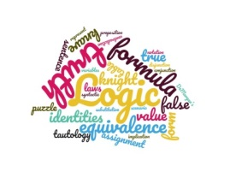
Repeated operations: Associativity rule
Now get $(¬A∨¬C)∨(¬B∨C)$
  When you have 3+4+5+6, the result is the same whether you do (3+4)+(5+6) or ((3+4)+5)+6, since all operations are +
  In fact you’d probably write it without parentheses
  Similarly, the order in which you do multiplications in 3*4*5*6 does not matter.
The same applies when we have repeated ∨ or repeated ∧ (but not the mix of the two!)
  Can write $(¬A∨¬C)∨(¬B∨C)$ as $¬A∨¬C∨¬B∨C$
  We can draw this on the syntax tree as one big ∨ or ∧
    Just as we saw when we talked about Boolean circuits.
$$∨$$
$$∨$$
$$∨$$
$$¬$$
$$¬$$
$$¬$$
C
A
C
B
$$∨$$
$$¬$$
$$¬$$
$$¬$$
C
A
C
B

Slide 45
Changing the order: commutativity rule
$$∨$$
We simplified $A∧C →¬B∨C$ to $¬A∨¬C∨¬B∨C$
  Can we go any further?
  In arithmetic, 3+4+5 = 4+5+3, etc
  The answer remains the same if you change order
  As long as terms are part of the same “big” sum or product
In logic, also can change the order of subformulas in a big $∨$ or big $∧$
  Let’s rewrite $¬A∨¬C∨¬B∨C$ as $¬A∨¬B∨¬C∨C$
  But $¬C∨C$is always true! So the whole formula is a tautology.
$$¬$$
$$¬$$
$$¬$$
C
A
C
B

Slide 46
Logical equivalences
For any logic formulas A, B, C,
  like in arithmetic (with $∨$ as +, $∧$as *)
  $A∨B≡B∨A$ $A∧B≡B∧A$
  $\left(A∨B\right)∨C≡A∨\left(B∨C\right) \left(A∧B\right)∧C≡A∧\left(B∧C\right)$
  $\left(A∨B\right)∧C≡\left(A∧C\right)∨\left(B∧C\right)$
  And unlike arithmetic $\left(A∧B \right)∨C≡ \left(A∨C\right)∧(B∨C)$
Properties of $TRUE$ and $FALSE$
  $TRUE∨A≡TRUE. TRUE∧A≡A$
  $FALSE ∨A≡A. FALSE∧A≡FALSE$
  $A∨¬A ≡TRUE$ $A∧¬A≡ FALSE$
  $A∨A≡A A∧A≡A$
Commutativity
Associativity
Distributivity (2)
Double negation: $¬¬A≡A$
De Morgan’s laws:
$¬\left(A∨B\right)≡¬A∧¬B$
$$¬\left(A∧B\right)≡¬A∨¬B$$

Slide 47
Simplification with distributivity example
$¬ \left( \left(A∨¬B\right)→ \left(¬A∧C\right)\right)$
$≡\left(A∨¬B\right)∧¬\left(¬A∧C\right)$ (negating $→)$
  $≡\left(A∨¬B\right)∧\left(¬¬A∨¬C\right)$ (de Morgan’s law)
  $≡\left(A∨¬B\right)∧\left(A∨¬C\right)$ (double negation$)$
Can now simplify further, if we want to.
  $≡A∨(¬B∧¬C)$ (distributivity: factor out A)

Slide 48
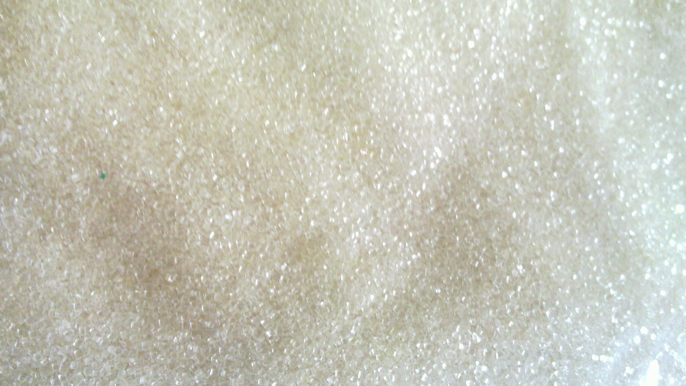
Laws of logic can prove equivalence
Every Boolean function can be written as a formula.
  Moreover, as a CNF or DNF formula, using only $∨, ∧, ¬$
    So for every Boolean function we can build a formula to compute it just out of $∨, ∧, ¬$
    Connectives $→and ↔$ are syntactic sugar.
  Though there are many formulas with the same truth table, for each truth table there is just one canonical CNF and one canonical DNF.
So the logic equivalences (laws of logic) can be used to find out whether any two formulas are equivalent.
  Use laws of logic to convert both formulas to their canonical CNFs (or canonical DNFs).
  Check if you got the same answer.

Slide 50
Complete set of connectives
CNFs only use $¬, ∨, ∧$, yet any formula can be converted into a CNF
  Any truth table can be coded as a CNF
Call a set of connectives which can be used to express any truth table a functionally complete set of connectives.
  So $¬, ∨, ∧$, is a complete set of connectives.
Is this as small as complete sets of connectives can be?
$$∧$$
$$∨$$
$$∨$$
$$∨$$
$$¬$$
$$¬$$
$$r$$
$$¬$$
$$q$$
$$¬$$
$$p$$
p
q
r
q

Slide 51
Complete set of connectives
In fact, $¬, ∨$ is already complete. So is $¬, ∧ .$
  By DeMorgan’s, $\left(A∨B\right)≡¬(¬A∧¬B)$ No need for $∨$!
But $∧, ∨$ is not complete: cannot do $¬$ with just $∧, ∨.$
  Because when both inputs have the same value,
  both $∧, ∨$ leave them unchanged.
    $A∧A≡A∨A≡A$
$$¬$$
$$∨$$
$$∧$$
$$¬$$
$$¬$$
$$¬$$
$$∨$$
$$∨$$
$$∨$$
$$∨$$
$$∨$$
$$∨$$
$$¬$$
$$¬$$
$$r$$
$$¬$$
$$q$$
$$¬$$
$$p$$
$$¬$$
$$¬$$
$$r$$
$$¬$$
$$q$$
$$¬$$
$$p$$
p
q
r
q
p
q
r
q

Slide 52
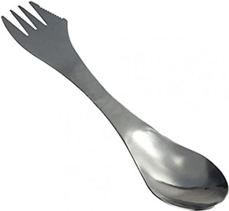

Complete set of connectives
There is a complete set with just one connective: NAND (NotAND)
  Also called Sheffer stroke, written | and defined by this truth table:
To show that NAND is enough, show how to simulate
a complete set of connectives (say $¬, ∨$) using only |
  $¬ A≡A | A$
  $A∨B≡¬\left(¬A∧¬B\right)$ $≡\left(¬A \right| ¬ B)$ $≡\left( \left(A \right|A\right)| (B |B))$
  In practice, most often stick to $∧,∨, ¬$ (called De Morgan basis)
A | B | A | B
True | True | False
True | False | True
False | True | True
False | False | True

Slide 54

Ways to say $A→B$ in English
Lots of ways to say $A→B.$
  “If A, then B” (“If A, B”)
  “A implies B”
  “A only if B”
  “B unless ¬A”
  “B if A” (“B when(ever) A”)
  “B follows from A”
  “A is sufﬁcient for B”
  “B is necessary for A”
$A:$ “it’s wet”, B: “it’s slippery”. $A→B$
  If it’s wet, it’s slippery
  It’s wet implies that it’s slippery
  It’s wet only if it’s slippery.
  It’s slippery unless it is not wet.
  It’s slippery when it’s wet.
  Being slippery follows from being wet
  Being wet is sufficient (to make it) slippery
  It must be slippery when it is wet

Slide 55
More on if… then…
You see the following cards. Each has a letter on one side and a number on the other.
Which cards do you need to turn to check that if a card has a J on it then it has a 5 on the other side?
B
5
2
J

Slide 56
Contrapositive
Let $A→B$ be an implication (if A then B, A implies B).
  If a card has a J on one side, then it has 5 on the other.
Its contrapositive is $¬B→¬A$.
  If a card does not have 5 on one side, then it cannot have J on the other.
Contrapositive is equivalent to the original implication:
$$A→B≡¬B→¬A\text{.}$$
  This is why we need to check cards with numbers other than 5!
  Proof: $¬B→¬A≡ ¬¬B∨¬A ≡B∨¬ A ≡¬A∨B$

Slide 57
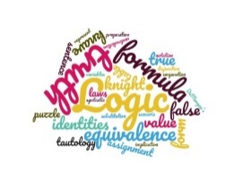
Converse and inverse
Let $A→B$ be an implication (if A then B).
  if a card has a J on one side then it has a 5 on the other
Its converse is $B→A$
  If a card has 5 on one side, then it has J on the other.
Converse is not equivalent to the original implication!
  For $A=true, B=false,$ $A→B$ is false, $B→A$is true.
Converse is not equivalent to the negation of $A→B$
  $¬\left(A→B\right)≡ A∧¬B$ .
  For A=true, B=true, $B→A$ is true, but $¬\left(A→B\right)$ is false.
Converse is equivalent to the inverse $¬A→¬ B$ of $A→B$
  If a card does not have J on one side, it cannot have 5 on the other.
J
2
5
B

Slide 58
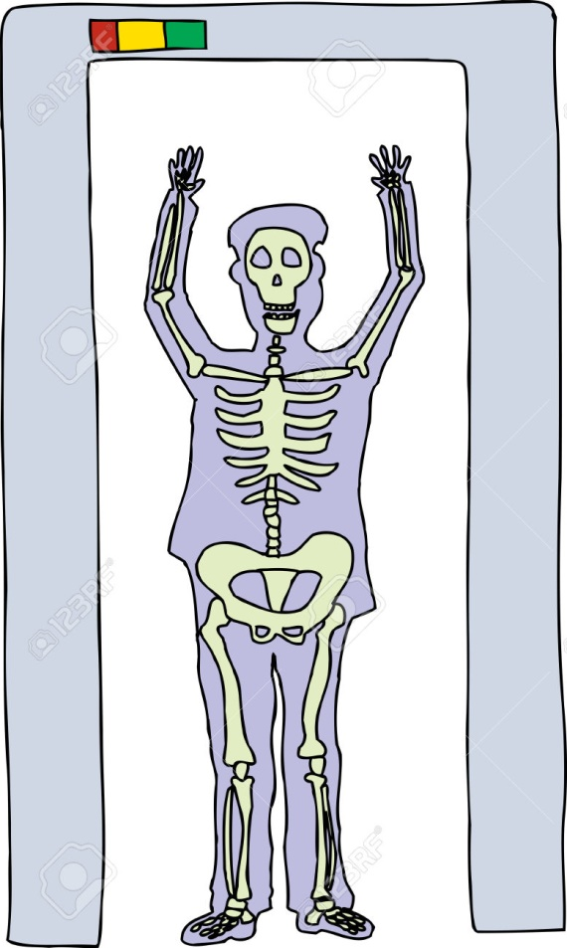
Contrapositive vs. Converse
“If a person is carrying a weapon, then the airport metal detector will ring”.
  Same as “If the airport metal detector does not ring, then the person is not carrying a weapon”.
  Not the same as: “If the airport metal detector rings, then the person is carrying a weapon.”
“If the person is sick, then the test is positive”.
“If he is a murderer, his fingerprints are on the knife”.

Slide 59
$$A →B$$
$$≡$$
$$B →A$$
Converse of $A→B$
/
$$≡$$
$$≡$$
$$¬B →¬A$$
Contrapositive of $A→B$
$$≡$$
$$¬A →¬B$$
Inverse of $A→B$
/

Slide 60
If and only if
$A↔B$(“A if and only if B”, biconditional, also written as “A iff B”) is true exactly when both the implication $A→B$and its converse $B→A$(equivalently, inverse $¬A→¬B)$ are true
  Come to the lab on Monday if and only if you are in section 2.
    If you are in section 2, then come to lab on Monday
    If you came to lab on Monday, you better be in section 2
      Equivalently, if you are not in section 2, do not come to Monday lab: come to Wednesday lab instead.
  Arnold is a knight if and only if he what he said is true.

Slide 62

Treasure hunt
In the back of an old cupboard you discover a note signed by a pirate famous for his bizarre sense of humour and love of logical puzzles. In the note he wrote that he had hidden a treasure somewhere on the property. He listed 5 true statements and challenged the reader to use them to figure out the location of the treasure

Slide 63

Treasure hunt
If this house is next to a lake, then the treasure is not in the kitchen
If the tree in the front yard is an elm, then the treasure is in the kitchen
This house is next to a lake
The tree in the front yard is an elm, or the treasure is buried under the flagpole
If the tree in the back yard is an oak, then the treasure is in the garage.
Where is the gold?

Slide 65
Treasure hunt
In the back of an old cupboard you discover a note signed by a pirate famous for his bizarre sense of humour and love of logical puzzles. In the note he wrote that he had hidden a treasure somewhere on the property. He listed 5 true statements and challenged the reader to use them to figure out the location of the treasure
Where is the gold?

Slide 66
Treasure hunt
If this house is next to a lake, then a treasure is not in the kitchen
If the tree in the front yard is an elm, then the treasure is in the kitchen
This house is next to a lake
The tree in the front yard is an elm, or the treasure is buried under the flagpole
If the tree in the back yard is an oak, then the treasure is in the garage.

Slide 67

Treasure hunt
If this house is next to a lake, then a treasure is not in the kitchen
If the tree in the front yard is an elm, then the treasure is in the kitchen
This house is next to a lake
The tree in the front yard is an elm, or the treasure is buried under the flagpole
If the tree in the back yard is an oak, then the treasure is in the garage.
A: this house is next to a lake.
B: the treasure is in the kitchen
C: The tree in front is elm
D: the treasure is under the flagpole.
E: The tree in the back is oak
F: The treasure is in the garage
Too many variables for a nice truth table...
$A→¬B$
$C→B$
A
C $∨$ D
E $→$ F
If A then not B
If C then B
A
C or D
If E then F

Slide 68
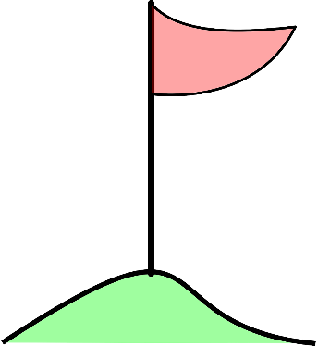

Natural deduction
A: this house is next to a lake.
B: the treasure is in the kitchen
C: The tree in front is elm
D: the treasure is under the flagpole.
E: The tree in the back is oak
F: The treasure is in the garage
$A→¬B$
$C→B$
A
C $∨$ D
E $→$ F
$¬B$
$¬C$
$D$
If house is next to the lake then the treasure is not in the kitchen
The house is next to the lake
Therefore, the treasure is not in the kitchen.

Slide 70
Arguments and validity
An argument, in logic, is a sequence of propositional statements.
  Called argument form when statements are formulas involving variables.
The last statement in the sequence is called the conclusion. All the rest are premises.
An argument is valid if whenever all premises are true, the conclusion is also true.
  So if premises are $P_{1},…,P_{n},$and conclusion is C,
  The argument is valid ${ P}_{1}∧P_{2}∧…P_{n}→C$ is a tautology
If and only if

Slide 71
Treasure hunt
Premises
If this house is next to a lake, then a treasure is not in the kitchen
If the tree in the front yard is an elm, then the treasure is in the kitchen
This house is next to a lake
The tree in the front yard is an elm, or the treasure is buried under the flagpole
If the tree in the back yard is an oak, then the treasure is in the garage.
The treasure is under the flagpole.
Argument
Conclusion

Slide 72
Arguments and validity
Arguments are often written in this format:
  Symbol $∴$ is pronounced “therefore”
$$P_{1}$$
$$P_{2}$$
$$⋮$$
$$P_{n}$$
_____
$$∴C$$
If house is next to the lake then the treasure is not in the kitchen
The house is next to the lake
________________ $∴\text{the} \text{treasure} \text{is} \text{not} \text{in} \text{the} \text{kitchen}$
If $x>3$, then $x>2$
If $x>2,$then $x≠1$
$x>3$
________________ $∴ x≠1$

Slide 73
Arguments and validity
Valid argument: “AND of premises $→$ conclusion” is a tautology
If $x>3$, then $x>2$
If $x>2,$then $x≠1$
$x>3$
________________
$∴ x≠1$
Valid argument:
($\left(p→q\right)∧p→q$
is a tautology
Valid argument:
$$\left(p→q\right)∧\left(q→r\right)∧p→r$$
is a tautology
If $x>3$, then $x>2$
If $x>2,$then $x≠1$
$x≠1$
________________
$$∴ x>3$$
  If house is next to the lake then the treasure is not in the kitchen
  The house is next to the lake
  _______________________
  $$∴\text{the} \text{treasure} \text{is} \text{not} \text{in} \text{the} \text{kitchen}$$
Invalid argument!
$\left(p→q\right)∧\left(q→r\right)∧r→p$
is a not a tautology!
False when r is true, and p and q are both false.

Slide 74
Natural deduction
A: this house is next to a lake.
B: the treasure is in the kitchen
C: The tree in front is elm
D: the treasure is under the flagpole.
E: The tree in the back is oak
F: The treasure is in the garage
$A→¬B$
$C→B$
A
C $∨$ D
E $→$ F
$¬B$
$¬C$
$D$
If house is next to the lake then the treasure is not in the kitchen
The house is next to the lake
Therefore, the treasure is not in the kitchen.
How do we get the intermediate steps?

Slide 76
Rules of inference
Just like we used equivalences to simplify a formula instead of writing truth tables
Can apply tautologies of the form $F→G$
  so that if F is an AND of several formulas derived so far, then we get G, and add G to premises.
  Such as $(\left(p→q\right)∧p)→q$
Keep going until we get the conclusion.
If house is next to the lake then the treasure is not in the kitchen
The house is next to the lake
Therefore, the treasure is not in the kitchen.
Here, p is “the house is next to the lake”, and q is “the treasure is not in the kitchen”.

Slide 77
Modus ponens
  The main rule of inference, given by the tautology $\left(p→q\right)∧p→q$, is called Modus Ponens.
    “Method of affirming” in Latin
If house is next to the lake then the treasure is not in the kitchen
The house is next to the lake
_______________ $∴\text{the} \text{treasure} \text{is} \text{not} \text{in} \text{the} \text{kitchen}$
If Socrates is a man, then Socrates is mortal
Socrates is a man
_______________ $∴\text{Socrates} \text{is} \text{mortal}$
If $x>2,$then $x≠1$
$x>2$
________________ $∴ x≠1$

Slide 78
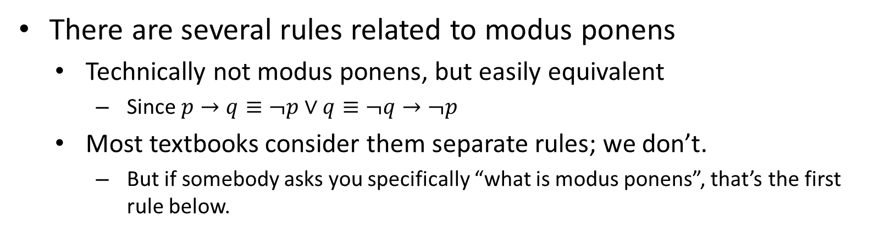
Modus ponens and friends
  There are several rules related to modus ponens
    Technically not modus ponens, but easily equivalent
      Since $p→q≡¬p∨q≡¬q→¬p$
    Most textbooks consider them separate rules; we don’t.
      But if somebody asks you specifically “what is modus ponens”, that’s the first rule below.
$p→q$
p
________ $∴\text{q}$
$¬q→¬p$
p
__________ $∴\text{q}$
$¬p∨q$
p
__________ $∴\text{q}$
Modus Ponens Modus Tollens Disjunctive syllogism

Slide 79
Resolution rule and friends
  Another group of equivalent rules is the resolution rule (that we will see a lot in the next lecture)
    And its friend hypothetical syllogism
Resolution
Hypothetical syllogism
$¬p∨q$
$¬q∨r$
________ $∴¬p∨r$
$p→q$
$q→r$
________ $∴p→r$
If $x>3$then $x>2$
If $x>2$ then $x>1$
________________ $∴$If $x>3$then $x>1$

Slide 80
Auxiliary rules
  These are short “common-sense” rules. You don’t need to know them by name, just be able to use them.
$p$
$q$
________ $∴p∧q$
$p∧q$
________ $∴p$
$p$
________ $∴p∨q$
If derived both p and q, can conclude $p∧q$
If $p∧q$is true, then in particular $p$ is true
If $p$ is true, then $p∨q$is true for any possible $q$

Slide 82
Proof vs. disproof
To disprove that something is always true, enough to give just one scenario where it is false (find a falsifying assignment).
  To disprove that $A→B≡B→A$
    Take $A=true, B=false,$
    Then $A→B$ is false, but $B→A$is true.
  To disprove that $B→A≡ ¬ (A→B)$
    Take A=true, B=true
    Then $B→A$ is true, but $¬\left(A→B\right)$ is false.
  I have classes every day! – No, you don’t have classes on Saturday
  Women don’t do Computer Science! – Me?

Slide 83


False premises
An argument can still be valid when some of its premises are false.
  Remember, contradiction implies anything.
Bertrand Russell: “If 2+2=5, then I am the pope”
Puzzle: can you see how to prove this?

Slide 85
False premises
An argument can still be valid even when some of the premises are false.
  Remember, “contradiction implies A” is true for any A.
Bertrand Russell: “If 2+2=5, then I am the pope”
Puzzle: can you see how to prove this?

Slide 86
False premises
Bertrand Russell: “If 2+2=5, then I am the pope”
Proof:
  Suppose 2+2=5
  If 2+2=5, then 1=2 (subtract 3 from both sides).
  So 1=2 (by modus ponens)
  Me and the pope are two people.
  Since 1=2, me and the pope are one person.
  Therefore, I am the pope!

Slide 87

Valid and invalid arguments
An argument is valid if whenever all premises $P_{1},…,P_{n}$ are true, the conclusion C is also true.
  That is, $P_{1}∧P_{2}∧…P_{n}→C$ is a tautology
    $P_{1}∧P_{2}∧…P_{n}→C$should be true no matter what values propositional variables in premises and conclusion take.
  False premise does not make an argument invalid.
  Alternatively, there can be an invalid argument
  with true premises and/or conclusion.
  The only impossible combination is a valid argument
  with true premises and false conclusion.
$if 2+2=4 then 3+3=6$
$3+3=6$
___________________
$∴2+2=4$
Invalid argument
$$\left(p→q\right)∧q→p$$
Is not a tautology!

Slide 88
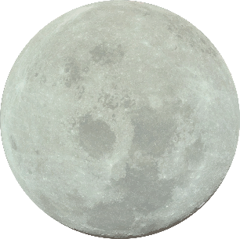
Inconsistent statements
A list of logic statements that cannot all be true at the same time is called inconsistent.
  That is, an AND of these statements is a contradiction (unsatisfiable).
  $p, ¬p$ are inconsistent, because $p∧¬p$ is a contradiction
  ($p∨q), (p∨¬q), ¬p$ are inconsistent, since $\left(p∨q\right)∧\left(p∨¬q\right)∧¬p$ is unsatisfiable.
  “I have a lab only on Tuesday. I don’t have a class on Tuesday. I have a class and a lab on the same day.”
  “If the sky is clear then the sun is shining. If it is night, then the sky is clear. It is night and the sun is not shining”.

Slide 89


Inconsistent statements
From a policy rules :
  You need to change your password every 6 month you otherwise you will get locked out of your account.
  If your device tries to access the system unsuccessfully several times, you will be locked out of your account.
From common sense:
  While I am changing the password on my computer, my phone would be trying to read mail and so will be unsuccessfully accessing my account!
So the policy rules, common sense and not being locked out of my account are inconsistent! ☹

Slide 90
Inconsistent premises
What if the premises are inconsistent, that is, they contradict each other?
  Then anything can be a conclusion!
  In particular, a contradiction (such as the constant FALSE) can be a conclusion of a valid argument if and only if its premises are inconsistent
  Any argument with inconsistent premises is valid (and useless).
Today is Sunday
Today is not Sunday
_______
$∴$ 2+2=5
$p∨q$
$p∨¬q$
$¬p$
_______
$∴FALSE$
$bears are black or bears are white$
$bears are black or bears are not white$
$bears are not black$
_______
$∴it is cold outside$

Slide 91
Proof vs. disproof
To prove that something is (always) true:
  Make sure it holds in every scenario
    $¬B→¬A$ $≡$ $A→B,$ because $¬B→¬A≡ ¬¬B∨¬A ≡B∨¬ A ≡¬A∨B≡A→B$
    So $\left(¬B→¬A\right)↔(A→B)$is a tautology.
    I have classes every day that starts with T. I have classes on Tuesday and Thursday (and Monday, but that’s irrelevant).
  Or assume it does not hold, and then get something strange as a consequence:
    To show A is true, enough to show $¬A→FALSE$.
    Suppose there are finitely many prime numbers. What divides the number that’s a product of all primes +1?

Slide 93



Natural deduction vs. Truth tables
It was faster to solve the puzzle using natural deduction than writing a truth table.
But is it always better?
The answer is...
It is a very closely related to the question of how fast can one check if something is a tautology.
  And that’s a million dollar question!
Nobody knows!

Slide 94
Automated provers
How to make an automated prover which checks whether a formula is a tautology?
  And so can check if an argument is valid, etc.
Truth tables:
  easy to program, but proofs are huge.
Natural deduction:
  proofs might be smaller than a truth table
    Are they always? Good question...
  even if there is a small proof, how can we find one quickly?
    Nobody knows...

Slide 95

Automated provers
$$C∨x$$
$$D∨¬x$$
________
$$∴C∨D$$
Work with the CNF formulas
  $∧$ on top (can have single input, no inputs, many inputs)
  All children of that $∧$ are $∨$ (also any number of inputs)
    Called clauses
  Each child of each $∨$ is a literal
    a variable, or
    single $¬$ and then a variable.
Use only the resolution rule
  Basis for many practical provers (SAT solvers)
  Used in scheduling, verification, etc…
$$∧$$
$$∨$$
$$∨$$
$$∨$$
$$¬$$
$$¬$$
$$r$$
$$¬$$
$$q$$
$$¬$$
$$p$$
p
q
r
q

Slide 96
Converting any formula to CNF
Rewrite it with only $∧, ∨, ¬$ using equivalences
$A→B≡¬A∨B$as well as $A↔B≡\left(¬A∨B\right)∧\left(A∨¬B\right)$
Propagate negations to variables, getting rid of double negations.
Convert each $F∨\left(G∧H\right)$ to $\left(F∨G\right)∧\left(F∨H\right).$
Example: $p →q∧r$
  $≡¬ p∨(q∧r)$
  $≡\left(¬ p∨q\right)∧\left( ¬p∨r\right)$
Special cases:
  An empty clause () is FALSE.
  An empty CNF is TRUE.
$$→$$
$$∨$$
$$∧$$
$$∧$$
$$¬$$
$$∧$$
$$∨$$
$$∨$$
$$p$$
$$q$$
$$r$$
$$p$$
$$q$$
$$r$$
$$¬$$
$$q$$
$$¬$$
$$r$$
$$p$$
p

Slide 97
CNFs in resolution proofs vs. canonical CNFs
  For proofs, get a formula (much smaller than the truth table)
  and want to get some information about its truth table (is it all false?) without writing the truth table out.
    CNFs on which we do resolution are tiny in comparison to their truth tables, and we hope to find out if they are contradictions faster than writing their truth tables.
  For canonical CNFs, get a truth table, and want a formula computing it.
    We have the truth table (and so can figure out if $f$ is 0 everywhere) before even starting to write a canonical CNF!
    If $f$ is 0 everywhere, its canonical CNF has as many clauses as lines in the truth table.

Slide 99
Resolution rule revisited
Suppose the premises are clauses $\left(C∨x\right), \left(D∨¬x\right)$
  Where C, D are both $∨$of literals, possibly empty
Now, use the following special form of the resolution rule:
$$C∨x$$
$$D∨¬x$$
________
$$∴C∨D$$
$$y∨¬z ∨w$$
$$u ∨¬w$$
___________
$$∴y∨¬z ∨u$$
$$y∨w∨¬z$$
$$¬z ∨¬w$$
__________
$$∴y∨¬z$$
$$w$$
$$¬w$$
__________
$$∴FALSE$$
  Ignore the order of literals in a clause and remove duplicates.

Slide 100
Finding inconsistencies: resolution refutation
Remember that a list of logic statements $A_{1},…,A_{n}$ is inconsistent if and only if
  $A_{1}∧A_{2}∧…∧A_{n}$ is unsatisfiable (contradiction)
  From $A_{1},…,A_{n}$ as premises can derive $FALSE$ as conclusion.
When $A_{1},…,A_{n}$ are all CNFs,
  can check that $A_{1},…,A_{n}$ are inconsistent by repeatedly applying the resolution rule to (the clauses in) $A_{1},…,A_{n}$ until FALSE (empty clause) is derived.
$p∨q$
$p∨¬q$
$¬p$
_______
$∴FALSE$
$w$
$¬w$
_______
$∴FALSE$

Slide 101
Resolution refutation
$C∨x$
$D∨¬x$
________
$∴C∨D$
Resolution refutation: a proof that a CNF $A_{1}∧…∧ A_{n}$ is a contradiction by applying resolution rule repeatedly to get FALSE
  If FALSE (empty clause) is derived
    then $A_{1}∧…∧ A_{n}$ is unsatisfiable (contradiction).
    Any scenario makes at least one clause (and so $A_{1}∧…∧ A_{n}$ ) false
  If reached the point when there are no more clauses to derive by the resolution rule
    Then $A_{1}∧…∧ A_{n}$ is not a contradiction (satisfiable).

Slide 102
Resolution refutation
$C∨x$
$D∨¬x$
________
$∴C∨D$
Start with $A_{1}∧…∧ A_{n}$ (viewed as a list of clauses)
At every step
  pick two clauses (original or derived) sharing a variable
    In one clause negated and in another not negated, such as $(C∨x),(D∨¬x)$
  Derive a new clause $\left(C∨D\right)$ and add it to the list
    Nothing ever goes away! No cancellations!
Repeat until FALSE is derived
  or cannot derive anything new

Slide 103
Resolution refutation
$C∨x$
$D∨¬x$
________
$∴C∨D$
Start with $A_{1}∧…∧ A_{n}$ (viewed as a list of clauses)
At every step
  pick two clauses (original or derived) sharing a variable
    In one clause negated and in another not negated, such as $(C∨x),(D∨¬x)$
  Derive a new clause $\left(C∨D\right)$ and add it to the list
    Nothing ever goes away! No cancellations!
Repeat until FALSE is derived
  or cannot derive anything new
$$\left(y∨¬z\right)∧ \left(¬y\right)∧ \left(y∨z\right)$$

Slide 104
Resolution refutation
$C∨x$
$D∨¬x$
________
$∴C∨D$
Start with $A_{1}∧…∧ A_{n}$ (viewed as a list of clauses)
At every step
  pick two clauses (original or derived) sharing a variable
    In one clause negated and in another not negated, such as $(C∨x),(D∨¬x)$
  Derive a new clause $\left(C∨D\right)$ and add it to the list
    Nothing ever goes away! No cancellations!
Repeat until FALSE is derived
  or cannot derive anything new
$$\left(y∨¬z\right)∧ \left(¬y\right)∧ \left(y∨z\right)$$
$\left(¬z\right)$
FALSE
$$\left(z\right)$$

Slide 105
Resolution refutation
$C∨x$
$D∨¬x$
________
$∴C∨D$
Start with $A_{1}∧…∧ A_{n}$ (viewed as a list of clauses)
At every step
  pick two clauses (original or derived) sharing a variable
    In one clause negated and in another not negated, such as $(C∨x),(D∨¬x)$
  Derive a new clause $\left(C∨D\right)$ and add it to the list
  Repeat until FALSE is derived
  or cannot derive anything new
Note that $\left(¬y\right)$ was used twice.
$\left(y∨¬z\right)$
$\left(¬ y\right)$
$\left(y∨z\right)$
$\left(¬z\right)$from 1. and 2. (from $\left(y∨¬z\right)$ and $\left(¬y\right))$
$\left(z\right)$ from 2. and 3. (from $\left(y∨z\right)$ and $\left(¬y\right))$
FALSE from 4. and 5. (from $\left(¬z\right)$ and $\left(z\right))$
$$\left(y∨¬z\right)∧ \left(¬y\right)∧ \left(y∨z\right)$$
$\left(¬z\right)$
FALSE
$$\left(z\right)$$

Slide 106

Decision trees
$C∨x$
$D∨¬x$
________
$∴C∨D$
Refutation (deriving FALSE):
  shows that all clauses cannot be made true at the same time.
An “upside-down” view: decision tree.
  For every truth assignment, some clause is false.
$$z$$
True
False
$$\left(y∨¬z\right)∧ \left(¬y\right)∧ \left(y∨z\right)$$
$\left(¬z\right)$
FALSE
$$y$$
$$y$$
True
True
False
False
$$\left(z\right)$$
$$(¬y)$$
$$(y∨¬z)$$
$$(¬y)$$
$$(y∨z)$$

Slide 108
$\left(x∨¬y∨z\right)∧\left(¬x∨¬ z\right)∧\left(y∨¬z\right)∧\left(¬y∨¬z\right)∧\left(x∨y\right)∧(¬x∨z)$
$C∨x$
$D∨¬x$
________
$∴C∨D$

Slide 109
$\left(x∨¬y∨z\right)∧\left(¬x∨¬ z\right)∧\left(y∨¬z\right)∧\left(¬y∨¬z\right)∧\left(x∨y\right)∧(¬x∨z)$
$$(¬z)$$
$$(x∨¬y)$$
$$(¬x)$$
$$(x)$$
$C∨x$
$D∨¬x$
________
$∴C∨D$
$$FALSE$$

Slide 110
$\left(x∨¬y∨z\right)∧\left(¬x∨¬ z\right)∧\left(y∨¬z\right)∧\left(¬y∨¬z\right)∧\left(x∨y\right)∧(¬x∨z)$
$$(¬z)$$
Used more than once
Never used
$$(x∨¬y)$$
$$(¬x)$$
$$(x)$$
$C∨x$
$D∨¬x$
________
$∴C∨D$
$$FALSE$$

Slide 111

Pens puzzle
Suppose that nobody in our class carries more than 10 pens.
There are 148 students in our class.
Prove that there are at least 2 students in our class who carry the same number of pens.
  In fact, there are at least 14 who do

Slide 113

Pens puzzle
Suppose that nobody in our class carries more than 10 pens.
There are 148 students in our class.
Prove that there are at least 2 students in our class who carry the same number of pens.
  In fact, there are at least 14 who do

Slide 114
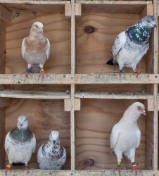
Pigeonhole Principle
Suppose that nobody in our class carries more than 10 pens. There are 148 students in our class.
Prove that there are at least 2 students in our class who carry the same number of pens.
  In fact, there are at least 14 who do.
The Pigeonhole Principle:
  If there are n pigeons
  And n-1 pigeonholes
  Then if every pigeon is in a pigeonhole
  At least two pigeons sit in the same hole

Slide 115
Pigeonhole Principle
Suppose that nobody in our class carries more than 10 pens. There are 148 students in our class. Prove that there are at least 2 students in our class who carry the same number of pens.
The Pigeonhole Principle:
If there are n pigeons and n-1 pigeonholes
Then if every pigeon is in a pigeonhole
At least two pigeons sit in the same hole
Applying to our problem:
  n-1 = 11 possible numbers of pens
    (from 0 to 10)
  Even with n=12 people, there would be 2 who have the same number.
  If there were less than 14, say 13 for each scenario, total would be 143.
  Note that it does not tell us which number or who these people are!

Slide 116
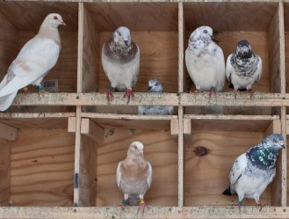
Pigeonhole Principle
The Pigeonhole Principle:
  If there are n pigeons
  And n-1 pigeonholes
  Then if every pigeon is in a pigeonhole
  At least two pigeons sit in the same hole
It is possible that some holes are empty, and other have more than two pigeons.
  But at least one hole should have more than one pigeon.
Also works for any $m<n$ holes, with $n$ pigeons

Slide 117
Resolution and Pigeons
It is not that hard to write the Pigeonhole Principle as a tautology
But we can prove that resolution has trouble with this kind of reasoning
  the smallest resolution proof of this tautology is on the order of $2^{n}$!
By contrast, natural deduction (and you!) can figure it out fairly quickly
  though it is not straightforward.
So some things resolution cannot prove fast.
  What can it prove quickly? Big open problem!

Slide 118





Meow-stery
One evening there was a cat fight in a family consisting of a mother cat, a father cat, and their son and daughter kittens.
One of these four cats attacked and bit another!
One of the cats watched the fight.
The other one hissed at the fighters.
These are the things we know for sure:
  1. The watcher and the hisser were not of the same gender.
  2. The oldest cat and the watcher were not of the same gender.
  3. The youngest cat and the victim were not of the same gender.
  4. The hissing cat was older than the victim.
  5. The father was the oldest of the four.
  6. The attacker was not the youngest of the four.
Which nasty cat was the attacker?

Slide 120
Natural deduction vs. resolution
Natural deduction and resolution both can be used to show that a formula is a tautology
  For resolution, show that the negation of a formula is a contradiction
  Both can also be used to derive conclusions from premises.
We now know that resolution proofs can be essentially as big as truth tables: Pigeon Hole Principle.
  For natural deduction, nobody knows.
Somehow, in practice, it is easier to get resolution to work than natural deduction.
  Why??? Great question. Not for the lack of trying.

Slide 121
Resolution refutations for verifying that an argument is valid
An argument with premises $P_{1}, P_{2},…{,P}_{n}$ and conclusion $C$is valid if and only if $P_{1}∧P_{2}∧…∧P_{n}→C$ is a tautology
  It is invalid if there is a scenario where $P_{1}, P_{2},…{,P}_{n}$ are all true, but $C$ is false.
To verify that an argument is valid
  That $P_{1}∧P_{2}∧…∧P_{n}→C$ is a tautology,
Check that ${¬(P}_{1}∧P_{2}∧…∧P_{n}→C$) is a contradiction.
  That no scenario makes both $P_{1}∧P_{2}∧…∧P_{n}$ and $¬C$ true.
  $¬\left(P_{1}∧P_{2}∧…∧P_{n}→C\right)≡ P_{1}∧P_{2}∧…∧P_{n}∧¬C$
  Convert all premises and $¬C$to CNFs
  Then do resolution on $P_{1}∧P_{2}∧…∧P_{n}∧¬C$
  If could derive $FALSE$, then the argument was valid.

Slide 123
Treasure hunt
If this house is next to a lake, then a treasure is not in the kitchen
If the tree in the front yard is an elm, then the treasure is in the kitchen
This house is next to a lake
The tree in the front yard is an elm, or the treasure is buried under the flagpole
If the tree in the back yard is an oak, then the treasure is in the garage.
A: this house is next to a lake.
B: the treasure is in the kitchen
C: The tree in front is elm
D: the treasure is under the flagpole.
E: The tree in the back is oak
F: The treasure is in the garage
$A→¬B$
$C→B$
A
C $∨$ D
E $→$ F
__________
$∴ D$

Slide 124
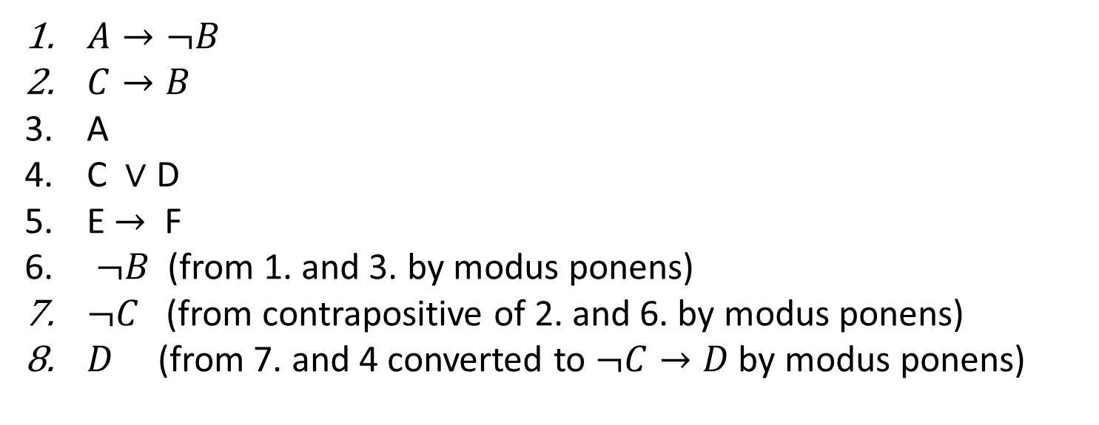
Verifying validity
$A→¬B$
$C→B$
A
C $∨$ D
E $→$ F
$¬B$ (from 1. and 3. by modus ponens)
$¬C$ (from contrapositive of 2. and 6. by modus ponens)
$D$ (from 7. and 4 converted to $¬C→D$ by modus ponens)
A: this house is next to a lake.
B: the treasure is in the kitchen
C: The tree in front is elm
D: the treasure is under the flagpole.
E: The tree in the back is oak
F: The treasure is in the garage
Let’s check that this argument is valid. That is, that
$\left(A→¬B\right)∧\left(C→B\right)∧A∧\left(C∨D\right)∧\left(E→F\right) →D$ is a tautology

Slide 125
Verifying validity
If this house is next to a lake, then a treasure is not in the kitchen
If the tree in the front yard is an elm, then the treasure is in the kitchen
This house is next to a lake
The tree in the front yard is an elm, or the treasure is under the flagpole
If the tree in the back yard is an oak, then the treasure is in the garage.
A: this house is next to a lake.
B: the treasure is in the kitchen
C: The tree in front is elm
D: the treasure is under the flagpole.
E: The tree in the back is oak
F: The treasure is in the garage
Argument
Tautology iff argument is valid
$\left(A→¬B\right)∧\left(C→B\right)∧\left(A\right)∧\left(C∨D\right)∧\left(E→F\right)→D$
$A→¬B$
$C→B$
A
C $∨$ D
E $→$ F
______
$∴ D$
Contradiction iff argument is valid
$\left(A→¬B\right)∧\left(C→B\right)∧\left(A\right)∧\left(C∨D\right)∧\left(E→F\right)∧¬D$

Slide 126
Verifying validity
If this house is next to a lake, then a treasure is not in the kitchen
If the tree in the front yard is an elm, then the treasure is in the kitchen
This house is next to a lake
The tree in the front yard is an elm, or the treasure is under the flagpole
If the tree in the back yard is an oak, then the treasure is in the garage.
A: this house is next to a lake.
B: the treasure is in the kitchen
C: The tree in front is elm
D: the treasure is under the flagpole.
E: The tree in the back is oak
F: The treasure is in the garage
Premises and negated conclusion in CNF
Contradiction iff argument is valid
Argument
$\left(A→¬B\right)∧\left(C→B\right)∧\left(A\right)∧\left(C∨D\right)∧\left(E→F\right)∧¬D$
$A→¬B$
$C→B$
A
C $∨$ D
E $→$ F
______
$∴ D$
$¬A∨¬B$
$¬C∨B$
A
C $∨$ D
$¬E∨$ F
$¬D$
Contradiction iff argument is valid (in CNF)
$\left(¬A∨¬B\right)∧\left(¬C∨B\right)∧\left(A\right)∧\left(C∨D\right)∧\left(¬E∨F\right)∧¬D$

Slide 127
Verifying validity
If this house is next to a lake, then a treasure is not in the kitchen
If the tree in the front yard is an elm, then the treasure is in the kitchen
This house is next to a lake
The tree in the front yard is an elm, or the treasure is under the flagpole
If the tree in the back yard is an oak, then the treasure is in the garage.
A: this house is next to a lake.
B: the treasure is in the kitchen
C: The tree in front is elm
D: the treasure is under the flagpole.
E: The tree in the back is oak
F: The treasure is in the garage
$\left(¬A∨¬B\right)∧\left(¬C∨B\right)∧\left(A\right)∧\left(C∨D\right)∧\left(¬E∨F\right)∧¬D$

Slide 128
Verifying validity
If this house is next to a lake, then a treasure is not in the kitchen
If the tree in the front yard is an elm, then the treasure is in the kitchen
This house is next to a lake
The tree in the front yard is an elm, or the treasure is under the flagpole
If the tree in the back yard is an oak, then the treasure is in the garage.
A: this house is next to a lake.
B: the treasure is in the kitchen
C: The tree in front is elm
D: the treasure is under the flagpole.
E: The tree in the back is oak
F: The treasure is in the garage
$\left(¬A∨¬B\right)∧\left(¬C∨B\right)∧\left(A\right)∧\left(C∨D\right)∧\left(¬E∨F\right)∧¬D$
$$(¬A∨¬C)$$
$$(C)$$
$$(¬C)$$
$$FALSE$$

Slide 130




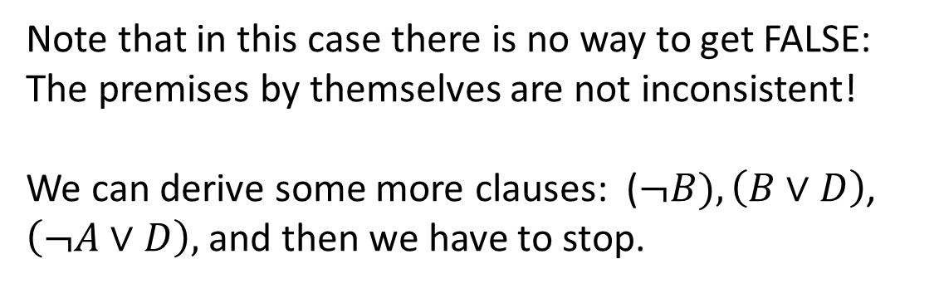
Deriving conclusions using resolution
$\left(¬A∨¬B\right)∧\left(¬C∨B\right)∧\left(A\right)∧\left(C∨D\right)∧\left(¬E∨F\right)$
How do we actually derive a conclusion using resolution?
  Like finding the treasure.
Suppose the conclusion is just one clause or a literal
  otherwise derive each clause of the CNF equivalent to the conclusion separately
Take premises converted to CNF, and keep applying resolution rule until get a conclusion clause
  Such as a clause containing a single variable stating “the treasure is here”
$$(¬A∨¬C)$$
$$(¬C)$$
$$(D)$$
Note that in this case there is no way to get FALSE:
The premises by themselves are not inconsistent!
We can derive some more clauses: ($¬B), \left(B∨D\right)$, $\left(¬A∨D\right),$and then we have to stop.

Slide 131
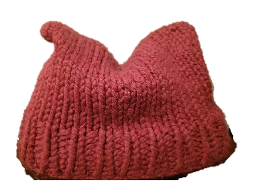
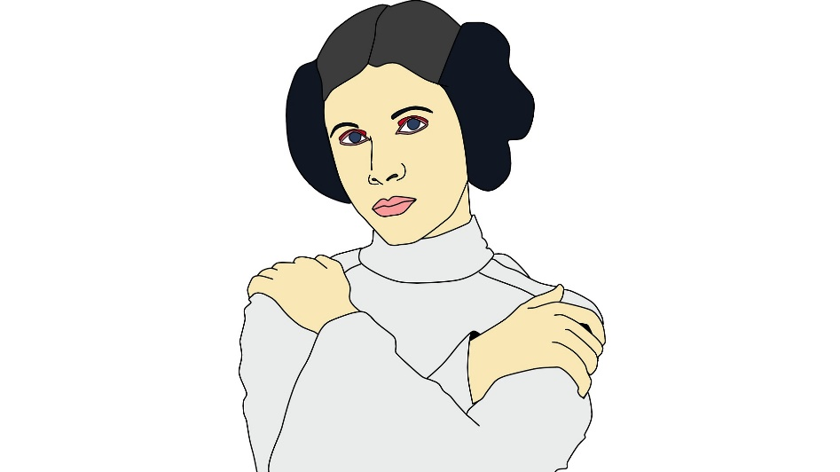
Stereotypes puzzle
Susan is 28 years old, single, outspoken, and very bright. She majored in philosophy. As a student she was deeply concerned with issues of discrimination and social justice and also participated in anti-pipeline demonstrations.
Please rank the following possibilities by how likely they are. List them from least likely to most likely. Susan is:
a kindergarden teacher
works in a bookstore and takes yoga classes
an active feminist
a psychiatric social worker
a member of an outdoors club
a bank teller
an insurance salesperson
a bank teller and an active feminist

