Slide 1
Unit 10
Logic and algorithms

Slide 2
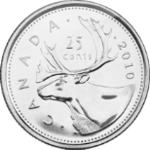
Probabilistic method
Idea: if a probability of an event is strictly greater than 0, this event can happen.
So to show that there is a scenario where it happens, show that its probability is $>0$.
Non-constructive existence proof.
Example:
Expected number of heads when flipping 3 fair coins is 1.5
So there is a way to flip 3 coins to get $≥$1.5 heads
The number of heads is an integer.
Therefore, there is a way to flip 3 coins to get at least 2 heads.
Tells us nothing about what this outcome might look like.

Slide 3
Team selection puzzle
Imagine that your friend is a project manager, and her team consist of great programmers – if only she could get them to stop fighting among each other!
She decides to split them in two smaller teams
To minimize fighting within each team.
She knows who fights with whom (the “CONFLICT relation”), but how can she do the splitting?
And is it possible at all to eliminate at least half the conflicts? If not, why bother…
Do you think it is possible to split any group into two teams
to eliminate all conflicts?
How about eliminating half the conflicts?
How would you do the splitting?
Suppose this is the graph of the CONFLICT relation for a group.
Here, lines are double-direction arrows, since CONFLICT is symmetric.
What do you think is the best split?
Beth
Al
Cora
Eli
Dan

Slide 4
Team selection puzzle
Do you think it is possible to split any group into two teams
to eliminate all conflicts?
How about eliminating half the conflicts?
How would you do the splitting?
Look at the graph of the CONFLICT relation.
Assume that CONFLICT is symmetric and anti-reflexive, and let’s draw a single line for each double-direction arrow, to keep it less messy
This kind of drawing is called an undirected graph
Suppose this is the graph of the CONFLICT relation for a group.
Beth
Al
Cora
Eli
Dan

Slide 5
Team selection puzzle
Do you think it is possible to split any group into two teams
to eliminate all conflicts?
What if we only have Al, Beth and Cora?
Counterexample! No way to split ☹
Graph of the CONFLICT relation
Symmetric and anti-reflexive
Drawn as an undirected graph
Beth
Al
Cora
Beth
Eli
Dan
Al
Cora

Slide 6
Team selection puzzle
Do you think it is possible to split any group
into two teams
How about eliminating half the conflicts?
In terms of the CONFLICT graph:
Is there a way to split vertices into two groups so that at least half of the edges go between groups?
Graph of the CONFLICT relation
Symmetric and anti-reflexive
Drawn as an undirected graph
Beth
Al
Cora
Eli
Dan

Slide 7
Team selection puzzle
Is there a way to split vertices into two groups so that at least half of the edges go between groups?
Suppose that the probability of every person to be on Team Orange vs. Team Green is ½.
Then the probability for each edge (conflict) to be between people assigned to different teams is: ½
Expected number of edges to go between different colours: ½ $⋅$ total number of edges.
Therefore, there exists a way to split any group into two teams so that at least half of the conflicts are between people on different teams!
Graph of the CONFLICT relation
Symmetric and anti-reflexive
Drawn as an undirected graph
Beth
Al
Cora
Eli
Dan

Slide 8
Team selection puzzle
There exists a way to split any group into two teams so that at least half of the conflicts are between people on different teams
But how would we do this split?
Let’s do something random!
Just assign each person to team Green or team Orange at random with probability ½
So this proof not only tells us that such a split exists, but also gives a (randomized) algorithm that finds it.
Can prove that it finds it with decent probability
Can be even made deterministic (that is, it is possible to make the choices without randomness).
Graph of the CONFLICT relation
Symmetric and anti-reflexive
Drawn as an undirected graph
Beth
Al
Cora
Eli
Dan

Slide 9
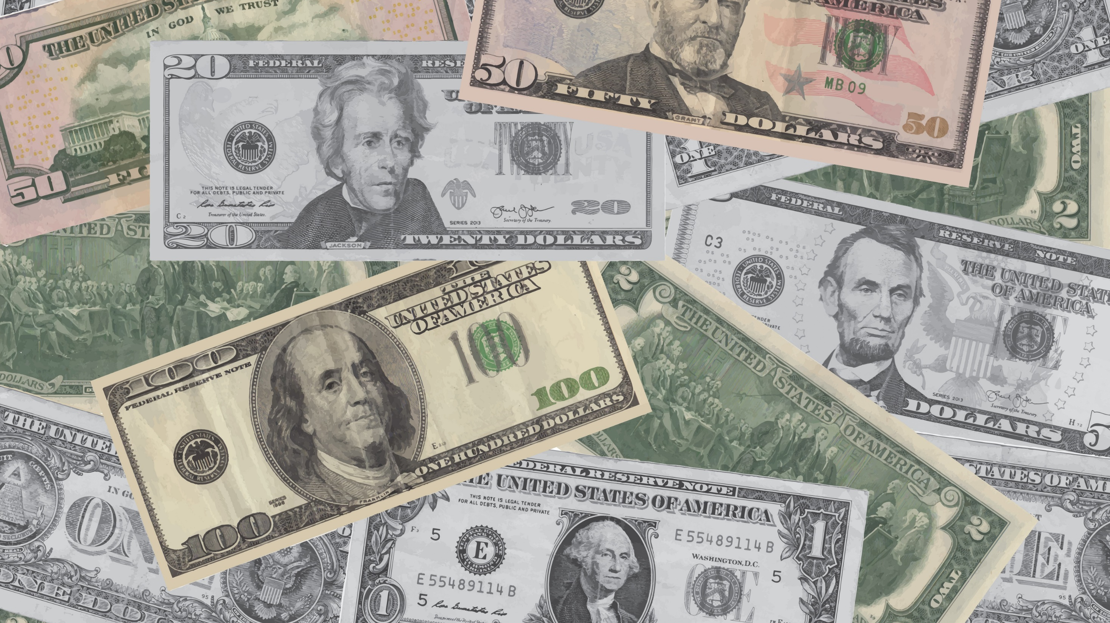
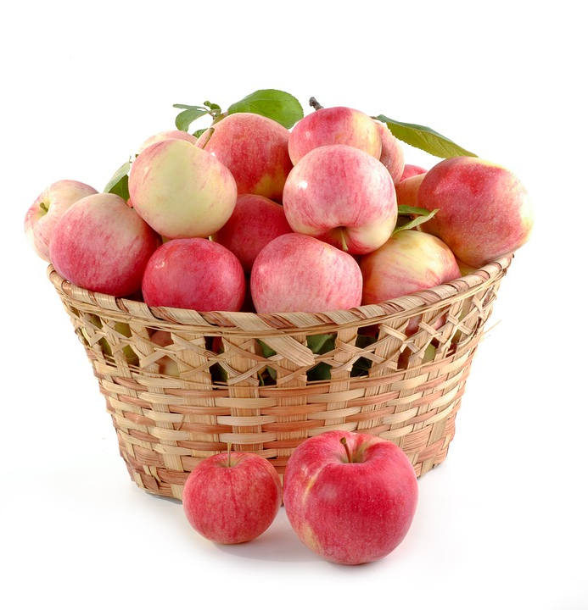
Team selection puzzle
This algorithm finds a split with at least half of the edges
But not necessarily the split across maximum possible number of conflicts.
Is there a similarly fast algorithm to find the best split?
If such an algorithm exists, then P=NP,
And can check if a formula is a tautology just as fast!
Beth
Al
Cora
Eli
Dan
That’s a million-dollar question!

Slide 11
How else does it all relate to programming?
You will be using logic to describe what a program should be doing
and proofs, in particular induction to show that it does that correctly
And occasionally to get algorithms
Sets, relations and especially graphs to model problems and optimize performance.
Recurrence relations to give a guarantee on long it takes in the worst case.
With O-notation to talk about the time.
And combinatorics to calculate possible options.
and probabilities/expectation to estimate how long it might take on average.
And what is a probability of success of a randomized algorithm

Slide 12
Example: search in an array
0 1 2 3 4 5 n-1
Given:
an array A containing n elements,
and a specific item x
Goal: find the index of x in A, if x is in A.
Which box contains ? Box 4.

Slide 13
0 1 2 3 4 5 n-1
Precondition: A is an array containing x
Postcondition: Returned k such that A[k]=x
Algorithm arraySearch(A, x)‏
Input array A of n integers, number x
Output k such that A[k]=x
i = 0
out = -1
while out < 0 do
if A[i] = x then
out = i
i = i+1
return out

Slide 14
The good news about computers is that they do what you tell them to do. The bad news is that they do what you tell them to do.
Ted Nelson

Slide 15
Logic: specifications
0 1 2 3 4 5 n-1
Precondition: what should be true before a piece of code (or the whole algorithm) starts
E.g.: A is an array of numbers and A is not empty and x is a number.
Postcondition: what should be true after a program (piece of code) finished.
E.g. If the program returned value k, then A[k]=x
or k=-1, if x is not in A.

Slide 16
Correctness of algorithms
Prove that if the program starts with precondition being true, it ends with postcondition being true
If x is in the array, then the program should return its index.
If there is a loop, prove its correctness by induction
Called loop invariant
If the program is recursive, prove its correctness by strong induction
If all recursive calls return correct answers, the program returns a correct answer.

Slide 17
0 1 2 3 4 5 n-1
Precondition: A is an array containing x: $∃i A\left[i\right]=x$
Postcondition: Returned k such that A[k]=x: $A\left[k\right]=x$
Algorithm arraySearch(A, x)‏
Input array A of n integers, number x
Output k such that A[k]=x
i = 0
out = -1
while out < 0 do
if A[i] = x then
out = i
i = i+1
return out

Slide 18
Algorithm arraySearch(A, x)‏
Input array A of n integers, number x
Output k such that A[k]=x
$∃i∈\left\{0…n−1\right\} A\left[i\right]=x$
i = 0
out = -1
$∃i∈\left\{0…n−1\right\} A\left[i\right]=x ∧i=0∧out=−1$
while out < 0 do
if A[i] = x then
out = i
i = i+1
$A\left[out\right]=x$
return out
Program returned k such that A[k]=x
A = [5,10,8,7]
x = 8
out = 2

Slide 19
Loop invariant: a condition that is true on each iteration of the loop
Implied by loop precondition
Implies the loop postcondition
Implies next loop iteration is correct
I(k): $i=k ∧(\left(out=i ∧A\left[out\right]=x\right)∨(∃j>i A\left[j\right]=x))$
Guard condition: condition in the while loop
G= “out <0”
$∃i∈\left\{0…n−1\right\} A\left[i\right]=x ∧$
$∧ i=0∧out=−1$
while out < 0 do
if A[i] = x then
out = i
i = i+1
$A\left[out\right]=x$
Termination: proof that $∃$ $k_{0}$ such that after${ k}_{0}$ iterations G becomes false
Loop is correct when:
precondition $→$ I(0)
for all k, $G∧I\left(k\right)→I\left(k+1\right)$
If $k_{0}$ is the smallest number such that $¬G,$
then $¬G∧I\left(k_{0}\right)→$ postcondition

Slide 20
$∃i∈\left\{0…n−1\right\} A\left[i\right]=x ∧$
$∧ i=0∧out=−1$
while out < 0 do
if A[i] = x then
out = i
i = i+1
$A\left[out\right]=x$
Proving the loop invariant by induction on i:
Base case: I(0)
$∃i∈\left\{0…n−1\right\} A\left[i\right]=x∧i=0∧out=−1$
Implies I(0)
$i=0 ∧(\left(out=0 ∧A\left[out\right]=x\right)∨(∃j>i A\left[j\right]=x))$
Assume I(k): $i=k ∧(\left(out=i ∧A\left[out\right]=x\right)∨(∃j>i A\left[j\right]=x))$
Show: if $G,$then I(k+1): $i=k+1 ∧(\left(out=i ∧A\left[out\right]=x\right)∨(∃j>i A\left[j\right]=x))$
i=k+1 because of “i=i+1” statement
If A[i]=x, then $\left(out=i ∧A\left[out\right]=x\right)$ holds
Otherwise, $(∃j>i A\left[j\right]=x)$ holds.
Otherwise, if $¬G$, postcondition holds:
in this case, $\left(out=i ∧A\left[out\right]=x\right)$ should have been true in I(k), for i=k.
So A[out]=x

Slide 21
Correctness of recursive programs
Algorithm arraySearch(A, x)‏
Input array A of n integers, number x
Output k such that A[k]=x, -1 if no such k
if A[0] = x then
return 0
else if n > 1 then
first = arraySearch(A[0..$\frac{n}{2}−1], x)$
second = arraySearch(A[n/2$, n−1], x)$
if second > 0 then
return second+$n/2$
else
return first
else
return -1
2
arraySearch([9,3,5,8] ,5)
-1
0
arraySearch([9,3] ,5)
arraySearch([5,8] ,5)
-1
-1
0
-1
arraySearch([9] ,5)
arraySearch([3] ,5)
arraySearch([5] ,5)
arraySearch([8] ,5)
Use strong induction!
Assume both calls return correct value
Show that the program returns correct value

Slide 23
Running time: worst case
0 1 2 3 4 5 n-1
Precondition: A is an array containing x
Therefore, in the worst scenario need to check all n boxes A[i]
Running time: O(n)
Ignoring how many steps exactly are inside of the loop, as long as it is constant.
Algorithm arraySearch(A, x)‏
Input array A of n integers, number x
Output k such that A[k]=x
i = 0
out = -1
while out < 0 do
if A[i] = x then
out = i
i = i+1
return out

Slide 24
Running time: average case
0 1 2 3 4 5 n-1
Suppose there is just one x in A
Probability of finding x in each step is $\frac{1}{n}$
Let random variable X denote the number of loop iterations till x is found
E(X) = $Σ_{i=1}^{n} i∗\operatorname{Pr}\left(X=i\right)=\frac{1}{n}Σ_{i=1}^{n}i=(n+1)/2$
Expect to find x roughly in the middle of A
Running time O(n)
Algorithm arraySearch(A, x)‏
Input array A of n integers, number x
Output k such that A[k]=x
i = 0
out = -1
while out < 0 do
if A[i] = x then
out = i
i = i+1
return out

Slide 25
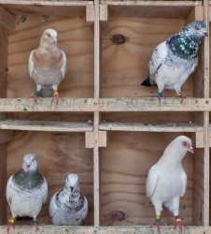
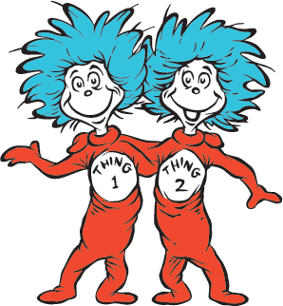
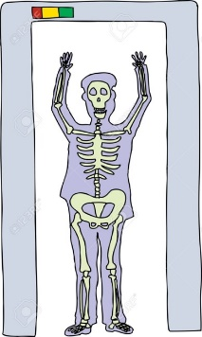
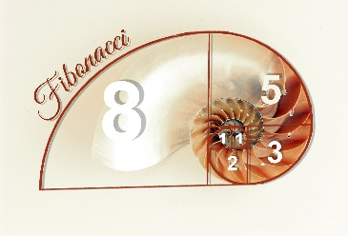
More to come in other courses!
You will see a lot of algorithm analysis and use of the concepts we developed in COMP 2002 and beyond.
Logic, sets, relations and graphs for specifications, modeling problems and describing what you are doing.
Logic, induction and models of computation for proving program correctness and analysis of problem complexity.
Recursive definitions of algorithms, counting and probability for algorithm performance and problem solving.
With the million dollar problem rearing its head every now and then

