Slide 1
Graphics with libGDX
Dr. Andrew Vardy
Adapted from the following sources:
libGDX slides by Jussi Pohjolainen (Tampere Unversity of Applied Sciences)
transformation slides by Dr. Paul Gillard (Memorial University)
ENGI 5895
Software Design
Memorial University

Slide 2
Introduction
The goal here is to illustrate some concepts in computer graphics
The tool we will use is libGDX, a cross-platform game development environment
  libGDX library provides six interfaces to abstract away platform details
    Application, Files, Input, Net, Audio, Graphics
  The graphics library wraps OpenGL ES or WebGL
    OpenGL has emerged as a standard library for graphics; ES = Embedded Systems
  OpenGL ES available on Android and iOS
  WebGL is a Javascript API that conforms to OpenGL ES

Slide 3
Cross-platform
libGDX targets Desktop, Android, HTML5, and iOS
  Desktop via LWJGL (Lightweight Java Game Library)
  Android via Android SDK
  HTML5 via GWT (Google Web Toolkit)
    Java -> Javascript
  iOS via RoboVM
    Java -> Objective-C
For an alternate intro to libGDX try “2D Game Development with libGDX” from Udacity

Slide 4
interface Application
According to the libGDX API:
“An Application is the main entry point of your project. It sets up a window and rendering surface and manages the different aspects of your application, namely Graphics, Audio, Input and Files. Think of an Application being equivalent to Swing's JFrame or Android's Activity.”
Application is an interface which is implemented by one of the following:
  JglfwApplication (Desktop)
  AndroidApplication (Android)
  GwtApplication (HTML5)
  IOSApplication (iOS)

Slide 5
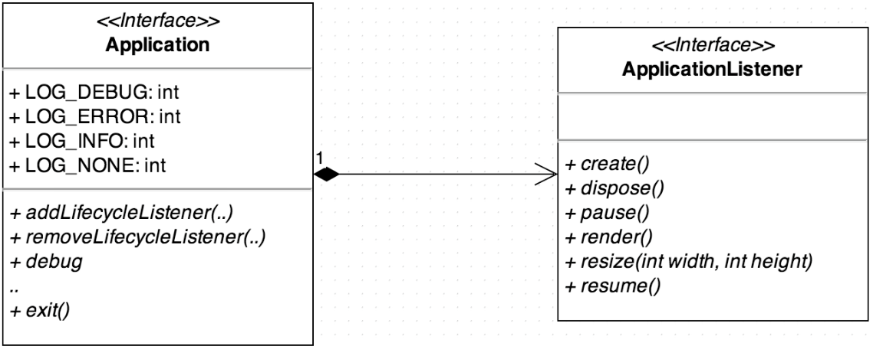
The Application interface and the corresponding XXXApplication (e.g. AndroidApplication) classes exist and don’t need to be modified
Create your own app by implementing ApplicationListener

Slide 6
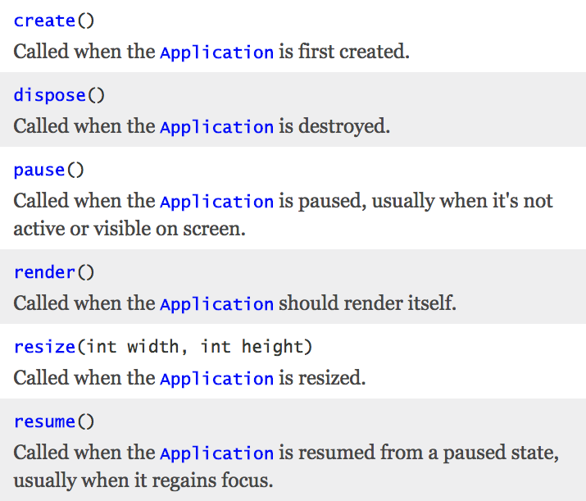

Slide 8
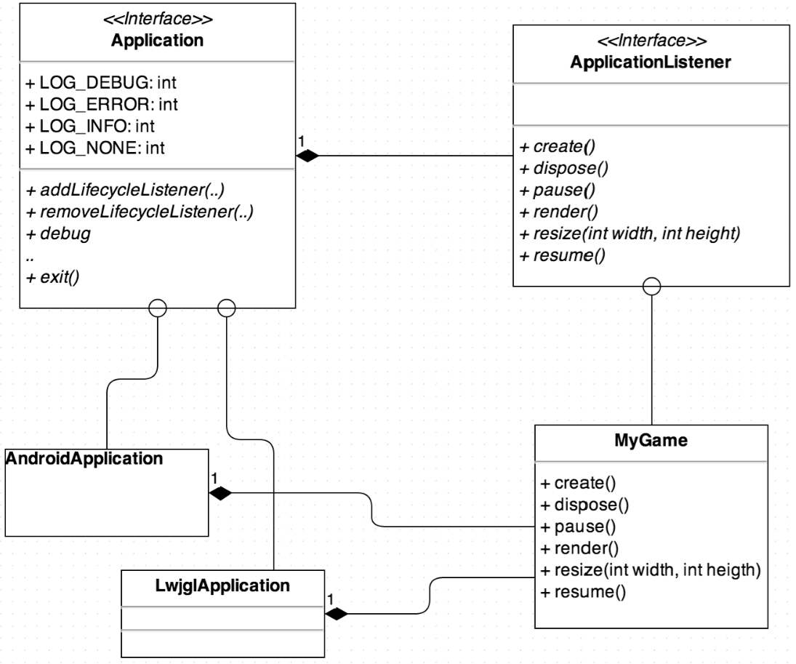
This is what you
have to implement
to make your own
game/app

Slide 9
Listeners and Adapters (Java Concept)
Usually a “Listener” in Java responds to events
  e.g. in Swing interface MouseListener defines the following methods:
  mouseClicked, mouseEntered, mouseExited, mousePressed, mouseReleased
This is really just another flavour of the Observer pattern
But what if you only care about “mouseClicked” events? Your concrete Listener has to define all 5 of the methods above
To avoid this the abstract class MouseAdapter is defined which provides empty methods for all of these
Now your concrete Listener can extend MouseAdapter instead of implementing MouseListener and you define only the methods you want

Slide 10
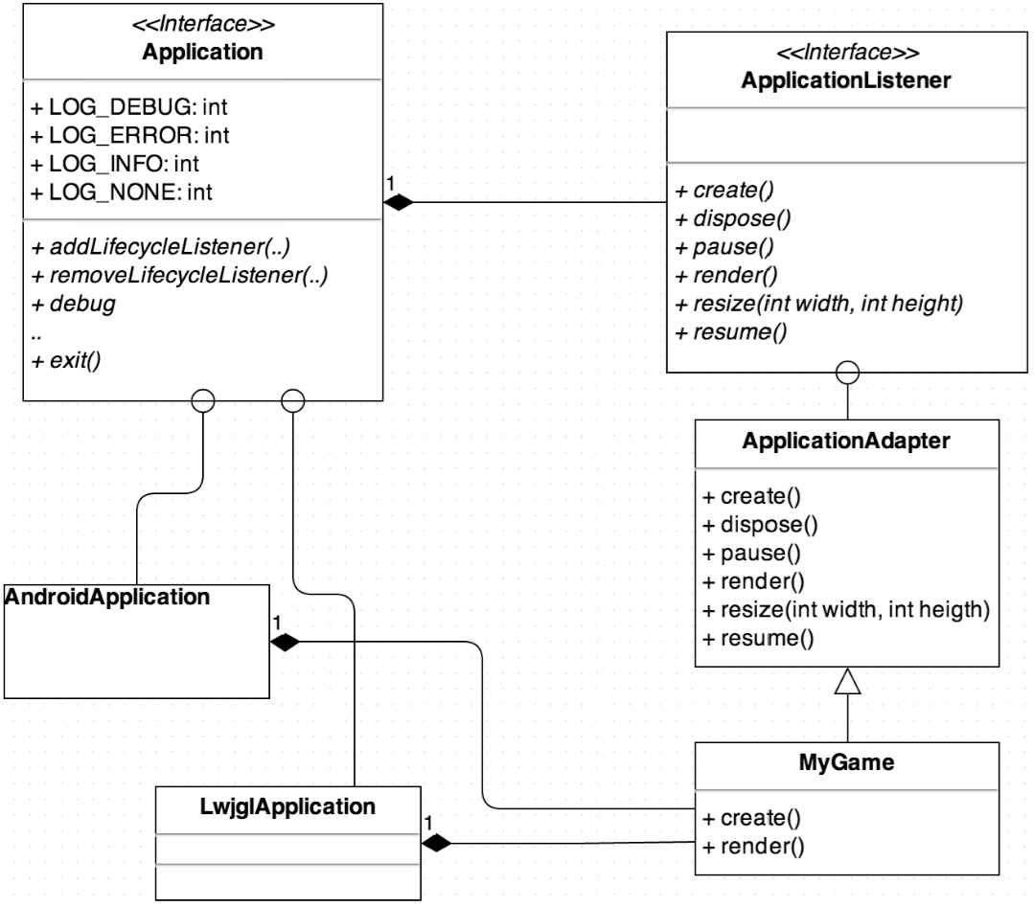

Slide 16
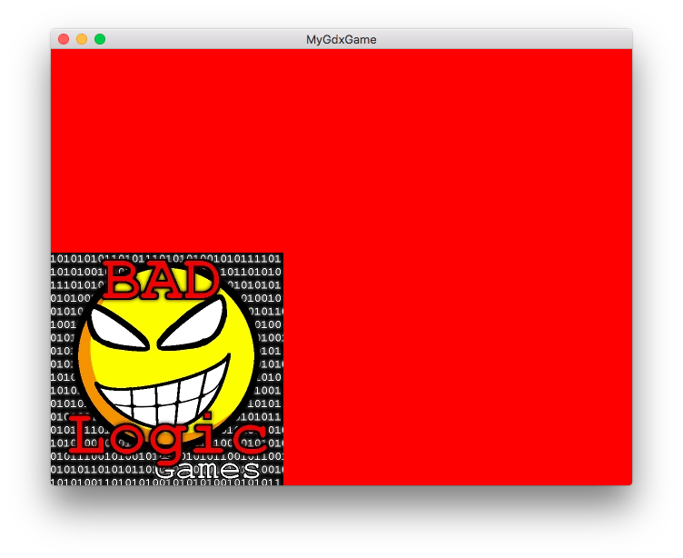
Project Setup
Rather than craft your own Starter Classes, I recommend using the project generator (gdx-setup.jar) referred to here:
  https://github.com/libgdx/libgdx/wiki/Project-Setup-Gradle
To run on the desktop:
  Click Run -> “Edit Configurations...”
  Click ”+” in upper-left corner
  Select “Gradle” (the build system)
    Change “Name” to Desktop
    Set “Tasks” to desktop:run
  With “Desktop” selected, hit the play button
  If everything works, this should appear:

Slide 17
The following class will be defined in core/src/com.mygdx.game
public class MyGdxGame extends ApplicationAdapter {
SpriteBatch batch;
Texture img;
@Override
public void create () {
batch = new SpriteBatch();
img = new Texture("badlogic.jpg");
}
@Override
public void render () {
Gdx.gl.glClearColor(1, 0, 0, 1);
Gdx.gl.glClear(GL20.GL_COLOR_BUFFER_BIT);
batch.begin();
batch.draw(img, 0, 0);
batch.end();
}
@Override
public void dispose () {
batch.dispose();
img.dispose();
}
}
Located in android/assets (other platforms link to this dir)
Two lines of actual OpenGL;
Colour specified as red, green, blue, alpha (opacity)
Entities (here an image) drawn in a batch to optimize them for processing
by the GPU
Isn’t Java supposed to have garbage collection (GC)? Unfortunately, GC
is unpredictable and costly. If large resources (e.g. images) were subject to GC it could
cause game lag. Also, objects allocated outside the JVM (e.g. by calling C++ code) are
not GC’d.

Slide 18
Example: “A Simple Game”
This example was adapted from
https://github.com/libgdx/libgdx/wiki/A-simple-game
A simple zen-like game with no end:
  Catch raindrops with a bucket on the bottom of the screen.
  Raindrops spawn randomly at the top of the screen every second and accelerate downwards.
  Player drags the bucket horizontally via the mouse/touch or by the keyboard using left and right cursor keys.

Slide 19
package com.mygdx.game;
import /* NOT SHOWN */
public class Drop extends ApplicationAdapter {
private Texture dropImage;
private Texture bucketImage;
private SpriteBatch batch;
private OrthographicCamera camera;
private Sprite bucket;
private Array<Sprite> raindrops;
private long lastDropTime;
// The width and height of the screen --- assumed not
// to change (otherwise define resize).
private int width, height;
...
Images to be loaded from files
Having a camera enables manipulating the
view independent of the world. Two choices:
- PerspectiveCamera: Distant objects will appear
smaller. Good for 3D.
- OrthographicCamera: The scene is projected
onto a plane. Good for 2D.

Slide 20
@Override
public void create() {
// load the images for the droplet and the bucket, 64x64 pixels each
dropImage = new Texture(Gdx.files.internal("droplet.png"));
bucketImage = new Texture(Gdx.files.internal("bucket.png"));
width = Gdx.graphics.getWidth();
height = Gdx.graphics.getHeight();
// create the camera and the SpriteBatch
camera = new OrthographicCamera();
camera.setToOrtho(false, width, height);
batch = new SpriteBatch();
// create a Sprite to logically represent the bucket
bucket = new Sprite(bucketImage);
bucket.setX(width / 2 - bucket.getWidth() / 2); // center the bucket horizontally
bucket.setY(20); // bottom left corner of the bucket is 20 pixels above the bottom screen edge
// create the raindrops array and spawn the first raindrop
raindrops = new Array<Sprite>();
spawnRaindrop();
}

Slide 21
This Sprite is created with new. GC will still happen as normal and as long
as the objects created are small, there
shouldn’t be a big impact.
private void spawnRaindrop() {
Sprite raindrop = new Sprite(dropImage);
raindrop.setX(MathUtils.random(0, width-raindrop.getRegionWidth()));
raindrop.setY(height);
raindrops.add(raindrop);
lastDropTime = TimeUtils.nanoTime();
}

Slide 22
render method: part 1 / 3
@Override
public void render() {
// clear the screen with a dark blue color. The arguments to glClearColor are the red, green blue and alpha component
// in the range [0,1] of the color to be used to clear the screen.
Gdx.gl.glClearColor(0, 0, 0.2f, 1);
Gdx.gl.glClear(GL20.GL_COLOR_BUFFER_BIT);
// tell the camera to update its matrices.
camera.update();
// tell the SpriteBatch to render in the coordinate system specified by the camera.
batch.setProjectionMatrix(camera.combined);
// begin a new batch and draw the bucket and all drops
batch.begin();
bucket.draw(batch);
for(Sprite raindrop: raindrops) {
raindrop.draw(batch);
}
batch.end();
...
Not really necessary here since the camera is not changing

Slide 23
render method: part 2 / 3
...
// process user input
if(Gdx.input.isTouched()) {
Vector3 touchPos = new Vector3();
touchPos.set(Gdx.input.getX(), Gdx.input.getY(), 0);
camera.unproject(touchPos);
bucket.setX(touchPos.x - bucket.getWidth() / 2);
}
if(Gdx.input.isKeyPressed(Keys.LEFT)) bucket.translateX( -400 * Gdx.graphics.getDeltaTime());
if(Gdx.input.isKeyPressed(Keys.RIGHT)) bucket.translateX( 400 * Gdx.graphics.getDeltaTime());
// make sure the bucket stays within the screen bounds
if(bucket.getX() < 0) bucket.setX(0);
if(bucket.getX() > width - bucket.getWidth()) bucket.setX(width - bucket.getWidth());
// check if we need to create a new raindrop
if(TimeUtils.nanoTime() - lastDropTime > 1000000000) spawnRaindrop();
...

Slide 24
render method: part 3 / 3
...
// move the raindrops, remove any that are beneath the bottom edge of
// the screen or that hit the bucket.
Iterator<Sprite> iter = raindrops.iterator();
while(iter.hasNext()) {
Sprite raindrop = iter.next();
raindrop.translateY(-200 * Gdx.graphics.getDeltaTime());
if(raindrop.getY() + raindrop.getHeight() < 0) iter.remove();
if(raindrop.getBoundingRectangle().overlaps(bucket.getBoundingRectangle())) {
iter.remove();
}
}
}

Slide 25
@Override
public void dispose() {
// dispose of all the native resources
dropImage.dispose();
bucketImage.dispose();
batch.dispose();
}
}
What needs to be disposed of? Any classes
that implement Disposable.

Slide 26
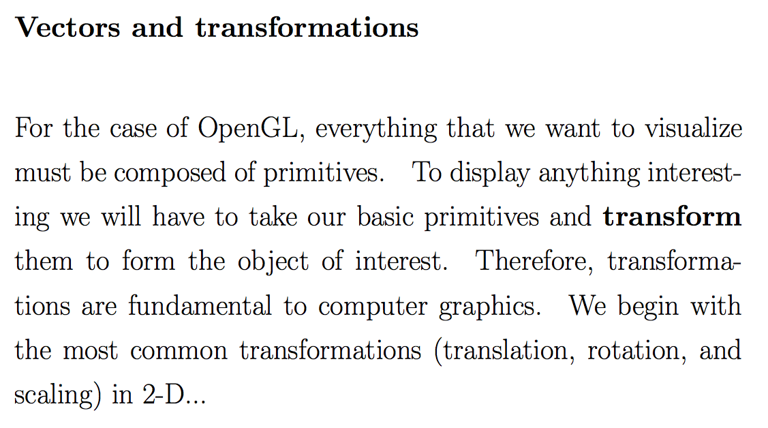

Slide 27

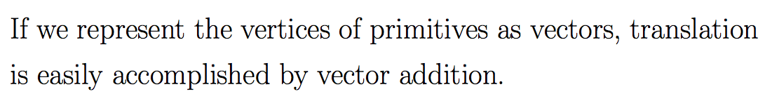
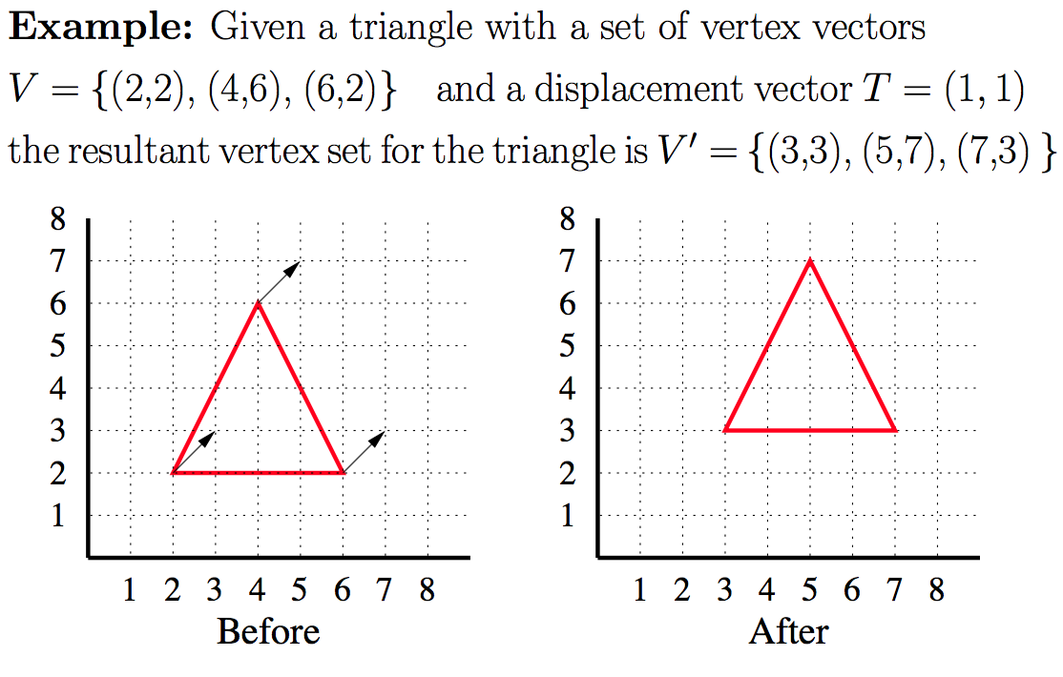


Slide 28
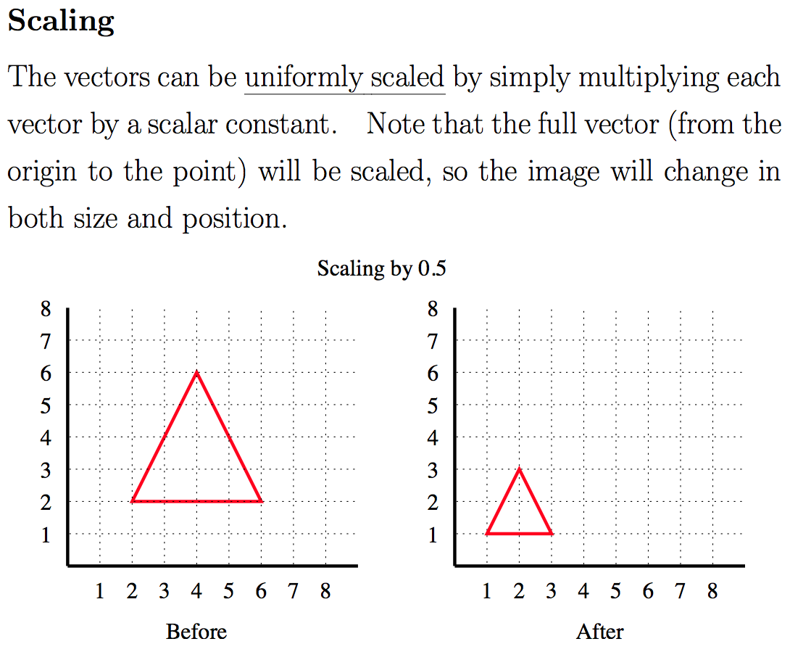

Slide 29
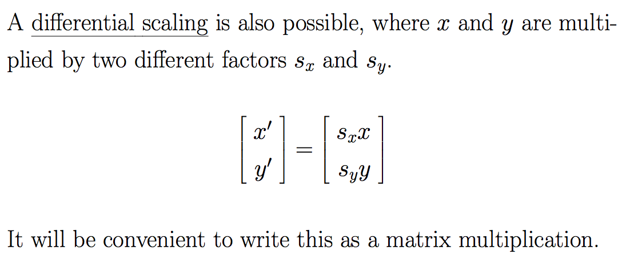
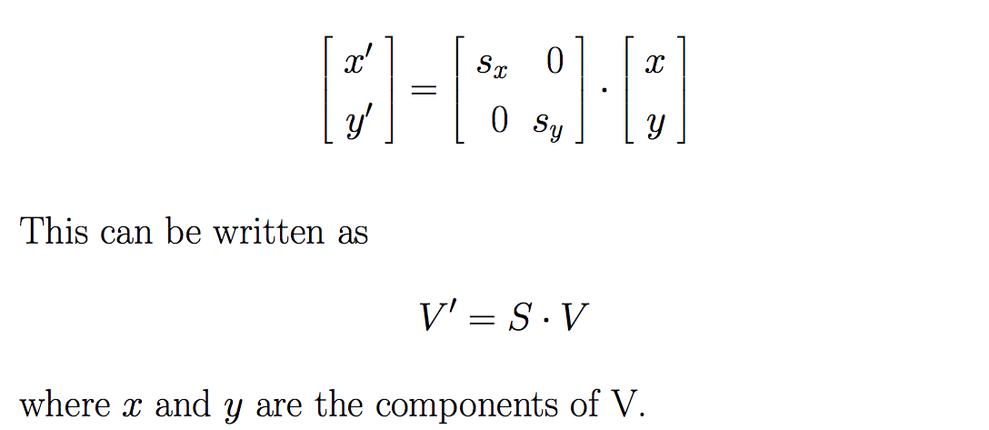

Slide 30
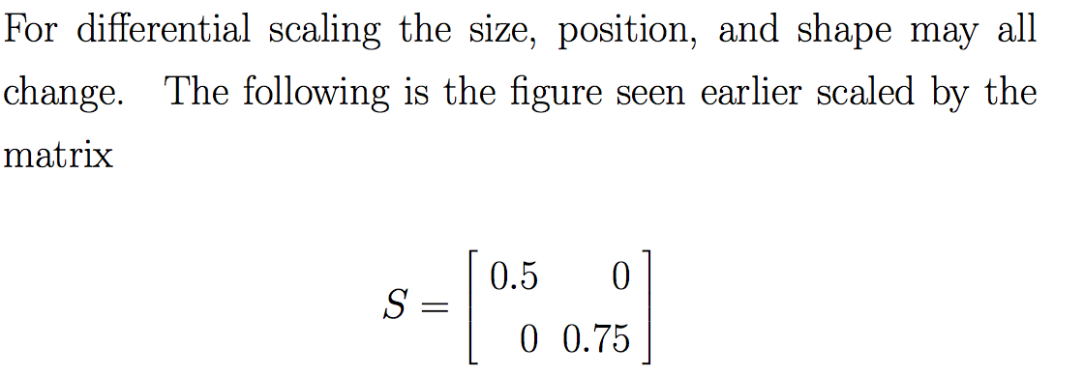
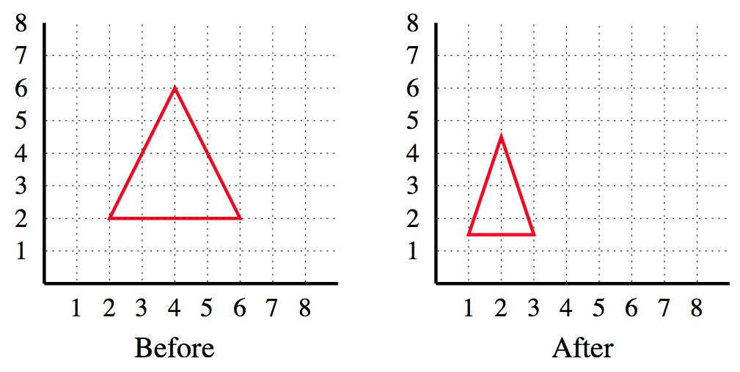

Slide 31
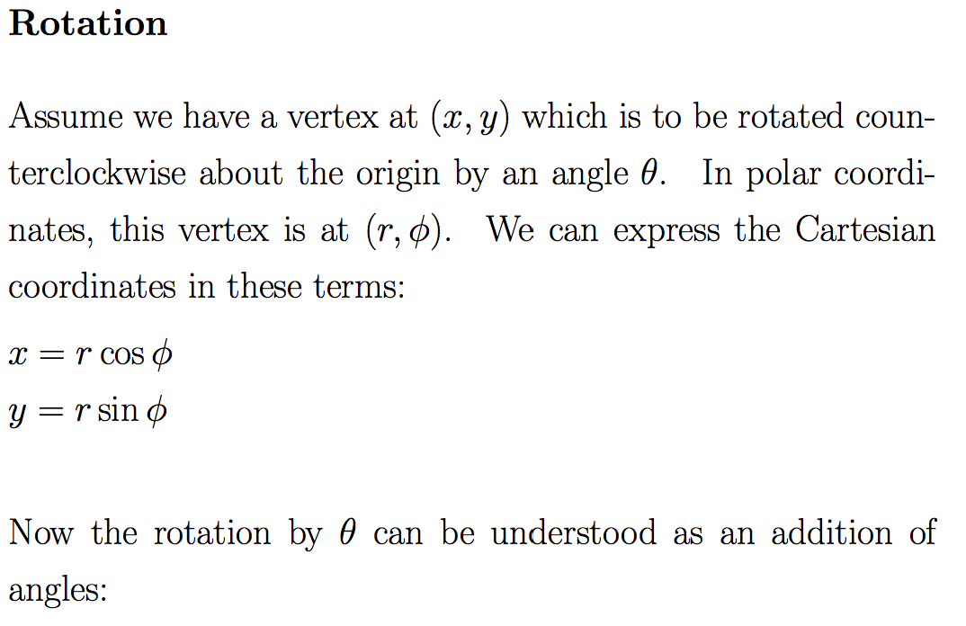
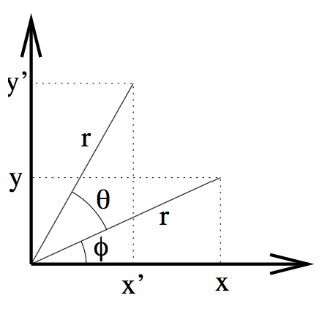
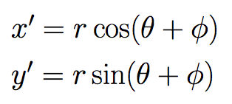

Slide 32
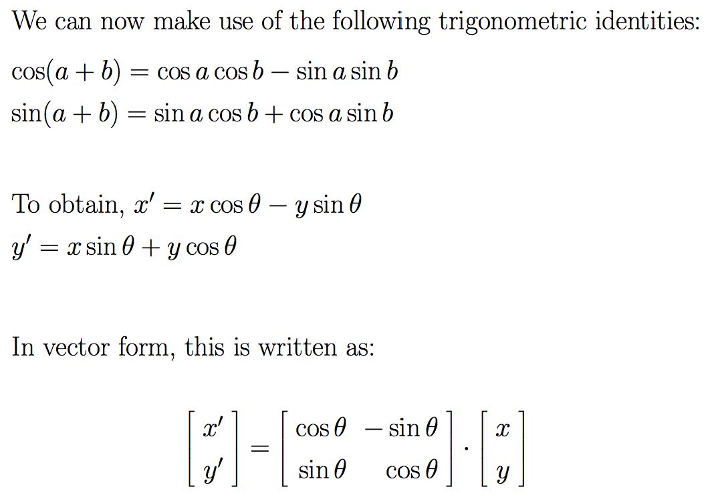


Slide 33
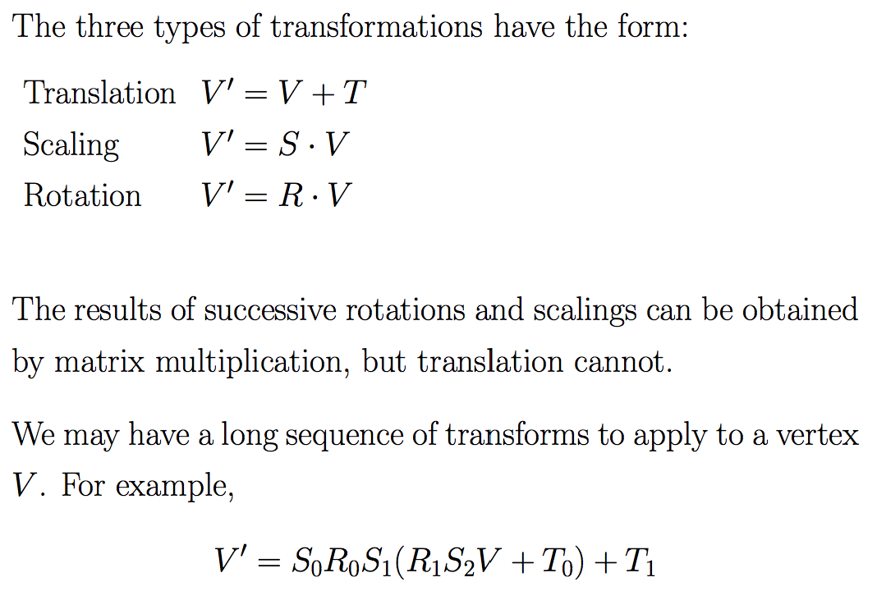

Slide 34
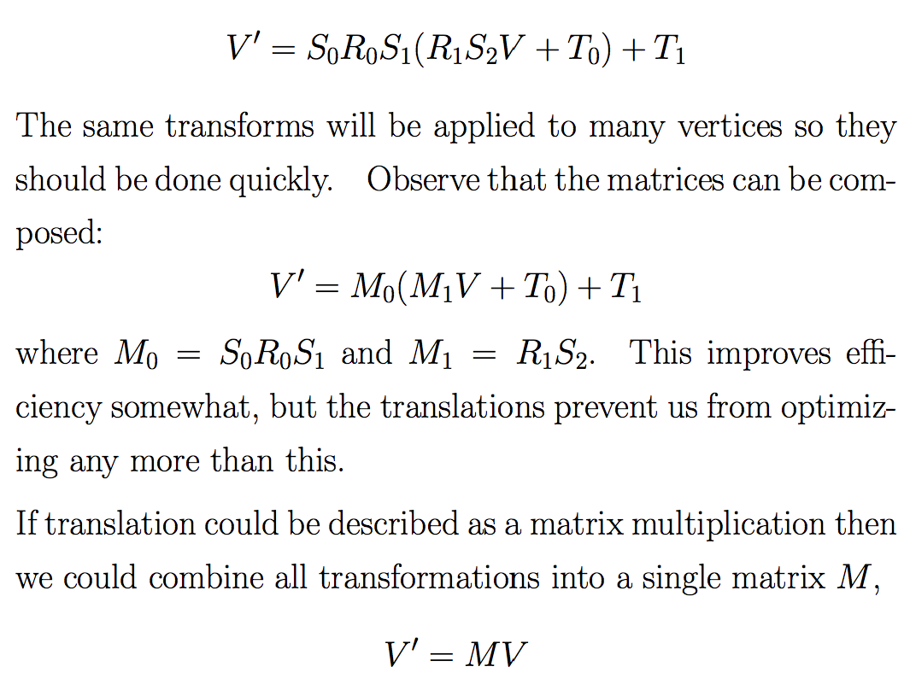

Slide 35
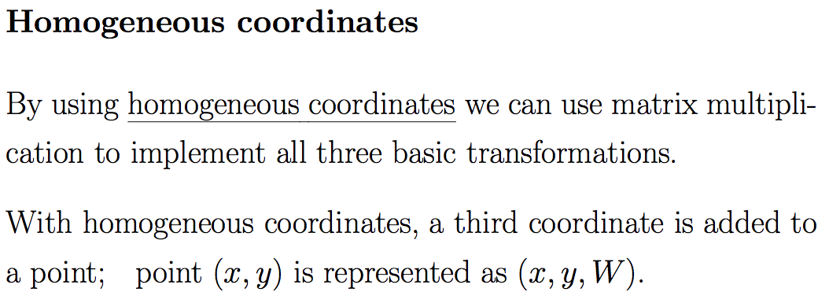
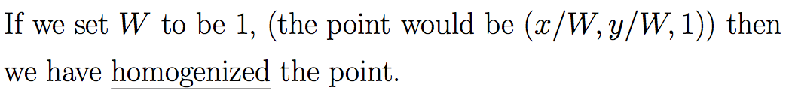

Slide 36
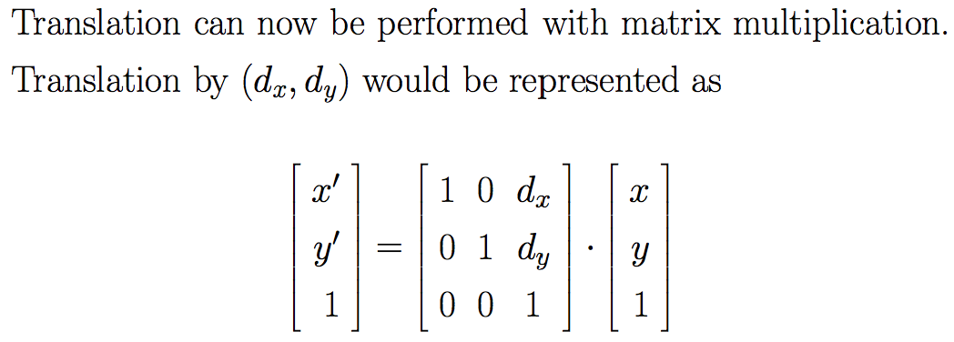
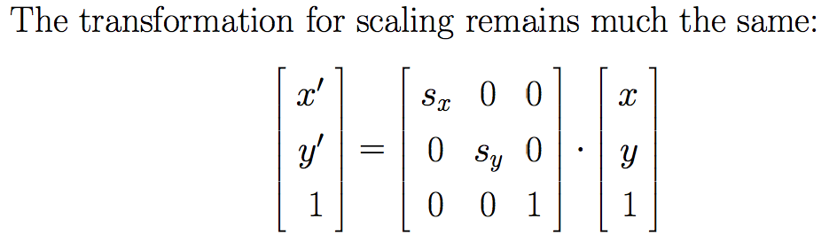
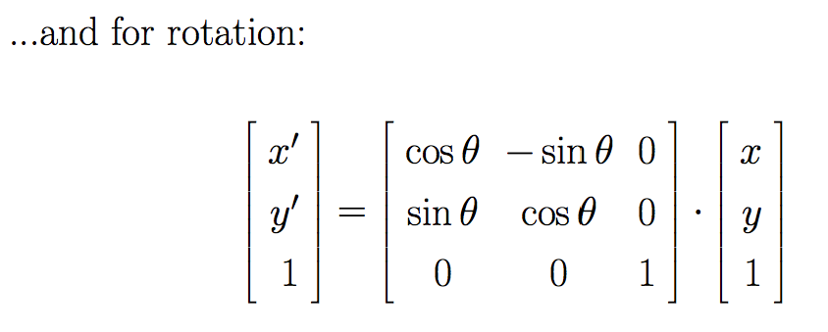

Slide 37
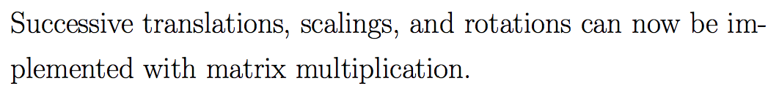
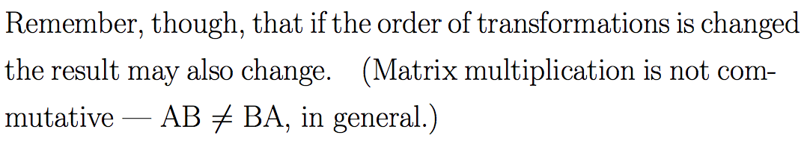

Slide 38
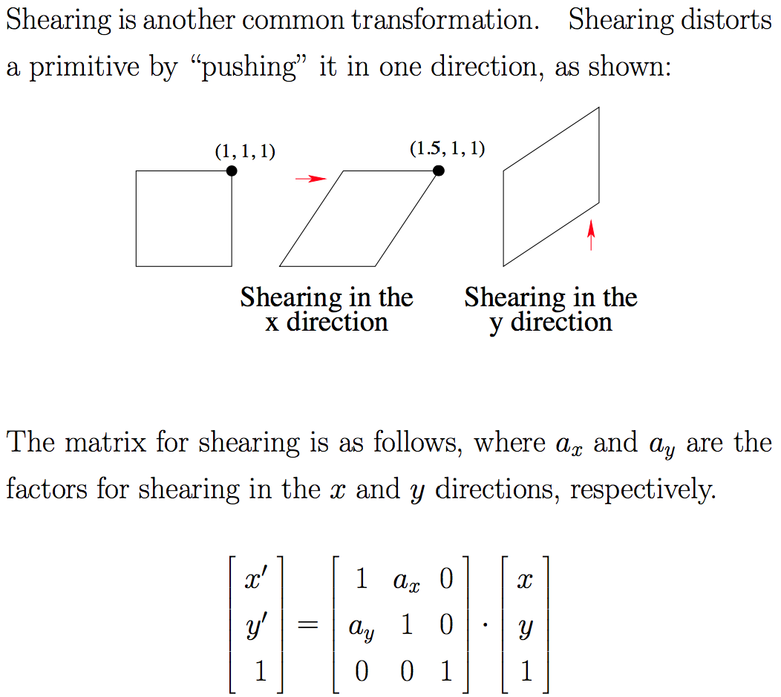

Slide 39
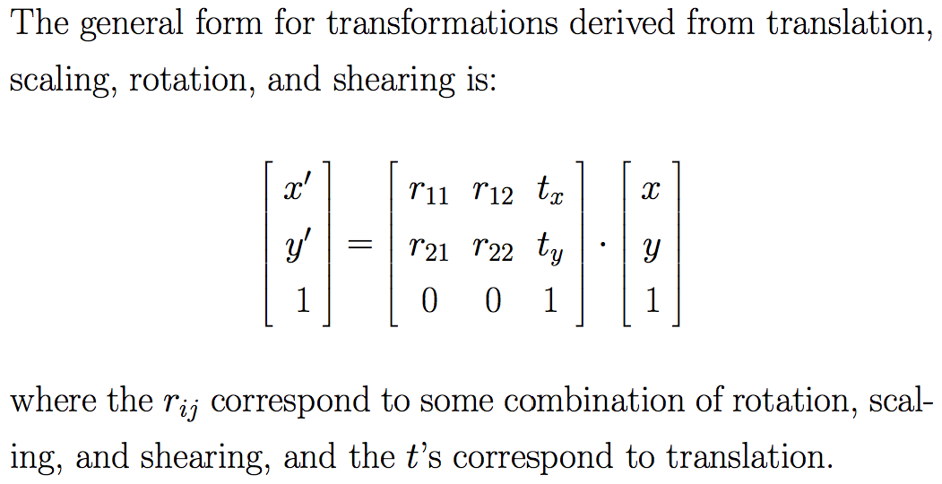

Slide 40
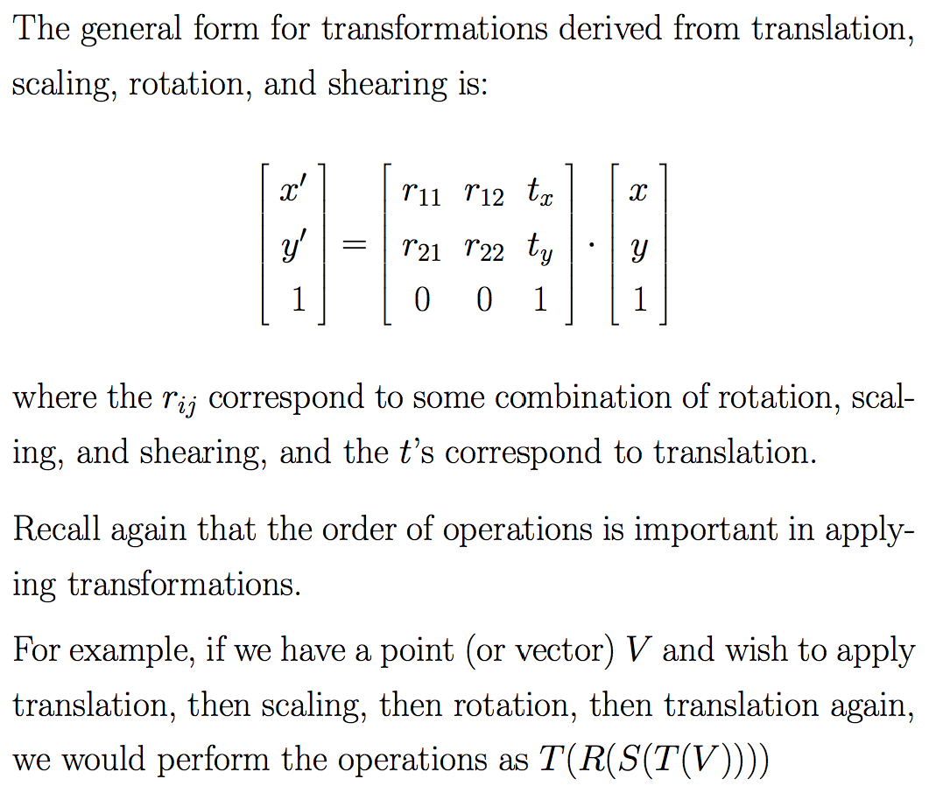

Slide 41
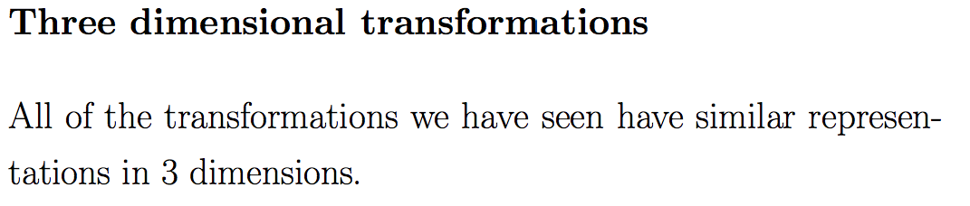
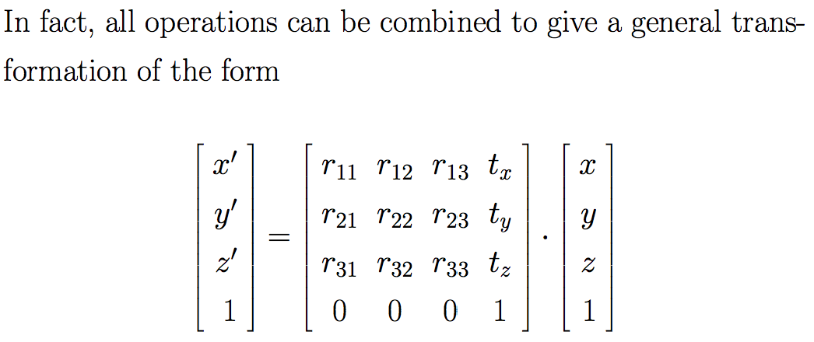

Slide 42
Example: “Zen Garden”
”A Simple Game”
  Rain falls randomly from the sky
  User controls a bucket to catch raindrops
Here we invert this setup
  User controls a cloud in the sky, from which raindrops fall
  If rain falls on a tree, the tree grows

Slide 43
Download the code for this example (see notes page)
The main files:
  ZenGardenGame (extends ApplicationAdapter)
  Tree (interface)
  SimpleTree (implements Tree)
  RecursiveTree (implements Tree)
First, consider SimpleTree’s draw method…

Slide 44
draw method: part 1 / 2
public void draw(SpriteBatch batch) {
// An affine transform is used to represent translation, rotation, and scaling operations.
Affine2 transform = new Affine2();
// Initial translation and rotation, bringing us to the base of the tree, pointed upwards.
transform.translate(baseX, baseY);
transform.rotate(90.0f);
// Store the current transform state for use below.
Affine2 savedTransform = new Affine2(transform);
drawBranch(batch, transform);
….
private void drawBranch(SpriteBatch batch, Affine2 transform) {
// Draw the current branch. We draw it as two halves because transformations such as
// rotation are made with respect to the lower left corner of the image.
batch.draw(stickLeft, stickLeftWidth, stickLeftHeight, transform);
transform.scale(1f, -1f);
batch.draw(stickRight, stickRightWidth, stickRightHeight, transform);
transform.scale(1f, -1f);
}

Slide 45
draw method: part 2 / 2
// Translate to the first branching point
transform.translate(stickLeftWidth * 0.86f, 0);
// Draw the first branch
transform.rotate(30.0f);
transform.scale(FIRST_BRANCH_SCALE, FIRST_BRANCH_SCALE);
drawBranch(batch, transform);
// Reposition to second branching point by restoring the saved transform.
transform = savedTransform;
transform.translate(stickLeftWidth * 0.55f, 0);
// Draw the second branch
transform.rotate(-30.0f);
transform.scale(SECOND_BRANCH_SCALE, SECOND_BRANCH_SCALE);
drawBranch(batch, transform);
}

Slide 46
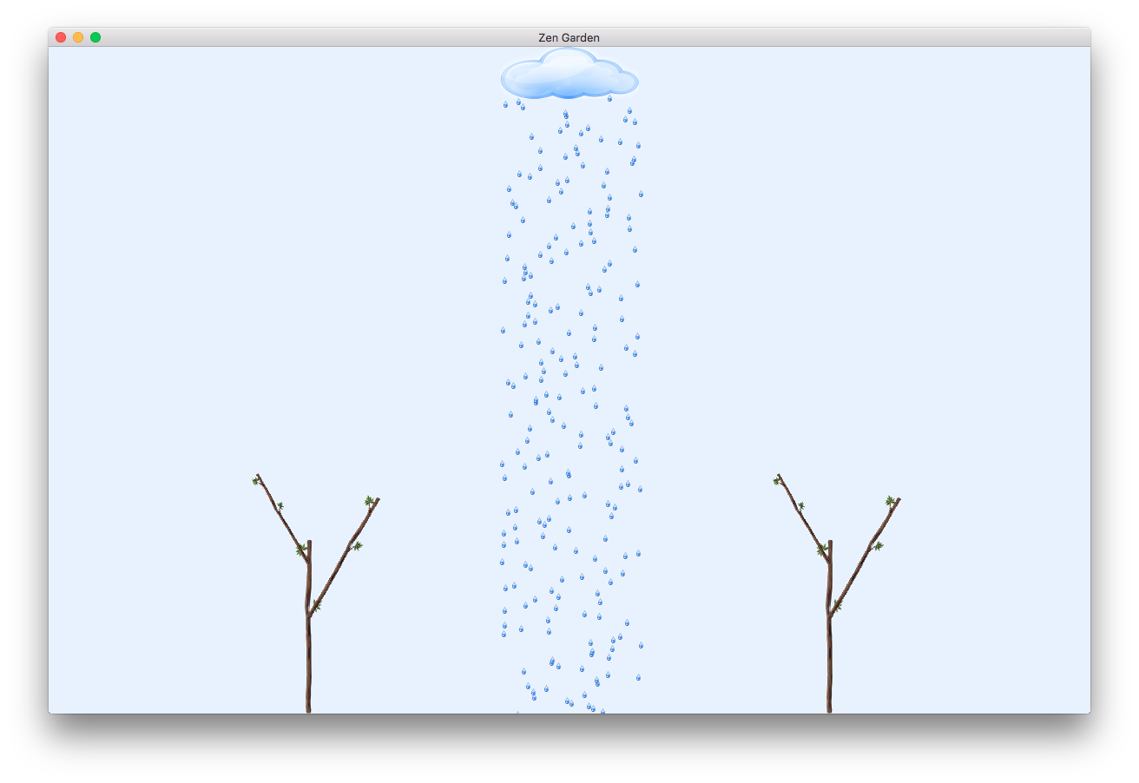

Slide 47
On the previous slide we are using the SimpleTree class which draws the basic trunk of the tree and two branches.
RecursiveTree adds the following:
  Tree grows in response to water drops falling on it
  Tree grows fractally by recursive branching
  When at the maximum growth level, berries emerge!
Please see the attached code for details…

Slide 48
